Slide 1
The Game Engine of the Future
Mike Acton
macton@insomniacgames.com
Twitter: @mike_acton

Slide 2
Why am I here?

Slide 3
Say anything you want.

Slide 4
The Game Engine of the Future
Mike Acton
macton@insomniacgames.com
Twitter: @mike_acton

Slide 5
It’s all about the data.

Slide 6
THE END.

Slide 7
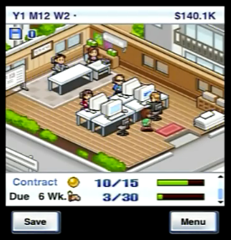
Game dev story

Slide 8
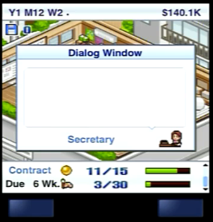


Slide 9
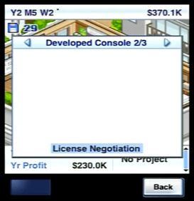
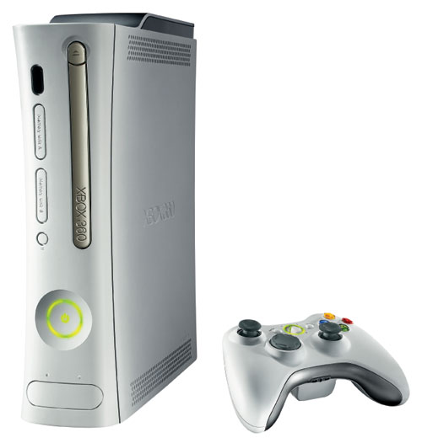


Slide 10
Lots of big changes. What are you going to do?

Slide 11
Shared my personal vision with team.

Slide 12
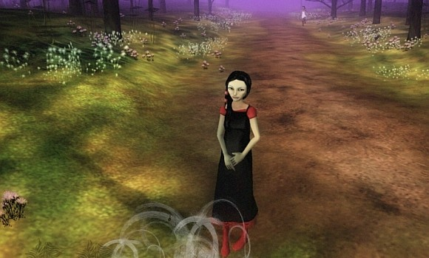
The Path

