Slide 1

Your turn.
Part 2

Slide 2
Why are you here?

Slide 3
What are you most passionate about?

Slide 4
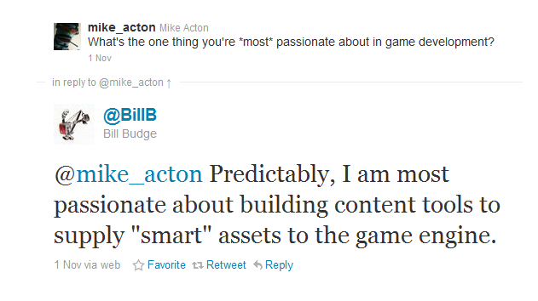

Slide 5
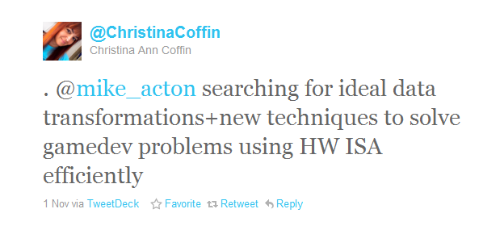

Slide 6
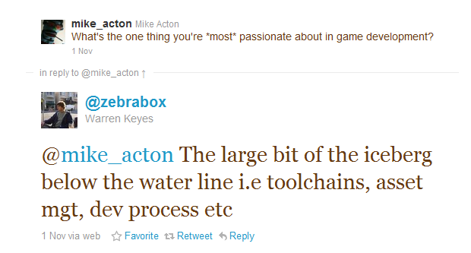

Slide 7
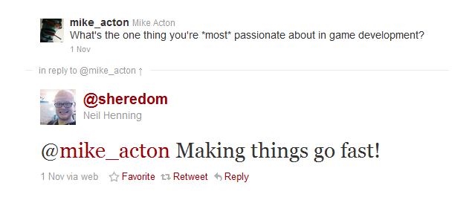

Slide 8
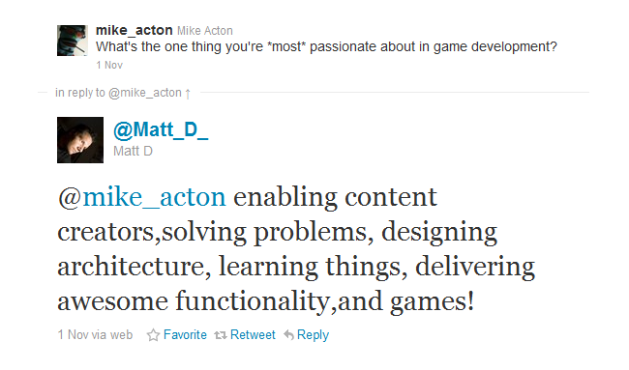

Slide 9
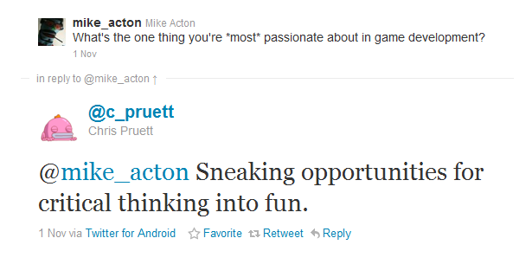

Slide 10
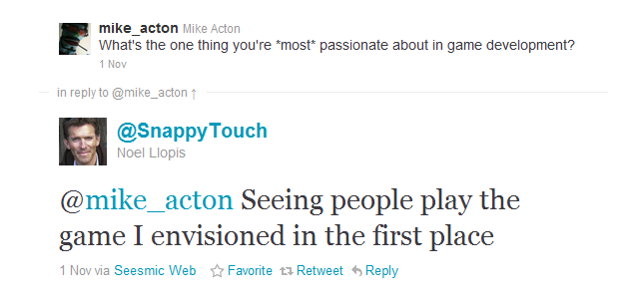

Slide 11
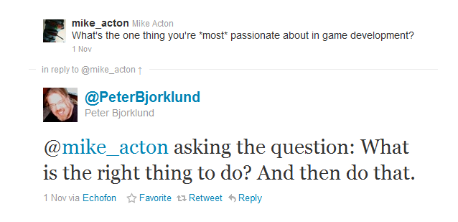

Slide 12
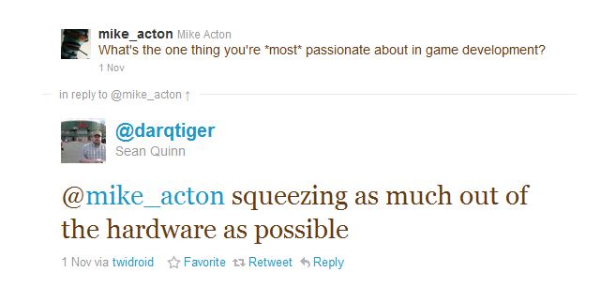

Slide 13
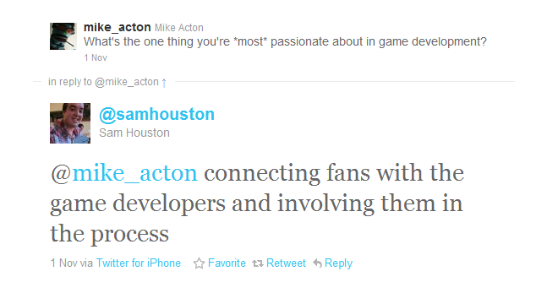

Slide 14
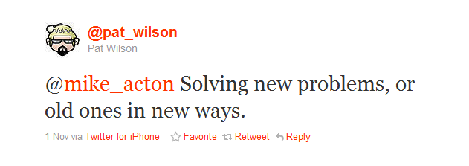

Slide 15
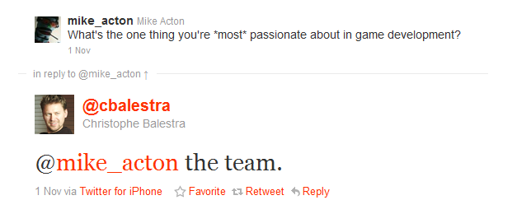

Slide 16
What gets in your way?

Slide 17
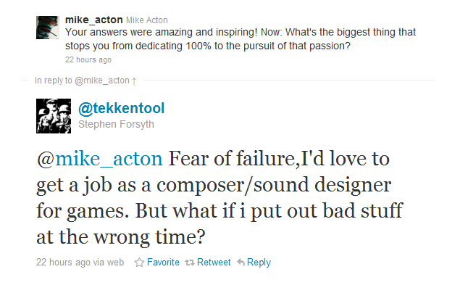

Slide 18
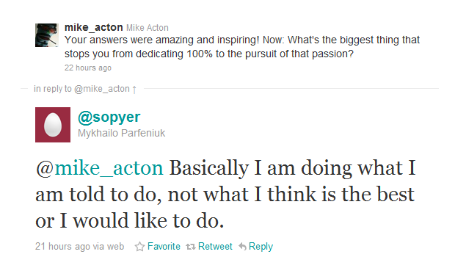

Slide 19
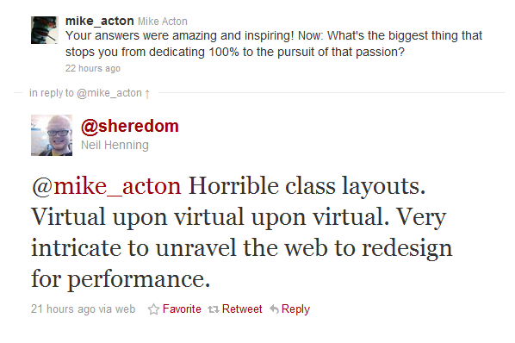

Slide 20
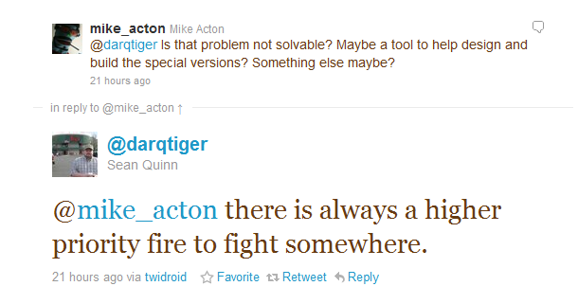

Slide 21
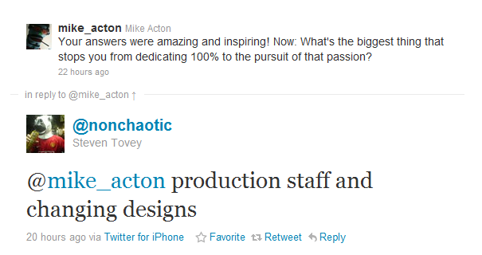

Slide 22
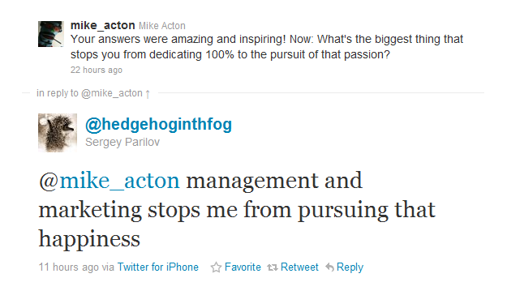

Slide 23
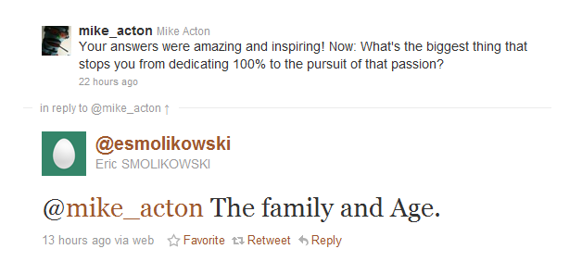

Slide 24
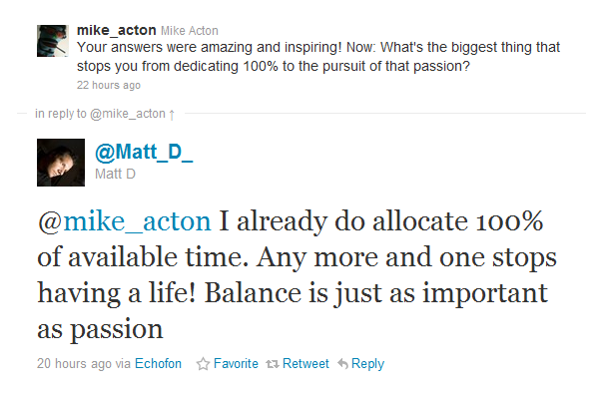

Slide 25
How can you make a bigger impact?

Slide 26
How can we better reflect the world?

Slide 27
How can we better reflect the player?

Slide 28
How can we better reflect our passions?

Slide 29
How can we overcome our biases?

Slide 30
How can we use feedback better?

Slide 31
Where can I make all new mistakes?

Slide 32
What am I going to focus on?

Slide 33
What else is out there?

Slide 34
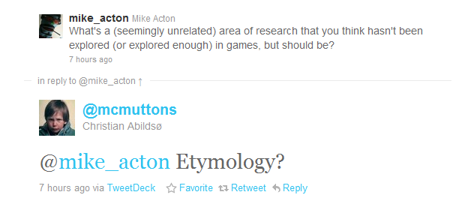

Slide 35
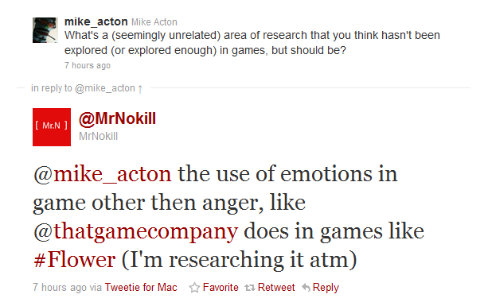

Slide 36
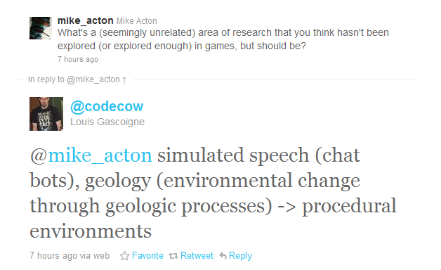

Slide 37
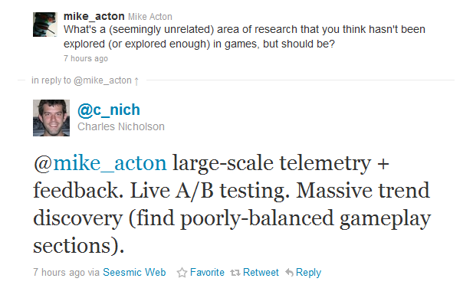

Slide 38
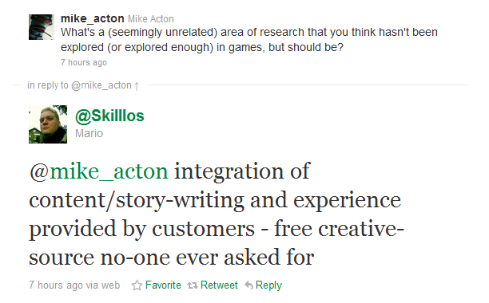

Slide 39
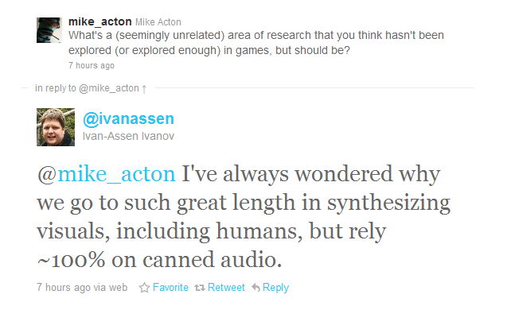

Slide 40
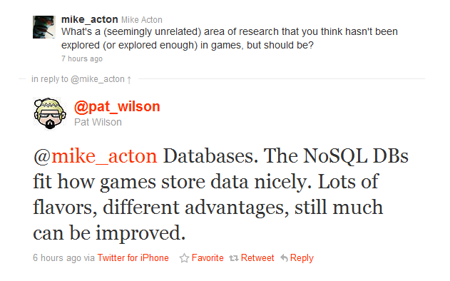

Slide 41
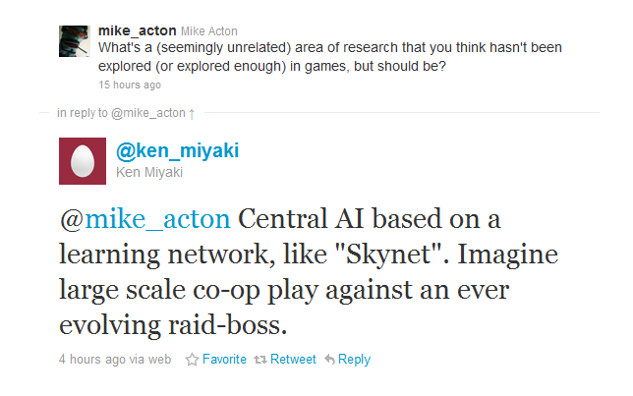

Slide 42
How can we use the unexpected?

Slide 43
How can we have more fun?

Slide 44
How can we better understand the data?

Slide 45

Mike Acton
macton@insomniacgames.com
Twitter: @mike_acton

