Slide 1

Structures
Just because you put your data in a
struct doesn’t mean your data is
structured

Slide 2
Structured Data vs. Bag O’ Data
Common pitfalls and easy tips.

Slide 3
Don’t mix context information
data to be transformed.
with
These are two unrelated sets of
data.

Slide 4
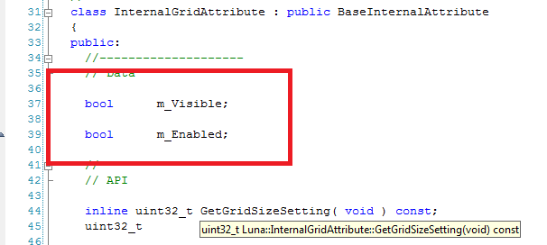
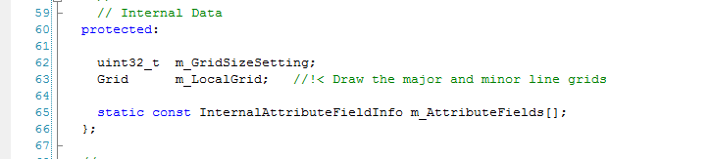
Example 1: How does the above relate to the below?

Slide 5
Example 2: Mixing state machine state and transformed data

Slide 6
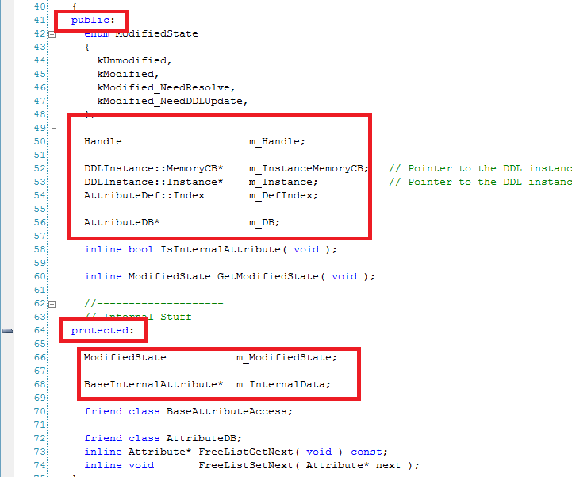
Example 3: Public, protected, private data

Slide 7
There’s no such thing as
“optional” data.
“Optional” is context information.
Separate that data.

Slide 8
Don’t
mix data with
lifespans.
different
n” is context.
half the time just
ee if the data exists.
Example:
Update classes.
Build-time data versus
runtime data.
“Lifespa
You’ll spend
checking to s

Slide 9
For each vs. For all
“For each” considered harmful.
What if branching was one of the most expensive things you could do on the CPU? …oh, wait.

Slide 10
Easy Step #1: SOA
SOA by default.
Combine as appropriate.

Slide 11
Easy
Step
#1:
SOA
SOA by default.
Combine as appropr
Combine based on use:
e.g. xyzw
iate.

Slide 12
Easy Step #1: SOA
SOA by default.
Combine as appropr
Co
mbine based on use:
e.g. xyzw
iate.
What about confl
combinations?
What about conflicting
This problem already exists.

Slide 13
Easy Step #1: SOA
hat about conflicting
combinations?
roblem already exists.
SOA by default.
Combine as appropr
Co
mbine based on use:
e.g. xyzw
iate.
W
Can solve for
_{~2B PPU cy}
ted on y.
Can solve for cache
coherency.
~2B PPU cycles/sec
was
This p
waiting for memor

Slide 14
And, of course…
Concurrency.
Separating data by context makes
much simpler to solve for data concurrency.
it

Slide 15
Real-life example:
David Thall

