Slide 1
Mustard Ferrets
Analysis of Australian Stock Market

Slide 2
Question ?
Is there a correlation between macro economic indicators and performance of the top 5 companies on the Australia stock exchange by their industry type ?

Slide 3
- Health Care Sector – referred to as HC - Real Estate Sector – referred to as RE - Utilities Sector – referred to as UL - Consumer Staples Sector – referred to as CS - Information Technology Sector – referred to as IT This information was sourced from the Australian Stock exchange via the yahoo finance api The two Marco economic indicators we choose to review was the unemployment data and foreign exchange rates over the same time period. - Job Vacancies Data from ABS website - AUD against multiple currency sourced Reserve Bank of Australia website
We compared the top five companies in the following industries with daily stocks over the past 2 years.

Slide 4
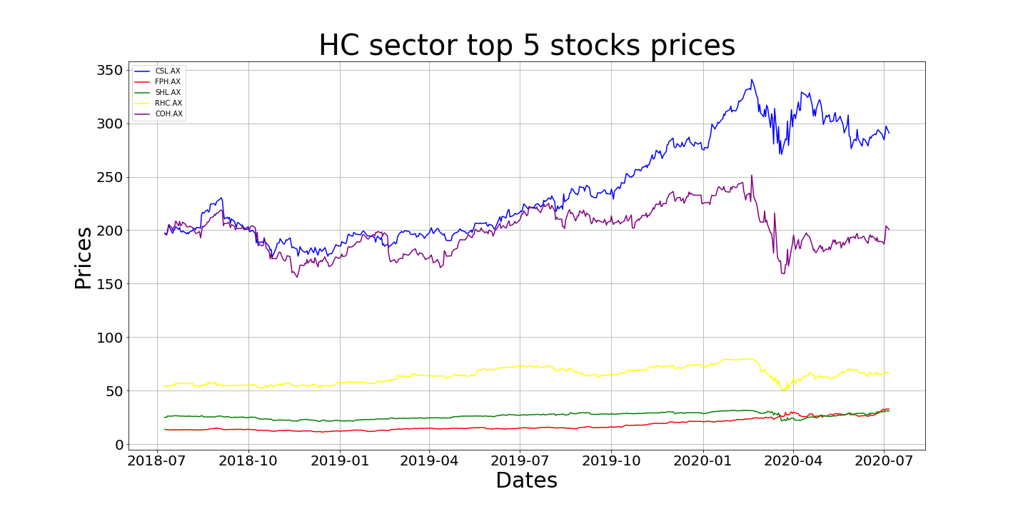

Slide 5
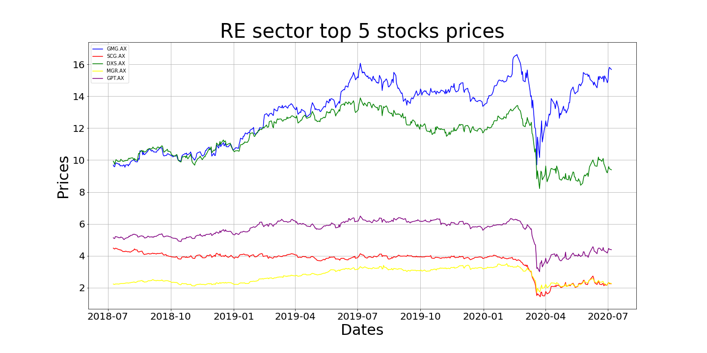

Slide 6
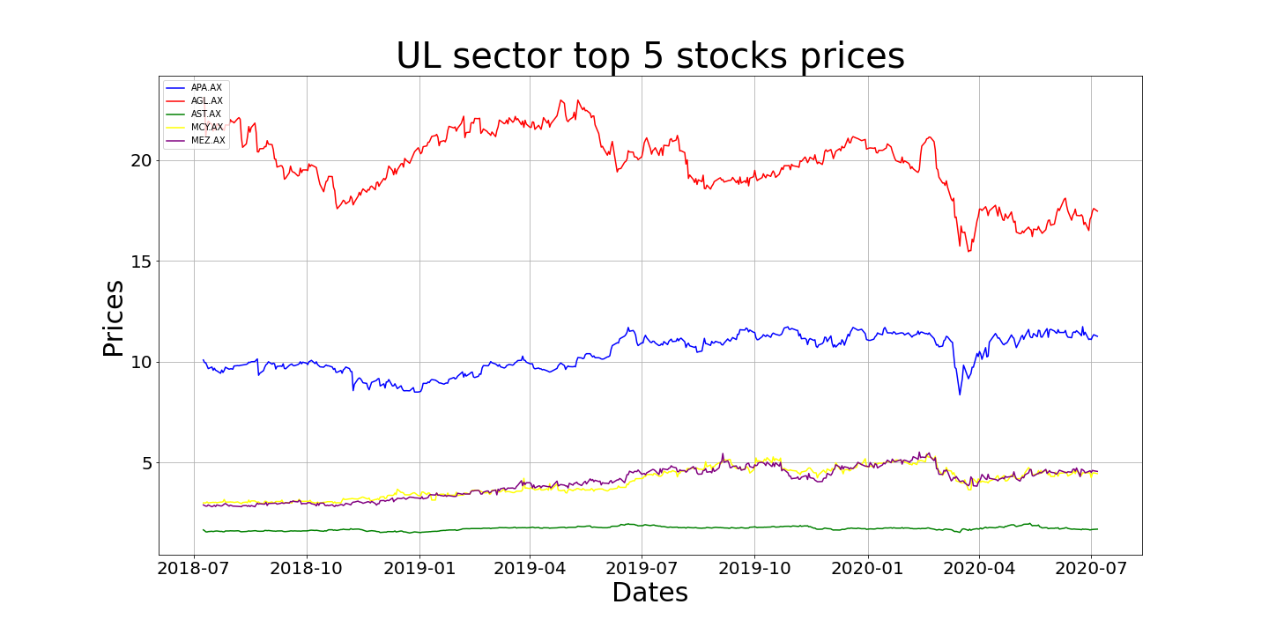

Slide 7
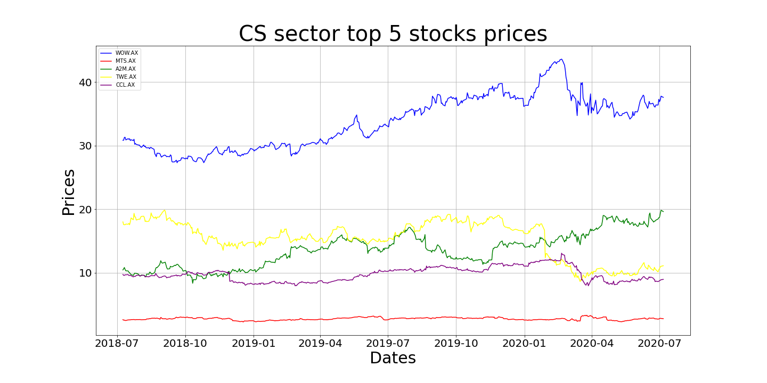

Slide 8
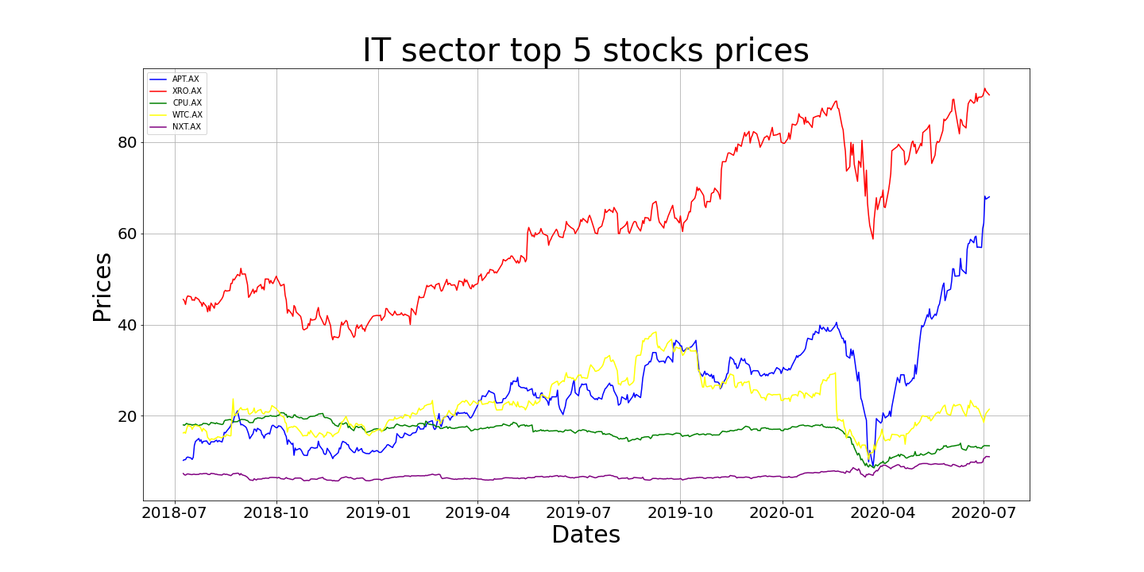

Slide 9
Before comparing our stock information against our indicators. We wanted to gauge how each industry performed in comparison to the market as a whole. In order to identify any over or under performing industries (i.e. outliers). We needed to transform the individual stock information into a weighted average time series. This combined our into one line per industry type. Then the ASX 200 was overlay against all of the industries.

Slide 10
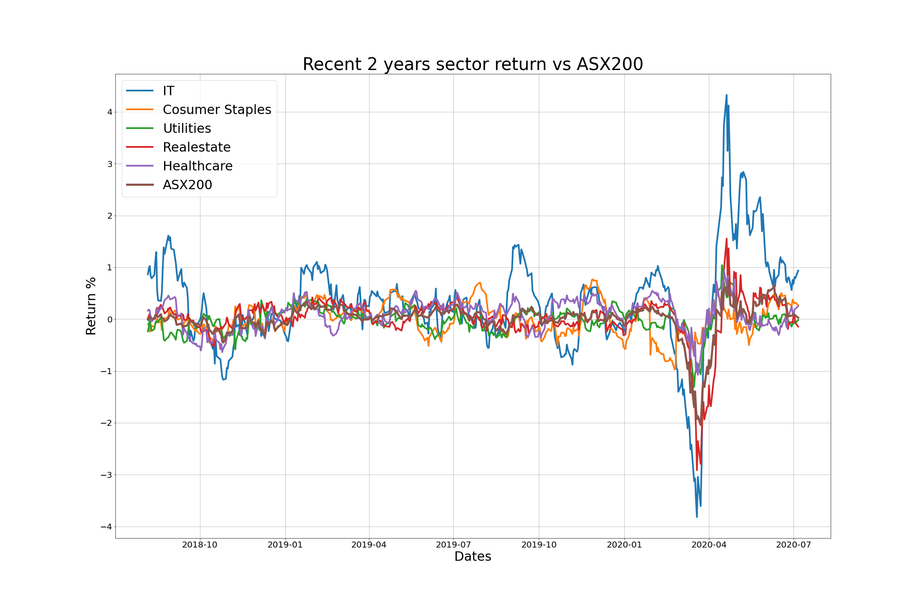
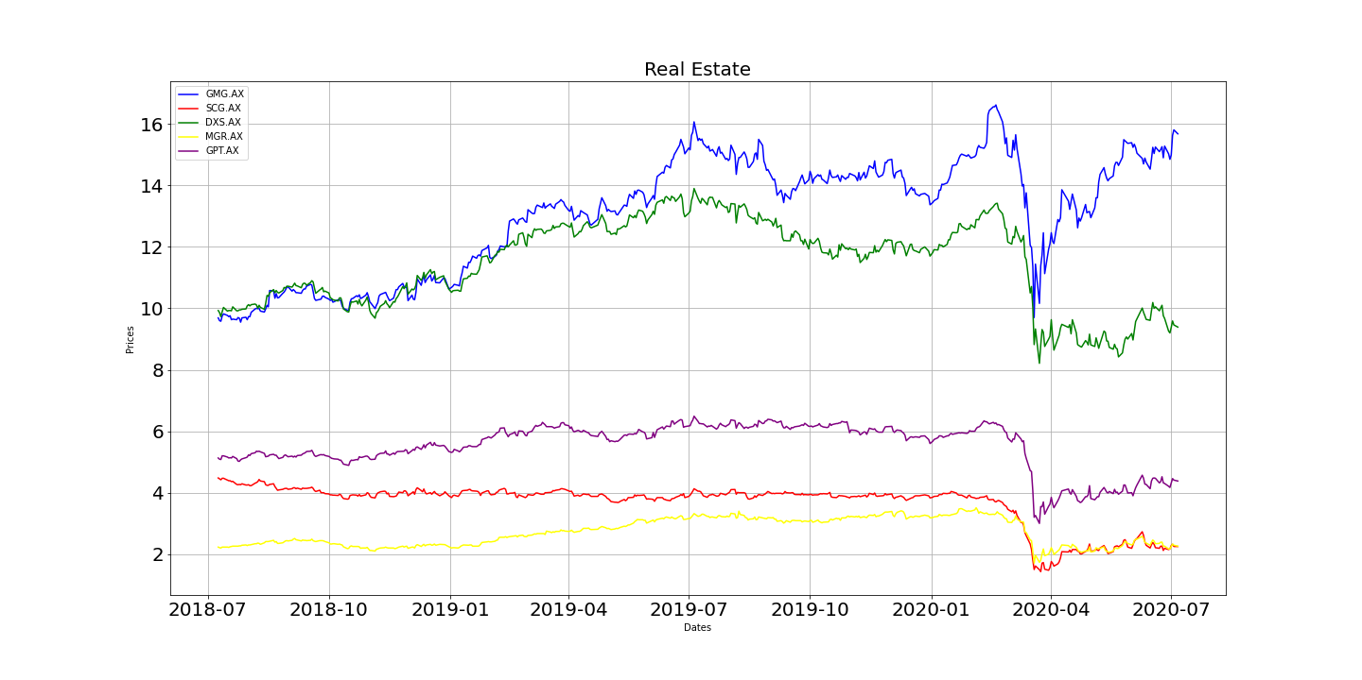

Slide 11
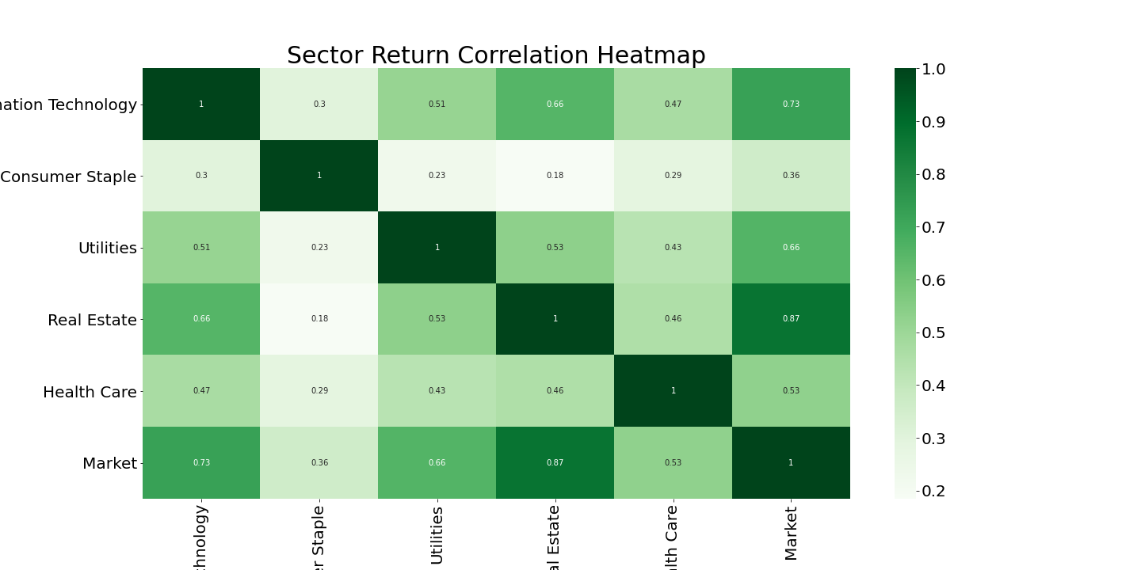
Our conclusion was that graph to difficult to discern anything meaningful. We then preformed a pairwise analysis using the Pearson’s Correlation and see which industries have the closest correlation to the market. We identified that real estate had the highest correlation to the ASX 200 closely followed by IT sector

Slide 12
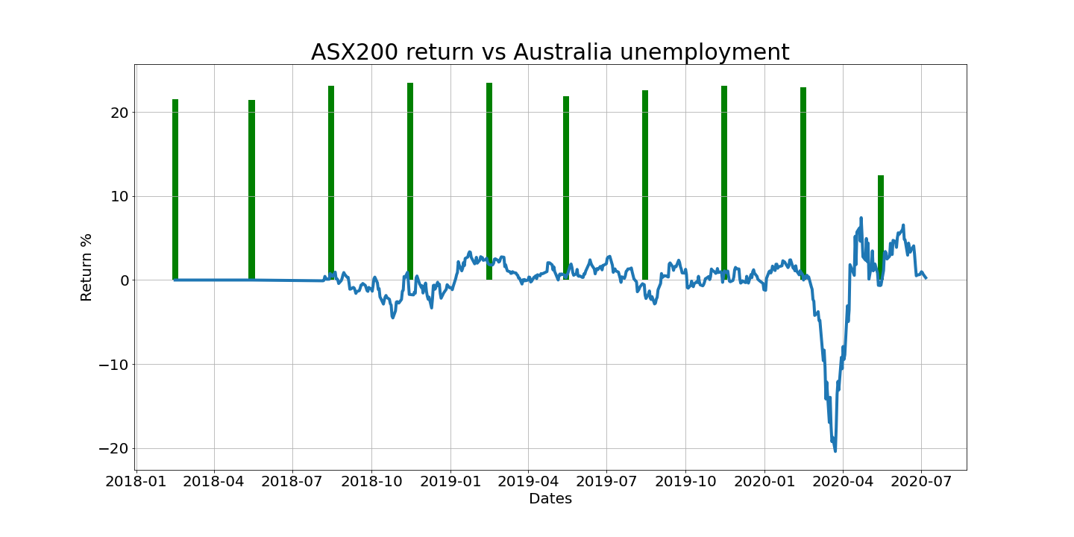

Slide 13
It is noted that unemployment data is quarterly and there is a clear drop in most recent quarter. It is important to note that unemployed data being used is Job vacancies listings and therefore a of report total number of jobs advertised. We can see that they while the market is operating normally the vacancies are buoyant. As market has contracted the less job are available.

Slide 14
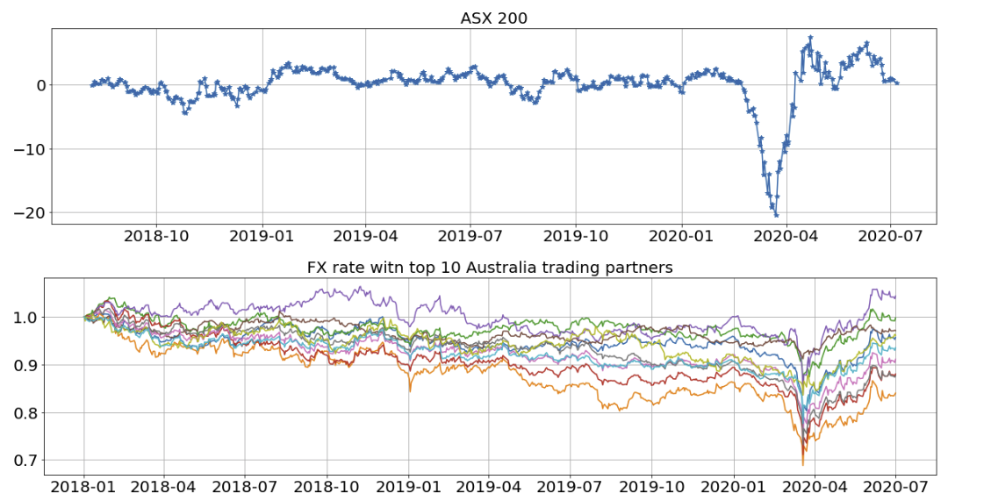

Slide 15
Conclusion
As we see a common trend in all five industries. We concluded that there is a correlation between both Foreign Exchange and Unemployed and the performance of the industries selected.

Slide 16
Further Investigation
It may be interesting to see if we applied the Pearson Correlation test to the top ten currencies against the ASX.
In order to see if there any strong correlations with any particular currencies, similar to observations from the real estate industry against the ASX.

Slide 17
Difficulties

