Slide 1
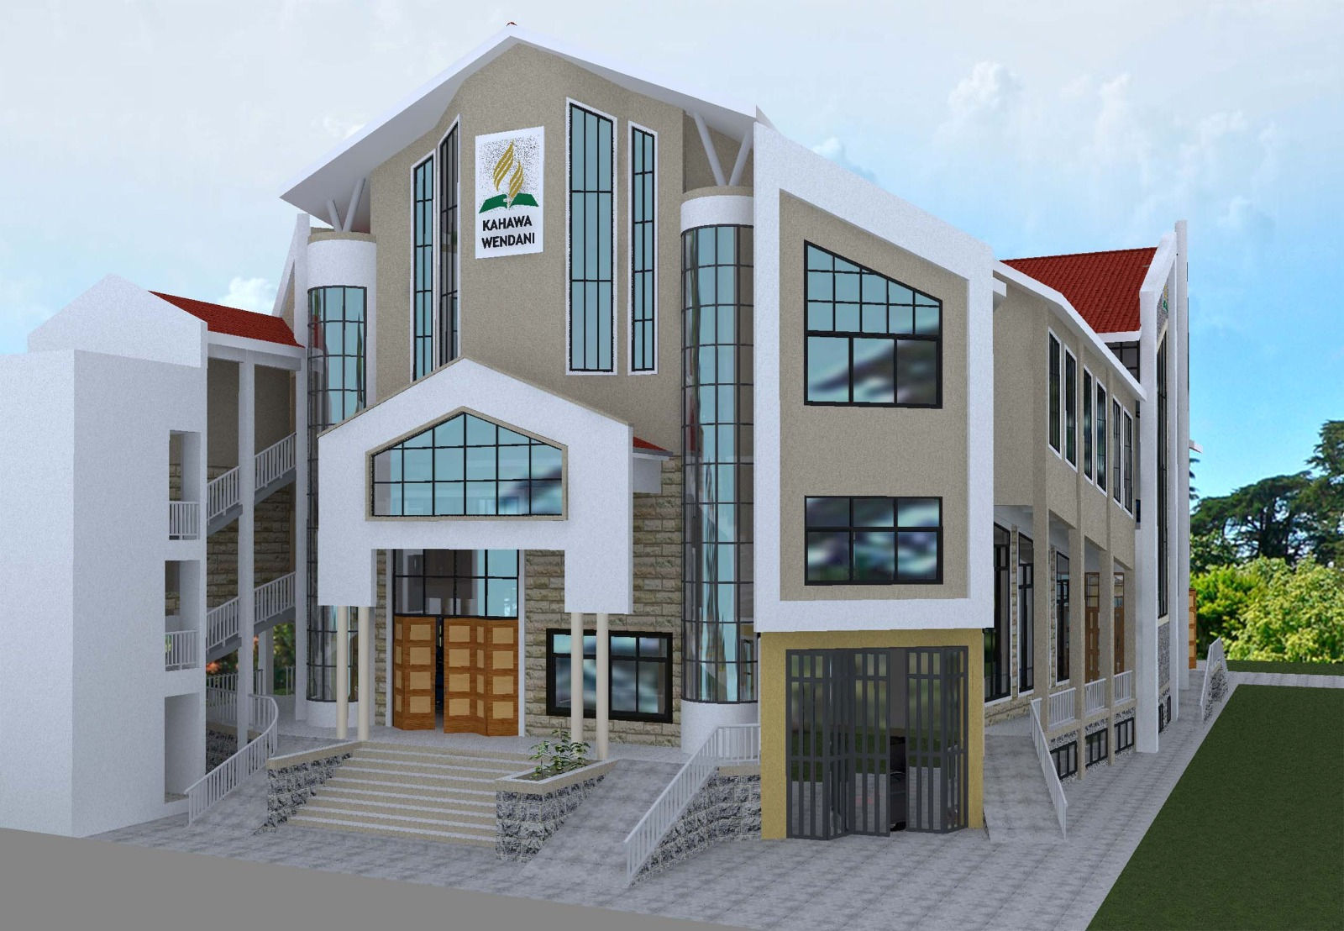

SDA CHURCH KAHAWA WENDANI
ANNOUNCEMENTS
11th October, 2025

Slide 2
SABBATH FACILITATORS
This Sabbath’s worship is led by the Adventist Men’s Ministry (AMM) led by Eld. Evans Matoke and team.
The Lead Chorister is Mrs. Sarah Abaya
We also have Pastors’ Appreciation Sabbath today. Let’s remember all our pastors and gospel ministers in prayers

Slide 3
1. DEPARTMENTAL COUNCILS AND MEETINGS
The following Councils are scheduled to meet today in the evening;
Camp Meeting Committee as from 4.00 pm in the Upper room
AYS Council today at 4 pm at the parking yard
Masterguides as from 4.30 pm at the parking yard
Church choir council at 4:30 pm
Adventurers council at 4pm.

Slide 4
2. AMBASSADORS’ AUDIO 4 LAUNCH
Our Ambassadors take the honour of inviting the whole church to their Audio 4 Launch tomorrow Sunday 12th October, 2025 in our church as from 10 am.
All are invited.
Lets come and support our ambassadors. Feel invited

Slide 5
3. PRAYER NEEDS FOR THE CHURCH
The following members have been affected and call for our prayers and support;
Eld. Daniel Ombati’s family – Mother in law Sick
Ruth Odoyo’s family – Had a sick daughter admitted at KNH
Eld. Dismus Nduko’s family – Had their son Jesse sick and admitted at Nairobi Regional Hospital (NRH), Kahawa Barracks
Winnie – Sick and admitted at NRH, Kahawa Barracks
Let’s remember to lift them up in prayers in our family alters

Slide 6
4. NOTICE OF BEREAVEMENT
We are sorry to announce the death of mzee Francis Manyara, Father to our CL Callen Akama which occurred on 09th October, 2025 at Annex Hospital, Nakuru Further details will be shared
Let’s keep the family in prayers at such a trying time. Shalom

Slide 7
5. MID WEEK SERVICE AND FRIDAY VESPERS
This week Mid week service on Wednesday will be led by Juliet Kerubo while Friday vespers service will be led by Amos Chacha
Church service begins at 5.30 pm
All are invited

Slide 8
6. ELDER ON DUTY FOR THE WEEK
Our elder on duty for the entire week and ending on the sabbath of 18th October, 2025 will be CL Hellen Wandollah. Let’s work with her as the spirit leads. Her contact is 0725 765 987

Slide 9
7. UPCOMING CLUB EVENTS FOR PFs & ADVs
ADVENTURERS’ FAMILY CAMP OUT AT KAMITI HOSTEL GROUNDS FROM 11TH -16TH NOVEMBER, 2025. Registration closing by 14th Oct
ANNUAL PATHFINDER FAIR ON 23RD NOVEMBER 2025 AT RIVERSIDE BURUBURU
Registration for each Participant is KES 250/- payable by 16th November, 2025
PATHFINDER CAMPOUT IN NYAHURURU ADVENTIST PRIMARY SCHOOL FROM 9TH – 14TH DECEMBER 2025.
Registration for each participant is KES 1,300/- payable by 1st December, 2025

Slide 10
DISTRICT ANNOUNCEMENTS

Slide 11
1. PASTOR’S GREETINGS
Receive greetings from our Pastor, he is worshipping at SDA Church Kahawa Wendani today.
2. ASAM RETREAT
This will take place from 17th – 20th October, 2025 at Kikambala hotel in Kilifi County. All ASAM intending to participate to prepare to register with KES 13,950/-

Slide 12
3. ENF ANNUAL MUSIC FELLOWSHIP FAIR
The annual music fellowship fair is set to take place on 18th and 19th October at Mutitu SDA Church, Mbooni Station. Participating choirs are required to present 3No items, Set Piece NZK 103 – Njooni kwangu, Own Composition and Own Choice. Registration for the Music fair is KES 2,500/- payable to Station Music leaders and the deadline is 30th September, 2025.
4. 2ND ENF QUINQUINNIAL MEETING
This will take place on Sunday 9th November, 2025. Each church is required to choose delegates as per the attached letter. Lets pray for the exercise

Slide 13
5. DISTRICT AYS SABBATH ON 22ND NOVEMBER, 2025
Our District Youths will be having their District Sabbath on 22nd November 2025 at Kahawa Sukari SDA Church. This will be followed by District AYS Social Sunday the following day.
6. ENF WOMEN’S MINISTRY CONGRESS 8TH TO 14TH DECEMBER, 2025
There will be ENF Women’s Ministry Congress at Huruma Girls High School from 8th -14th December 2025 under the THEME: “Chosen for Such a Time as This (Esther 4:14).” Registration fees is KES 4,600/- for boarders and KES 3,600/- for dayscholars

Slide 14
7. DISTRICT AYS YOUTH MISSION/CRUSADE
Our District AYS is planning for a mission at Mukurweini in Nyeri County from 14th – 27th December, 2025. Let’s remember our youths in prayer as they prepare for the same. All youths to note and prepare accordingly

Slide 15
END OF ANNOUNCEMENTS
HAPPY BLESSED SABBATH

