Slide 1

Web Development & Design Foundations with HTML5
Tenth Edition
Chapter 11
WEB MULTIMEDIA AND INTERACTIVITY
Copyright © 2021, 2019, 2017 Pearson Education, Inc. All Rights Reserved

Slide 2
Learning Outcomes (1 of 2)
In this chapter, you will learn how to ...
Describe the purpose of media containers and codecs
Describe types of multimedia files used on the Web
Configure hyperlinks to multimedia files
Configure audio and video on a web page
Describe features and common uses of JavaScript, Ajax, and jQuery
Create an interactive image gallery with CSS

Slide 3
Learning Outcomes (2 of 2)
Create an interactive drop-down navigation menu with CSS
Configure a widget with the HTML5 details and summary elements
Configure the CSS3 transform, transition, and animation properties
Describe the purpose of geolocation, web storage, manifest, service workers, and canvas HTML5 APIs.

Slide 4
Containers & Codecs
Container
Designated by the file extension – contains the media and metadata
Codec
The algorithm used to compress the media
HTML5 audio & video
Native to the browser
ISSUE: Browsers do not all support the same codecs
http://www.longtailvideo.com/html5/ (2017)
https://caniuse.com/#search=video%20format (current)

Slide 5
Common Audio File Types
.wav Wave File
.aiff Audio Interchange File Format
.mid Musical Instrument Digital Interface (MIDI)
.au Sun UNIX sound file
.mp3 MPEG-1 Audio Layer-3
.ogg Ogg Vorbis (open-source)
. m4a MPEG 4 Audio. This audio-only MPEG-4 format is supported by Quicktime, iTunes, and iPods.

Slide 6
Common Video File Types
.avi Microsoft Audio Video Interleaved
.av1 Alliance for Open Media (open-source)
.wmv Windows Media File
.mpg MPEG (Motion Picture Experts Group)
.m4v .mp4 (MPEG-4)
.ogv Ogg Theora (open-source)
.webm VP8 codec (open video format, free)

Slide 7
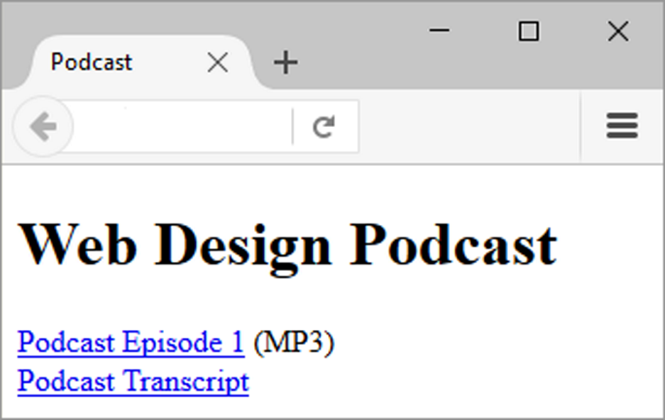
Configure Audio & Video
Hyperlink The most basic method to provide audio or video files
<a href="wdfpodcast.mp3" title="Web Design Podcast">Web Design Podcast</a>
Figure 11.1 The default MP3 player will launch in the browser when the visitor clicks on Podcast Episode 1

Slide 8
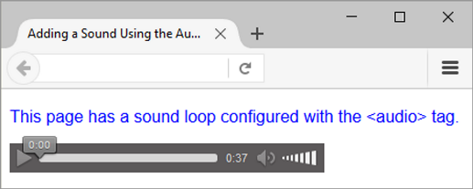
Figure 11.2 The Firefox browser supports the HTML5 audio element.

Slide 9
HTML5 Audio & Source Elements
<audio controls="controls">
<source src="soundloop.mp3" type="audio/mpeg">
<source src="soundloop.ogg" type="audio/ogg">
<a href="soundloop.mp3">Download the Audio File</a> (MP3)
</audio>

Slide 10
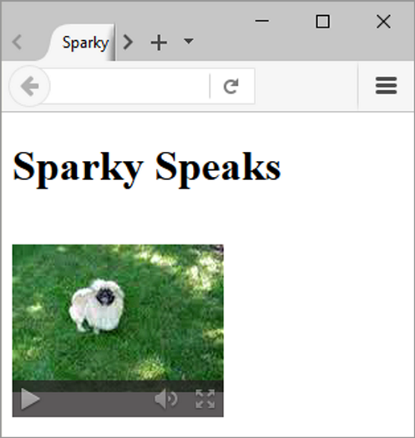
Figure 11.4 The Firefox browser. Screenshots of Mozilla Firefox. Courtesy of Mozilla Foundation.

Slide 11
HTML5 Video & Source Elements
<video controls="controls" poster="sparky.jpg"
width="160" height="150">
<source src="sparky.m4v" type="video/mp4">
<source src="sparky.ogv" type="video/ogg">
<a href="sparky.mov">Sparky the Dog</a> (.mov)
</video>

Slide 12
What is JavaScript?
Object-based client-side scripting language
Originally developed by Brendan Eich at Netscape
Manipulates the objects associated with a web page document:
the window
the document
the elements such as forms, images, hyperlinks, and so on

Slide 13
Common Uses of JavaScript
Display a message box
Select list navigation
Edit and validate form information
Create a new window with a specified size and screen position
Image Rollovers
Status Messages
Display Current Date
Calculations

Slide 14
Document Object Model (DOM)
A portion of the DOM is shown at the left.
Defines every object and element on a Web page
Hierarchical structure
Accesses page elements and apply styles to page elements

Slide 15
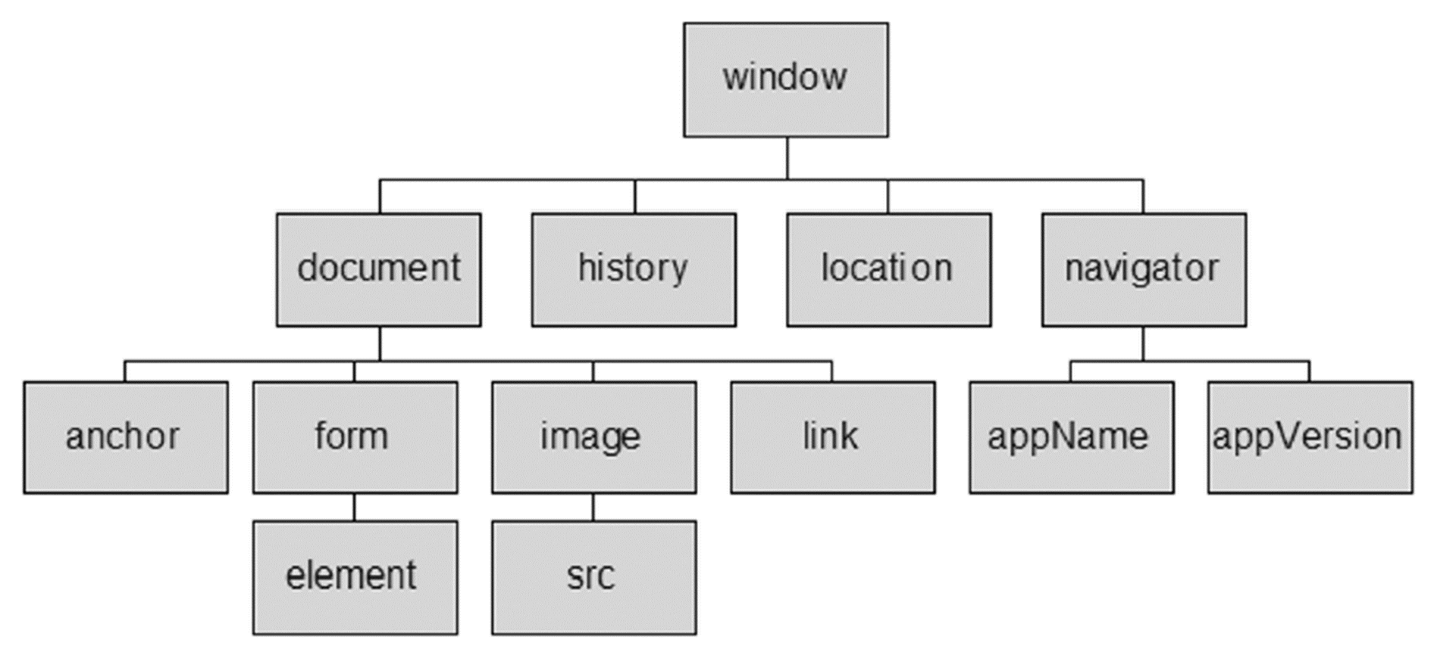
Figure 11.18 The Document Object Model (DOM)

Slide 16
Exploring JQuery (1 of 2)
A JavaScript library intended to simplify client-side scripting
Example: http://webdevfoundations.net/jquery
API – Application Programming Interface
A protocol that allows software components to communicate – interacting and sharing data.

Slide 17
Exploring JQuery (2 of 2)
The jQuery API can be used to configure many interactive features, including:
image slideshows
animation (moving, hiding, fading)
event handling (mouse movements and mouse clicking)
document manipulation

Slide 18
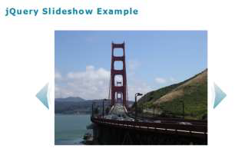
Figure 11.19 jQuery is used to configure a slideshow

Slide 19
Summary
This chapter introduced many HTML & CSS techniques and technologies used to configure sound, video, animation, and interactivity on web pages.
Issues related to accessibility and copyright were also discussed.

