Slide 1
Tutorial: Processing
Linda Vorberg, Lea Henrich
Summerschool 2019 Sarntal
Course: Wearable AI for Human Augmentation
Machine Learning and Data Analytics Lab (CS 14)

Slide 2
Basics
Download processing
https://processing.org/download/
Programming language: Java (optional JavaScript)
For creating interactive visual programs
Processing contains methods and functions
And libraries for advanced features

Slide 3
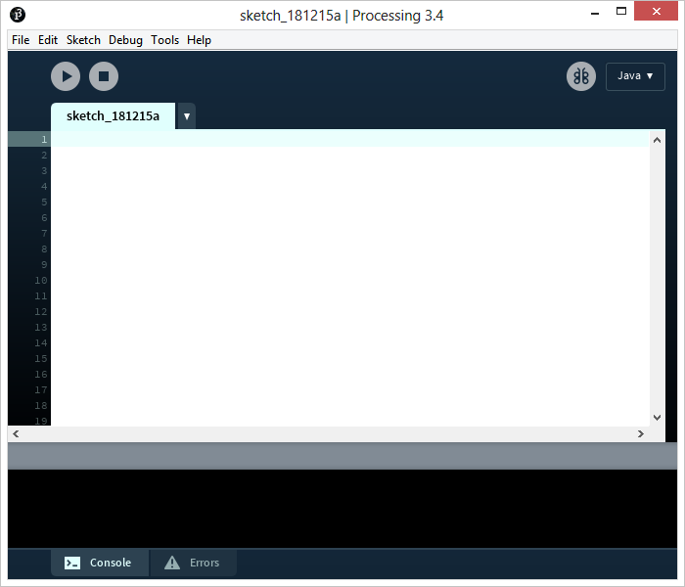
Basics
Run program
Stop program
Editor
Console

Slide 4
Basics
Processing program called Sketch, stored in Sketchbook
setup() block for initialization (background etc.)
draw() block to handle the animation
setup() executed once,
draw() executed continuously

Slide 5
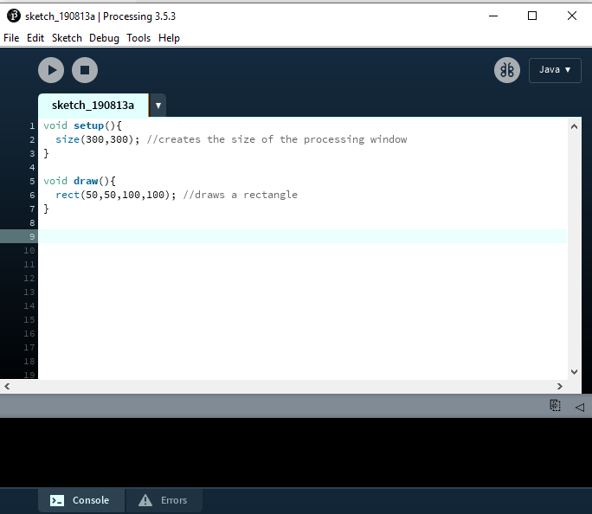
Basics
size(x,y)creates a processing window
x: horizontal pixels
y: vertical pixels

Slide 6
Basics
save sketch as application ( for Mac, Windows, etc):
File→ Export application
show example sketches to help you creating your own sketch:
File→ Examples

Slide 7
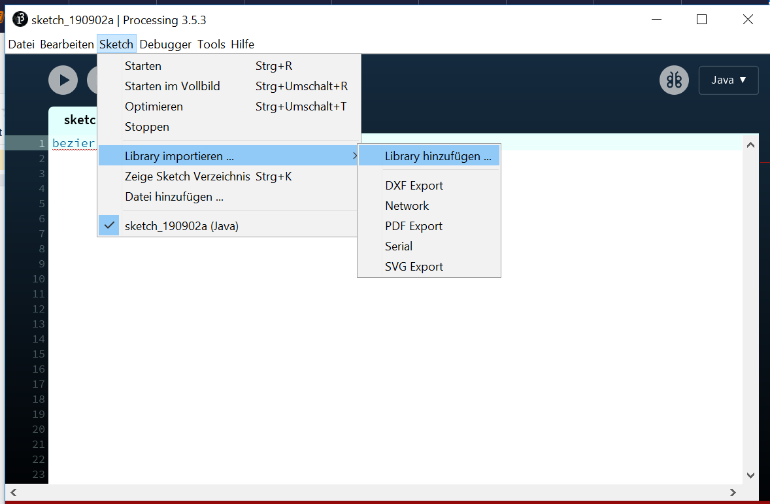
Integrating libraries
Reference to libraries: https://procBasisessing.org/reference/libraries/

Slide 8
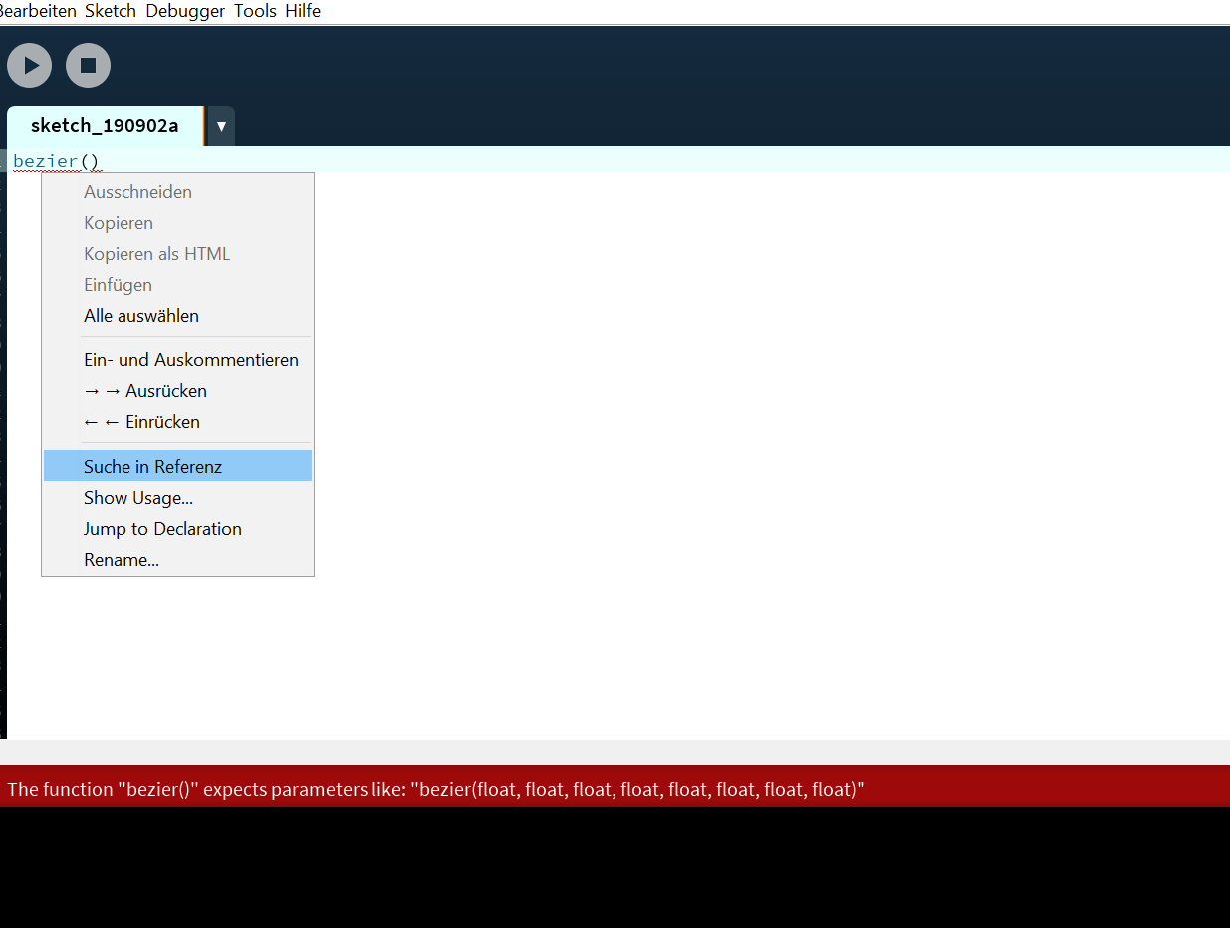
Methods
click right on function to show its reference
all methods: https://processing.org/reference/

Slide 9
GUI
Library to create a GUI:
ControlP5
Sketch → Import Library → Add Library (search for ControlP5)
see documentation:
https://github.com/sojamo/controlp5
http://www.sojamo.de/libraries/controlP5/

Slide 10
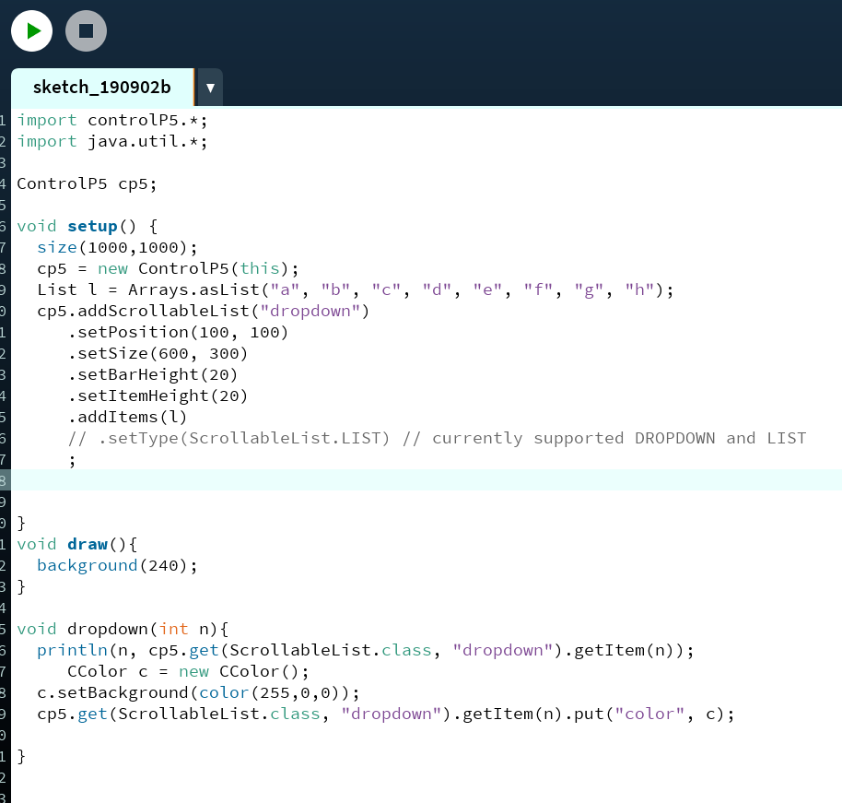
ControlP5
adding sliders, buttons, dropdowns etc.

Slide 11
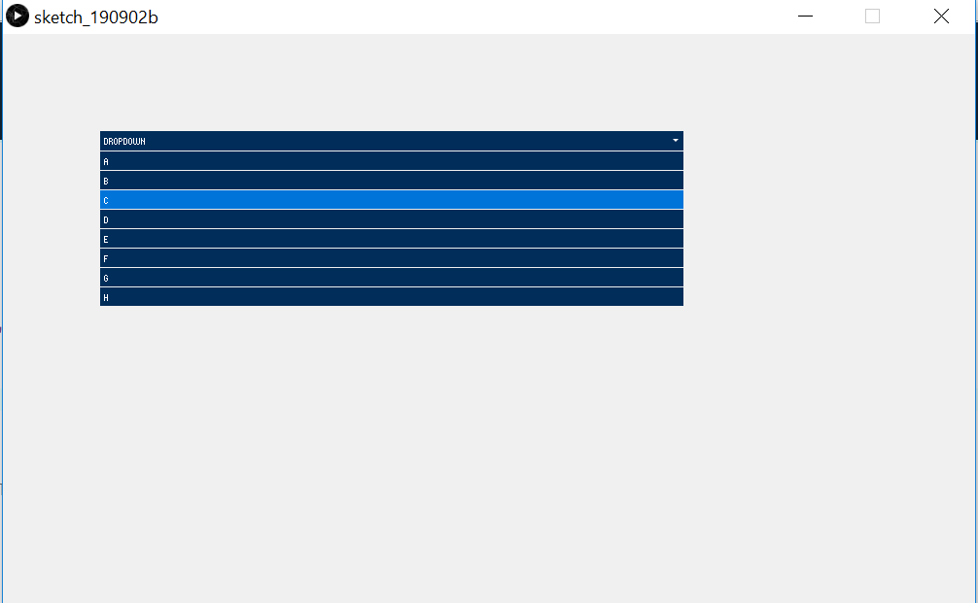
ControlP5
adding sliders, buttons, dropdowns etc.

Slide 12
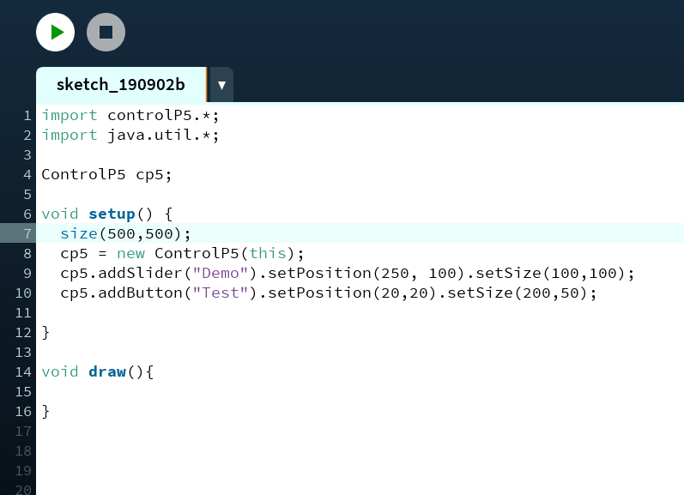
ControlP5
adding sliders, buttons, dropdowns etc.

Slide 13
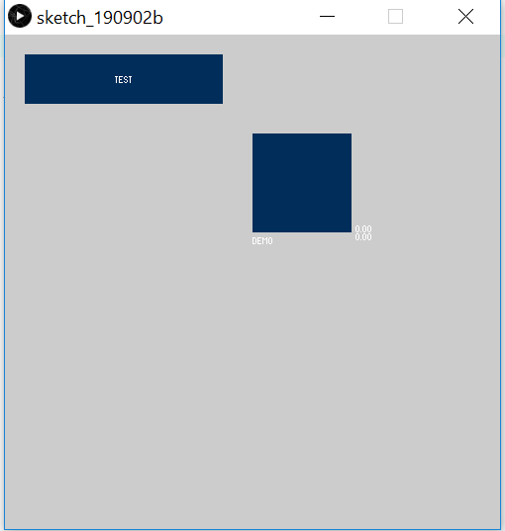
ControlP5
adding sliders, buttons, dropdowns etc.

Slide 14
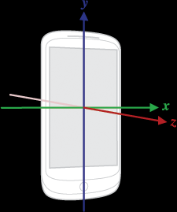
Packages to use Android sensors
smartphone contains sensors
obtain information about movement, position etc.
import packages from Android SDK to include sensor measurement in sketch
https://developer.android.com/reference/android/
hardware/Sensor.html
https://android.processing.org/tutorials/
sensors/index.html

Slide 15
Android sensors
1. Create sensor manager
create sketch that responds to changes in acceleration
import android.content.Context;
import android.hardware.Sensor;
import android.hardware.SensorManager;
Context context;
SensorManager manager;
Sensor sensor;
void setup(){
…
}
void draw(){
…
}

Slide 16
Android sensors
2. Add sensor listener
notifies sketch that new data is available
...
import android.hardware.SensorEvent;
import android.hardware.SensorEventListener;
...
AccelerometerListener listener;
void setup(){
…
}
void draw(){
…
}

Slide 17
Android sensors
3. Reading the sensor data
data consists of three float numbers
acceleration along the X, Y, and Z axis
...
Context context;
SensorManager manager;
Sensor sensor;
AccelerometerListener listener;
float ax, ay, az;
void setup(){
…
textFont(createFont("SansSerif", 30 * displayDensity));
}
void draw() {
background(0);
text("X: " + ax + "\nY: " + ay + "\nZ: " + az, 0, 0, width, height);
}

Slide 18
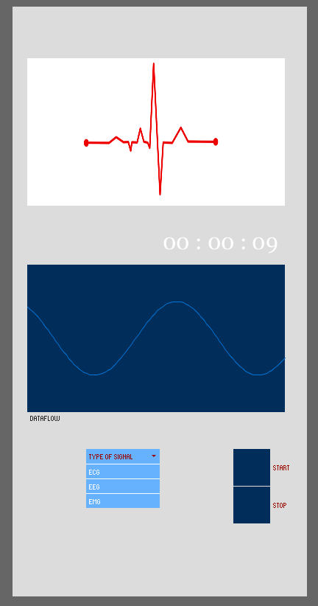
Example Application
Possibility to display signals
include dropdowns, buttons
display animations
create GUIs

Slide 19
Thank you for your attention!

Slide 20
References
https://processing.org/

