Slide 1
Quick Recap: Hill-Climbing:
  Idea: Always follow the best neighbor
  Pros: Easy to implement; performs well in convex spaces
  Cons: Gets stuck in local-maximum; lost in plateaus; ridges
Global-Maximum
Local-Maximum
Valley

Slide 2
Quick Recap: Beam-Search
  Idea: Keep track of N-th good-looking neighbors; expand them to see if they lead somewhere better.
  Pros: Has “memory”, can backtrack a little to overcome HC limitation
  Cons: Ability to overcome local-maxima is limited; Memory.
Global-Maximum
Local-Maximum
Valley

Slide 3
Simulated Annealing
Idea:
  Instead of following the best neighbor(s), sometimes expand less-optimal neighbors
  May lead to global-maxima that lie beyond poor-looking regions
Global-Maximum
Local-Maximum
Valley

Slide 4
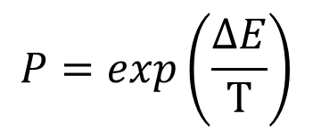
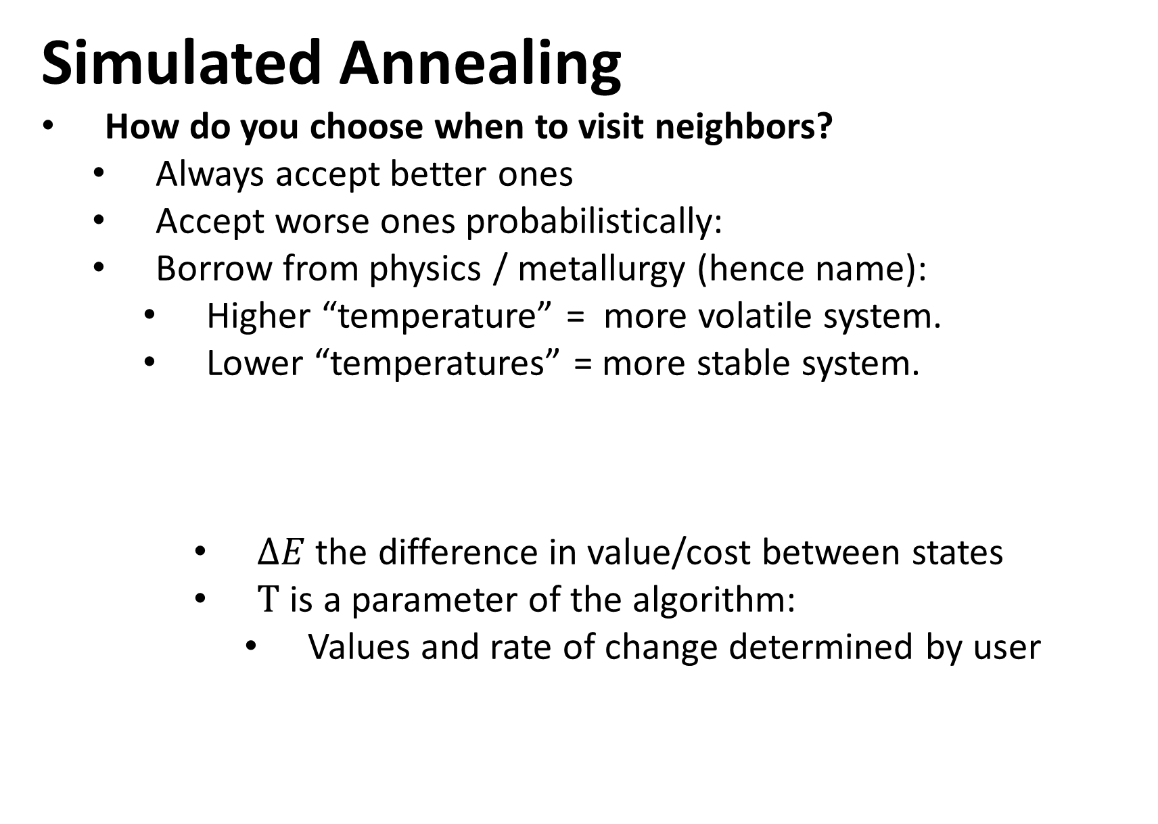
Simulated Annealing
How do you choose when to visit neighbors?
  Always accept better ones
  Accept worse ones probabilistically:
  Borrow from physics / metallurgy (hence name):
    Higher “temperature” = more volatile system.
    Lower “temperatures” = more stable system.
      $ΔE$ the difference in value/cost between states
      $T$ is a parameter of the algorithm:
        Values and rate of change determined by user
$$P=exp\left(\frac{ΔE}{T}\right)$$

Slide 5
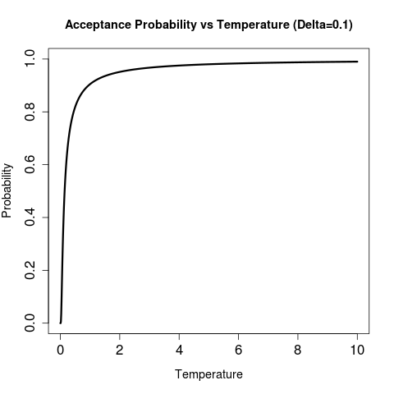
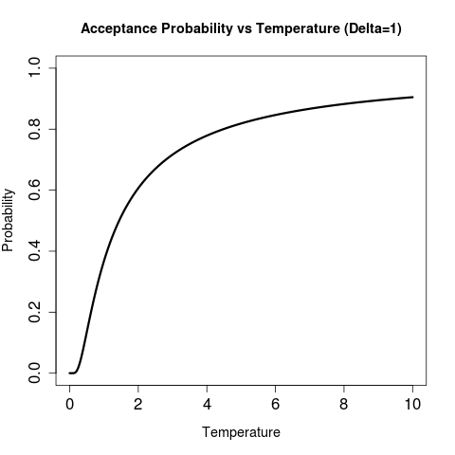
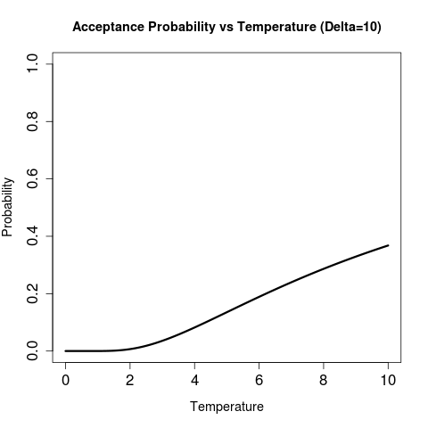
Simulated Annealing
Acceptance of new state is a function of temperature and how good/bad the state is compared to current one:
Relatively good states (low-delta) are almost always accepted

Slide 6
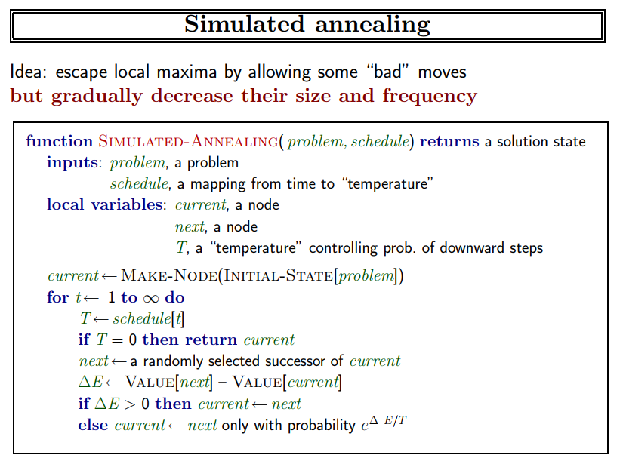
Simulated Annealing

Slide 7
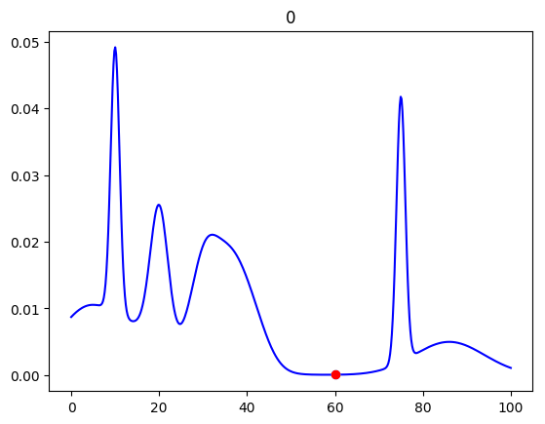
Simulated Annealing
http://www.mad-lab.org/presentations/

