Slide 1




Testing of Hypothesis & Data Analysis
RESEARCH METHODOLOGY AND DATA ANALYSIS
Workshop conducted by KSTA and VTU
Session 3:
Madhurima Panja
Research Scholar Center for Data Sciences - IIIT Bangalore

Slide 2
Today’s Topics…
Introduction to R statistical software
Role of Statistics and Data Analysis
Data summarization
Concepts of Descriptive Statistics
Hypothesis Testing
Analysis of Variance
Correlation Analysis
Linear Regression

Slide 3

History of R…
R is an open source programming language and software environment for statistical computing and graphics.
The R language is widely used among statisticians and data scientists for developing statistical and data analytics tools.
Modelled after S & S-plus, developed at AT&T labs in late 1980s.
R project was started by Robert Gentleman and Ross Ihaka Department of Statistics, University of Auckland (1995).
Currently maintained by R core development team – an international team of volunteer developers (since 1997).

Slide 4
Download R & RStudio
http://www.r-project.org/
http://cran.r-project.org/doc/contrib/Verzani-SimpleR.pdf
Download R: http://cran.r-project.org/bin/
Download RStudio: http://www.rstudio.com/ide/download/desktop
R for beginers
https://www.youtube.com/watch?v=cX532N_XLIs&ab_channel=MarinStatsLectures-RProgramming%26Statistics
https://www.youtube.com/watch?v=eD07NznguA4&ab_channel=OpenIntroOrg

Slide 5
INSTALLATION
Download R software from http://cran.r-project.org/bin/windows/base/
Run the R set up (exe) file and follow instructions
Double click on the R icon in the desktop and R window will open
Download RStudio from http://www.rstudio.com/
Run R studio set up file and follow instructions
Click on R studio icon, R Studio IDE Studio will load
Tools – Global Options – Appearances – Change Colour Size Theme
(if you wish to change the background, not a mandatory step)
Go to R-Script (Ctrl + Shift + N)
Write ‘Hello World !’
Save & Run (Ctrl + Enter)
Congrats ! You have written your very first R-Program

Slide 6
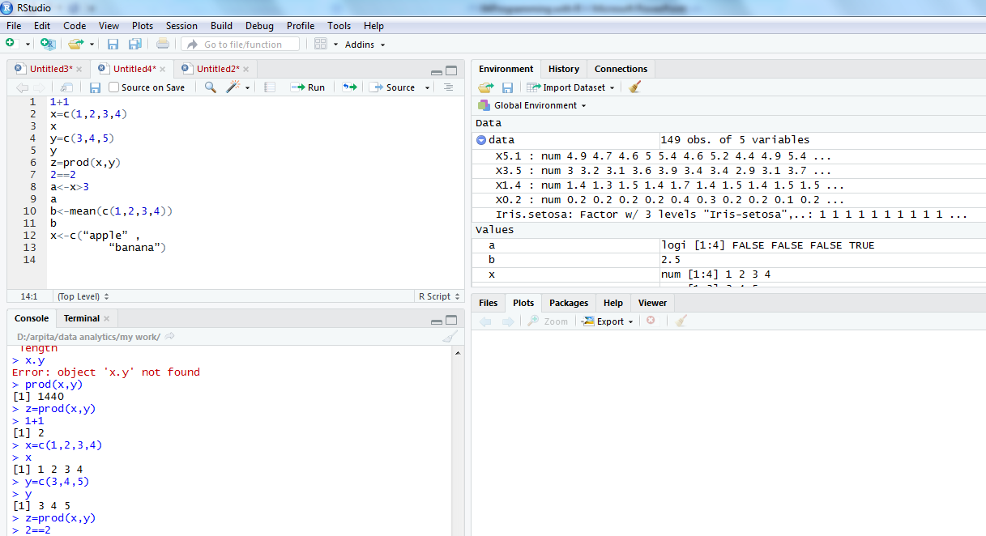
R command in integrated environment

Slide 7
How to use R for simple Mathematics
> 3+5
> 12 + 3 / 4 – 5 + 3*8
> (12 + 3 / 4 – 5) + 3*8
> pi * 2^3 – sqrt(4)
>factorial(4)
>log(2,10)
>log(2, base=10)
>log10(2)
>log(2)
Note
R ignores spaces

Slide 8
How to store results of calculations for future use
> x = 3+5
> x
> y = 12 + 3 / 4 – 5 + 3*8
> y
> z = (12 + 3 / 4 – 5) + 3*8
> z
> A <- 6 + 8 ## no space should be between < & -
> a ## Note: R is case sensitive
>A

Slide 9
Using c command
> data1 = c(3, 6, 9, 12, 78, 34, 5, 7, 7) ## numerical data
> data1.text = c(‘Mon’, ‘Tue’, “Wed”) ## Text data
## Single or double quote both ok
##copy/paste into R console may not work
> data1.text = c(data1.text, ‘Thu’, ‘Fri’)

Slide 10
Concept of working directory
>getwd()
[1] "C:\Users\DA\R\Database"
> setwd('D:\Data Analytics\Project\Database)
> dir() ## working directory listing
>ls() ## Workspace listing of objects
>rm(‘object’) ## Remove an element “object”, if exist
> rm(list = ls()) ## Cleaning

Slide 11
Reading data from a data file
> setwd("D:/Tanujit/data analytics/my work") #Set the working directory to file location
> getwd()
[1] "D:/Tanujit/data analytics/my work“
> dir()
rm(list=ls(all=TRUE)) # Refresh session
> data=read.csv('iris.csv', header = T, sep=",")
(data = read.table(‘iris.csv', header = T, sep = ','))
> ls()
[1] "data"
> str(data)
'data.frame': 149 obs. of 5 variables:
$ X5.1 : num 4.9 4.7 4.6 5 5.4 4.6 5 4.4 4.9 5.4 ...
$ X3.5 : num 3 3.2 3.1 3.6 3.9 3.4 3.4 2.9 3.1 3.7 ...
$ X1.4 : num 1.4 1.3 1.5 1.4 1.7 1.4 1.5 1.4 1.5 1.5 ...
$ X0.2 : num 0.2 0.2 0.2 0.2 0.4 0.3 0.2 0.2 0.1 0.2 ...
$ Iris.setosa: Factor w/ 3 levels "Iris-setosa",..: 1 1 1 1 1 1 1 1 1 1 ...

Slide 12
Accessing elements from a file
> data$X5.1
[1] 4.9 4.7 4.6 5.0 5.4 4.6 5.0 4.4 4.9 5.4 4.8 4.8 4.3 5.8 5.7
> data$X5.1[7]=5.2
> data$X5.1
[1] 4.9 4.7 4.6 5.0 5.4 4.6 5.2 4.4 4.9 5.4 4.8 4.8 4.3 5.8 5.7
#Note: This change has happened in workspace only not in the file.
How to make it permanent?
write.csv / write.table
>write.table(data, file =‘iris_mod.csv', row.names = FALSE, sep = ',')
If row.names is TRUE, R adds one ID column in the beginning of file.
So its suggested to use row.names = FALSE option
>write.csv(data, file ==‘iris_mod.csv', row.names = TRUE) ## to test

Slide 13
Data frame in R
A data frame is more general than a matrix, in that different columns can have different modes (numeric, character, factor, etc.).
>d <- c(1,2,3,4)
>e <- c("red", "white", "red", NA)
>f <- c(TRUE,TRUE,TRUE,FALSE)
>myframe <- data.frame(d,e,f)
>names(myframe) <- c("ID","Color","Passed") # Variable names
>myframe
>myframe[1:3,] # Rows 1 , 2, 3 of data frame
>myframe[,1:2] # Col 1, 2 of data frame
>myframe[c("ID","Color")] #Columns ID and color from data frame
>myframe$ID # Variable ID in the data frame

Slide 14
DESCRIPTIVE STATISTICS
Exercise 1: The monthly credit card expenses of an individual in 1000 rupees is given in the file Credit_Card_Expenses.csv.
Read the dataset to R studio
Compute mean, median minimum, maximum, range, variance, standard deviation, skewness, kurtosis and quantiles of Credit Card Expenses
Compute default summary of Credit Card Expenses
Draw Histogram of Credit Card Expenses

Slide 15
DESCRIPTIVE STATISTICS
The monthly credit card expenses of an individual in 1000 rupees is given below. Kindly summarize the data
Month | Credit Card Expenses | Month | Credit Card Expenses
1 | 55 | 11 | 63
2 | 65 | 12 | 55
3 | 59 | 13 | 61
4 | 59 | 14 | 61
5 | 57 | 15 | 57
6 | 61 | 16 | 59
7 | 53 | 17 | 61
8 | 63 | 18 | 57
9 | 59 | 19 | 59
10 | 57 | 20 | 63

Slide 16
DESCRIPTIVE STATISTICS
Reading a csv file to R Studio : Source code
Credit_Card_Expenses <- read.csv(“Credit_Card_Expenses.csv")
To change the name of the data set to : mydata
> mydata = Credit_Card_Expenses
To display the contents of the data set
> print(mydata)
To read a particular column or variable of data set to a ne variable Example: Read CC_Expenses to CC
>CC = mydata$CC_Expenses

Slide 17
DESCRIPTIVE STATISTICS
Operator | Description
+ | addition
- | subtraction
* | multiplication
/ | division
^ or ** | exponentiation
x %% y | modulus (x mod y) 5%%2 is 1
x %/% y | integer division 5%/%2
Operator | Description
< | less than
<= | less than or equal to
> | greater than
>= | greater than or equal to
== | exactly equal to
! = | not equal to
!x | Not x
x | y | x OR y
x & y | x AND y
isTRUE(x) | test if X is TRUE

Slide 18
DESCRIPTIVE STATISTICS
Descriptive Statistics
Computation of descriptive statistics for variable CC
Function | Code | Value
Mean | > mean(CC) | 59.2
Median | > median(CC) | 59
Standard deviation | > sd(CC) | 3.105174
Variance | > var(CC) | 9.642105
Minimum | > min(CC) | 53
Maximum | > max(CC) | 65
Range | > range(CC) | 53.65

Slide 19
DESCRIPTIVE STATISTICS
Descriptive Statistics
Function | Code
Quantile | > quantile(CC)
Output
Quantile | 0% | 25% | 50% | 75% | 100%
Value | 53 | 57 | 59 | 61 | 65
Function | Code
Summary | >summary(CC)
Output
Minimum | Q1 | Median | Mean | Q3 | Maximum
53 | 57 | 59 | 59.2 | 61 | 65

Slide 20
DESCRIPTIVE STATISTICS
Descriptive Statistics
Function | Code
describe | > library(psych) > describe(CC)
Output
Statistics | Values
N | 20
mean | 59.2
sd | 3.11
median | 59
Trimmed | 59.25
mad | 2.97
min | 53
Max | 65
Range | 12
Skew | -0.08
Kurtosis | -0.85
se | 0.69

Slide 21
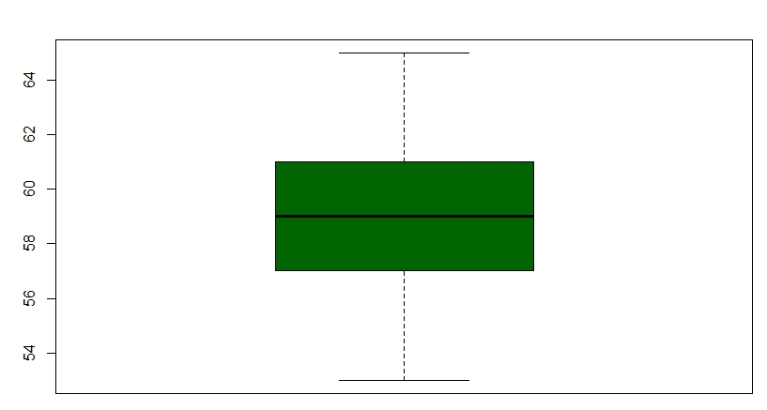
DESCRIPTIVE STATISTICS
Box plot : Variable - CC
> boxplot(CC, col="dark green")

Slide 22
DATA VISUALIZATION

Slide 23
DATA VISUALIZATION
With ever increasing volume of data, it is impossible to tell stories without visualizations. Data visualization is an art of how to turn numbers into useful knowledge.
Popular Data Visualization Techniques:
Scatter Plot
Histogram
Box Plot
HeatMap
Correlogram

Slide 24
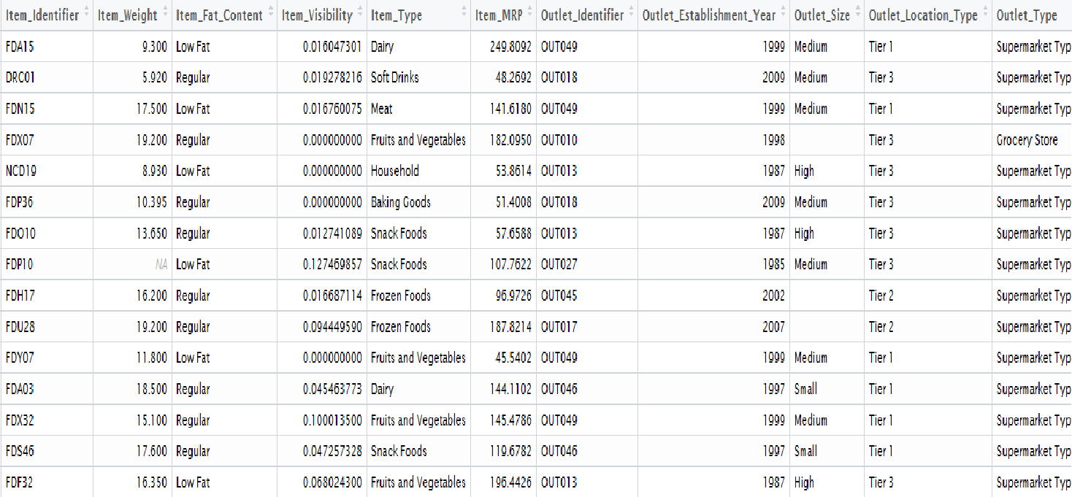
DATA VISUALIZATION
We’ll use ‘Big_Mart_Dataset.csv’ example as shown below to understand how to create visualizations.

Slide 25
DATA VISUALIZATION
1. Scatter Plot: It is used to see the relationship between two continuous variables. In our above mart dataset, if we want to visualize the items as per their cost data, then we can use scatter plot chart using two continuous variables, namely Item_Visibility & Item_MRP as shown.
Read data and simple scatter plot using function ggplot() with geom_point().
> train <- read.csv("Big_Mart_Dataset.csv")
> view(train)
> library(ggplot2)
> ggplot(train, aes(Item_Visibility, Item_MRP)) + geom_point() + scale_x_continuous("Item Visibility", breaks = seq(0,0.35,0.05))+ scale_y_continuous("Item MRP", breaks = seq(0,270,by = 30))+ theme_bw()

Slide 26
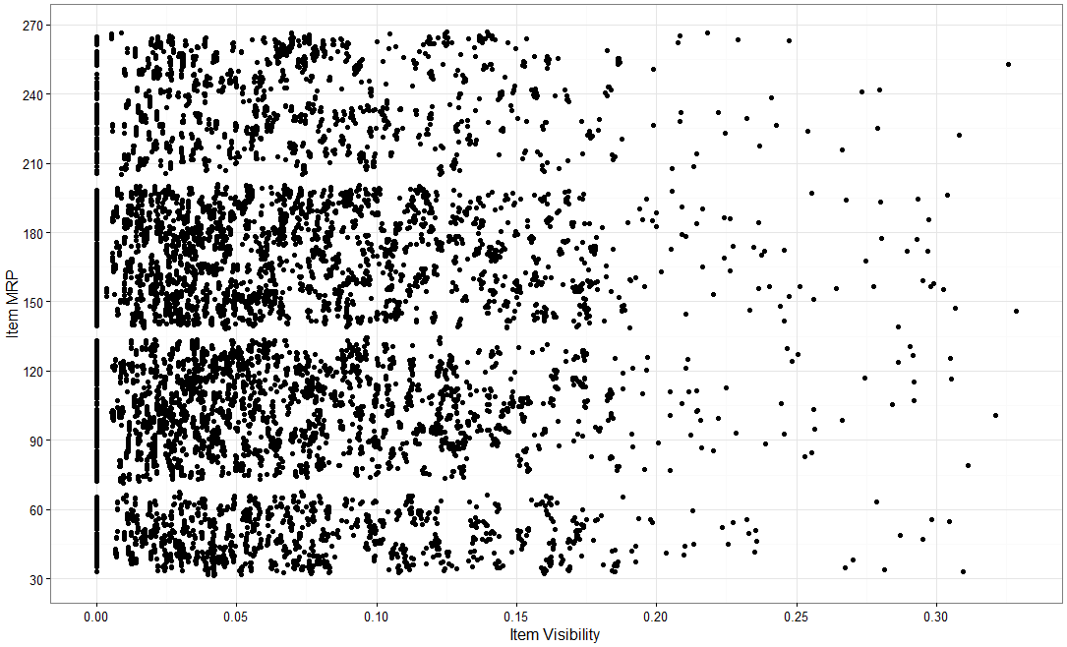
DATA VISUALIZATION

Slide 27
DATA VISUALIZATION
1. Scatter Plot: Now, we can view a third variable also in same chart, say a categorical variable (Item_Type) which will give the characteristic (item_type) of each data set. Different categories are depicted by way of different color for item_type in below chart.
Another scatter plot using function ggplot() with geom_point().
> library(ggplot2)
> ggplot(train, aes(Item_Visibility, Item_MRP)) + geom_point(aes(color = Item_Type)) + scale_x_continuous("Item Visibility", breaks = seq(0,0.35,0.05))+ scale_y_continuous("Item MRP", breaks = seq(0,270,by = 30))+ theme_bw() + labs(title="Scatterplot")

Slide 28
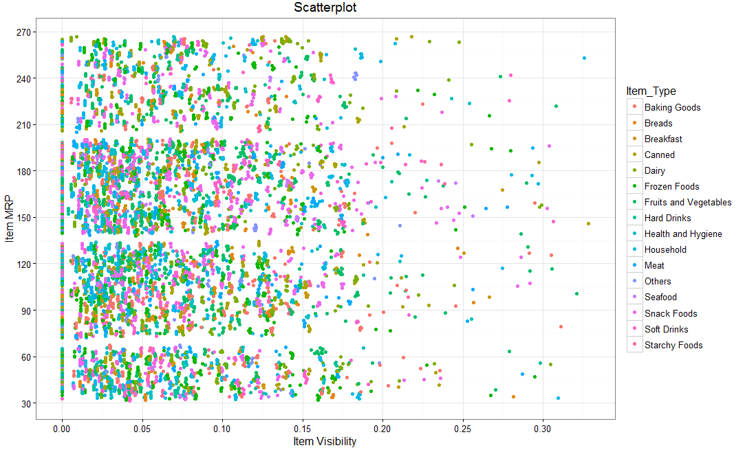
DATA VISUALIZATION

Slide 29
DATA VISUALIZATION
1. Scatter Plot: We can even make it more visually clear by creating separate scatter plots for each separate Item_Type as shown below.
Another scatter plot using function ggplot() with geom_point().
library(ggplot2)
ggplot(train, aes(Item_Visibility, Item_MRP)) + geom_point(aes(color = Item_Type)) + scale_x_continuous("Item Visibility", breaks = seq(0,0.35,0.05))+ scale_y_continuous("Item MRP", breaks = seq(0,270,by = 30))+ theme_bw() + labs(title="Scatterplot") + facet_wrap( ~ Item_Type)
Here, facet_wrap works well & wraps Item_Type in rectangular layout.

Slide 30
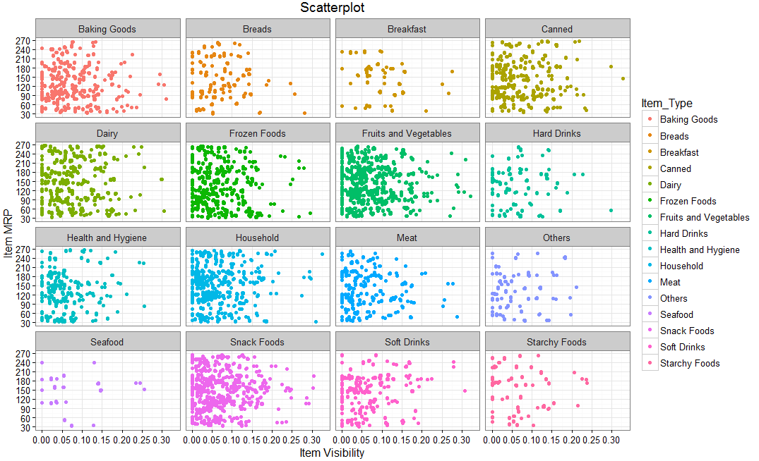
DATA VISUALIZATION

Slide 31
DATA VISUALIZATION
2. Histogram: It is used to plot continuous variable. It breaks the data into bins and shows frequency distribution of these bins. We can always change the bin size and see the effect it has on visualization.
For Big_Mart_Dataset, if we want to know the count of items on basis of their cost, then we can plot histogram using continuous variable Item_MRP as shown below.
Histogram plot using function ggplot() with geom_ histogram()
> ggplot(train, aes(Item_MRP)) + geom_histogram(binwidth = 2)+ scale_x_continuous("Item MRP", breaks = seq(0,270,by = 30))+ scale_y_continuous("Count", breaks = seq(0,200,by = 20))+ labs(title = "Histogram")

Slide 32
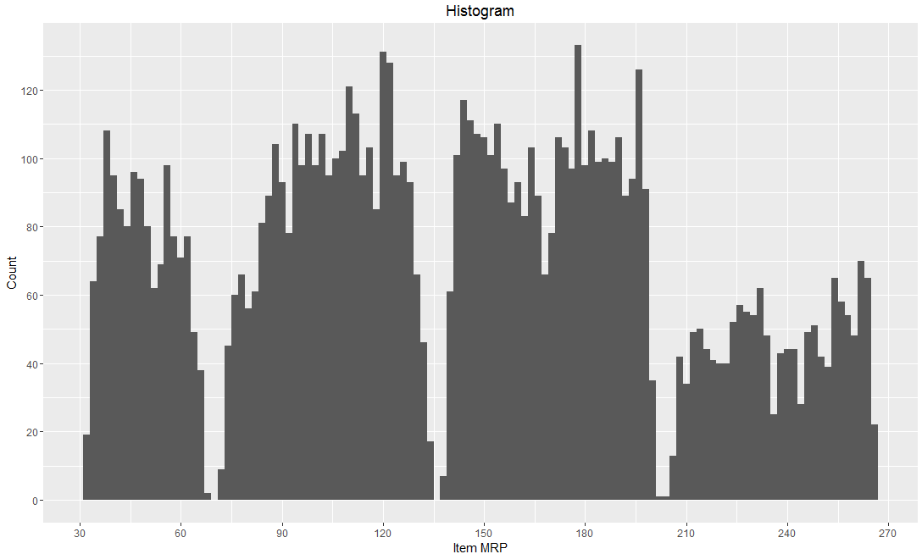
DATA VISUALIZATION

Slide 33
DATA VISUALIZATION
3. Box Plot: It is used to plot a combination of categorical and continuous variables. This plot is useful for visualizing the spread of the data and detect outliers. It shows five statistically significant numbers- the minimum, the 25th percentile, the median, the 75th percentile and the maximum.
For Big_Mart_Dataset, if we want to identify each outlet’s detailed item sales including minimum, maximum & median numbers, box plot can be helpful. In addition, it also gives values of outliers of item sales for each outlet as shown in below chart.
R Code:
> ggplot(train, aes(Outlet_Identifier, Item_Outlet_Sales)) + geom_boxplot(fill = "red")+scale_y_continuous("Item Outlet Sales", breaks= seq(0,15000, by=500))+labs(title = "Box Plot", x = "Outlet Identifier")

Slide 34
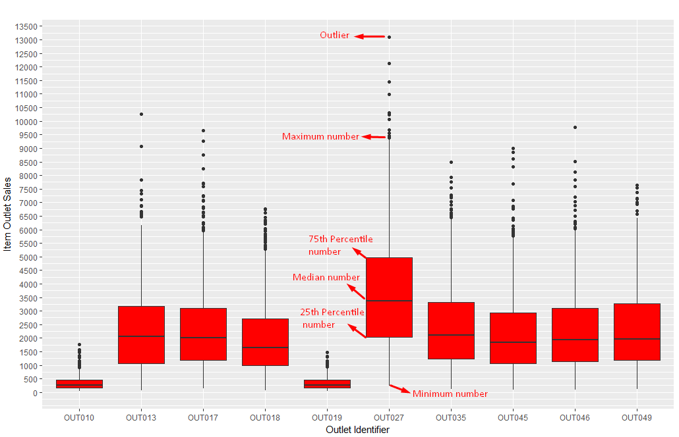
DATA VISUALIZATION
The black points are outliers. Outlier detection and removal is an essential step of successful data exploration.

Slide 35
DATA VISUALIZATION
4. Heat Map: It uses intensity (density) of colours to display relationship between two or three or many variables in a two dimensional image.
For Big_Mart_Dataset, if we want to know cost of each item on every outlet, we can plot heatmap as shown below using three variables Item MRP, Outlet Identifier & Item Type from our mart dataset.
R Code:
> ggplot(train, aes(Outlet_Identifier, Item_Type))+ geom_raster(aes(fill = Item_MRP))+ labs(title ="Heat Map", x = "Outlet Identifier", y = "Item Type")+ scale_fill_continuous(name = "Item MRP")

Slide 36
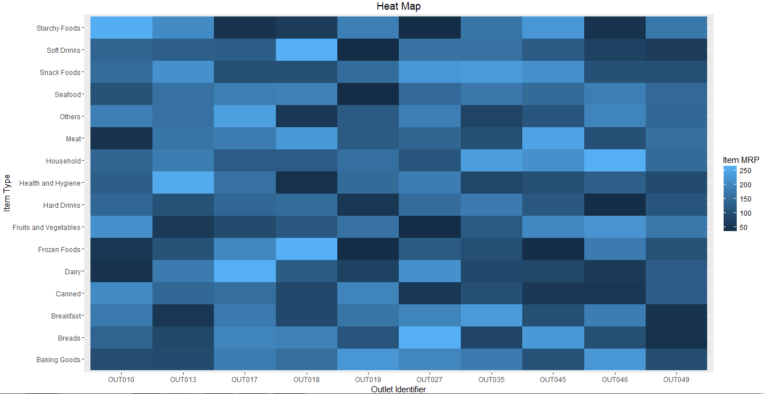
DATA VISUALIZATION
The dark portion indicates Item MRP is close 50.
The brighter portion indicates Item MRP is close to 250.

Slide 37
DATA VISUALIZATION
5. Correlogram: It is used to test the level of co-relation among the variable available in the data set. The cells of the matrix can be shaded or coloured to show the co-relation value.
For Big_Mart_Dataset, check co-relation between Item cost, weight, visibility along with Outlet establishment year and Outlet sales from below plot.
R Code for simple correlogram using function corrgram():
> install.packages("corrgram")
> library(corrgram)
> corrgram(train, order=NULL, panel=panel.shade, text.panel=panel.txt, main="Correlogram")

Slide 38
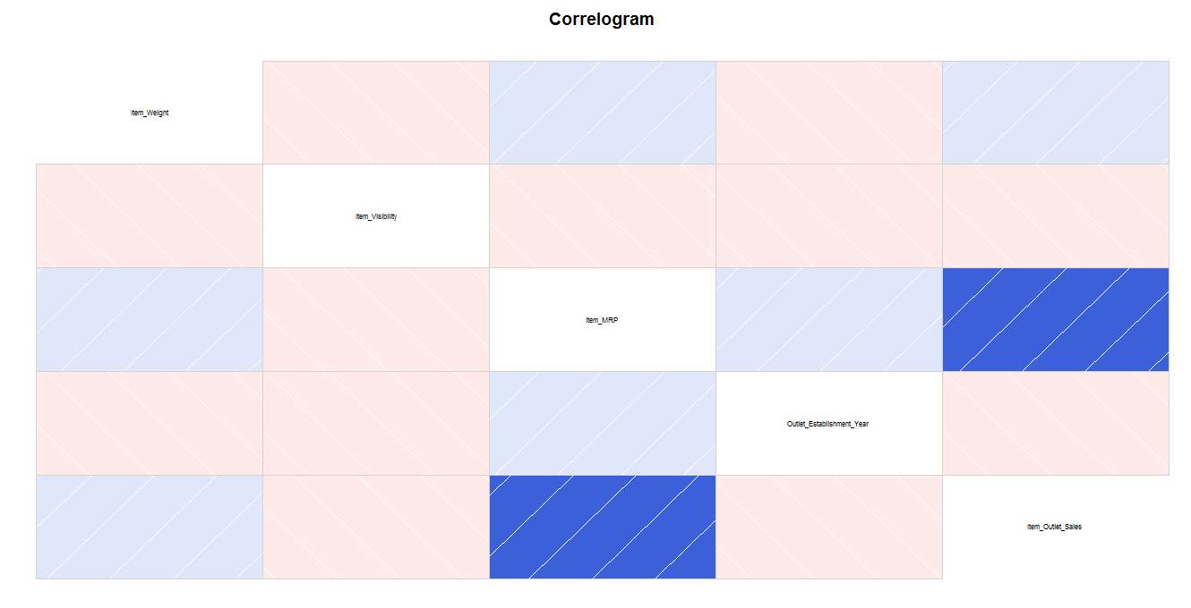
DATA VISUALIZATION
Darker the colour, higher the co-relation between variables. Positive co-relations are displayed in blue and negative correlations in red colour. Colour intensity is proportional to the co-relation value.
We can see that Item cost & Outlet sales are positively correlated while Item weight & its visibility are negatively correlated.

Slide 39
DATA PRE-PROCESSING

Slide 40
DATA PREPROCESSING
Missing value replenishment
Transformation or normalization
Random Sampling

Slide 41
Missing Value Handling
Example: Suppose a telecom company wants to analyze the performance of its circles based on the following parameters
1. Current Month’s Usage
2. Last 3 Month’s Usage
3. Average Recharge
4. Projected Growth
The data set is given in next slide. (Missing_Values_Telecom Data)

Slide 42
Missing Value Handling
Example: Circle wise Data

Slide 43
Missing Value Handling
Example: Read data and variables to R
> mydata = read.csv(“Missing_Values_Telecom.csv”)
> cmusage = mydata[,2]
> l3musage = mydata[,3]
> avrecharge = mydata[,4]

Slide 44
Missing Value Handling
Option 1: Discard all records with missing values
>newdata = na.omit(mydata)
>write.csv(newdata,"newdata.csv")
SL.No. | Current.Month.s.Usage | Last.3.Month.s.Usage | Average.Recharge | Projected.Growth | Circle
1 | 5.1 | 3.5 | 99.4 | 99.2 | A
2 | 4.9 | 3 | 98.6 | 99.2 | A
4 | 4.6 | 3.1 | 98.5 | 9..2 | A
6 | 5.4 | 3.9 | 98.3 | 99.4 | A
7 | 7 | 3.2 | 95.3 | 98.4. | B
8 | 6.4 | 3.2 | 95.5 | 98.5 | B
9 | 6.9 | 3.1 | 95.1 | 98.5 | B
11 | 6.5 | 2.8 | 95.4 | 98.5 | B
14 | 6.7 | 3.3 | 94.3 | 97.5 | C
15 | 6.7 | 3 | 94.8 | 97.3 | C
16 | 6.3 | 2.5 | 95 | 98.9 | C
18 | 6.2 | 3.4 | 94.6 | 97.3 | C
19 | 5.9 | 3 | 94.9 | 98.8 | C

Slide 45
Missing Value Handling
Option 2: Replace the missing values with variable mean, median, etc
Replacing the missing values with mean
Compute the means excluding the missing values
>cmusage_mean = mean(cmusage, na.rm = TRUE)
>l3musage_mean = mean(l3musage, na.rm = TRUE)
> avrecharge_mean = mean(avrecharge, na.rm = TRUE)
Replace the missing values with mean
> cmusage[is.na(cmusage)]=cmusage_mean
> l3musage[is.na(l3musage)]= l3musage_mean >avrecharge[is.na(avrecharge)]=avrecharge_mean

Slide 46
Missing Value Handling
Option 2: Replace the missing values with variable mean, median, etc
Replacing the missing values with mean
Replace the missing values with mean
> cmusage[is.na(cmusage)]=cmusage_mean
> l3musage[is.na(l3musage)]= l3musage_mean >avrecharge[is.na(avrecharge)]=avrecharge_mean
Making the new file
> mynewdata = cbind(cmusage, l3musage, avrecharge, mydata[,5],mydata[,6])
> write.csv(mynewdata, "E:/SUAD/mynewdata.csv")

Slide 47
Missing Value Handling
Option 2: Replace the missing values with variable mean, median, etc
Replacing the missing values with men
SL No | cmusage | l3musage | avrecharge | Proj Growth | Circle
1 | 5.1 | 3.5 | 99.4 | 11 | 1
2 | 4.9 | 3 | 98.6 | 11 | 1
3 | 5.975 | 3.2 | 96.14117647 | 11 | 1
4 | 4.6 | 3.1 | 98.5 | 1 | 1
5 | 5 | 3.105882353 | 98.4 | 11 | 1
6 | 5.4 | 3.9 | 98.3 | 12 | 1
7 | 7 | 3.2 | 95.3 | 6 | 2
8 | 6.4 | 3.2 | 95.5 | 7 | 2
9 | 6.9 | 3.1 | 95.1 | 7 | 2
10 | 5.975 | 2.3 | 96 | 5 | 2
11 | 6.5 | 2.8 | 95.4 | 7 | 2
12 | 5.7 | 3.105882353 | 95.5 | 5 | 2
13 | 6.3 | 3.3 | 96.14117647 | 8 | 2
14 | 6.7 | 3.3 | 94.3 | 3 | 3
15 | 6.7 | 3 | 94.8 | 2 | 3
16 | 6.3 | 2.5 | 95 | 10 | 3
17 | 5.975 | 3 | 94.8 | 4 | 3
18 | 6.2 | 3.4 | 94.6 | 2 | 3
19 | 5.9 | 3 | 94.9 | 9 | 3

Slide 48
TRANSFORMATION / NORMALIZATION
z transform:
Transformed data = (Data – Mean) / SD
Exercise : Normalize the variables in the Supply_Chain.csv ?
Read the files
>mydata = Supply_Chain
> mydata = mydata[,2:7]
Normalize or standardize the variable
>mystddata = scale(mydata)

Slide 49
RANDOM SAMPLING
Example: Take a sample of size 60 (10%) randomly from the data given in the file bank-data.csv and save it as a new csv file?
Read the files
>mydata = bank-data
> mysample = mydata[sample(1:nrow(mydata), 60, replace = FALSE),]
>write.csv(mysample,"E:/SUAD/mysample.csv")
Example: Split randomly the data given in the file bank-data.csv into sets namely training (75%) and test (25%) ?
Read the files
>mydata = bank-data
>sample = sample(2, nrow(mydata), replace = TRUE, prob = c(0.75, 0.25))
> sample1 = mydata[sample ==1, ]
> sample2 = mydata[sample ==2,]

Slide 50
TEST OF HYPOTHESIS using R

Slide 51
TEST OF HYPOTHESIS
Introduction:
In many situations, it is required to accept or reject a statement or claim about some parameter
Example:
The average cycle time is less than 24 hours
The % rejection is only 1%
The statement is called the hypothesis
The procedure for decision making about the hypothesis is called hypothesis testing
Advantages
Handles uncertainty in decision making
Minimizes subjectivity in decision making
Helps to validate assumptions or verify conclusions

Slide 52
TEST OF HYPOTHESIS
Commonly used hypothesis tests on mean of normal distribution:
Checking mean equal to a specified value (mu = mu₀)
Two means are equal or not (mu₁ = mu₂)
Null Hypothesis:
A statement about the status quo
One of no difference or no effect
Denoted by H0
Alternative Hypothesis:
One in which some difference or effect is expected
Denoted by H1

Slide 53
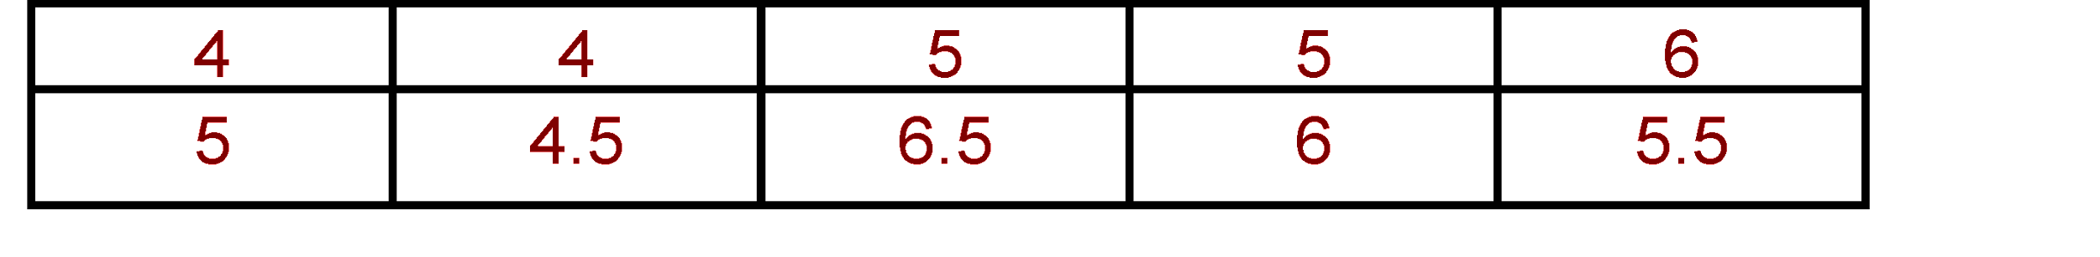
TEST OF HYPOTHESIS
Methodology demo: To Test Mean = Specified Value (mu = mu₀)
Suppose we want to test whether mean of a process characteristic is 5 based on the following sample data from the process
Calculate the mean of the sample, xbar = 5.15
Compare xbar with specified value 5
or xbar - specified value = xbar - 5 with 0
If xbar - 5 is close to 0
then conclude mean = 5
else mean ≠ 5

Slide 54
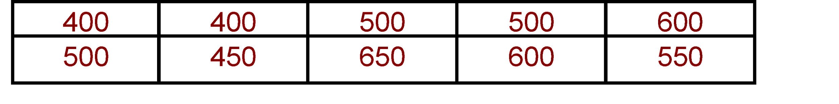
TEST OF HYPOTHESIS
Methodology demo : To Test Mean = Specified Value (mu = mu₀)
Consider another set of sample data. Check whether mean of the process characteristic is 500
Mean of the sample, xbar = 515
xbar - 500 = 515 - 500 = 15
Can we conclude mean ≠ 500?
Conclusion:
Difficult to say mean = specified value by looking at xbar - specified value alone

Slide 55
TEST OF HYPOTHESIS
Methodology demo: To Test Mean = Specified Value (mu = mu₀)
Test statistic is calculated by dividing (xbar - specified value) by a function of standard deviation
To test Mean = Specified value
Test Statistic t₀ = (xbar - Specified value) / (SD / √n)
If test statistic is close to 0, conclude that Mean = Specified value
To check whether test statistic is close to 0, find out p value from the sampling distribution of test statistic

Slide 56
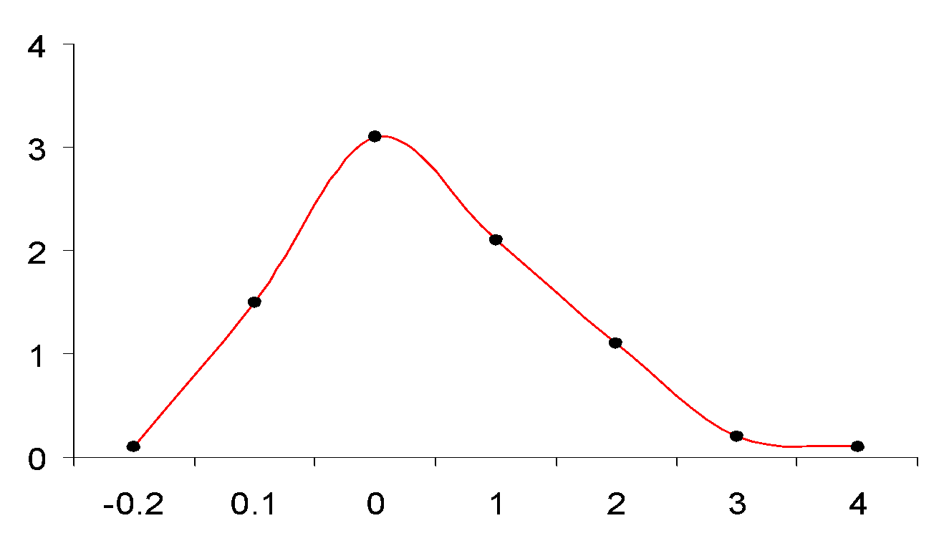
TEST OF HYPOTHESIS
Methodology demo: To Test Mean = Specified Value
P value
The probability that such evidence or result will occur when H0 is true
Based on the reference distribution of test statistic
The tail area beyond the value of test statistic in reference distribution
P value
t₀

Slide 57
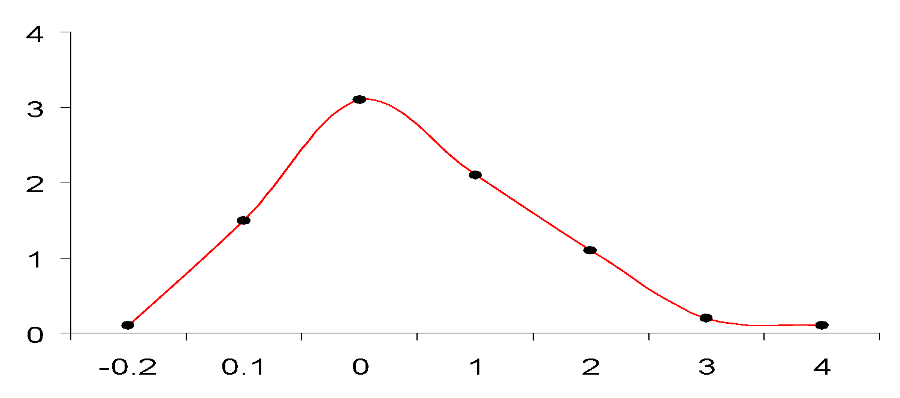
TEST OF HYPOTHESIS
Methodology demo : To Test Mean = Specified Value
P value
P value
t0
If test statistic t₀ is close to 0 then p will be high
If test statistic t₀ is not close to 0 then p will be small
If p is small , p < 0.05 (with alpha = 0.05), conclude that t ≠ 0, then
Mean ≠ Specified Value, H0 rejected

Slide 58
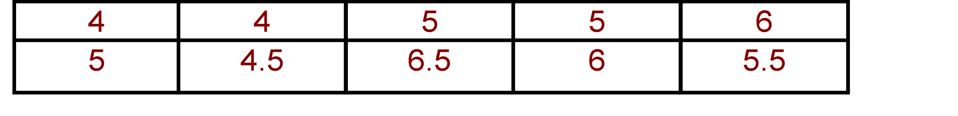
TEST OF HYPOTHESIS
To Test Mean = Specified Value (mu = mu₀)
Example: Suppose we want to test whether mean of the process characteristic is 5 based on the following sample data
H0: Mean = 5
H1: Mean ≠ 5
Calculate xbar = 5.15
SD = 0.8515
n = 10
Test statistic t₀ = (xbar - 5)/(SD / √n) = (5.15 - 5) / (0.8515 / √10) = 0.5571

Slide 59
TEST OF HYPOTHESIS
Example: To Test Mean = Specified Value (mu = mu₀)
t₀ = 0.5571
P = 0.59
0.55
P ≥ 0.05, hence Mean = Specified value = 5.
H0: Mean = 5 is not rejected

Slide 60
TEST OF HYPOTHESIS
Hypothesis Testing: Steps
Formulate the null hypothesis H0 and the alternative hypothesis H1
Select an appropriate statistical test and the corresponding test statistic
Choose level of significance alpha (generally taken as 0.05)
Collect data and calculate the value of test statistic
Determine the probability associated with the test statistic under the null hypothesis using sampling distribution of the test statistic
Compare the probability associated with the test statistic with level of significance specified

Slide 61
TEST OF HYPOTHESIS
Install the necessary packages
> install.packages("car")
> library(car)
> install.packages("gplots")
> library(gplots)
> install.packages("ggplot2")
> library(ggplot2)
> install.packages("qqplotr")
> library(qqplotr)
> install.packages("boot")
> library(boot)

Slide 62
TEST OF HYPOTHESIS
One sample t test
Exercise 1 : A company claims that on an average it takes only 40 hours or less to process any purchase order. Based on the data given below, can you validate the claim? The data is given in PO_Processing.csv
Reading data to mydata
> mydata = read.csv('PO_Processing.csv',header = T,sep = ",")
> PT = mydata$Processing_Time
Performing one sample t test
> t.test(PT, alternative = 'greater', mu = 40)
Statistics | Value
t | 3.7031
df | 99
P value | 0.0001753

Slide 63
NORMALITY TEST

Slide 64
NORMALITY TEST
Normality test
A methodology to check whether the characteristic under study is normally distributed or not
Two Methods :
Normality test - Quantile – Quantile (Q- Q) plot
Plots the ranked samples from the given distribution against a similar number of ranked quantiles taken from a normal distribution
If the sample is normally distributed then the line will be straight in the plot
Normality test – Shapiro – Wilk test
H0: Deviation from bell shape (normality) = 0
H1 : Deviation from bell shape ≠ 0
If p value ≥ 0.05 (5%), then H0 is not rejected, distribution is normal

Slide 65
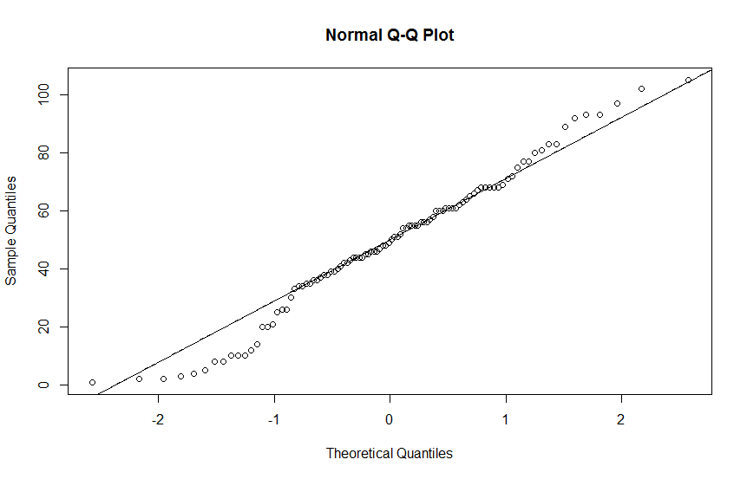
NORMALITY TEST
Normality test
Exercise 1 : The processing times of purchase orders is given in PO_Processing.csv. Is the distribution of processing time is normally distributed?
Normality Check using Normal Q – Q plot
> qqnorm(PT)
> qqline(PT)

Slide 66
NORMALITY TEST
Normality test
Exercise 1 : The processing times of purchase orders is given in PO_Processing.csv. Is the distribution of processing time is normally distributed?
Normality Check using Shapiro – Wilk test
> shapiro.test(PT)
Statistics | Value
W | 0.9804
p value | 0.1418
Conclusion: The data is Normal if p-value is above 0.05

Slide 67
SIMPLE LINEAR REGRESSION USING RStudio

Slide 68
Regression
Correlation helps
To check whether two variables are related
If related
Identify the type & degree of relationship
Regression helps
To identify the exact form of the relationship
To model output in terms of input or process variables

Slide 69
Practical Problem:
Exercise1: The data from the pulp drying process is given in the file DC_Simple_Reg.csv. The file contains data on the dry content achieved at different dryer temperature. Develop a prediction model for dry content in terms of dryer temperature.

Slide 70
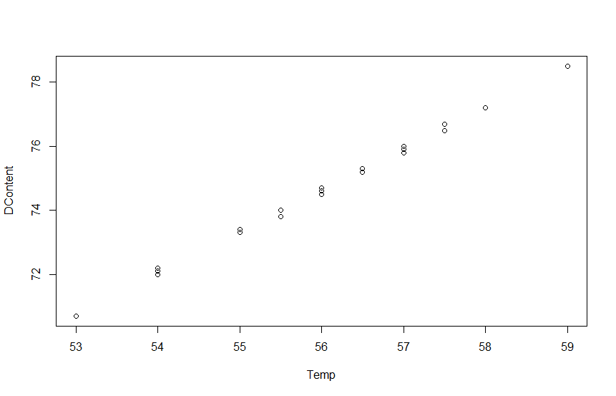
Path to Solution:
Reading the data and variables
> mydata = read.csv('DC_Simple_Reg.csv',header = T,sep = ",")
> Temp = mydata$Dryer.Temperature
> DContent = mydata$Dry.Content
2. Checking Correlation
Scatter Plot
> plot(Temp, DContent)

Slide 71
Path to Solution:
2. Computing Correlation
> cor(Temp, DContent)
Attribute | Dry Content
Temperature | 0.9992
Remark:
Correlation between y & x need to be high (preferably 0.8 to 1 to -0.8 to -1.0)

Slide 72
Path to Solution:
3. Performing Regression
> model = lm(DContent ~ Temp)
> summary(model)
Statistic | Value | Criteria
Residual standard error | 0.07059
R-squared | 0.9984 | > 0.6
Adjusted R-squared | 0.9984 | > 0.6
Model | df | F | p value
Regression | 1 | 24497 | 0.000
Residual | 40
Total | 41
Criteria:
P value < 0.05

Slide 73
Path to Solution:
3. Performing Regression
Attribute | Coefficient | Std. Error | t Statistic | p value
Intercept | 2.183813 | 0.463589 | 4.711 | 0.00
Temperature | 1.293432 | 0.008264 | 156.518 | 0.00
Interpretation
The p value for independent variable need to be < significance level α (generally α = 0.05)
Model:
Dry Content = 2.183813 + 1.293432 x Temperature

Slide 74
Path to Solution:
5. Residual Analysis
> pred = fitted(model)
> Res = residuals(model)
> write.csv(pred,"Pred.csv")
> write.csv(Res,"Res.csv")
SL No. | Fitted | Residuals | SL No. | Fitted | Residuals
1 | 73.32259 | -0.02259 | 22 | 74.61602 | -0.01602
2 | 74.61602 | -0.01602 | 23 | 75.26274 | -0.06274
3 | 73.96931 | 0.030693 | 24 | 73.96931 | 0.030693
4 | 78.49632 | 0.00368 | 25 | 75.90946 | -0.00946
5 | 74.61602 | -0.01602 | 26 | 75.26274 | 0.03726
6 | 73.96931 | 0.030693 | 27 | 73.96931 | 0.030693
7 | 75.26274 | -0.06274 | 28 | 78.49632 | 0.00368
8 | 77.20289 | -0.00289 | 29 | 76.55617 | -0.05617
9 | 75.90946 | -0.00946 | 30 | 74.61602 | -0.11602
10 | 74.61602 | -0.01602 | 31 | 75.90946 | 0.090544
11 | 73.32259 | -0.02259 | 32 | 76.55617 | -0.05617
12 | 75.90946 | -0.00946 | 33 | 76.55617 | 0.143828
13 | 75.90946 | 0.090544 | 34 | 75.90946 | 0.090544
14 | 74.61602 | -0.01602 | 35 | 75.90946 | -0.10946
15 | 74.61602 | 0.083977 | 36 | 73.96931 | -0.16931
16 | 74.61602 | -0.11602 | 37 | 73.32259 | -0.02259
17 | 70.73573 | -0.03573 | 38 | 74.61602 | -0.01602
18 | 72.02916 | -0.02916 | 39 | 73.32259 | 0.077409
19 | 72.02916 | 0.070841 | 40 | 75.90946 | 0.090544
20 | 72.02916 | 0.170841 | 41 | 73.96931 | 0.030693
21 | 70.73573 | -0.03573 | 42 | 75.26274 | -0.06274

Slide 75
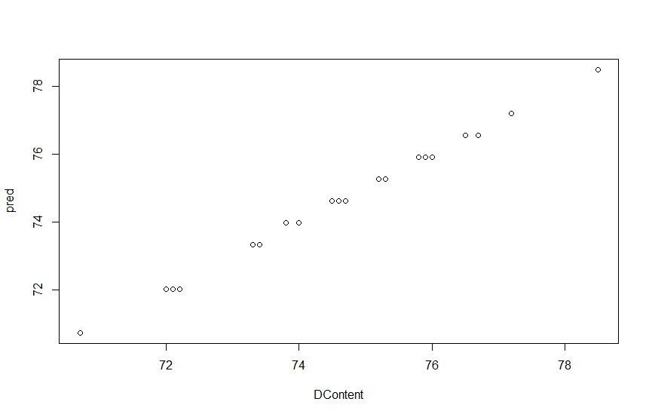
Path to Solution:
5. Residual Analysis
Scatter Plot: Actual Vs Predicted (fit)
> plot(DContent, pred)

Slide 76
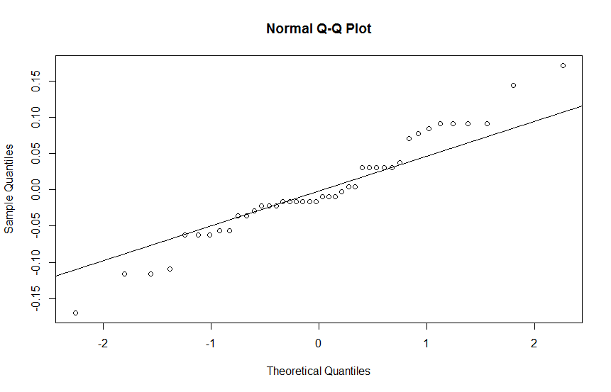
Path to Solution:
5. Residual Analysis
Normality Check on residuals
> qqnorm(Res)
> qqline(Res)
Residuals should be normally distributed or bell shaped

Slide 77
Path to Solution:
5: Residual Analysis
Normality Check on residuals
> shapiro.test(Res)
Shapiro-Wilk normality Test:
W | p value
0.9693 | 0.3132
Residuals should be normally distributed or bell shaped

Slide 78
Path to Solution:
5: Residual Analysis
> plot(pred, Res)
> plot(Temp, Res)
Residuals should be independent and stable
Plot the residuals against fitted value. The points in the graph should be scattered randomly and should not show any trend or pattern. The residuals should not depend in anyway on the fitted value.
If there is a pattern then a transformation such as log y or √y to be used
Similarly the residuals shall not depend on x. This can be checked by plotting residuals vs x. A pattern in this plot is an indication that the residuals are not independent of x. Instead of x, develop the model with a function of as predictor (Eg: x², 1/x, √x, log(x), etc.)

Slide 79
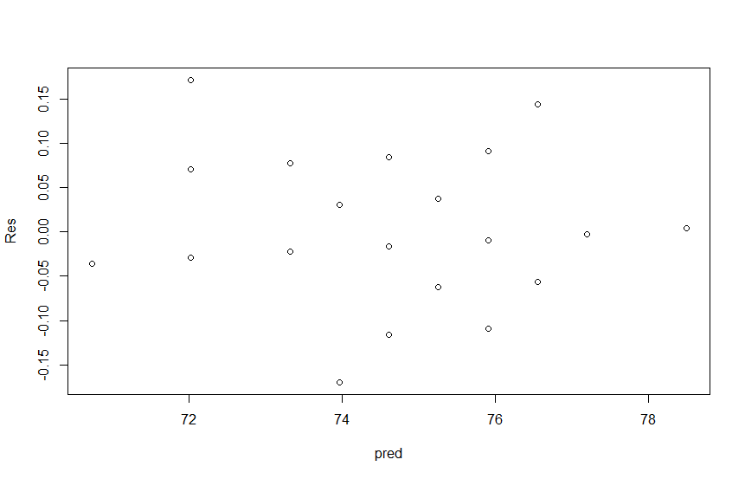
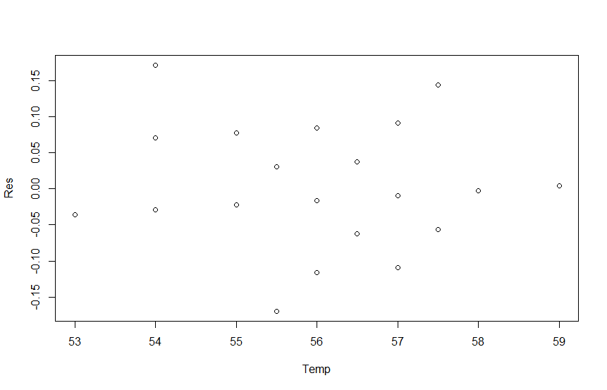
Path to Solution:
Residual Analysis
There is no trend or pattern on residuals vs fitted value ,residuals vs observation order or residuals vs x plot. Hence the assumptions of independence and stability of residuals are satisfied.

Slide 80
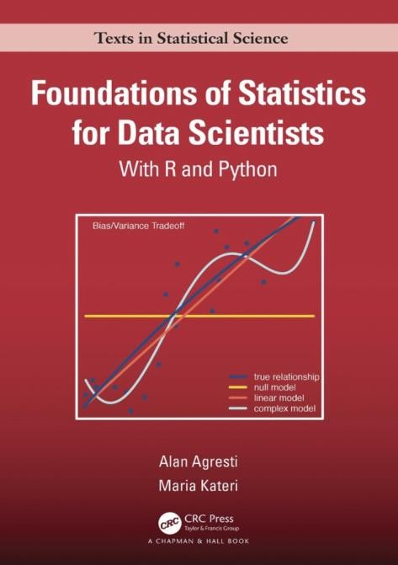
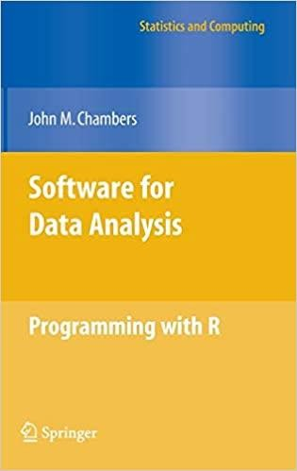
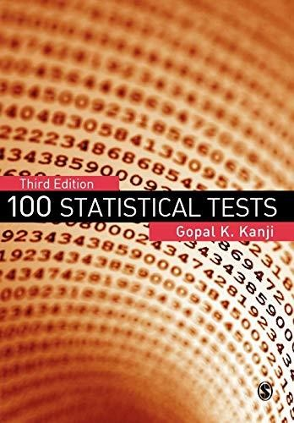
Reference
https://artofstat.com/web-apps
Foundations of Statistics for Data Scientists With R and Python
By Alan Agresti, Maria Kateri (2022)
Software for Data Analysis: Programming with R
By John Chambers
100 statistical tests Book by Gopal K. Kanji

Slide 81

For any query drop an email at madhurima.panja@iiitb.ac.in

