Slide 1
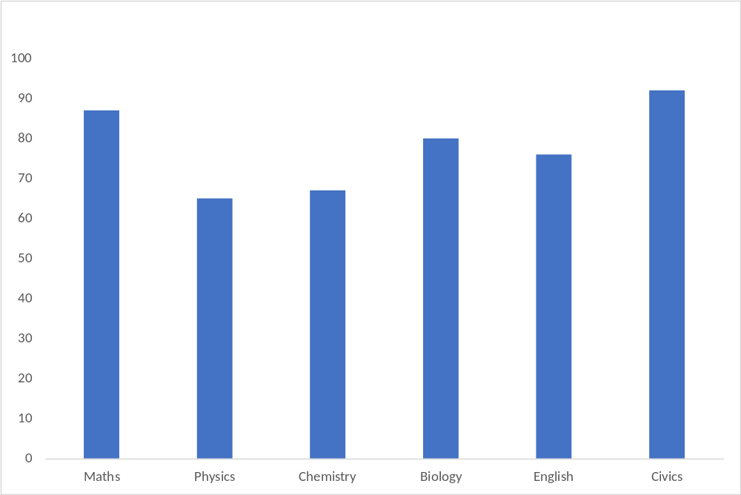
Average Marks Obtained

Slide 2
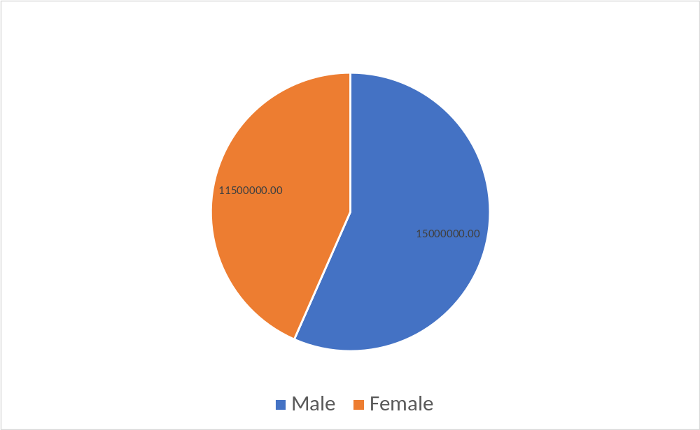
Country Population Gender Wise

