Slide 1
Content-Based Vocal Repertoire Ranking Framework Using Duration-Weighted Pitch Distributions
Madeline Johnson, Flint Million, Rajeev Bukralia
Minnesota State University, Mankato
CADSCOM 2026
Notes:
[~15 seconds]
Good morning/afternoon, everyone. My name is Madeline Johnson, and I'm here with my co-authors Flint Million and Rajeev Bukralia from Minnesota State University, Mankato. Today I'm going to talk about how we can use data from musical scores to help singers find repertoire that actually fits their voice.

Slide 2
“Have you ever wondered how a singer decides which songs are safe to sing?”
For singers, choosing the wrong piece is not just an inconvenience.
It is an injury risk.
What if we could use data to help?
Notes:
[~45 seconds]
Let me start with a question. Have you ever wondered how a singer decides which songs are safe to sing? If you're not a singer, that might sound like an odd question. But for singers, choosing the wrong piece isn't just a matter of preference. It can lead to real vocal injury. Research shows that misalignment between a piece's demands and a singer's capabilities raises the risk of strain (Apfelbach, 2022; Phyland et al., 1999). In practice, singers and voice teachers rely on intuition, trial and error, or vocal classification systems that aren't consistently defined. So what if we could use data to make this process more objective and safer?

Slide 3
The Gap
• Current tools (like Tessa) analyze a piece after you already picked it — they do not recommend new pieces likely to fit.
• Filtering by range alone is misleading: it shows the extremes, not where the voice spends most of its time.
• As a former performance major, I lived this problem. As a data scientist, I built a solution.
Notes:
[~45 seconds]
Here's the gap. Tools already exist that can analyze a song's tessitura -- where the voice sits in a piece. For example, a program called Tessa can extract a tessitura profile from a digital score. But these tools only work AFTER you've already picked a piece. They help you evaluate a choice you've made -- they don't help you discover new pieces that are likely to fit. And here's where my background matters. I was a vocal performance major before pursuing my master's in data science. I lived this problem as a singer. I know what it's like to pick a piece that doesn't sit well in your voice. And as a data scientist, I asked: can we build a system that recommends songs based on where they actually sit, not just their highest and lowest notes?

Slide 4
What Is Tessitura?
• Tessitura is NOT just the highest and lowest notes.
• It is where the voice lives in a piece — the pitches that receive the most singing time.
• Duration matters: sustaining a high note for 8 beats is far more demanding than touching it briefly.
Analogy for non-musicians: Think of it like your daily commute vs. the farthest you’ve ever driven. What matters for wear-and-tear is the daily average, not the one-time extreme.
Notes:
[~60 seconds]
Before we go further, let me explain a music concept that's central to this research: tessitura. If you look at a piece of vocal music, you can see the highest note and the lowest note -- that's the range. But range alone doesn't tell you where the voice SPENDS MOST OF ITS TIME. That's tessitura. A piece might have one very high note at the climax, but if the rest of the piece sits comfortably in the middle of the voice, it's very different from a piece that lives up high the entire time. Duration matters too: holding a high B-flat for eight beats is much more demanding than touching it for a sixteenth note. For those of you who aren't musicians, think of it like driving. What matters for the wear on your car isn't the farthest you've ever driven -- it's your daily commute. Tessitura is the voice's daily commute.

Slide 5
What Is a Tessituragram?
• A tessituragram is a fingerprint of a song — a histogram of how much singing time falls on each pitch.
• Built from MusicXML scores using music21: MIDI pitch → total duration in quarter-note beats.
• Duration-weighted: longer notes count more, because sustaining a pitch is more demanding than a passing tone.
• Can we use these fingerprints to match songs to singers?
Notes:
[~45 seconds]
So how do we capture tessitura computationally? With something called a tessituragram. It's essentially a fingerprint of a song. On one axis you have every pitch in the vocal line, and on the other you have how much total singing time is spent on that pitch, weighted by note duration. Longer notes count more because sustaining a pitch is more demanding than a passing tone. We parse digital sheet music -- MusicXML files -- using a toolkit called music21, and we build one of these profiles for every vocal line in our library. So the question becomes: can we use these fingerprints to match songs to singers?

Slide 6
The Pipeline
Singer Preferences
Range Filter
Ideal Profile Construction
Cosine Similarity Scoring
Ranked Song List
The singer provides range, favorites, and avoids
Remove songs outside the singer’s range
Build a target pitch-duration vector
Score each song by similarity minus avoid penalty
Songs ordered from best match to worst
The singer tells us three things: range, favorite pitches, and pitches to avoid. We do the rest.
Notes:
[~45 seconds]
Here's the big picture of how the system works. It's a pipeline with five steps. First, the singer provides three inputs: their comfortable vocal range -- the lowest and highest notes they can sing -- their favorite pitches, and pitches they want to avoid. Second, we filter out any song whose written range goes beyond what the singer specified. Third, we construct an ideal pitch profile from those preferences -- basically a target fingerprint of what the perfect song would look like for this singer. Fourth, we score every remaining song by how closely its tessituragram matches that ideal, minus a penalty for time spent on avoided pitches. And finally, we return a ranked list from best match to worst. The singer tells us three things; we do the rest.

Slide 7
How Scoring Works
final_score = cosine_similarity(song, ideal) − α × avoid_penalty
• Cosine similarity: how closely does this song’s pitch fingerprint align with the singer’s ideal profile? (1.0 = perfect match)
• Avoid penalty: what proportion of the song’s duration is spent on notes the singer wants to avoid?
• α (alpha = 0.5): controls how heavily we penalize avoided notes.
Analogy: Like a restaurant recommender that matches your food preferences and subtracts points for ingredients you dislike.
Notes:
[~60 seconds]
So let's look at exactly how the scoring works. The final score for each song is cosine similarity between that song's tessituragram and the singer's ideal profile, minus alpha times the avoid penalty. Let me break that down. Cosine similarity measures how closely a song's pitch-duration fingerprint aligns with what the singer wants. A score of 1.0 would be a perfect match in proportional shape. The avoid penalty is the proportion of the song's total singing duration that falls on notes the singer wants to avoid. Alpha controls the trade-off -- at 0.5, we're splitting the weight evenly. Think of it like a restaurant recommender. It finds dishes that match your taste preferences and then subtracts points for ingredients you don't like. Simple idea, but the question is: does it actually work? How do we know this produces good rankings?

Slide 8
The Dataset
• OpenScore Lieder Corpus (CC0, openly licensed) Real published scores: Schubert, Schumann, Debussy, Fauré, and more.
• Experiment 1: 101 vocal lines (one per composition) — compact library.
• Experiment 2: 1,655 vocal lines from 1,419 compositions (~16× larger). 342 lines from multi-part works, 1,313 from single-voice songs.
• These are not made-up examples — these are real art songs that singers perform every day.
Notes:
[~45 seconds]
To test this, we needed real musical data. We used the OpenScore Lieder Corpus -- a freely available, openly licensed collection of art songs. These are real scores by composers like Schubert, Clara and Robert Schumann, Debussy, and Fauré. We ran two experiments. The first used a compact library of 101 vocal lines, one per composition. The second used a much larger expanded library: 1,655 vocal lines drawn from 1,419 compositions -- about 16 times larger. Some compositions have multiple voice parts, like duets, so each vocal line is treated as its own item. These aren't made-up examples. These are real art songs that singers perform every day around the world.

Slide 9
How We Tested It: Synthetic Self-Retrieval
1. Pick a vocal line from the library.
2. Build a singer profile FROM that line’s own fingerprint (range, top-4 favorite pitches, bottom-2 avoid pitches).
3. Ask the system: can you find that same line among hundreds of candidates?
Three baselines compared:
Full model: cosine similarity + avoid penalty (α = 0.5)
Cosine-only: similarity without the avoid penalty (α = 0)
Null (random): range filter only, then random ordering
So what did we find?
Notes:
[~60 seconds]
Now, we didn't have human judges rating songs for us. That's future work. Instead, we used a rigorous method called synthetic self-retrieval. Here's how it works. We pick a vocal line from the library. We build a singer profile directly from that line's own tessituragram: the range becomes the singer's range, the four pitches with the most singing time become the favorites, and the two pitches with the least become the avoids. Then we ask the system to rank all the remaining candidates and see where the original line ends up. If the system is working, it should rank that line very highly -- ideally first. We compared three models: the full model with the avoid penalty, cosine-only without the penalty, and a null baseline that just filters by range and then ranks randomly. So what did we find?

Slide 10
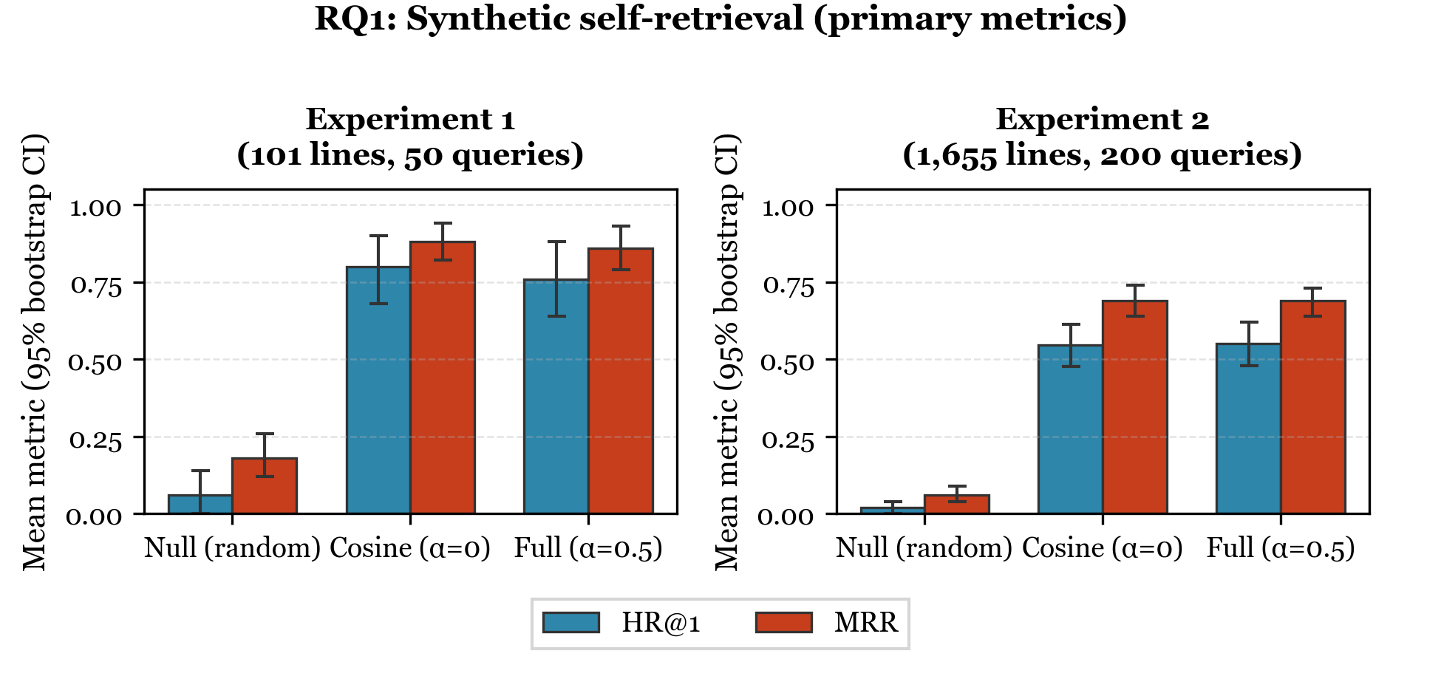
Results: Self-Retrieval Accuracy (RQ1)
Compact library: HR@1 = 76% vs. 6% random | Expanded library: HR@1 = 55% vs. 2% random
Expanded HR@5 = 86% — the target song lands in the top 5 nearly 9 times out of 10.
Notes:
[~60 seconds]
Here are the self-retrieval results. This figure shows Hit Rate at 1 -- how often the target song is ranked first -- and Mean Reciprocal Rank, which captures how high it ranks on average. On the left is Experiment 1, the compact 101-line library. The full model puts the right song first 76 percent of the time. Random guessing after the same range filter? About 6 percent. On the right is Experiment 2 with 1,655 lines. The full model still finds the right song first 55 percent of the time -- versus just 2 percent for random. And if we look at the top 5 instead of just the top 1, the system finds the target song 86 percent of the time. That's nearly 9 out of 10. These two experiments use different protocols and different candidate pools, so the drop from 76 to 55 percent is not purely a library-size effect. But the key takeaway is clear: the system massively outperforms random ordering in both cases.

Slide 11
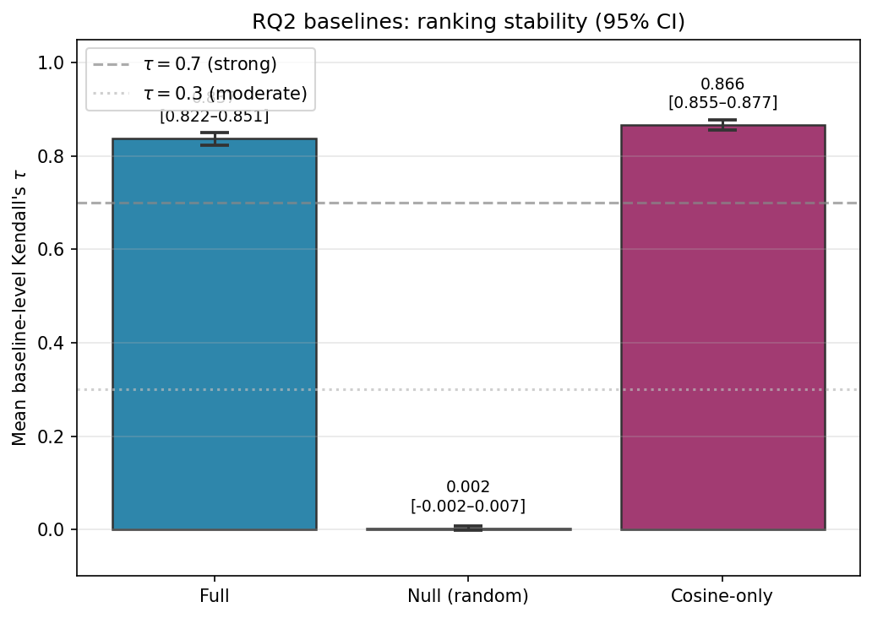
Results: Ranking Stability (RQ2)
• Mean Kendall’s τ = 0.84–0.85 (strong agreement; threshold = 0.7).
• Small changes to preferences → small changes in rankings.
• The system is stable and trustworthy.
Notes:
[~45 seconds]
Next: is the system stable? If a singer makes a small change to their preferences -- adds one favorite note or removes one avoid note -- does the whole ranking fall apart? We tested this with 580 one-note perturbations across 20 baseline profiles in the expanded library. We measured Kendall's tau, which compares two ranked lists. A tau of 1.0 means identical rankings; 0.0 means completely unrelated. Anything above 0.7 is considered strong agreement. Our full model achieved a mean tau of 0.84. The cosine-only model was 0.87, with overlapping confidence intervals. The random baseline was essentially zero, as expected. This means when a singer tweaks their preferences slightly, the recommendations stay largely the same. The system is stable and trustworthy.

Slide 12
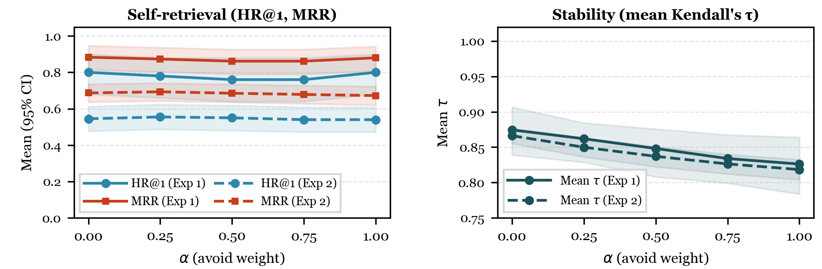
Sensitivity to the Avoid-Penalty Weight (α)
• Self-retrieval performance is largely flat across α values (0 to 1).
• Stability stays strong: τ ≥ 0.82 even at α = 1.0.
• α = 0.5 is a balanced default — meaningful avoid control without instability.
Notes:
[~45 seconds]
We also tested how sensitive the results are to the choice of alpha -- the parameter that controls how heavily we penalize avoided notes. We swept alpha from 0 to 1 in both experiments. As you can see, self-retrieval performance -- Hit Rate at 1 and MRR -- is largely flat across the entire range. The system isn't brittle to this choice. Stability does decrease slightly as alpha increases, which makes sense: a stronger avoid penalty creates more sensitivity to changes in avoid preferences. But even at alpha equals 1, tau stays above 0.82 -- well above the strong agreement threshold. We report alpha equals 0.5 as a balanced default: it gives singers meaningful control over their avoid preferences without making the rankings jittery.

Slide 13
Implementation Verification (RQ3)
• Identity check: max |final − (cos − 0.5 × avoid)| = 0 The formula is implemented with zero numerical error.
• OLS regression recovers exact coefficients: cos weight = 1.0, avoid weight = −0.5, R² = 1.0.
• Spearman correlations all in expected directions: ρ(final, cos) = +0.99 | ρ(final, avoid) = −0.32 | ρ(cos, fav_overlap) = +0.92
• No hidden bugs. No rounding surprises. The math checks out.
Notes:
[~30 seconds]
Finally, as an engineering sanity check, we verified that the formula is implemented exactly as designed. The identity residual -- the difference between the computed score and what the formula predicts -- is exactly zero. An OLS regression recovers the exact coefficients: cosine weight equals 1.0, avoid weight equals negative 0.5, R-squared equals 1.0. And all correlations go in the expected directions. Higher cosine similarity predicts a higher final score. Higher avoid penalty predicts a lower score. No hidden bugs, no rounding surprises. The math checks out.

Slide 14
What Does This Mean?
• Proof-of-concept: data science can make vocal health decisions safer and more objective.
• Familiar techniques applied to a novel domain: cosine similarity, cold-start recommendation, offline evaluation.
• Content-based methods can work even without user-interaction data (cold-start / no collaborative signal).
“How might content-based recommendation techniques from your own work apply to creative domains like music?”
Notes:
[~45 seconds]
So what does this all mean? This is a proof-of-concept that shows data science can bring objectivity to a domain where decisions are traditionally subjective -- and where bad decisions have real health consequences. For those of you working in recommendation systems or information retrieval, this demonstrates that familiar techniques -- cosine similarity, content-based filtering, offline evaluation metrics -- can work in a completely new domain. And it works in a cold-start setting with no collaborative filtering data, which is often the hardest case. I'd love for you to think about this: how might content-based recommendation techniques from YOUR work apply to creative domains like music, art, or design? The tools are the same -- the application is what makes it novel.

Slide 15
Limitations & Future Work
• Synthetic profiles only — no human evaluation yet.
• One corpus (German & French art song); opera, musical theatre, and popular song are untested.
• Pitch and duration only — dynamics, tempo, and text omitted.
• Future: real singer preferences | diverse repertoire richer features | interactive recommendation tool.
Notes:
[~30 seconds]
I want to be upfront about limitations, because honesty strengthens research. First, these are synthetic profiles, not real singer preferences. We haven't done a human study yet. Second, we only tested on one corpus of German and French art song. Opera, musical theatre, and popular song are untested. Third, we only model pitch and duration -- we don't account for dynamics, tempo, or text setting. For future work, we want to evaluate with real singers and their actual preferences, expand to more diverse repertoire, add richer musical features, and ultimately build an interactive tool that singers and voice teachers can use in practice.

Slide 16
Duration-weighted tessituragrams can rank vocal repertoire by fit — and this is just the beginning.
“Next time a singer asks ‘What should I sing?’ — data might have an answer.”
Thank You
Madeline Johnson, Flint Million, Rajeev Bukralia
Minnesota State University, Mankato
Notes:
[~15 seconds]
To wrap up: duration-weighted tessituragrams can rank vocal repertoire by fit -- and this is just the beginning. Next time a singer asks 'What should I sing?', data might have an answer. Thank you very much for your time. I'd be happy to take any questions.

