Slide 1
Content-Based Vocal Repertoire Ranking Framework Using Duration-Weighted Pitch Distributions
Madeline Johnson, Flint Million, Rajeev Bukralia
Minnesota State University, Mankato
CADSCOM 2026
Notes:
[~20 seconds]
Good morning/afternoon, everyone. My name is Madeline Johnson, and I am currently pursuing a master's in data science here at Minnesota State University, Mankato. My undergraduate background is in vocal performance -- I hold a Bachelor of Music from Illinois Wesleyan University -- so this project sits right at the intersection of my two worlds. This work is co-authored with Flint Million and Rajeev Bukralia, and today I want to show you how we can use data from musical scores to help singers find repertoire that actually fits their voice.

Slide 2
“Have you ever wondered how a singer decides which songs are safe to sing?”
The wrong piece is not just an inconvenience.
It is an injury risk.
What if data could help?
Apfelbach, 2022; Phyland et al., 1999
Notes:
[~45 seconds]
As a trained singer, one of the first things I learned is that choosing the wrong piece is not just an inconvenience -- it can lead to real vocal injury. For example, a singer with a naturally lower voice will usually not feel as comfortable spending long periods in a high range as a singer with a naturally higher voice. Research shows that when a piece's demands do not match a singer's capabilities, the risk of strain goes up significantly (Apfelbach, 2022; Phyland et al., 1999). In practice, singers and voice teachers rely on intuition, trial and error, or vocal classification systems that are not consistently defined. That is what motivated this research: using data to make the process of choosing repertoire more objective and safer.

Slide 3
The Current Approach
Filtering by Range
• Filter songs by minimum and maximum pitch in the vocal line.
• Shows the extremes — not how much time the voice spends there.
• One high climax note looks the same as sitting high the whole time.
Filtering by Fach
• Categorizes voices by range, weight, and color (e.g. lyric soprano).
• Labels inconsistently defined across regions (Schloneger et al., 2024).
• Many voices fall between categories.
• Broad categories, not tailored to an individual singer.
Neither captures where the voice actually spends its time.
Notes:
[~55 seconds]
Today, singers mainly rely on two approaches. The first is filtering by range. Some databases let you filter by the notes in the vocal line -- you set a minimum and maximum pitch. That is useful, but it only tells you the extremes. A piece with one very high note at the climax looks the same as a piece that sits up high the entire time. Range tells you the boundaries, not where the voice actually lives.
The second approach is Fach -- the system opera uses to categorize voices by range, weight, and color. Lyric soprano, dramatic mezzo, and so on. But Fach labels are not consistently defined across regions or pedagogical traditions (Schloneger et al., 2024), and many voices fall between categories -- which makes it hard to assign a single label. Fach gives you a broad category, not a profile tailored to a specific singer's unique voice. Neither approach captures where the voice actually spends its time -- and that distinction matters.

Slide 4
Tessitura & the Tessituragram
Tessitura
The pitches where the voice spends most of its time — not just the highest and lowest notes.
Tessituragram
• Thurmer (1988): histogram of singing time per pitch — a song's fingerprint.
• Duration-weighted: longer notes count more (Titze, 2008).
• Range and Fach don't quantify a song's internal pitch-duration distribution.
Notes:
[~65 seconds]
There is a concept that does capture where the voice spends its time: tessitura. Range tells you the highest and lowest notes, but tessitura tells you where the voice actually lives -- the pitches where it spends most of its time. A piece might touch its highest note once at the climax, but if it sits in the middle of the range for most of its duration, that is where the real demand is. What matters most is not the extremes -- it is where you spend the bulk of your time.
A researcher named Stefan Thurmer formalized a way to represent tessitura visually. In 1988 he introduced the tessituragram -- a histogram of singing time per pitch. Titze, in 2008, refined this with duration weighting, meaning longer notes count more because sustaining a pitch is more demanding than a passing tone. The result is a fingerprint of where the voice spends its time in that piece. This is exactly what range and Fach miss -- the internal distribution of vocal demand. That raises a natural follow-up: whether any existing tools already use tessituragrams this way.

Slide 5
The Gap
Existing Tessitura Tools
• Tessa (Apfelbach, 2022): extracts tessituragrams and summary statistics.
• Kassia Database: human-assessed tessitura per art song entry.
• Both evaluate a piece after it has already been selected.
What’s Missing
• No tool recommends pieces whose pitch distribution fits a singer.
• No pitch-level query: “Find pieces on THESE notes, avoid THOSE.”
• 217,000+ cataloged settings (LiederNet) — manual search can’t scale.
Tessituragrams capture vocal demand —
but no tool uses them to recommend new repertoire.
Notes:
[~55 seconds]
There are tools that work with tessituragrams, but they are purely analytic. Tessa, developed by Apfelbach in 2022, extracts a tessituragram from a digital score and produces summary statistics. The Kassia Database -- a wonderful resource for art song by women composers -- displays a human-assessed tessitura for each entry. Both of these help you evaluate a piece after you have already found it. But neither one lets you use a tessituragram as a query -- to search for new pieces whose pitch distribution is likely to fit.
The scale of the problem makes manual discovery impractical. The LiederNet Archive alone catalogs over 217,000 art-song settings. No voice teacher, no matter how experienced, can know all of that literature. Tessituragrams carry detailed information about a song's vocal demand -- but to our knowledge, no existing system uses them on the query side to recommend repertoire. That is the gap we wanted to explore.

Slide 6
The Pipeline
MusicXML scores parsed with music21: pitch → duration in quarter-note beats.
Singer Preferences
Range Filter
Ideal Profile Construction
Cosine Similarity Scoring
Ranked Song List
Range, favorites, and avoids
Drop songs outside range
Target profile from preferences
Similarity minus avoid penalty
Best match to worst
Three inputs: range, favorites, avoids. We do the rest.
Notes:
[~50 seconds]
Let me walk you through the pipeline. First, a quick note on the data. We parse digital sheet music -- MusicXML files -- using a Python toolkit called music21, and for each vocal line we build a tessituragram: every pitch maps to its total duration in quarter-note beats. That is the input to the system.
The pipeline has five steps. The singer provides three inputs: their comfortable vocal range, favorite pitches, and pitches to avoid. We filter out any song whose written range goes beyond what the singer specified. Then we build an ideal pitch profile from those inputs -- the next slide explains exactly how that profile is formed. We score every remaining song by how closely its tessituragram matches that ideal, minus a penalty for time on avoided pitches. Finally, we return a ranked list from best match to worst.

Slide 7
How Scoring Works
final_score = cosine_similarity(song, ideal) − α × avoid_penalty
Cosine Similarity
Same pitches, same proportions? 1.0 = perfect match
Avoid Penalty
Share of singing time on pitches the singer avoids. Higher = worse fit
α (Alpha = 0.5)
Balances rewarding good pitches vs. penalizing avoided ones. 0.5 = even split
Notes:
[~70 seconds]
Here is how the scoring works. We create a list of numbers -- one per pitch in the singer's range. Every pitch starts with a small base weight so it is not ignored entirely. Favorite pitches get a large boost on top of that, and avoided pitches are dropped to zero. The result is a profile that peaks at the singer's preferred pitches and has nothing where they want to avoid.
Each song has its own list built the same way -- one number per pitch -- but from the actual score, showing how much singing time falls on each pitch. Cosine similarity then compares the pattern of these two lists. If both concentrate time on the same pitches in the same proportions, the score is high -- close to 1.0. It focuses on shape rather than total duration, so a short song and a long song that distribute time across pitches the same way score equally well. It is a standard tool for this kind of comparison in information retrieval, which is why we chose it.
The avoid penalty is the proportion of the song's total singing duration that falls on notes the singer wants to avoid. Alpha controls the trade-off between rewarding good-fit pitches and penalizing avoided ones -- at 0.5, we split the weight evenly. The scoring function is straightforward in structure. To find out whether it actually produces good rankings, we ran two experiments on real musical data.

Slide 8
The Dataset
OpenScore Lieder Corpus — CC0-licensed art-song scores
Experiment 1 — Compact Library
• 101 vocal lines
• One per composition
• Initial validation baseline
Experiment 2 — Expanded Library
• 1,655 lines from 1,419 compositions
• ~16× larger
• 342 multi-part, 1,313 single-voice
Multi-part works (e.g. duets): each vocal line is its own item.
Notes:
[~35 seconds]
We used the OpenScore Lieder Corpus -- a freely available, openly licensed collection of art songs. Conveniently, all of the composers have been dead long enough that copyright is not a concern. We ran two experiments. The first used a compact library of 101 vocal lines, one per composition. The second used a much larger expanded library: 1,655 vocal lines drawn from 1,419 compositions -- about 16 times larger. Some compositions have multiple voice parts, like duets, so each vocal line is treated as its own item.

Slide 9
How We Tested It: Synthetic Self-Retrieval
Synthetic self-retrieval
• Pick a vocal line from the library.
• Build a singer profile from that line’s tessituragram (range, top-4 favorites, bottom-2 avoids).
• Rank all other candidates — does the same line rank first?
Three models compared
• Full: cosine similarity + avoid penalty (α = 0.5).
• Cosine-only: similarity without the avoid penalty (α = 0).
• Null: range filter, then random ordering.
Notes:
[~60 seconds]
We did not have human judges rating songs for us -- that is future work. Instead, we used a rigorous method called synthetic self-retrieval. Here is how it works. We pick a vocal line from the library and build a singer profile directly from that line's own tessituragram: the range becomes the singer's range, the four pitches with the most singing time become the favorites, and the two pitches with the least become the avoids. Then we ask the system to rank all the remaining candidates and see where the original line ends up. If the system is working, it should rank that line very highly -- ideally first. We compared three models: the full model with the avoid penalty, cosine-only without the penalty, and a null baseline that just filters by range and then ranks randomly. Here is what we found.

Slide 10
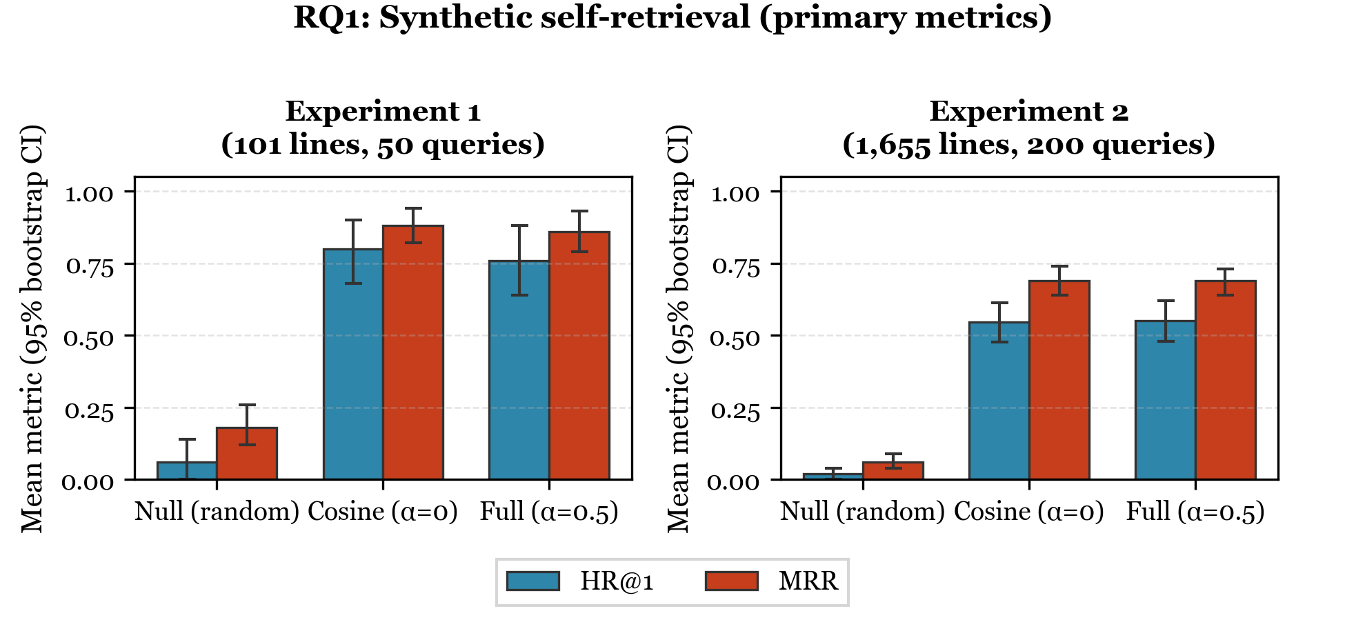
Results: Self-Retrieval Accuracy (RQ1)
Compact HR@1 = 76% vs. 6% random | Expanded HR@1 = 55% vs. 2% random
Expanded HR@5 = 86% — target in top 5 nearly 9/10 times.
Notes:
[~60 seconds]
This figure shows the self-retrieval results. The metric on the left of each panel is Hit Rate at 1 -- how often the target song is ranked first -- and Mean Reciprocal Rank on the right, which captures how high it ranks on average. In Experiment 1, the compact 101-line library, the full model puts the right song first 76 percent of the time. Random guessing after the same range filter gets about 6 percent. In Experiment 2 with 1,655 lines, the full model still finds the right song first 55 percent of the time -- versus just 2 percent for random. And if we look at the top 5 instead of just the top 1, the system finds the target song 86 percent of the time -- nearly 9 out of 10. These two experiments use different protocols and different candidate pools, so the drop from 76 to 55 percent is not purely a library-size effect. The key takeaway is clear: the system massively outperforms random ordering in both cases.

Slide 11
Results: Ranking Stability (RQ2)
Model | Experiment 1 (5 baselines, 130 perturbations) | Experiment 2 (20 baselines, 580 perturbations)
 | Mean τ (95% CI) | Mean τ (95% CI)
Null (random) | −0.04 [−0.05, −0.02] | 0.00 [−0.002, 0.007]
Cosine-only (α = 0) | 0.87 [0.84, 0.91] | 0.87 [0.86, 0.88]
Full (α = 0.5) | 0.85 [0.81, 0.88] | 0.84 [0.82, 0.85]
Table 2. Ranking stability: mean Kendall’s τ per baseline (95% CI). τ = 1 means identical order; τ near 0 means unrelated rankings.
τ > 0.7 indicates strong agreement (Kendall, 1948).
Notes:
[~45 seconds]
The next thing we wanted to know was whether the system is stable -- whether a small change to preferences causes the rankings to shift dramatically. We tested this with 580 one-note perturbations across 20 baseline profiles in the expanded library. We measured stability using Kendall's tau, a statistic that compares two ranked lists. A tau of 1.0 means identical rankings; 0.0 means completely unrelated. Anything above 0.7 is considered strong agreement. Our full model achieved a mean tau of 0.84. The cosine-only model was 0.87, with overlapping confidence intervals. The random baseline was essentially zero, as expected. When a singer tweaks their preferences slightly, the recommendations stay largely the same. The system is stable and trustworthy.

Slide 12
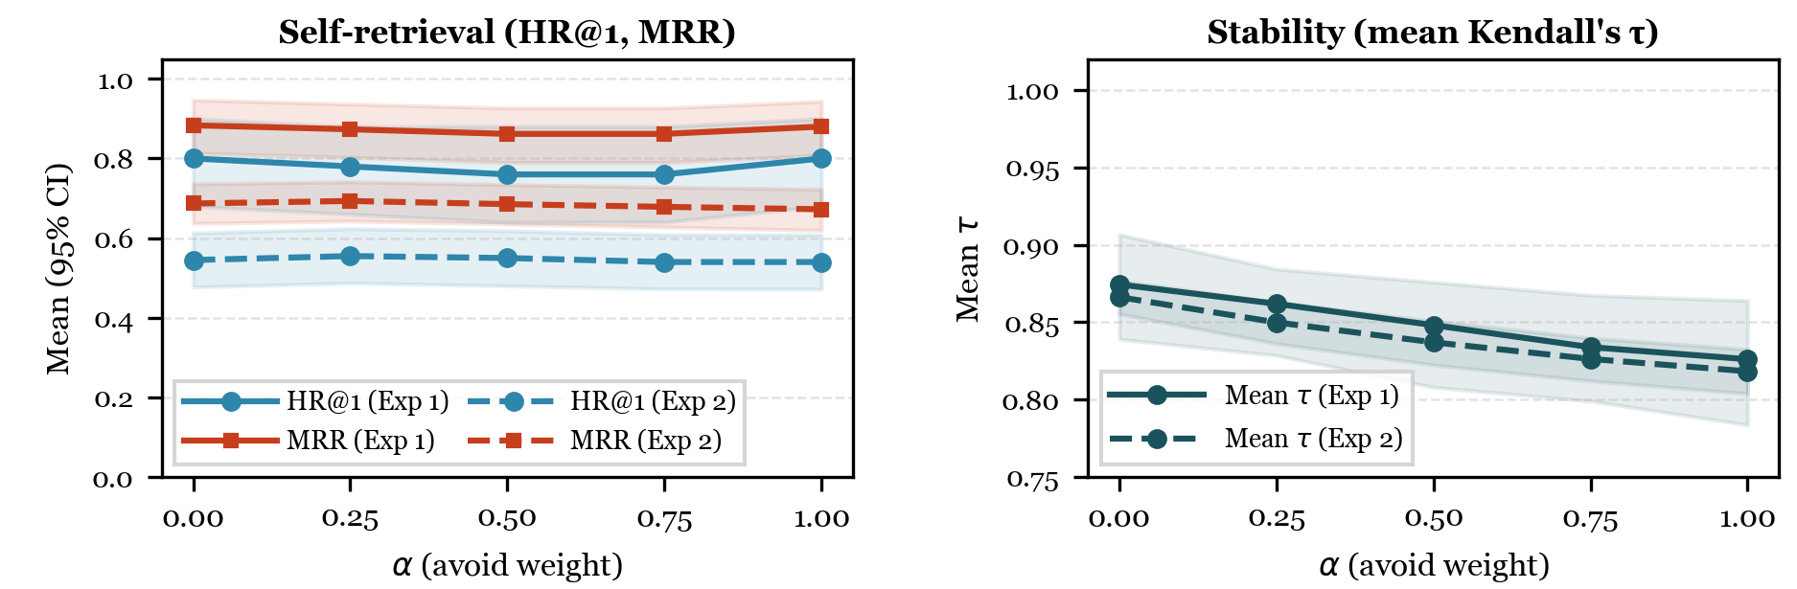
Sensitivity to the Avoid-Penalty Weight (α)
• Performance flat across α = 0–1.
• Stability holds: τ ≥ 0.82 even at α = 1.0.
• α = 0.5 balances avoid control and stability.
Notes:
[~45 seconds]
We also tested how sensitive the results are to the choice of alpha -- the parameter that controls how heavily we penalize avoided notes. We swept alpha from 0 to 1 in both experiments. As you can see, self-retrieval performance -- Hit Rate at 1 and MRR -- is largely flat across the entire range. The system is not brittle to this choice. Stability does decrease slightly as alpha increases, which makes sense: a stronger avoid penalty creates more sensitivity to changes in avoid preferences. But even at alpha equals 1, tau stays above 0.82 -- well above the strong agreement threshold. We report alpha equals 0.5 as a balanced default: it gives singers meaningful control over their avoid preferences without making the rankings jittery.

Slide 13
Implementation Verification (RQ3)
• Identity residual = 0 — zero numerical error.
• OLS recovers exact coefficients: cos = 1.0, avoid = −0.5, R² = 1.0.
• Spearman ρ in expected directions: (final, cos) +0.99 | (final, avoid) −0.32 | (cos, fav) +0.92
• The math checks out.
Notes:
[~30 seconds]
As an engineering sanity check, we verified that the formula is implemented exactly as designed. The identity residual -- the difference between the computed score and what the formula predicts -- is exactly zero. An OLS regression recovers the exact coefficients: cosine weight equals 1.0, avoid weight equals negative 0.5, R-squared equals 1.0. All correlations go in the expected directions: higher cosine similarity predicts a higher final score, and higher avoid penalty predicts a lower score. No hidden bugs, no rounding surprises. The math checks out.

Slide 14
What Does This Mean?
• Data science can make vocal health decisions safer and more objective.
• Pitch-level queries give different information than broad labels like Fach.
• Familiar techniques, novel domain: cosine similarity, cold-start, offline eval.
“How might content-based recommendations apply to creative domains like music?”
Notes:
[~50 seconds]
Let me step back and talk about what this means in practice. This is a proof-of-concept showing that data science can bring objectivity to a domain where decisions are traditionally subjective -- and where bad decisions have real health consequences. Think about the practical impact for a voice teacher. Right now, they recommend pieces from their own training and experience. But a query based on specific pitches -- 'find me pieces that live on these notes and avoid those' -- gives a different kind of information than Fach labels. It could surface a piece the teacher has never encountered that still looks like a strong fit on these pitch patterns for their student's unique voice. For those of you in CS and data science, this also demonstrates that familiar tools -- cosine similarity, content-based filtering, offline evaluation -- can work in a completely new domain, and in a cold-start setting with no collaborative signal. I think there is a broader takeaway here for anyone working with content-based recommendation: these familiar techniques can open up entirely new domains, and I would welcome a conversation about where else they might apply.

Slide 15
Limitations & Future Work
• Synthetic profiles only — no human evaluation yet.
• One corpus (German & French art song); opera, theatre, pop untested.
• Pitch + duration only — dynamics, tempo, text omitted.
• Next: real singers, diverse repertoire, richer features, interactive tool.
Notes:
[~30 seconds]
I want to be upfront about limitations, because honesty strengthens research. First, these are synthetic profiles, not real singer preferences -- we have not done a human study yet. Second, we only tested on one corpus of German and French art song; opera, musical theatre, and popular song are untested. Third, we only model pitch and duration -- we do not account for dynamics, tempo, or text setting. For future work, we want to evaluate with real singers and their actual preferences, expand to more diverse repertoire, add richer musical features, and ultimately build an interactive tool that singers and voice teachers can use in practice.

Slide 16
Duration-weighted tessituragrams can rank vocal repertoire by fit — and this is just the beginning.
“Next time a singer asks ‘What should I sing?’ — data might have an answer.”
Thank You
Madeline Johnson, Flint Million, Rajeev Bukralia
Minnesota State University, Mankato
Notes:
[~15 seconds]
To wrap up: duration-weighted tessituragrams can rank vocal repertoire by fit -- and this is just the beginning. Next time a singer asks 'What should I sing?', data might have an answer. Thank you very much for your time. I would be happy to take any questions.

