Slide 1
Content-Based Vocal Repertoire Ranking Framework Using Duration-Weighted Pitch Distributions
Madeline Johnson, Dr. Flint Million, Dr. Rajeev Bukralia
Minnesota State University, Mankato
CADSCOM 2026
Notes:
[~20 seconds]
Good morning/afternoon, everyone. My name is Madeline Johnson, and I am currently pursuing a master's in data science here at Minnesota State University, Mankato. My undergraduate background is in vocal performance -- I hold a Bachelor of Music from Illinois Wesleyan University -- so this project sits right at the intersection of my two worlds. This work is co-authored with Flint Million and Rajeev Bukralia, and today I want to show you how we can use data from musical scores to help singers find repertoire that actually fits their voice.

Slide 2
Problem & Motivation
The wrong piece is an injury risk
• Singing outside your comfort zone strains the voice.
• Singers rely on intuition and trial and error to choose repertoire.
• Data could make this safer and more objective.
Current filters fall short
• Range: shows extremes, not where the voice actually lives.
• Fach: labels inconsistent across regions (Schloneger et al., 2024).
• Neither captures where the voice spends its time.
Notes:
[~90 seconds]
As a trained singer, one of the first things I learned is that choosing the wrong piece is not just an inconvenience -- it can lead to real vocal injury. For example, a singer with a naturally lower voice will usually not feel as comfortable spending long periods in a high range as a singer with a naturally higher voice. Research shows that when a piece's demands do not match a singer's capabilities, the risk of strain goes up significantly (Apfelbach, 2022; Phyland et al., 1999). In practice, singers and voice teachers rely on intuition, trial and error, or vocal classification systems that are not consistently defined. That is what motivated this research: using data to make the process of choosing repertoire more objective and safer.
Today, singers mainly rely on two approaches. The first is filtering by range -- you set a minimum and maximum pitch. That is useful, but it only tells you the extremes. A piece with one very high note at the climax looks the same as a piece that sits up high the entire time. The second approach is Fach -- the system opera uses to categorize voices by range, weight, and color. But Fach labels are not consistently defined across regions or pedagogical traditions (Schloneger et al., 2024), and many voices fall between categories. Neither approach captures where the voice actually spends its time -- and that distinction matters.

Slide 3
Tessituragrams & the Gap
Tessituragram
• Thurmer (1988): histogram of singing time per pitch
• Titze (2008): duration-weighted — longer notes count more.
• Captures what range and Fach miss: the internal pitch-duration distribution.
The Gap
• Existing tools (Tessa, Kassia) are purely analytic.
• No query-side recommendation: “Find songs on THESE notes.”
Notes:
[~90 seconds]
There is a concept that does capture where the voice spends its time: tessitura. Range tells you the highest and lowest notes, but tessitura tells you where the voice actually lives -- the pitches where it spends most of its time. A piece might touch its highest note once at the climax, but if it sits in the middle of the range for most of its duration, that is where the real demand is.
A researcher named Stefan Thurmer formalized a way to represent tessitura visually. In 1988 he introduced the tessituragram -- a histogram of singing time per pitch. Titze, in 2008, refined this with duration weighting, meaning longer notes count more because sustaining a pitch is more demanding than a passing tone. The result is a fingerprint of where the voice spends its time in that piece.
There are tools that work with tessituragrams, but they are purely analytic. Tessa extracts a tessituragram from a digital score. The Kassia Database displays a human-assessed tessitura for each entry. Both help you evaluate a piece after you have already found it. But neither one lets you use a tessituragram as a query -- to search for new pieces whose pitch distribution is likely to fit. The LiederNet Archive alone catalogs over 217,000 art-song settings. To our knowledge, no existing system uses tessituragrams on the query side to recommend repertoire. That is the gap we wanted to explore.

Slide 4
Methodology
MusicXML parsed with music21: pitch
Singer Preferences
Range Filter
Ideal Profile Construction
Cosine Similarity Scoring
Ranked Song List
Range, favorites, and avoids
Drop songs outside range
Target profile from preferences
Similarity minus avoid penalty
Best match to worst
final_score = cosine_similarity(song, ideal) − (α × avoid_penalty
Cosine Similarity
Same pitches, same proportions? 1.0 = perfect match.
Avoid Penalty
Time on pitches to avoid. Higher = worse fit.
α = 0.5
Balances good-fit reward vs. avoid penalty.
Notes:
[~100 seconds]
Let me walk you through the methodology. We parse digital sheet music -- MusicXML files -- using a Python toolkit called music21, and for each vocal line we build a tessituragram: every pitch maps to its total duration in quarter-note beats.
The pipeline has five steps. The singer provides three inputs: their comfortable vocal range, favorite pitches, and pitches to avoid. We filter out any song whose written range goes beyond what the singer specified. Then we build an ideal pitch profile from those inputs. We create a list of numbers -- one per pitch in the singer's range. Every pitch starts with a small base weight so it is not ignored entirely. Favorite pitches get a large boost on top of that, and avoided pitches are dropped to zero. The result is a profile that peaks at the singer's preferred pitches and has nothing where they want to avoid.
Each song has its own list built the same way -- but from the actual score, showing how much singing time falls on each pitch. Cosine similarity then compares the pattern of these two lists. If both concentrate time on the same pitches in the same proportions, the score is high -- close to 1.0. It focuses on shape rather than total duration. The avoid penalty is the proportion of the song's total singing duration that falls on notes the singer wants to avoid. Alpha controls the trade-off -- at 0.5, we split the weight evenly. Finally, we return a ranked list from best match to worst.

Slide 5
Data & Evaluation Design
OpenScore Lieder Corpus (CC0)
• Exp 1: 101 vocal lines (one per composition).
• Exp 2: 1,655 lines from 1,419 compositions (~16× larger).
• Multi-part works: each vocal line is its own item.
Synthetic Self-Retrieval
• Pick a vocal line from the library.
• Build a singer profile from that line’s own tessituragram.
• Rank all candidates — does the same line come back first?
Three models: Full (α = 0.5) | Cosine-only (α = 0) | Null (random)
Notes:
[~80 seconds]
We used the OpenScore Lieder Corpus -- a freely available, openly licensed collection of art songs. Conveniently, all of the composers have been dead long enough that copyright is not a concern. We ran two experiments. The first used a compact library of 101 vocal lines, one per composition. The second used a much larger expanded library: 1,655 vocal lines drawn from 1,419 compositions -- about 16 times larger. Some compositions have multiple voice parts, like duets, so each vocal line is treated as its own item.
We did not have human judges rating songs for us -- that is future work. Instead, we used a rigorous method called synthetic self-retrieval. We pick a vocal line from the library and build a singer profile directly from that line's own tessituragram: the range becomes the singer's range, the four pitches with the most singing time become the favorites, and the two pitches with the least become the avoids. Then we ask the system to rank all the remaining candidates and see where the original line ends up. If the system is working, it should rank that line very highly -- ideally first. We compared three models: the full model with the avoid penalty, cosine-only without the penalty, and a null baseline that just filters by range and then ranks randomly.

Slide 6
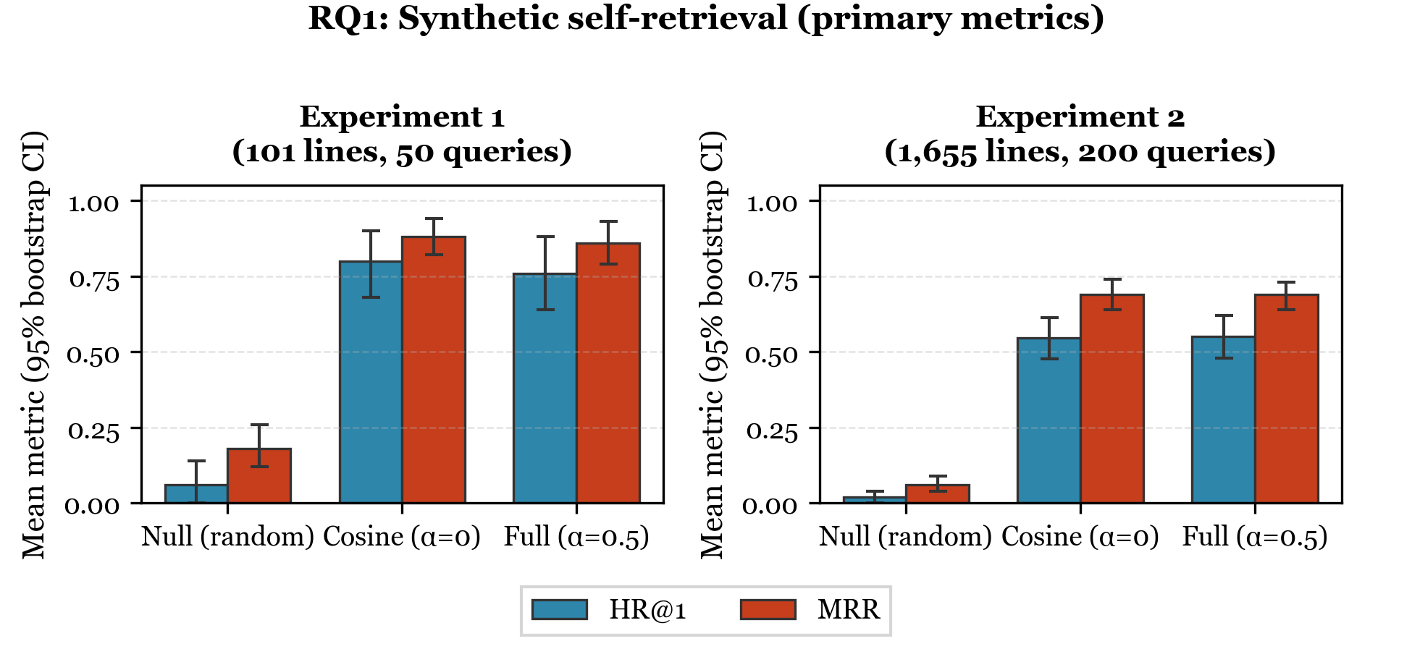
Results: Self-Retrieval Accuracy
Dataset | HR@1 | HR@3 | HR@5
Compact (101 lines) | 76% | 98% | 100%
Expanded (1,655 lines) | 55% | 80% | 86%
Notes:
[~60 seconds]
This figure shows the self-retrieval results. The metric on the left of each panel is Hit Rate at 1 -- how often the target song is ranked first -- and Mean Reciprocal Rank on the right, which captures how high it ranks on average. In Experiment 1, the compact 101-line library, hit rates are 76 percent at top 1, 98 percent at top 3, and 100 percent at top 5. In Experiment 2 with 1,655 lines, hit rates are 55 percent at top 1, 80 percent at top 3, and 86 percent at top 5. These two experiments use different protocols and different candidate pools, so the drop from 76 to 55 percent is not purely a library-size effect. The key takeaway is clear: the system massively outperforms random ordering in both cases.

Slide 7
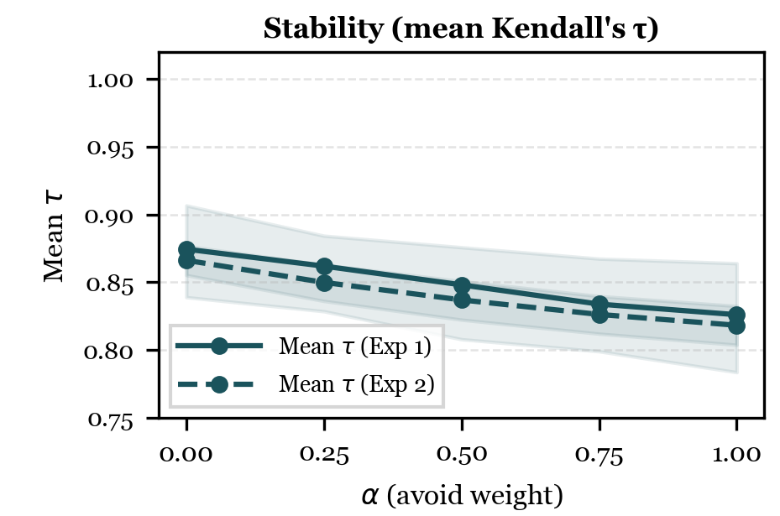
Robustness: Stability & α Sensitivity
Model | Exp 1 (5 baselines, Perturbation Trials = 130 , s = 101 ) | Exp 2 (20 baselines, Perturbation Trials = 580, s = 1655)
 | Mean τ (95% CI) | Mean τ (95% CI)
Null | −0.04 [−0.05, −0.02] | 0.00 [−0.002, 0.007]
Cos-only (α=0) | 0.87 [0.84, 0.91] | 0.87 [0.86, 0.88]
Full (α=0.5) | 0.85 [0.81, 0.88] | 0.84 [0.82, 0.85]
Table 2. Mean Kendall’s τ.
Small preference changes → small ranking changes (τ = 0.84–0.85).
Mean τ stays high across α = 0–1 (τ ≥ 0.82 at α = 1).
α = 0.5 balances avoid control and ranking stability.
Notes:
[~90 seconds]
So the system can find the right song -- but the next question is: is it consistent? If a singer tweaks just one note in their preferences, does the whole list of recommendations shuffle around, or does it mostly stay the same? That matters, because a system that gives you completely different answers every time you make a tiny change would not be very trustworthy.
To test this, we made small, one-note changes to singer profiles and compared the recommendations before and after. We needed a measure that applies when the output is a ranked list of the same songs twice -- once before the edit and once after. Kendall's tau is a standard rank-correlation statistic for exactly that situation (Kendall, 1948): it looks at every pair of songs and checks whether they still appear in the same relative order in both lists. That is why it fits a stability question better than a top-one accuracy number alone -- Hit Rate at 1 only tells you whether the target song stayed first, whereas tau summarizes how much the entire ordering moved.
Tau runs from 1.0 when the two lists are identical in order, down toward 0 when the rankings are unrelated, and can go negative if they tend to disagree. In our analysis we treat values above 0.7 as strong agreement between the two rankings. Our full model averaged about 0.84 -- well above that cutoff. The cosine-only variant was very similar, and the random baseline was near zero, as expected.
The table on the left shows those consistency scores. On the right, the plot shows what happens when we change how much weight we give to the avoid penalty -- the alpha value from the formula earlier. We tried every value from 0 to 1. Self-retrieval accuracy was on the previous slide; here the curves show that ranking stability stays strong across the whole alpha range. We chose 0.5 as the default because it gives singers meaningful control over which notes to avoid without making the recommendations unstable.

Slide 8
Takeaways & Limitations
What does this mean?
• Proof of concept
• Looking at where notes are actually spent can reveal useful options.
• Simple, proven ranking tools can help in this new use case.
Limitations & Future Work
• Synthetic profiles only — no human evaluation yet.
• One corpus (German & French art song); opera, theatre, pop untested.
• Pitch + duration only — dynamics, tempo, text omitted.
• Full model vs cosine-only performed similarly in Exp 2; needs human testing.
• Next: real singers, diverse repertoire, richer features, interactive tool.
Notes:
[~50 seconds]
Let me step back and talk about what this means in practice. This is a proof-of-concept showing that data science can bring objectivity to a domain where decisions are traditionally subjective -- and where bad decisions have real health consequences. Looking at specific pitches gives a different kind of information than broad labels like Fach. It can surface pieces a teacher may not have considered that still look like a strong fit on these pitch patterns. For those of you in CS and data science, this also demonstrates that familiar tools -- cosine similarity, content-based filtering, offline evaluation -- can be useful in this vocal-repertoire setting and in a cold-start setting.
I want to be upfront about limitations. These are synthetic profiles, not real singer preferences. We only tested on one corpus of German and French art song. And we only model pitch and duration -- dynamics, tempo, and text setting are not included. Also, in the larger experiment, the full model and the cosine-only model were often very close on the main retrieval metrics. For future work, we want to evaluate with real singers, expand to more diverse repertoire, add richer features, and ultimately build an interactive tool.

Slide 9

Thank You
Madeline Johnson, Dr. Flint Million, Dr. Rajeev Bukralia
Minnesota State University, Mankato
Notes:
[~15 seconds]
To wrap up: duration-weighted tessituragrams can rank vocal repertoire by fit -- and this is just the beginning. Next time a singer asks 'What should I sing?', data might have an answer. Thank you very much for your time. I would be happy to take any questions.

