Slide 1

An Adaptive, Explainable Multi-Agent Retrieval Framework for Intelligent Document Analysis
Under the Guidance of
Mr. shaileshbhosekar
Team members:
N Ajay Charan
M V S Madhav
N Sachin Goud
P Sohel Khan

Slide 2
Abstract
🎯 Problem Statement
• Hallucinations
• Static Retrieval
• Limited Explainability
🎯 Objective
• Build an adaptive and explainable multi-agent document intelligence system
🎯 Proposed Solution
• Adaptive Retrieval
• Multi-Agent AI
• Evidence Verification
• Explainability
🎯 Technology Stack Next.js | FastAPI | LangGraph | Qdrant PostgreSQL | Gemini/OpenAI
🎯 Expected Outcome Reliable, transparent, and trustworthy AI-powered document analysis

Slide 3
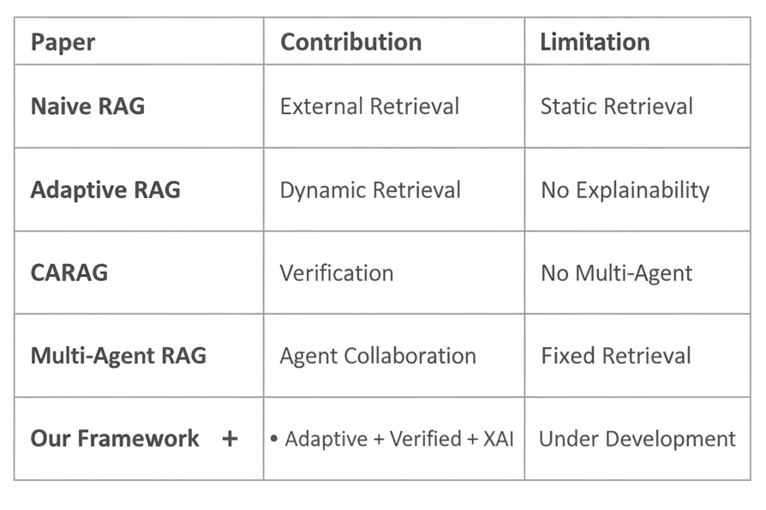
Literature Survey
Key Observations
✓ Static retrieval is common
✓ Limited explainability
✓ Limited evidence verification
✓ Research gap identified

Slide 4
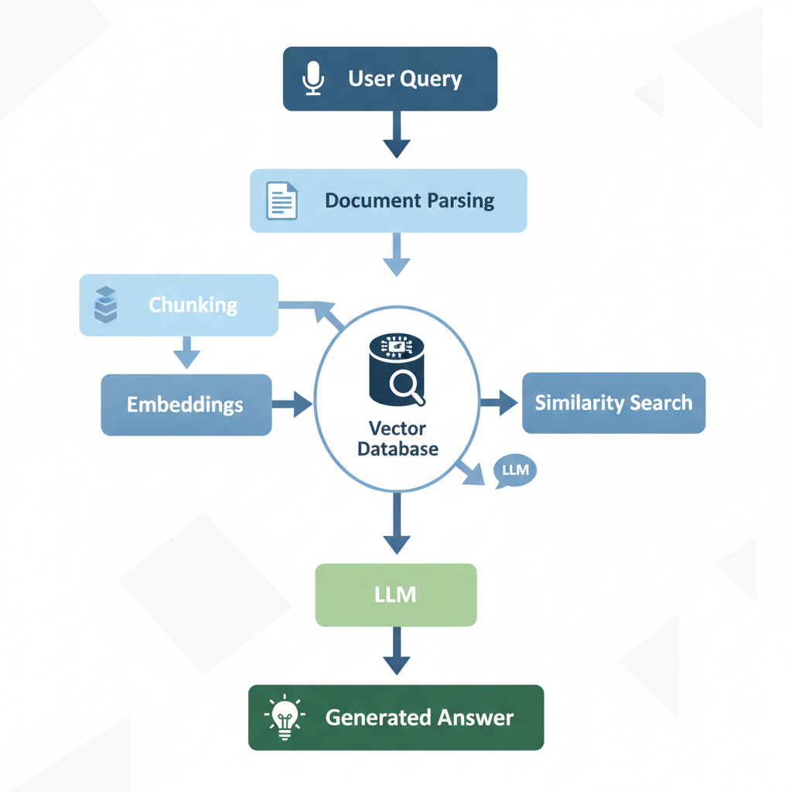
Existing System
Features
✔ Semantic Search
✔ Vector Database
✔ LLM-based QA
✔ Knowledge Retrieval
✔ Document Summarization
Applications
• Enterprise Search
• Research Assistant
• Customer Support
• Digital Libraries

Slide 5
Disadvantages of Existing System
❌ Static Retrieval Strategy
❌ Hallucinated Responses
❌ No Evidence Verification
❌ Limited Explainability
❌ Poor Handling of Complex Queries
❌ Reduced User Trust
Why a New Framework?
Adaptive Retrieval
+
Multi-Agent AI
+
Evidence Verification
+
Explainability

Slide 6
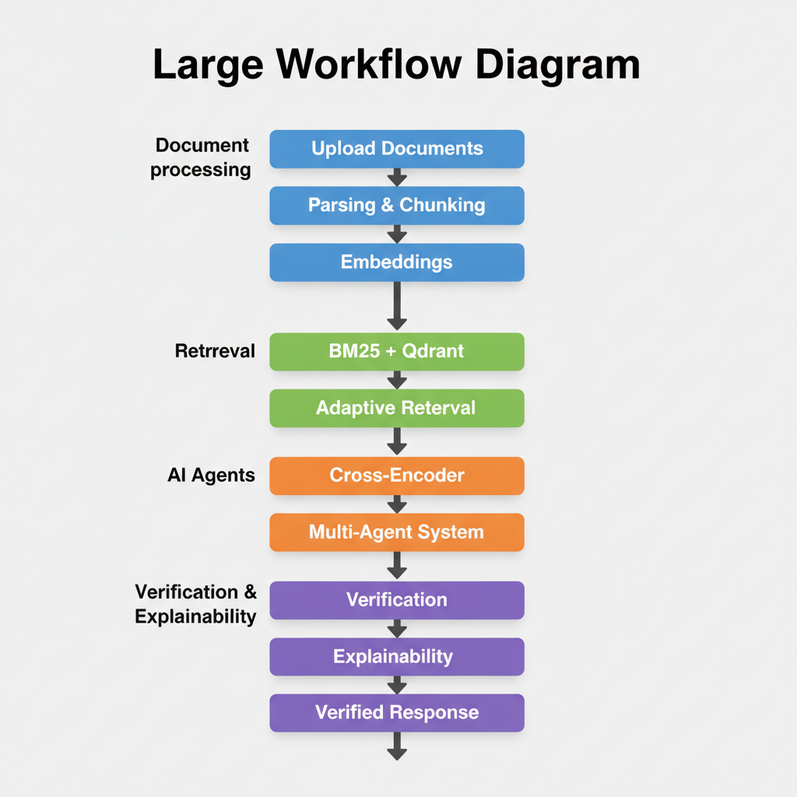
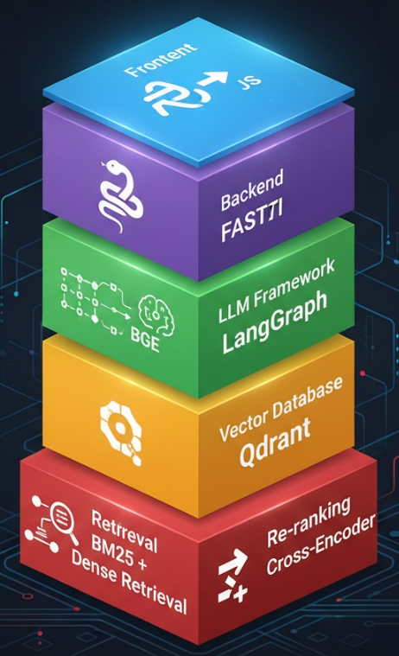
Proposed System
Key Features
✓ Adaptive Retrieval
✓ Multi-Agent AI
✓ Evidence Verification
✓ Explainability
✓ Confidence Score

Slide 7
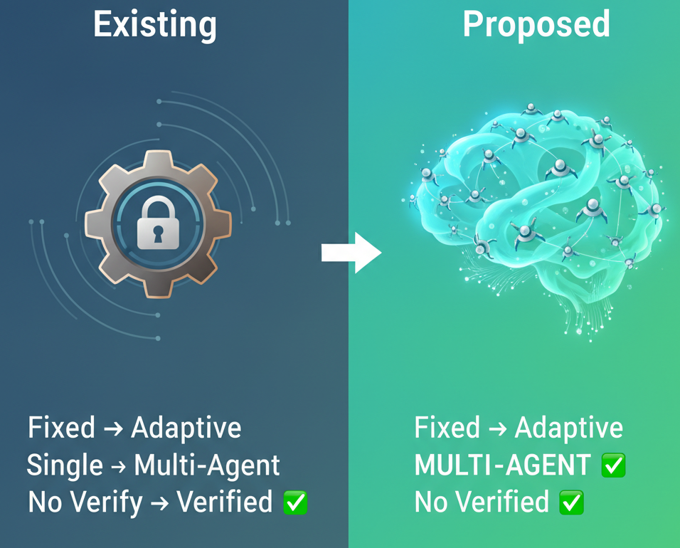
Advantages of Proposed System
✅ Adaptive Retrieval
✅ Multi-Agent Collaboration
✅ Evidence Verification
✅ Explainable Responses
✅ Better Complex Query Handling
✅ Scalable & Modular Design

Slide 8
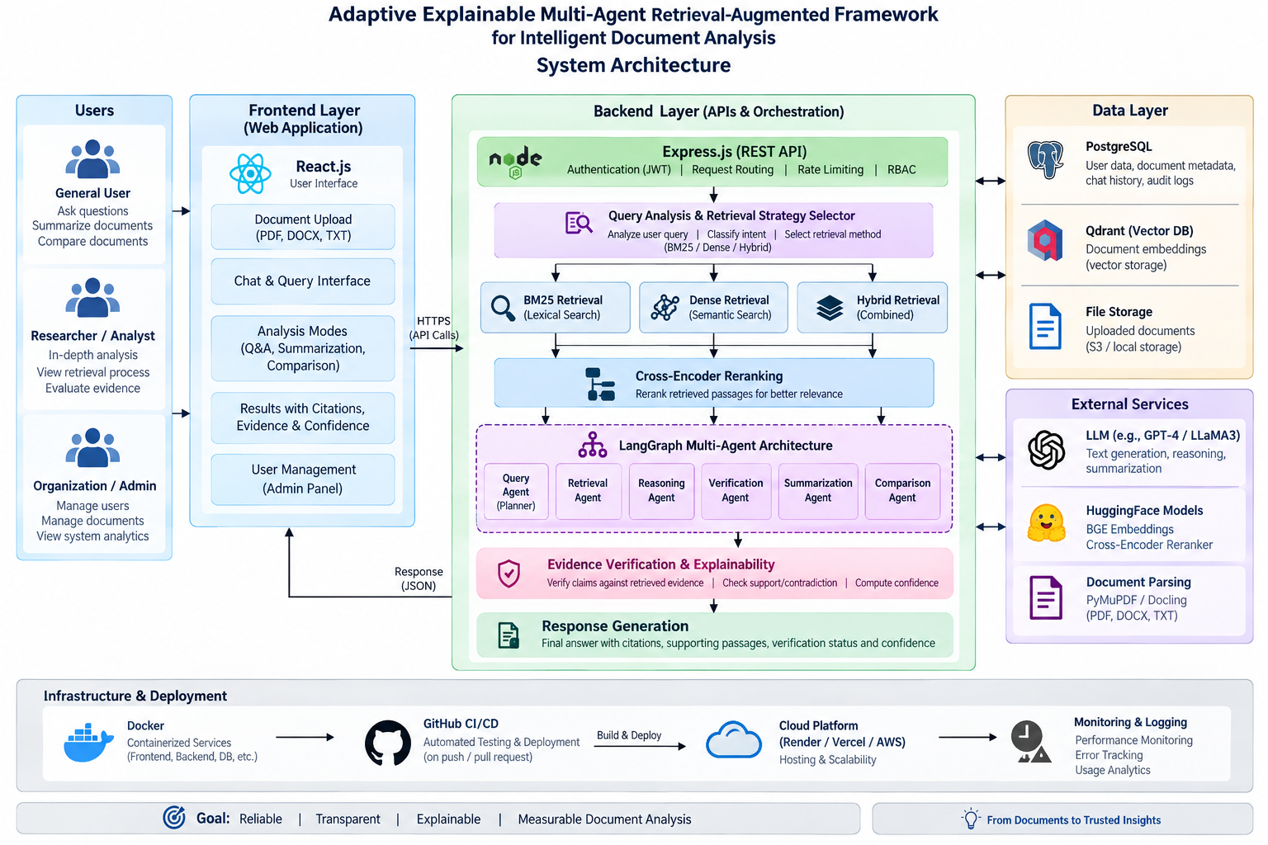
Architecture or Flow diagram (if any)

Slide 9
Software Requirements Specification
Functional Requirements
User registration, login & role-based access
Upload and manage PDF, DOCX & TXT documents
Document parsing, chunking & metadata extraction
Natural-language Q&A, summarization & document comparison
Adaptive retrieval: BM25 / Dense / Hybrid
Cross-Encoder based reranking
Multi-Agent processing using LangGraph
Evidence verification and citation generation
Confidence-aware explainable responses
Non-Functional Requirements
Security: JWT authentication, RBAC, prompt-injection protection
Performance: Low-latency retrieval and response generation
Reliability: Evidence-backed and verified responses
Scalability: Containerized and cloud-deployable architecture
Usability: Simple web interface with transparent results
Technology Stack
Next.js • FastAPI • PostgreSQL • Qdrant • BM25 • BGE Embeddings • Cross-Encoder • LangGraph • LLM • Docker

Slide 10
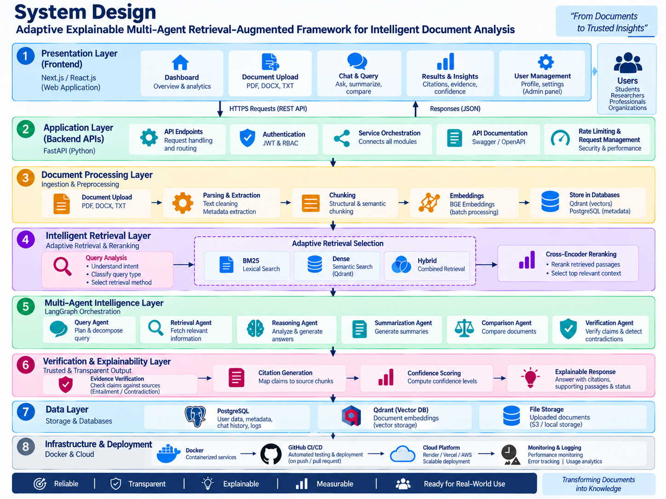
System Design

Slide 11
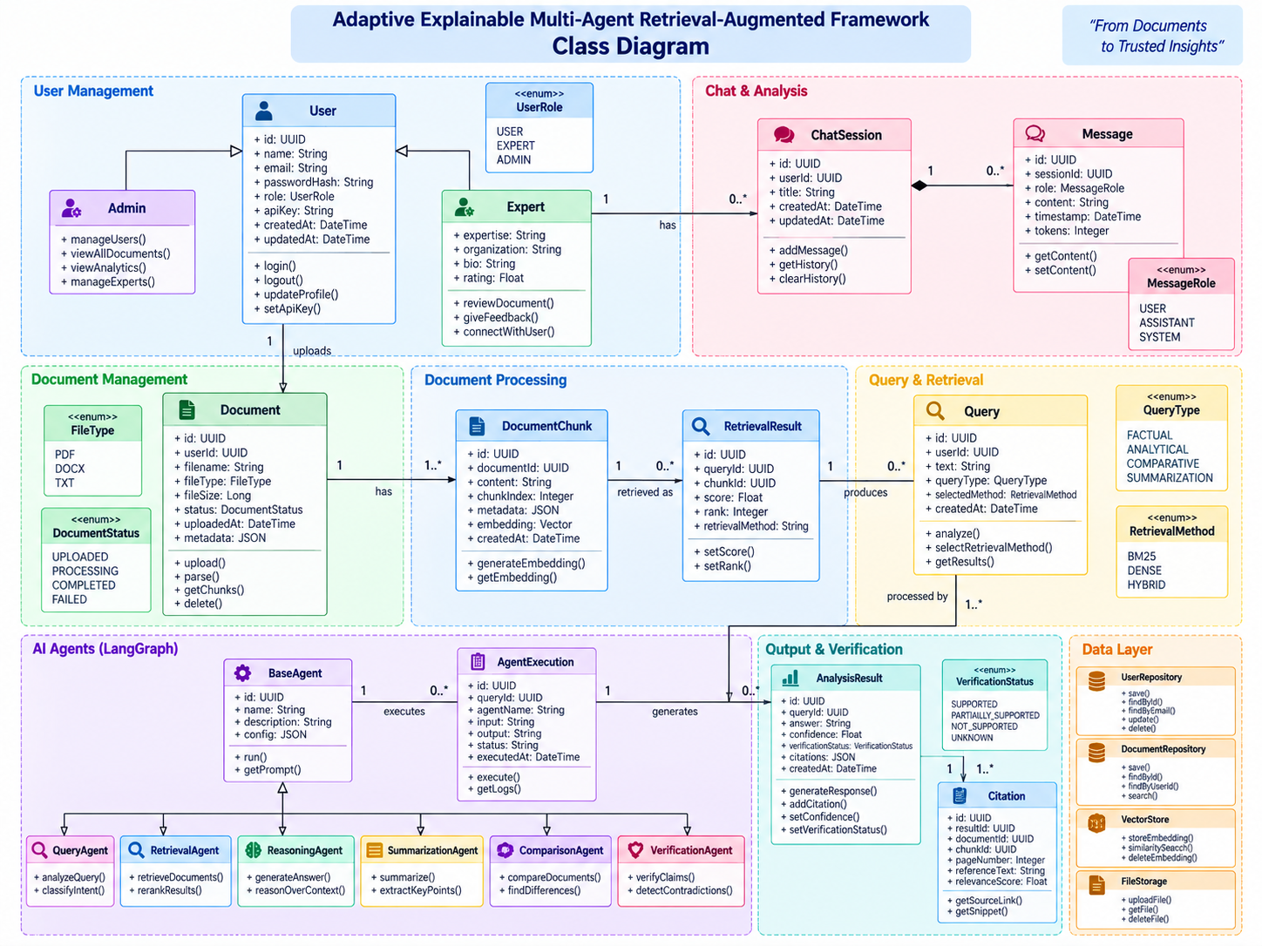
Class Diagram

Slide 12
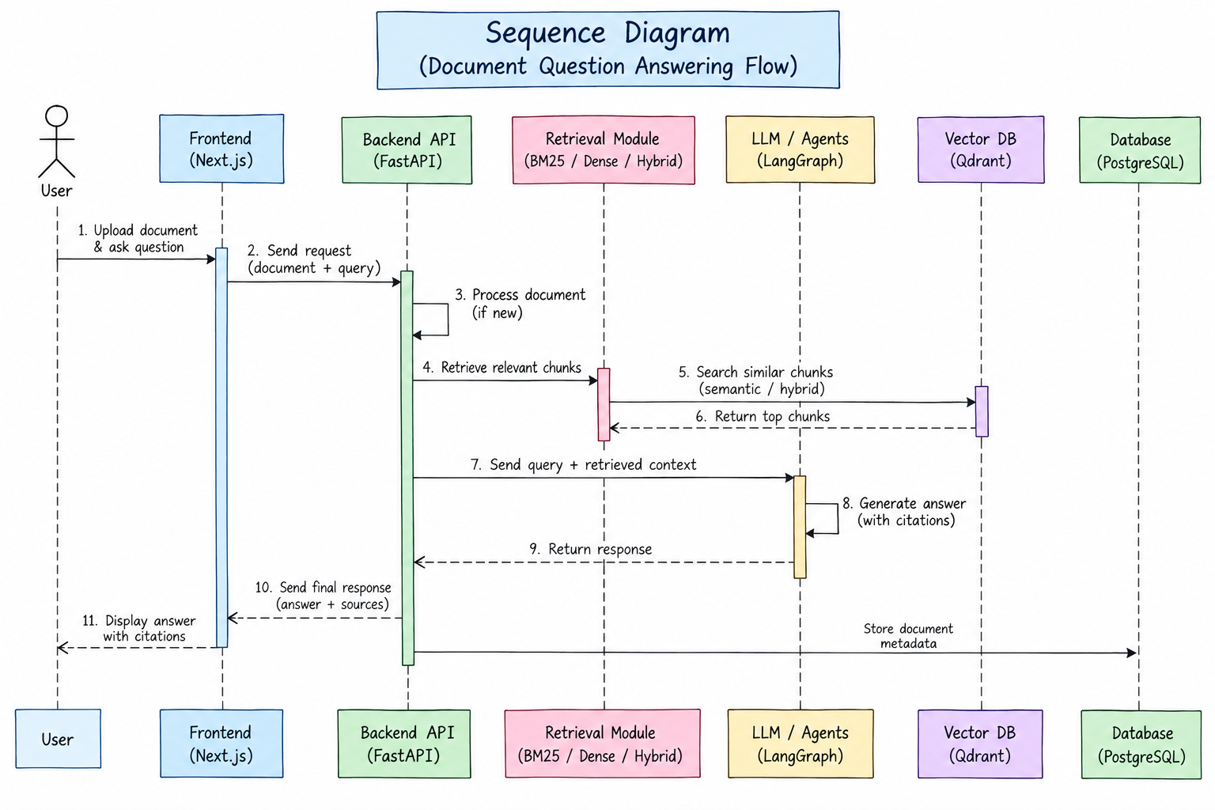
Sequence Diagram

Slide 13
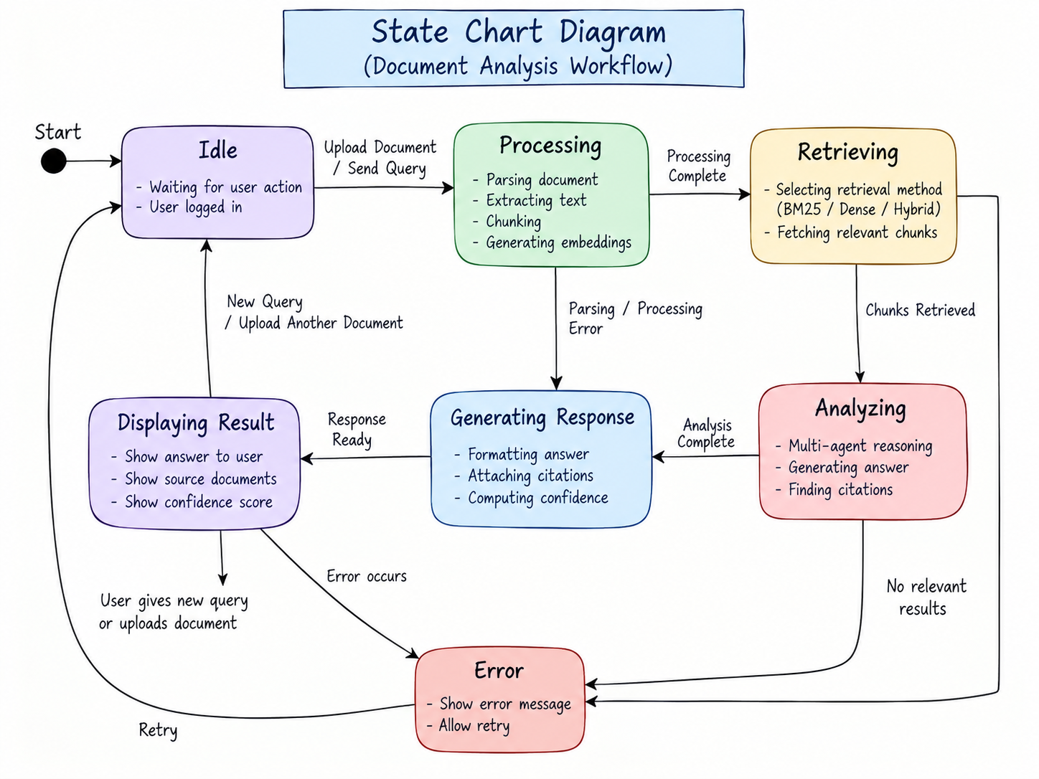
State Chart Diagram

Slide 14
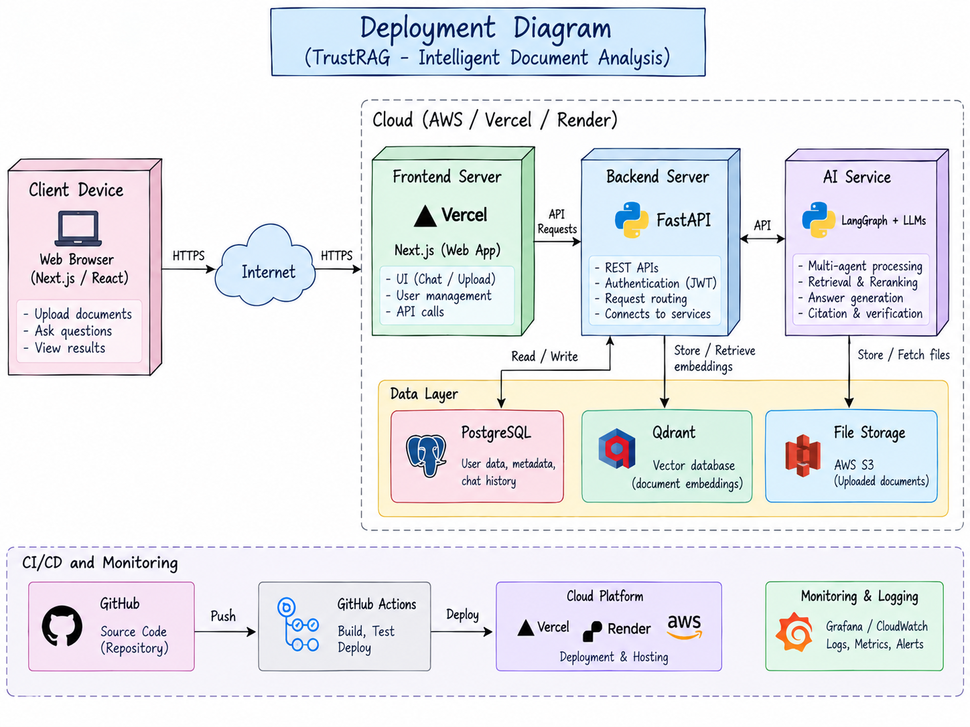
Deployment Diagram

Slide 15
Thank You

