Slide 1

AI IDEA — XL CB
Cloud Brokers & AI - Use Cases
February 2026
Authors: Blaise DiMartino & Alex Grinberg
CONFIDENTIALITY LEVEL : INTERNAL
www.axa.com

Slide 2
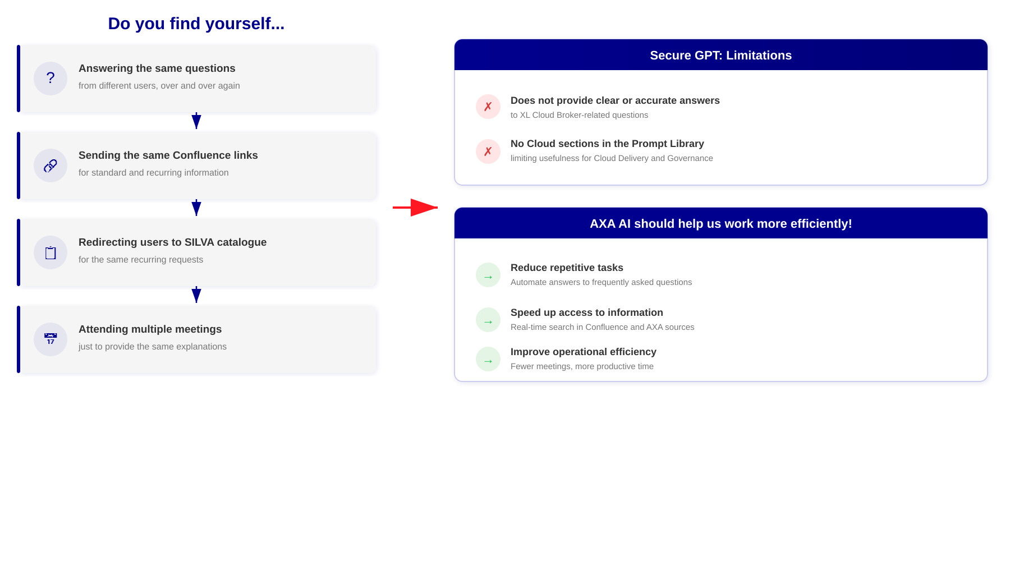
PROBLEM STATEMENT
CONFIDENTIALITY LEVEL : INTERNAL
www.axa.com

Slide 3
SECURE GPT: NO CLOUD SECTIONS
0
Cloud sections in the Prompt Library
No section for Cloud, Cloud Broker or XL Cloud Broker
under the IT category of Secure GPT
Impact on Teams
Cloud Delivery
Cloud Governance
Cloud Operations
No prompts for cloud delivery questions
No AI assistance for cloud governance topics
Operational questions left unanswered by AI
CONFIDENTIALITY LEVEL : INTERNAL
www.axa.com

Slide 4
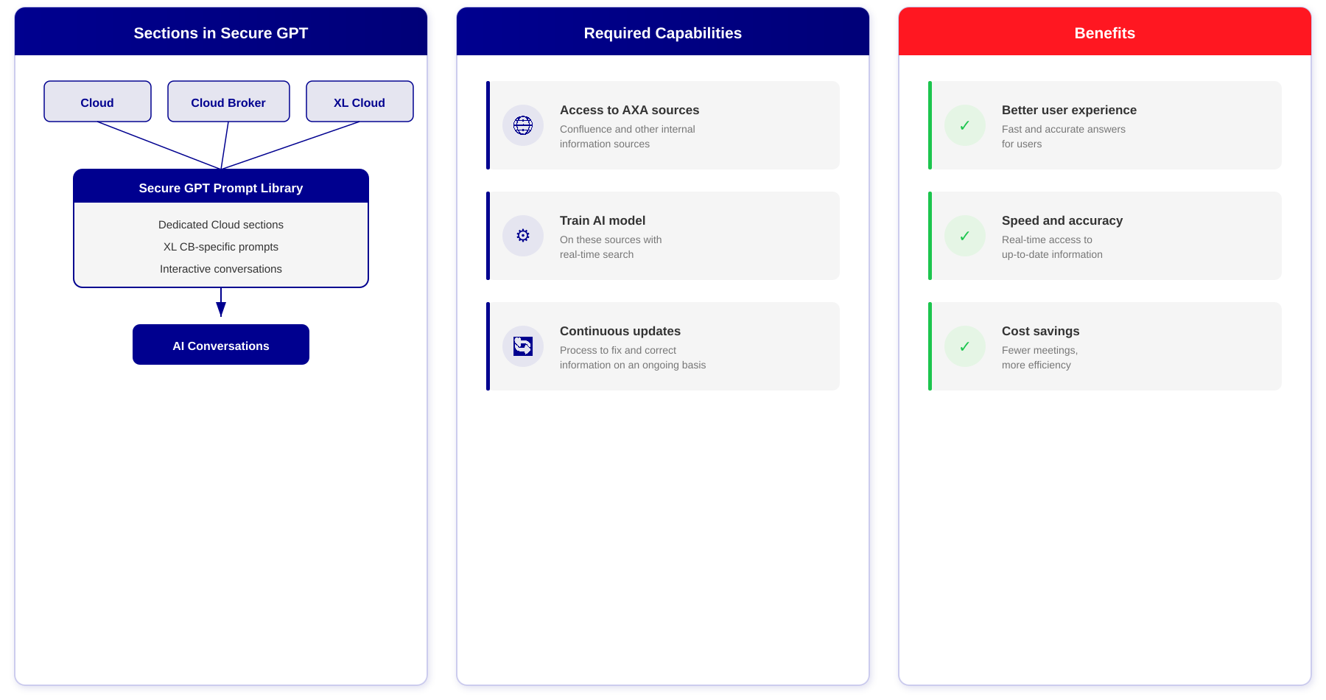
PROPOSED SOLUTION
CONFIDENTIALITY LEVEL : INTERNAL
www.axa.com

Slide 5
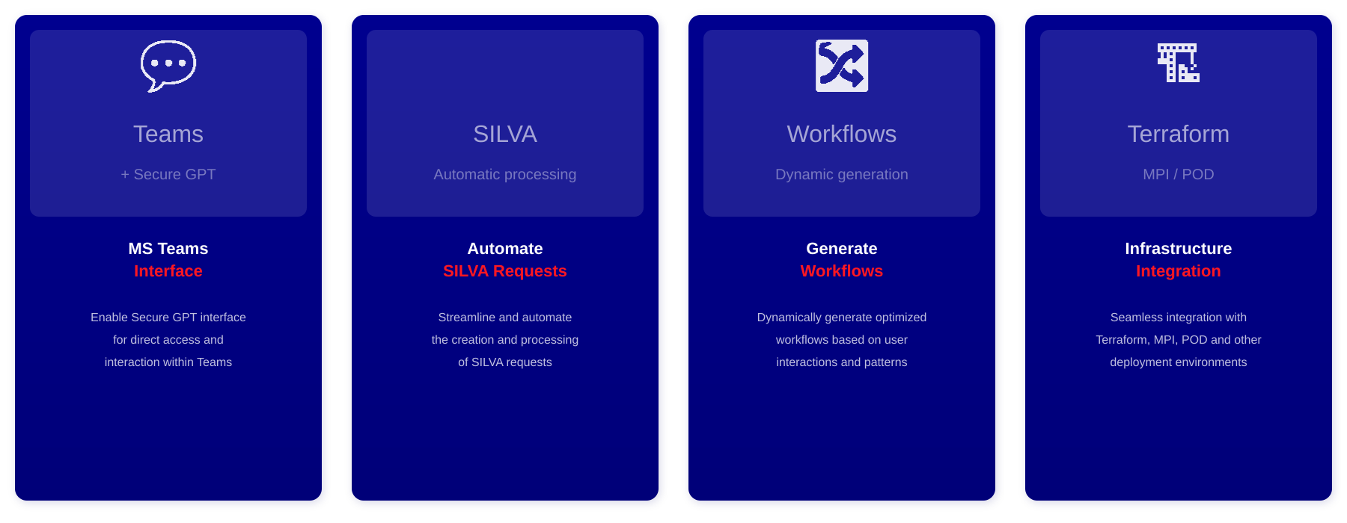
FUTURE ENHANCEMENTS
CONFIDENTIALITY LEVEL : INTERNAL
www.axa.com

Slide 6
THANK YOU
Know You Can
www.axa.com
CONFIDENTIALITY LEVEL : INTERNAL

