Slide 1
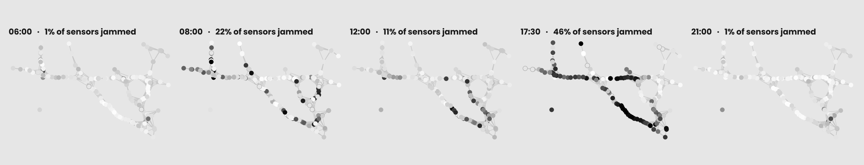
T082
Team T082 · Section B
Problem
Data
Models
Insights
WHY TRAFFIC?
Forecasting highway speed 15, 30 and 60 minutes ahead from sensor data · Phase 1 · Team T082, Section B
t + 60 min
207 sensors
15–20 km/h
Real-world impact
Real, public data
A physics hint
A traffic-signal controller needs the next hour's jam map, not the current one. Phase 1 builds that forecast; Phase 2 will use it.
METR-LA: a speed reading every 5 minutes on Los Angeles highways, March–June 2012. The standard benchmark (Li et al., 2018).
A jam's tail moves backwards against the cars (LWR model, 1955), so the sensor ahead of you knows your near future.
01
Wednesday 13 June 2012, five moments · one dot per sensor · dark = jammed (below 35 mph) · hollow = sensor offline
Notes:
Good morning. Our project is about predicting traffic. Los Angeles has 207 sensors buried in its highways, and every five minutes each one reports how fast cars are moving over it. We want to predict what that speed will be 15, 30 and 60 minutes from now, for every sensor. Why: if a traffic-signal system can see a jam coming before it arrives, it can react in time. Three things frame the project. First, the horizon: a controller needs the next hour, not the present. Second, the data: METR-LA, the standard public benchmark, so we can compare with published numbers. Third, a piece of physics: a jam grows backwards, like a queue, at about 15 to 20 kilometres an hour, so the sensor ahead of you knows something about your near future. The strip at the bottom is one real Wednesday: almost nothing at 6 am, 22 percent of sensors jammed at 8, half the network at 5.30 pm, empty again by 9. Phase 1, today, uses classical machine learning; Phase 2 adds a graph neural network on the same data and scoring.

Slide 2
T082
Team T082 · Section B
Problem
Data
Models
Insights
THE
DATA
HOW WE GOT THE EXAMPLES
STEP
TRAIN
VALIDATION
TEST
1 Five-minute time slots
23,967
3,403
6,831
1 Mar – 23 May
23 May – 4 Jun
4 – 27 Jun
2 Readings (slots × 207 sensors)
4,961,169
704,421
1,414,017
METR-LA is one table: a row every five minutes from 1 March to 27 June 2012, a column for each of 207 sensors, and in each cell the average speed in mph. It comes with a road map that says how far apart the sensors are by road, so we know which sensors are neighbours.
3 Exactly 0 mph → marked unknown
−353,732
−49,317
−171,637
7.1%
7.0%
12.1%
4 Inputs per example: 34 numbers
26 about the sensor itself + 8 about its neighbours
17 WEEKS
5 Examples whose answer (speed +60 min) is known
4,607,444
655,115
1,242,308
Examples used, per horizon
4.6 M
0.66 M
1.24 M
12 train · 1 March – 23 May
of which jammed (below 35 mph)
8.6%
8.7%
10.3%
2 validation · 23 May – 4 June
3 test · 4 – 27 June
A reading of exactly 0 mph is an offline sensor, not stopped traffic: a highway never averages zero over five minutes, the zeros come in runs, and on 6% of slots all 207 sensors read 0 at once. We mark them unknown — nothing deleted, nothing invented. Tree models accept unknown inputs; an unknown answer is skipped in training and in scoring.
Split by date, never shuffled, with a one-hour gap at each boundary: a test answer never appears in training. The validation weeks only decide when to stop training.
02
Notes:
The data is METR-LA. One table: a row every five minutes for four months, a column per sensor, each cell a speed in miles per hour. On the left you see how we cut the four months: the first twelve weeks are for training, the next two are the validation weeks that only decide when to stop training, and the last three and a half weeks of June are the test, which no model sees. We split by date, never by shuffling: rows five minutes apart are near-copies, so a random split would leak the test set into training and make the score look too good. There is a one-hour gap at each boundary. The table on the right shows how the examples are made. 23,967 training slots times 207 sensors gives about five million readings. The first thing we found is that 8 percent of readings are exactly zero. That is not a jam, it is a sensor that was offline: the zeros come in runs, and on 6 percent of the slots every sensor in the city reads zero at once. We mark those cells unknown. We do not delete rows or sensors and we do not fill in guessed values. Each example has 34 input numbers and an answer, the speed 15, 30 or 60 minutes later; if that answer is unknown the example is skipped. That leaves 4.6 million training examples and 1.24 million test examples per horizon, about 10 percent of them jammed.

Slide 3
T082
Team T082 · Section B
Problem
Data
Models
Insights
THE
INPUTS
GRP
FEATURE
WHAT IT TELLS THE MODEL
COUNT
USED BY
IMPOR.
A
lag_0 … lag_11
speed now and in the previous 11 slots (one hour)
12
L + S
34%
B
win_mean / std / min / max
summary of that hour
4
L + S
12%
B
win_frac_missing, trend_15min
share of the hour unknown; change over 15 min
2
L + S
2%
What is local / spatial?
C
tod_sin / cos, dow_sin / cos
time of day, day of week — midnight wraps round
4
L + S
10%
Local = the 26 numbers a sensor knows about itself. Spatial = those plus 8 numbers about its neighbours. Every model is trained both ways, so the difference measures exactly what the neighbours are worth.
C
is_weekend, hour
weekend flag; hour of the day
2
L + S
8%
D
ha_now, dev_from_ha
usual speed at this time of week (train only); gap from usual
2
L + S
9%
E
up_mean (now, −5, −10 min)
upstream neighbours: what is about to arrive
3
S
8%
E
down_mean (now, −5, −10 min)
downstream neighbours: a queue growing back to you
3
S
10%
How are the groups made?
E
nbr_min, nbr_frac_congested
slowest neighbour; share of neighbours jammed
2
S
7%
By what the number describes. Nothing from the future leaks in: lags look backwards, the usual speed is computed from training weeks only.
—
speed +15 / +30 / +60 min
the answers we predict
3
—
—
A
Own last hour
12 numbers
B
Summary of that hour
6 numbers
Importance = share of XGBoost's split gain, averaged over all 207 sensors and 3 horizons. L = local models, S = spatial models. Neighbour weights follow the road graph: nearer neighbours count more (Gaussian kernel on road distance, as in DCRNN).
C
The clock
6 numbers
D
Usual speed
2 numbers
E
Neighbours
8 numbers
03
Notes:
A model learns from examples of the form situation to outcome, so we have to describe each situation with numbers. For every sensor at every five-minute slot we build 34 numbers, in five groups. A: the sensor's own speeds over the last hour, twelve numbers. B: a summary of that hour, its mean, spread, min, max, how much of it is unknown and the trend over the last 15 minutes. C: the clock, time of day and day of week written as sine and cosine so that five to midnight and five past are close together, plus a weekend flag and the hour. D: what is normal for this sensor at this time of week, computed from the training weeks only, and how far from normal it is now. E: eight numbers about the neighbours: upstream and downstream average speeds now, five and ten minutes ago, the slowest neighbour and how many neighbours are jammed. The first 26 are the sensor alone, we call that local; adding the 8 neighbour numbers gives spatial. Every model is trained both ways, so the gap between them is exactly what the neighbours add. The last column shows how much the trained model relies on each group: the current speed is the biggest single input, and the second biggest is the downstream neighbours, the sensors ahead, which is what the physics predicts.

Slide 4
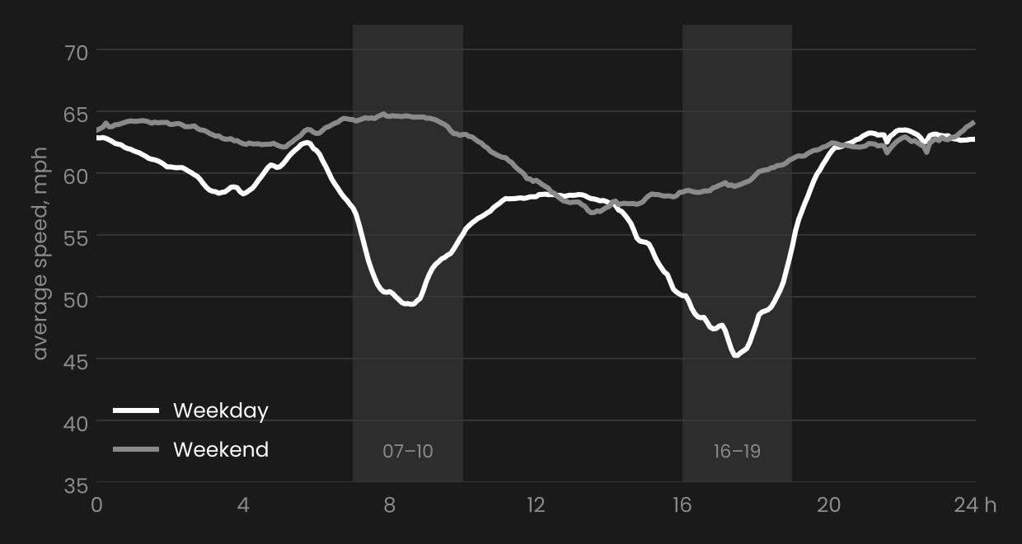
T082
Team T082 · Section B
Problem
Data
Models
Insights
EDA
AVERAGE SPEED BY TIME OF DAY · ALL FOUR MONTHS
35% of sensors are jammed at 17:00 on a weekday; about 24% at 08:00, under 1% at 03:00
Exploratory data analysis, all four months
AVERAGE VALUE
OFF-PEAK
RUSH HOUR
.84 correlation of a sensor's speed with its own speed one hour earlier → the last hour is a strong input
Mean speed (mph)
59.6
50.1
Spread of speeds, std (mph)
10.6
18.5
Readings below 35 mph
5.2%
26.5%
.64 with 24 hours earlier → a daily cycle worth a feature
Sensors jammed at 17:00, weekdays
—
35%
Rush hour = weekdays 07–10 and 16–19. Weekends look like off-peak all day (mean 61.7 mph). The same pattern repeats every week, so "the usual speed at this time of week" becomes an input, and the models are scored in rush hour and off-peak separately.
Two slow periods on weekdays, the evening one deeper; weekends flat. The shaded bands are the rush-hour windows used in the evaluation.
04
Notes:
Before modelling we looked at the data. The table compares off-peak with weekday rush hour over the four months: the average speed drops from about 60 to 50 miles per hour, the spread almost doubles, and the share of readings below 35 miles per hour, our definition of jammed, goes from 5 percent to 26 percent. At 5 pm on a weekday more than a third of all sensors are jammed. The chart shows the average speed through the day: two slow periods on weekdays, morning and evening, with the evening worse, and weekends flat. The pattern repeats every week, which means the usual speed at this time of week is a very good predictor. We also measured memory: a sensor's speed is 84 percent correlated with its own speed one hour earlier, and 64 percent with 24 hours earlier. These findings became inputs: the last hour of history, the clock, and the usual speed. They also decide how we score: rush hour and off-peak separately, because that is where the models differ.

Slide 5
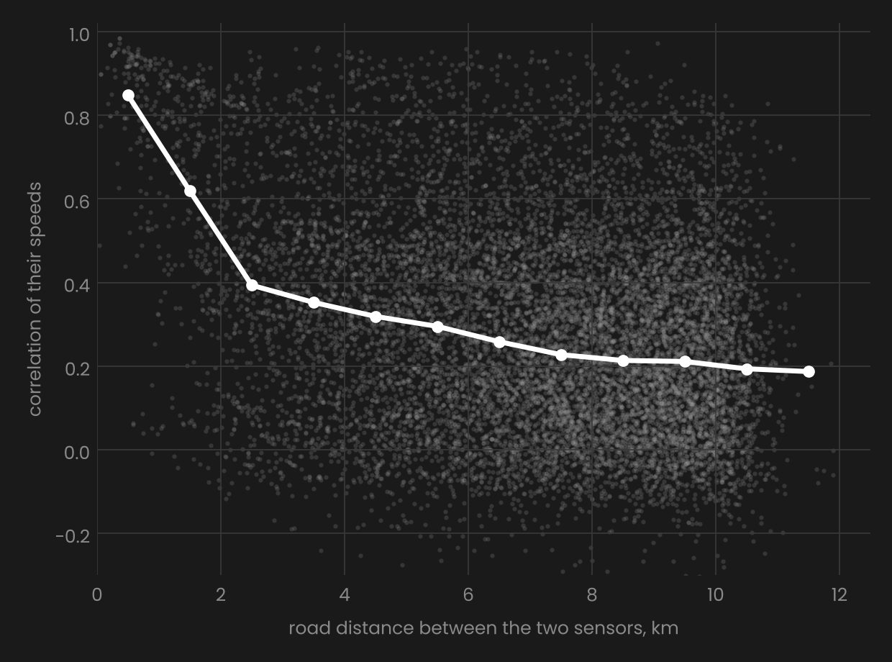
T082
Team T082 · Section B
Problem
Data
Models
Insights
WHY
NEIGHBOURS
A jam grows like a queue: cars join at the back, so its tail moves against the traffic at 15–20 km/h (Lighthill–Whitham–Richards model, 1955). The sensor ahead of you sees your next few minutes first. We turned that into eight numbers.
up_mean (now, −5, −10 min)
upstream neighbours: what is about to arrive
down_mean (now, −5, −10 min)
downstream neighbours: a queue growing back to you
nbr_min, nbr_frac_congested
slowest neighbour; share of neighbours jammed
weights
nearer neighbours count more; unknown neighbours left out
CORRELATION WITH A NEIGHBOUR'S SPEED, BY ROAD DISTANCE
CORRELATION OF TWO SENSORS' SPEEDS VS THEIR ROAD DISTANCE
under 1 km apart
0.85
20,000 sensor pairs
white line = median per km
12 training days
5–6 km apart
0.29
10–11 km apart
0.19
Only close neighbours carry information, so one-hop features are the right first step. A wave at 15–20 km/h crosses one hop (1–3 km) in 5–15 minutes, so they should help most at short horizons — keep that in mind for the results.
05
Notes:
This is the most important chart in our exploration. Each dot is a pair of sensors: left to right is the road distance between them, bottom to top is how correlated their speeds are. Sensors under one kilometre apart have a correlation of 0.85; at five kilometres it drops to 0.3, at ten to 0.2. So neighbours do carry information, but only close ones. Why should they? Think of a queue at a ticket counter: new people join at the back, so the queue grows backwards. A traffic jam is the same: its tail moves against the direction of the cars, at about 15 to 20 kilometres an hour. This was worked out in 1955 and is called the LWR model. So if the sensor ahead of you is jammed now, that jam will reach you in a few minutes, and the sensor behind you tells you how much traffic is about to arrive. We turned that into eight numbers: upstream and downstream average speeds now, five and ten minutes ago, the slowest neighbour, and the share of neighbours that are jammed, with nearer neighbours weighted more. One consequence to remember: a neighbour one hop away can only tell you about the next 5 to 15 minutes; what hits you in an hour is still several sensors away.

Slide 6
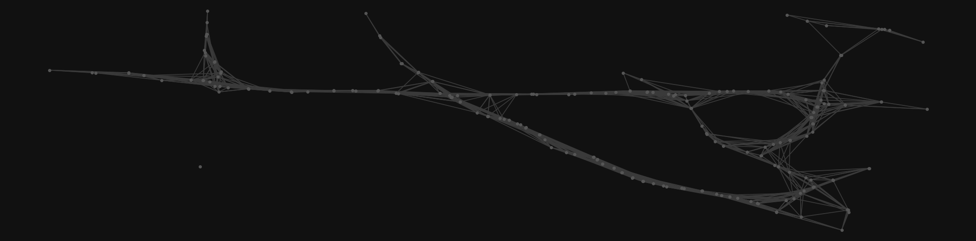
T082
Team T082 · Section B
Problem
Data
Models
Insights
01 · FLOOR
02 · FLOOR
03 · LINEAR
04 · MAIN MODEL
05 · CROSS-CHECK
Hist. average
Persistence
Ridge
XGBoost
Random Forest
The usual speed at this time of week. No learning, no present.
The speed stays what it is now. No learning, no memory.
A weighted sum of the 26 inputs. Is a straight line enough?
Trees built one after another, each fixing the last one's mistakes. 621 models.
100 trees averaged; one forest predicts all three horizons.
VAL MAE 15
VAL MAE 60
VAL MAE 15
VAL MAE 60
VAL MAE 15
VAL MAE 60
VAL MAE 15
VAL MAE 60
VAL MAE 15
VAL MAE 60
4.32
4.30
no present
3.21
4.75
no memory
3.10
4.87
straight lines
2.70
3.63
best → test
2.73
3.69
a tie
THE
MODELS
Validation weeks only (23 May – 4 June), never the test set; MAE in mph at 15 and 60 minutes ahead. Each model answers one question, from a no-learning rule to boosted trees. One model per sensor; XGBoost one per sensor and horizon — 621 in all, about 12 minutes on two CPU cores.
Why XGBoost
Trees combine clues ("5 pm and speed dropping and the sensor ahead is slow"), which a straight line cannot: it beats Ridge by 22% at 60 min. It accepts unknown inputs, so the outages need no filling. It stops adding trees when the validation error stops improving — about 130 of the 600 allowed.
But it is a tie
The Random Forest is 0.03–0.06 mph behind on validation and 0.01 on test, with a slightly lower RMSE. XGBoost was chosen because it trains three times faster, not because it is clearly better.
06
Notes:
We compared five models, all one per sensor. Two are floors with no learning: the historical average, which predicts the usual speed at this time of week, and persistence, which predicts the speed stays as it is now. Every real model must beat both. Ridge regression is a weighted sum of the inputs, our linear reference. The main model is XGBoost: decision trees built one after another, each one fitted to the mistakes of the ones before, with a small learning rate. One model per sensor per horizon, 621 in total, trained in about twelve minutes. It stops adding trees when the validation error stops improving, typically after about 130 of the 600 allowed, so it is not over-fitting. It also accepts unknown inputs, so our masked outages need no filling. The Random Forest is the cross-check: 100 trees averaged, one forest per sensor predicting all three horizons at once. The numbers on the cards are validation errors, never the test set: XGBoost 2.70 at 15 minutes and 3.63 at 60; the forest 2.73 and 3.69. That is a tie; we lead with XGBoost because it trains three times faster.

Slide 7
T082
Team T082 · Section B
Problem
Data
Models
Insights
THE
RESULTS
TEST SET · XGBOOST + NEIGHBOURS · 60 MIN · JAM = BELOW 35 MPH
ACTUAL JAM
ACTUAL FREE
78,082
13,604
PREDICTED JAM
jams caught
false alarms
TEST MAE, MPH
XGB + NBRS
PERSISTENCE
HIST. AVG
50,475
1,100,147
15 min ahead
2.87
3.49
4.19
PREDICTED FREE
30 min ahead
3.32
4.18
4.19
jams missed
correct
60 min ahead
3.78
5.33
4.19
RMSE at 60 min
7.07
10.27
7.86
MODEL ACCURACY
ALWAYS "FREE"
94.8%
89.7%
Why not accuracy: 90% of answers are "free", so always saying "free" scores 89.7%. MAE — the average mistake in mph, counting only cells where the true speed is known — cannot be fooled that way. Persistence is excellent at 15 min and collapses by 60; the historical average ignores the present; the learned model combines both. XGB-local is 22% better than Ridge at 60 min; the Random Forest is 0.01 mph behind. Test weeks (4–27 June) were scored once, at the end. DCRNN, the published deep graph model on this data, reports 3.60 at 60 min.
PRECISION 0.85 · RECALL 0.61 · F1 0.71
07
Notes:
Here are the results on the June test weeks, which no model saw during training. The table gives the mean absolute error in miles per hour: persistence, just repeating the current speed, is very good at 15 minutes but bad at 60; the historical average is the same at every horizon because it ignores the present; XGBoost with neighbour features combines both ideas and wins, 2.87, 3.32 and 3.78 miles per hour. The Random Forest is a hundredth behind. For comparison, DCRNN, the famous deep-learning paper on this data, reaches 3.60 at 60 minutes, so our classical model is close. The box on the left turns the 60-minute forecast into a yes-or-no jam detector, jam meaning below 35 miles per hour. When it says jam, it is right 85 percent of the time; but it only catches 61 percent of the jams. Notice the accuracy trap: because 90 percent of answers are free-flowing, a model that always says free scores 89.7 percent, so we never use accuracy as the headline. We use MAE, masked, meaning cells where the true speed is unknown are skipped, so an outage never counts as a mistake.

Slide 8
T082
Team T082 · Section B
Problem
Data
Models
Insights
KEY
INSIGHTS
SAME XGBOOST, WITH VS WITHOUT 8 NEIGHBOUR NUMBERS · MAE REDUCTION
15 min ahead
−4.1%
30 min ahead
−3.3%
Neighbours help — most in rush hour
60 min ahead
−1.8%
Adding the eight neighbour numbers lowers the error at every horizon, three times more in the peaks: congestion really does spread between sensors. The model's second most-used input is the downstream neighbours.
60 min · rush hour
−3.2%
The help fades at 60 minutes
One hop sees 5–15 minutes of a jam moving at 15–20 km/h; what hits you in an hour is still several sensors away. That fade is the gap for Phase 2's graph network, which looks several hops out.
60 min · off-peak
−1.1%
Rush hour is the hard part
Error doubles in the peaks (5.67 vs 3.31 mph at 60 min) and sits almost entirely below 35 mph. Recall 0.61: a jam that has not arrived yet is invisible in a sensor's own history.
147 of 207 sensors improve at 60 min (up to 7.2%). The Random Forest shows the same: −3.4 / −3.1 / −1.4%. Same rows, same split, same settings — the only change is the eight neighbour columns.
The numbers are honest
Split by date with a gap; settings fixed in advance; validation ranks the models exactly like the test set; early stopping kept ~130 of 600 trees. One command reruns everything; 8 tests check split, features and scoring.
Next steps
Phase 2: a Graph Attention Network on the same data, split and scoring; check whether its attention follows the backward wave; any signal-control experiment is a simulation only.
08
Notes:
This is the key experiment of Phase 1. We take the same XGBoost and add the eight neighbour numbers, changing nothing else. The error falls at every horizon: by 4 percent at 15 minutes, 3 at 30 and about 2 at 60, for 147 of the 207 sensors, and the Random Forest shows the same. The help is three times larger in rush hour than off-peak, which is what you expect if the extra information is about jams spreading. Notice that the help fades at 60 minutes. That matches the physics: a neighbour one hop away only sees 5 to 15 minutes ahead; what reaches you in an hour is still several sensors away. A graph model that looks several hops out is what Phase 2 adds, and this tells us where it should help most. Where are the remaining mistakes? In rush hour and in jammed traffic: the error roughly doubles in the peaks, and the detector catches only 61 percent of jams an hour ahead, because a jam that has not reached a sensor yet is invisible in that sensor's own history. Finally, the numbers are honest: split by date with a gap, settings fixed in advance, validation ranks the models exactly like the test set, and everything reruns with one command. Phase 2 will train a Graph Attention Network on exactly the same data, split and scoring; any traffic-signal experiment will be a simulation only.

Slide 9
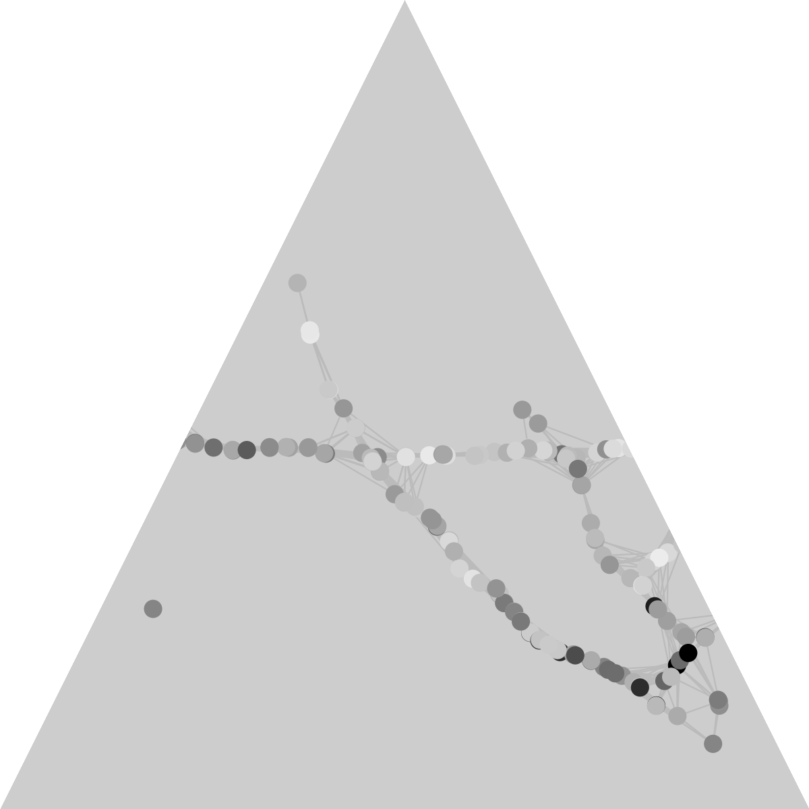
THANK YOU
Presented by
Phase 1
Team T082 · Section B
Advanced ML & Deep Learning (CSAI)
Kartik Madaan
Siddhanth Sadshiv Raikar
Data pipeline, road graph, repository, EDA
Models and the IEEE report
Arhan Alam
Abhijeet Dey
Feature engineering, LWR neighbour features, time split
Evaluation: masked metrics, ablation, results
Chirag Lalwani
Code
Model training: XGBoost, Random Forest, Ridge
github.com/madaankartik/traffic-aml-project
09
Notes:
Everything is in one repository and reruns with a single command: data, analysis, models, figures and every number in the report, so the report cannot disagree with the experiments. Kartik did the data pipeline and the exploration, Arhan the feature engineering, Chirag the model training, Siddhanth the models and the report, Abhijeet the evaluation — but we all reviewed everything. Thank you — we are happy to take questions.

