Slide 1
Object Persistence using Hibernate
An Object-Relational mapping framework
for object persistence
Pragati Software Pvt Ltd.

Slide 2
What Hibernate Does
Object - Relational mapping
Transparent persistence & retrieval of objects
Persistence of associations and collections
Guaranteed uniqueness of an object (within a session)
Pragati Software Pvt Ltd.

Slide 3
Hibernate Features
O-R mapping using ordinary JavaBeans
Can set attributes using private fields or private setter methods
Lazy instantiation of collections (configurable)
Polymorphic queries, object-oriented query language
Cascading persist & retrieve for associations, including collections and many-to-many
Transaction management with rollback
Can integrate with other container-provided services
Pragati Software Pvt Ltd.

Slide 4
Application Architecture
User Interface
UI event
data xfer object
Application Logic
data request
domain object
Domain Objects
DAO
SessionFactory
Hibernate API
domain object
Hibernate
hibernate.cfg.xml
JDBC API
ResultSet, etc.
*.hbm.xml class mappings
Foundation Classes
JDBC
Pragati Software Pvt Ltd.

Slide 5
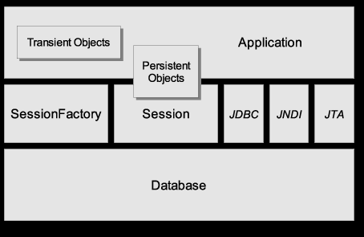
Another View
Pragati Software Pvt Ltd.
Source: Hibernate Reference Manual (online)

Slide 6
Example of Persisting an Object
// get a Hibernate SessionFactory for Session management
sessionFactory = new Configuration()
.configure().buildSessionFactory();
// an Event object that we want to save
Location ku = new Location( "Kasetsart University" );
ku.setAddress( "90 Pahonyotin Road; Bangkok" );
Event event = new Event("Java Days");
event.setLocation( ku );
Session session = sessionFactory.openSession();
Transaction tx = session.beginTransaction();
session.save( event );
tx.commit();
session.close();
Pragati Software Pvt Ltd.

Slide 7
Example of Retrieving an Object
// use the existing session factory
Session session = sessionFactory.openSession();
// query Event objects for "Java Days"
Transaction tx = session.beginTransaction();
Query query = session.createQuery(
"from Event where name='Java Days'" );
List events = query.list( );
out.println("Upcoming Java Days events: ");
for( Object obj : events ) {
Event event = (Event) obj;
String name = event.getName( );
Location loc = event.getLocation( );
...
}
tx.commit( );
Pragati Software Pvt Ltd.

Slide 8
Using Named Parameters in Query
// use the existing session factory
Session session = sessionFactory.openSession();
// Hibernate Query Language (HQL) can use named params
Query query = session.createQuery(
"from Event where name=:name");
query.setParameter( "name", "Java Days");
List events = query.list( );
out.println("Upcoming Java Days events: ");
for( Object obj : events ) {
Event event = (Event) obj;
String name = event.getName( );
Location loc = event.getLocation( );
...
Pragati Software Pvt Ltd.

Slide 9
Exercise 1
Configure a project with Hibernate
  create an EventManager project
  add Hibernate libraries to the project
  add JAR for database driver
  create a hibernate.cfg.xml file
  create log4j.properties
Pragati Software Pvt Ltd.

Slide 10
Project Configuration for Hibernate
EventManager/ the project base directory
src/
hibernate.cfg.xml Hibernate configuration file
log4j.properties Log4J configuration file
eventmgr/ base package is "eventmgr"
domain/
Location.java
location.hbm.xml O-R mapping file for a class
build/
hibernate.cfg.xml copied here by IDE during build
log4j.properties copied here by IDE during build
eventmgr/
domain/
Location.class
location.hbm.xml copied here by IDE during build
lib/
hibernate3.jar Hibernate requires several jars
asm.jar
...
Pragati Software Pvt Ltd.

Slide 11
Required Hibernate Libraries
Libraries are in lib/ directory of Hibernate distribution.
Which ones do you need?
  See _README.txt or my Using Hibernate notes.
In your IDE:
  create a Hibernate "library"
  add JARs to the library
  better than copying JAR files to your project
Required Libraries
hibernate3.jar
antlr-2.7.6.jar
asm.jar
cglib.jar
commons-collections.jar
commons-logging.jar
dom4j.jar
ehcache.jar
jta.jar
log4j.jar
// and maybe
xml-apis.jar
Pragati Software Pvt Ltd.

Slide 12
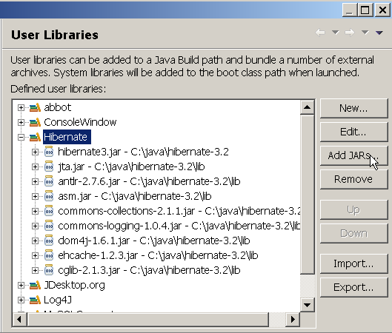
Create a Hibernate Library in Eclipse
1. Project -> Properties -> Java Build Path
2. select Libraries tab.
3. Click "Add Library..." and select "User Library", Next>
4. Create a new user library named "Hibernate"
5. Add Jar files
Pragati Software Pvt Ltd.

Slide 13
Add Library or jar for Database Driver
For Embedded Derby Database
/path-to-derby/lib/derby.jar
For HSQLDB
/path-to-hsqldb/lib/hsqldb.jar
Pragati Software Pvt Ltd.

Slide 14
hibernate.cfg.xml for Embedded Derby DB
<?xml version='1.0' encoding='utf-8'?>
<!DOCTYPE hibernate-configuration PUBLIC
"-//Hibernate/Hibernate Configuration DTD 3.0//EN"
"http://hibernate.sourceforge.net/hibernate-
configuration-3.0.dtd">
<hibernate-configuration>
<session-factory>
<property name="dialect">
org.hibernate.dialect.DerbyDialect</property>
<property name="connection.driver_class">
org.apache.derby.jdbc.EmbeddedDriver</property>
<property name="connection.url">
jdbc:derby:/temp/eventmgr;create=true</property>
<property name="hbm2ddl.auto">create</property>
<!-- O-R mappings for persistent classes -->
<mapping resource="eventmgr/domain/Location.hbm.xml"/>
</session-factory>
</hibernate-configuration>
Pragati Software Pvt Ltd.
Remove after database created

Slide 15
hibernate.cfg.xml for MySQL
<?xml version='1.0' encoding='utf-8'?>
<!DOCTYPE hibernate-configuration PUBLIC ... remainder omitted >
<hibernate-configuration>
<session-factory>
<property name="dialect">
org.hibernate.dialect.MySQLDialect </property>
<property name="connection.driver_class">
com.mysql.jdbc.Driver </property>
<property name="connection.username">student</property>
<property name="connection.password">secret </property>
<property name="connection.url">
jdbc:mysql://se.cpe.ku.ac.th/eventmgr </property>
<!-- Object-Relational mappings for classes -->
<mapping resource="eventmgr/domain/Location.hbm.xml"/>
... other mappings omitted
</session-factory>
</hibernate-configuration>
Pragati Software Pvt Ltd.

Slide 16
XML Syntax, 1
XML Declaration: "this file contains XML"
<?xml version='1.0' encoding='utf-8'?>
Root Element: "this whole file is a hibernate-configuration"
<hibernate-configuration>
content of document goes here
<hibernate-configuration>
Child Elements: define content, have a tree-like nested structure
<session-factory>
...
</session-factory>
Tree structure & Scope: all elements must have a closing tag
<class name="Event" table="EVENTS"> a start element
<property name="location" /> element start & end
</class> an end tag
XML is case sensitive
Pragati Software Pvt Ltd.

Slide 17
XML Syntax, 2
Attributes: values must always be quotes, no duplicates
<class name="Event" table="EVENTS">
Special characters: < > & ' " must use reference except in CDATA
<message>
&quot;Hello &lt;b&gt;world&lt;/b&gt;&quot
</message>
Child Elements can be repeated (depends on DTD)
<courselist name="courses">
<course>object oriented programming</course>
<course>software spec &amp; design</course>
</courselist>
Elements can sometimes be written as attributes
<course>
<id>219341</id> <course id="219341"/>
</course>
Pragati Software Pvt Ltd.

Slide 18
Logging
Hibernate apps will log errors and/or activity.
Two choices:
  Java SDK logging (since JDK 1.4)
  Log4j
  if you use Log4j, create a log4j.properties in your application source root directory.
  Copy this file from the Hibernate etc/ directory.
Pragati Software Pvt Ltd.

Slide 19
Sample log4j.properties
Too long to print here
See an actual file, for example:
[hibernate.dir]/doc/tutorial/src/log4j.properties
Configuration logging of Hibernate:
log4j.logger.org.hibernate=warn
Log the SQL generated by Hibernate:
#log4j.logger.org.hibernate.SQL=debug
Log JDBC bind parameters (can be security leak):
log4j.logger.org.hibernate.type=info
Pragati Software Pvt Ltd.

Slide 20
Exercise 2
Define a Location class and LOCATIONS table
Write the class
Create a mapping file for Location: Location.hbm.xml
Pragati Software Pvt Ltd.

Slide 21
Create the Location class
Location class
Location
id: int
name: String
address: String
LOCATIONS table (Hibernate can auto-generate this)
LOCATIONS
PK id INTEGER
name VARCHAR(80)
address VARCHAR(160)
Pragati Software Pvt Ltd.

Slide 22
Write the Location class
package eventmgr.domain;
public class Location {
private int id;
private String name;
private String address;
public Location() { } // a no argument constructor
public int getId( ) { return id; }
public void setId( int id ) { this.id = id; }
public String getName( ) { return name; }
public void setName( String n ) { this.name = n; }
public String getAddress( ) { return address; }
public void setAddress( String a ) { address = a; }
}
Use JavaBean conventions in Persistent object classes.
Pragati Software Pvt Ltd.

Slide 23
Hibernate can access private methods
package eventmgr.domain;
public class Location {
private int id;
private String name;
private String address;
public Location() { }
public int getId( ) { return id; }
private void setId( int id ) { this.id = id; }
public String getName( ) { return name; }
private void setName( String n ) { this.name = n; }
public String getAddress( ) { return address; }
private void setAddress( String a ) { address = a; }
}
OK to use "private" or "protected" for mutators.
Pragati Software Pvt Ltd.

Slide 24
Hibernate can access private data, too
public class Location {
private int id;
private String name;
private void setName( String name ) {
if ( name.length() < 3 )
new RuntimeException("name too short");
...
}
Some mutator methods contain data validity checks or other complicated logic.
to tell Hibernate to set the field values directly (don't use the "set" method) in the class mapping file write:
<hibernate-mapping default-access="field">
...
Pragati Software Pvt Ltd.

Slide 25
Schema to create Locations table
This works for MySQL.
Hibernate can generate table schema at runtime.
CREATE TABLE locations (
id INTEGER NOT NULL,
name VARCHAR(80) NOT NULL,
address VARCHAR(160),
PRIMARY KEY(id)
) DEFAULT CHARSET=utf8 ;
mysql> use eventmgr ;
mysql> source tableschema.sql ;
Pragati Software Pvt Ltd.

Slide 26
O-R Mapping for the Location class
Map between object attributes and table columns.
Location
id: int
name: String
address: String
O-R Mapping requires a mapping file
LOCATIONS
PK id INTEGER
name VARCHAR(80)
address VARCHAR(160)
Pragati Software Pvt Ltd.

Slide 27
Mapping File Location.hbm.xml
An XML file describing how to map object to table.
Filename: Location.hbm.xml
<!DOCTYPE hibernate-mapping PUBLIC ... remainder omitted >
<hibernate-mapping package="eventmgr.domain">
<class name="Location" table="LOCATIONS">
<id name="id" column="id">
<!-- let hibernate choose id for new entities -->
<generator class="native"/>
</id>
<property name="name" column="name" not-null="true"/>
<property name="address"/>
</class>
</hibernate-mapping>
Pragati Software Pvt Ltd.

Slide 28
Mapping File Explained
root element of a hibernate mapping
<hibernate-mapping>
<class name="eventmgr.domain.Location"
table="LOCATIONS"
options... >
<id name="id"
column="id"
unsaved-value="0">
<generator class="native"/>
</id>
object attribute mappings
</class>
</hibernate-mapping>
mapping for one class
Every persistent class needs an "identifier" attribute and column.
The identifier is used to establish object identity (obj1 == obj2) and locate the table row for a persisted object. The id is usually the Primary Key of the table.
Pragati Software Pvt Ltd.

Slide 29
Attribute Mapping: <property .../>
Name of the attribute in Java class
Column name in the database table
<property name="name"
column="name“
type=“name“
not-null="true“
/>
Hibernate or Java data type (usually you can omit it)
Constraints
You omit elements if Hibernate can guess the value itself:
<property name="address" column="ADDRESS" type="string"/>
<!-- omit data type and Hibernate will determine it -->
<property name="address" column="ADDRESS"/>
<!-- omit column if same as attribute (ignoring case)-->
<property name="address"/>
Pragati Software Pvt Ltd.

Slide 30
What you have so far
Project configured for Hibernate
Hibernate configuration file
Location class and mapping file Location.hbm.xml
Configure a database schema
(for learning, we will auto-generate schema)
Pragati Software Pvt Ltd.

Slide 31
HibernateUtil: a Session Factory (1)
// always use the same sessionFactory (Singleton)
SessionFactory sessionFactory = new Configuration()
.configure().buildSessionFactory();
// use sessionFactory to get a Session
Session session = sessionFactory.openSession();
// or the more convenient:
Session session = sessionFactory.getCurrentSession();
HibernateUtil
-sessionFactory: SessionFactory
+getSessionFactory( ): SessionFactory
+getCurrentSession( ): Session
+openSession( ): Session
1
Pragati Software Pvt Ltd.

Slide 32
HibernateUtil: a Session Factory (2)
public class HibernateUtil {
private static SessionFactory sessionFactory = null;
private static final Logger log = Logger.getLogger(..);
public static SessionFactory getSessionFactory() {
if ( sessionFactory == null ) {
try { // Create the SessionFactory
sessionFactory = new Configuration() .configure().buildSessionFactory();
} catch (Exception e) {
System.err.println("sessionFactory error "+ ex);
log.error("SessionFactory creation failed", ex);
//throw new ExceptionInInitializerError(ex);
}
}
return sessionFactory;
Pragati Software Pvt Ltd.

Slide 33
HibernateUtil: a Session Factory (3)
/**
* Get the current Hibernate session.
* This creates a new session if no current session.
* @return the current Hibernate Session
*/
public static Session getCurrentSession() {
return getSessionFactory().getCurrentSession();
}
public static Session openSession() {
return getSessionFactory().openSession();
}
Pragati Software Pvt Ltd.

Slide 34
Persistence Test: LocationTest.java
public class TestLocation {
public static void testSave() {
Location loc1 = new Location( );
loc1.setName("Kasetsart University");
loc1.setAddress("90 Pahonyotin Rd, Bangkok");
Location loc2 = new Location();
loc2.setName("UCLA");
loc2.setAddress("Westwood, California");
Session session =
HibernateUtil.getCurrentSession();
Transaction tx = session.beginTransaction();
session.saveOrUpdate( loc1 );
session.saveOrUpdate( loc2 );
tx.commit();
System.out.println("Locations saved");
}
Pragati Software Pvt Ltd.

Slide 35
Persistence Test: LocationTest.java
public static void testQuery() {
System.out.println("Retrieving locations");
Session session = HibernateUtil.getCurrentSession();
Transaction tx = session.beginTransaction();
Query query = session.createQuery("from Location");
// query.list() returns objects, cast to List<Location>
List<Location> list = (List<Location>)query.list( );
tx.commit();
for(Location l : list ) out.printf("%d %s %s\n",
l.getId(), l.getName(), l.getAddress() );
if ( session.isOpen() ) session.close();
}
public static void main( String [] args) {
testSave( ); testQuery( );
Pragati Software Pvt Ltd.

Slide 36
Exercise 3
Test object uniqueness:
  In one session get the same location two times and compare using (ku1 == ku2). Are they same?
  In different sessions get the same location and compare (ku1 == ku2). Are they same?
Test transparent persistence:
  Modify a location inside a session. Does database change?
  Reattach a modified object to new session. Does database change?
Pragati Software Pvt Ltd.

Slide 37
Getting a Unique Result
Session session = HibernateUtil.getCurrentSession();
Query query = session.createQuery(
"from Location where name=‘Kasetsart University’");
// query.uniqueResult() returns only first match
Location ku1 = (Location) query.uniqueResult( );
Pattern matches "like" - use "%" as wildcard character
Session session = HibernateUtil.getCurrentSession();
Query query = session.createQuery(
"from Location l where l.name like 'Kasetsart%'");
// query.uniqueResult() returns only first match
Location ku1 = (Location) query.uniqueResult( );
Pragati Software Pvt Ltd.

Slide 38
Mapping a Class with Associations
Event
id: long
name: String
startDate: Date
location: Location
Location
id: int
name: String
address: String
*
1
Simplified version of Event class.
Pragati Software Pvt Ltd.

Slide 39
O-R Mapping of n-to-1 Associations
Event
id: long
name: String
startDate: Date
location: Location
Location
id: int
name: String
address: String
*
1
The Data Mapper converts a n-to-1 association to a foreign key relation (persist) or foreign key to object (retrieve).
EVENTS
PK id BIGINT
name VARCHAR
start_date TIMESTAMP
FK location_id INTEGER
LOCATIONS
PK id INTEGER
name VARCHAR
address VARCHAR
Pragati Software Pvt Ltd.

Slide 40
Mapping for Event (Event.hbm.xml)
Use <many-to-one name="attribute" ... />
to map a reference to another object.
<!DOCTYPE hibernate-mapping PUBLIC ... remainder omitted >
<hibernate-mapping package="eventmgr.domain">
<class name="Event" table="EVENTS">
...
<property name="startDate" column="start_date"
type="timestamp" />
<many-to-one name="location" column="location_id"
class="Location" />
</class>
</hibernate-mapping>
you can omit class (Hibernate can determine itself)
Pragati Software Pvt Ltd.

Slide 41
Test: Save an Event
public static void testSave() {
Location loc1 = new Location( );
loc1.setName("Kasetsart University");
loc1.setAddress("90 Pahonyotin Rd, Bangkok");
Event event = new Event( );
event.setName("Java Days");
event.setLocation( loc1 );
event.setStartDate( new Date(108,Calendar.JULY, 1) );
Session session = HibernateUtil.getCurrentSession();
Transaction tx = session.beginTransaction();
session.saveOrUpdate( event );
tx.commit();
System.out.println("Event saved");
}
Pragati Software Pvt Ltd.

Slide 42
Did you get an Error?
The Location doesn't exist in database (transient object).
Exception in thread "main“
org.hibernate.TransientObjectException:
object references an unsaved transient instance - save the transient instance before flushing: eventmgr.domain.Location
Pragati Software Pvt Ltd.

Slide 43
Persisting the Event location
Solutions:
1. save location during the transaction (manual save)
2. tell Hibernate to cascade the save operation (automatically save Location)
<many-to-one name="location" column="location_id"
class="Location"
cascade="save-update" />
cascade="none" don't cascade operations
"all" cascade all operations (be careful)
"save-update" cascade save and updates
"delete-orphan" cascade all, delete unreferenced orphan children
Pragati Software Pvt Ltd.

Slide 44
Test: Retrieve an Event
public static void testRetrieve() {
System.out.println("Retrieving event");
Session session = HibernateUtil.getCurrentSession();
Transaction tx = session.beginTransaction();
Query query = session.createQuery(
"from Event e where e.name= :name");
query.setParameter("name", "Java Days");
// query.list() returns objects, cast to List<Location>
List<Event> list = (List<Event>)query.list( );
tx.commit();
for(Event e : list ) out.printf("%d %s %s\n",
e.getId(), e.getName(), e.getLocation().getName() );
}
Pragati Software Pvt Ltd.

Slide 45
Lazy Instances and Proxies
Transaction tx = session.beginTransaction();
Query query = session.createQuery(
"from Event e where e.name=:name");
query.setParameter("name", "Java Days");
List<Event> list = (List<Event>)query.list( );
tx.commit();
for(Event e : list ) out.printf("%d %s %s\n",
e.getId(), e.getName(), e.getLocation().getName() );
Error: LazyInstantiationException
Hibernate uses lazy instantiation and proxy objects
Hibernate instantiates the location object when it is first accessed
We closed the transaction before accessing the location
Pragati Software Pvt Ltd.

Slide 46
Two Solutions
Modify our code: getLocation( ) before closing the session.
Tell Hibernate not to use lazy instantiation of Location objects (in Location.hbm.xml)
List<Event> list = (List<Event>)query.list( );
for(Event e : list ) out.printf("%d %s %s\n",
e.getId(), e.getName(), e.getLocation().getName() );
tx.commit( );
<class name="Location" table="LOCATIONS" lazy="false">
...
</class>
Pragati Software Pvt Ltd.

Slide 47
Creating a Component for Address
Location
id: int
name: String
address: Address
Address
street: String
city: String
province: String
*
1
LOCATIONS
id name address
101 Kasetsart University street city province
102 Seacon Square
Pragati Software Pvt Ltd.

Slide 48
Organizing your Work
Use DAO to separate OR behavior from the rest of your project.
Pragati Software Pvt Ltd.

Slide 49
A DAO for the Location class
The "useful" methods depend on the domain class and the application.
LocationDao
findById(id: int) : Location
findByName(name : String): Location[*]
find(query: String) : Location[*]
save(loc: Location) : boolean
delete(loc: Location) : boolean
Pragati Software Pvt Ltd.

Slide 50
Java code for Simple LocationDao
package eventmgr.dao;
import ...;
public class SimpleLocationDao {
private static final Logger logger =
Logger.getLogger(LocationDao.class);
public LocationDao() { }
public Location findById( int id )
public List<Location> findByName( String name )
public List<Location> find( String query )
public boolean save( Location loc )
public boolean delete( Location loc )
}
Pragati Software Pvt Ltd.

Slide 51
The core of findById( ) - use "load"
public Location findById( int id ) {
Location result = null;
Session session = null;
Transaction tx = null;
try {
session = HibernateUtil.getCurrentSession();
tx = session.beginTransaction();
result =
(Location)session.load(Location.class, id);
tx.commit();
session.close( );
} catch ...
}
return result;
}
Pragati Software Pvt Ltd.

Slide 52
The details of findById( )
public Location findById( int id ) {
Location result = null;
Session session = null;
Transaction tx = null;
try {
session = HibernateUtil.getCurrentSession();
tx = session.beginTransaction();
result = (Location)session.load(Location.class,id);
tx.commit();
} catch (ObjectNotFoundException e) {
logger.info("Object not found. id = "+id, e);
if ( tx != null && ! tx.wasCommitted() ) tx.rollback();
} catch (HibernateException e) {
logger.error("Hibernate exception", e);
if ( tx != null && ! tx.wasCommitted() ) tx.rollback();
} finally {
if ( session != null && session.isOpen() ) session.close();
}
return result;
}
Pragati Software Pvt Ltd.

Slide 53
The core of findByName( ) - "query"
public List<Location> findByName( String name ) {
List<Location> result;
...
try {
session = HibernateUtil.getCurrentSession();
tx = session.beginTransaction();
Query query = session.createQuery(
"from Location where name=:name" );
query.setParameter( "name", name );
result = (List<Location>) query.list( );
tx.commit();
session.close( );
} catch ...
return result;
}
Pragati Software Pvt Ltd.

Slide 54
Details of findByName( )
Exercise
Pragati Software Pvt Ltd.

Slide 55
The core of save( ) - "saveOrUpdate"
public boolean save( Location location ) {
boolean result = false;
...
try {
session = HibernateUtil.getCurrentSession();
tx = session.beginTransaction();
session.saveOrUpdate( location );
tx.commit();
session.close( );
result = true;
} catch ...
return result;
}
Pragati Software Pvt Ltd.

Slide 56
Details of save
Exercise
Pragati Software Pvt Ltd.

Slide 57
The core of delete( ) - "delete"
public boolean delete( Location location ) {
boolean result = false;
...
try {
session = HibernateUtil.getCurrentSession();
tx = session.beginTransaction();
session.delete( location ); tx.commit();
session.close( );
result = true;
} catch ...
return result;
}
Pragati Software Pvt Ltd.

Slide 58
Redundant Code
Every DAO method has the same boilerplate code:
Session session = null;
Transaction tx = null;
try {
session = HibernateUtil.getCurrentSession();
tx = session.beginTransaction();
do the work here
tx.commit();
} catch (ObjectNotFoundException e) {
logger.info("Object not found. "+id, e);
if ( tx != null && ! tx.wasCommitted() ) tx.rollback();
} catch (HibernateException e) {
logger.error("Hibernate exception", e);
if ( tx != null && ! tx.wasCommitted() ) tx.rollback();
} finally {
if ( session != null && session.isOpen() ) session.close();
}
Pragati Software Pvt Ltd.

Slide 59
Factor out Redundant Code
Class SimpleLocationDao {
private Session session; // declare as attributes
private Transaction tx;
public Location findById( int id ) {
try {
beginTransaction( );
do the work here
commitTransaction( );
} catch (ObjectNotFoundException e) {
handleError( e );
} catch (HibernateException e) {
handleError( e );
} finally {
if ( session != null && session.isOpen() )
session.close();
}
Pragati Software Pvt Ltd.

Slide 60
Duplicate Code Between DAO
In every DAO, the CRUD methods are almost the same
Consider save( ) ...
public boolean save( Location location ) {
boolean result = false;
...
try {
beginTransaction( );
session.saveOrUpdate( location );
commitTransaction( );
} catch ( ... ) {
handleException( e );
} finally { ... }
return result;
}
Pragati Software Pvt Ltd.

Slide 61
Apply the Layer Superclass Pattern
AbstractDao
#load( class, id ) : Object
#find( class, query ) : List
#saveOrUpdate( object: Object )
#delete( object: Object )
LocationDao
EventDao
SpeakerDao
Pragati Software Pvt Ltd.

Slide 62
AbstractDao.save
protected Object save( Object obj ) {
Object result = null;
try {
beginTransaction();
result = session.saveOrUpdate( obj );
commitTransaction();
} catch (ObjectNotFoundException e) {
handleError( e );
} catch (HibernateException e) {
handleError( e );
} finally {
  closeSession( );
}
return result;
}
Pragati Software Pvt Ltd.

Slide 63
LocationDao using Layer Superclass
public class LocationDao extends AbstractDao {
public boolean save( Location location ) {
return super.save( location );
}
Pragati Software Pvt Ltd.

Slide 64
AbstractDao.load
protected Object load( Class clazz,
Serializable id ) {
Object result = null;
try {
beginTransaction();
result = session.load( clazz, id);
commitTransaction()
} catch (ObjectNotFoundException e) {
handleError( e );
} catch (HibernateException e) {
handleError( e );
} finally {
  closeSession( );
}
return result;
}
Pragati Software Pvt Ltd.

Slide 65
LocationDao using Layer Superclass
public class LocationDao extends AbstractDao {
public LocationDao( ) { super( ); }
public Location findById( int id ) {
return (Location) super.load(
Location.class, id );
}
Pragati Software Pvt Ltd.

Slide 66
Exercise
use your SimpleLocationDao to write a layer superclass named AbstractDao.
write a LocationDao that extends AbstractDao
Pragati Software Pvt Ltd.

Slide 67
Hibernate Query Language (HQL)
Query query = session.createQuery(
"from Event where name='Java Days'");
Query query = session.createQuery(
"select e from Event e where e.name='Java Days'");
Hibernate queries you Hibernate Query Language (HQL).
HQL is object-centric - use class and property names, not SQL table names.
Pragati Software Pvt Ltd.

Slide 68
HQL example
Problem: Find all events which are held at Kasetsart
HQL:
String query = "select e from Event e where
e.location.name = 'Kasetsart University'";
Query q = session.createQuery( query );
SQL and JDBC:
String sqlquery = "select * from EVENTS e
join LOCATIONS l ON e.location_id = l.id
where l.name = 'Kasetsart University'";
Statement stmt = connection.createStatement( sqlquery );
Pragati Software Pvt Ltd.

Slide 69
Many-to-one Associations
public class Event {
private long id;
private String name;
private Location location; // 1-to-many assoc.
private Date startDate;
private long duration;
public Event( ) { }
...
}
Pragati Software Pvt Ltd.

Slide 70
Event.hbm.xml Mapping File
<!DOCTYPE hibernate-mapping PUBLIC ... remainder omitted >
<hibernate-mapping package="eventmgr.domain">
<class name="Event" table="EVENTS">
<id name="id" column="id">
<generator class="native"/>
</id>
<property name="name" column="name" not-null="true"/>
<property name="startDate" column="start_date"
column="timestamp"/>
<property name="duraction" />
<many-to-one name="location" column="location_id"
class="Location"/>
</class>
</hibernate-mapping>
Pragati Software Pvt Ltd.

Slide 71
Cascading Save & Update
When you save an Event, should Hibernate automatically save the location, too?
no: then you must save the location yourself
Yes: specify cascade = "save-update"
<class name="Event" table="EVENTS">
<id name="id" column="id">
<generator class="native"/>
</id>
...
<many-to-one name="location" column="location_id"
class="Location"
cascade="save-update"/>
</class>
Pragati Software Pvt Ltd.
Other choices for cascade: all, none, save-update, delete

Slide 72
Learning Hibernate
Tutorial at www.hibernate.org
Another good tutorial: http://www.allapplabs.com/hibernate/hibernate_tutorials.htm
Peak & Heudecker, Hibernate Quickly, 2006.
Baur & King, Java Persistence with Hibernate, 2007, update of Hibernate in Action, and much longer.
Baur & King, Hibernate in Action, 2005, considered the best Hibernate book, by one of the Hibernate creators.
Pragati Software Pvt Ltd.

Slide 73
Hibernate Tools
Hibernate Tools Eclipse plugin - HibernateConsole and more
  Test HQL queries, browse database
Middlegen - generates class mapping files (hbm.xml) from an existing database schema. Has Eclipse plugin.
Hibernate Synchronizer - generates class mapping files (hbm.xml) and Java classes from a database schema.
hbm2ddl - creates a database schema (in SQL) from a hbm.xml file.
hbm2java - creates a Java class from a hbm.xml file.
Pragati Software Pvt Ltd.

Slide 74
JPA
Pragati Software Pvt Ltd.

Slide 75
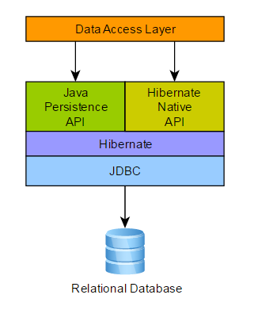
Overview of Architecture
https://docs.jboss.org/hibernate/orm/5.2/userguide
Pragati Software Pvt Ltd.

Slide 76
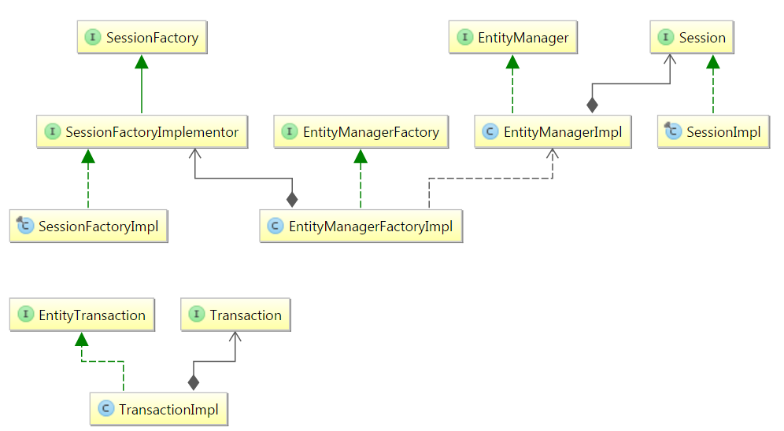
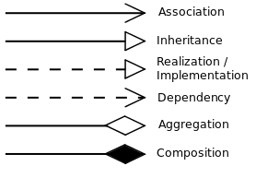
JPA & Hibernate Implementations
Pragati Software Pvt Ltd.

Slide 77
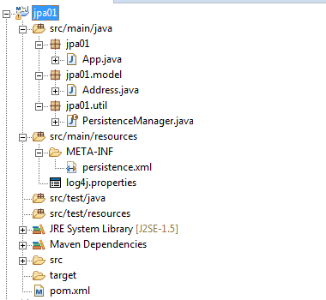
Project Configuration for JPA
Pragati Software Pvt Ltd.

Slide 78
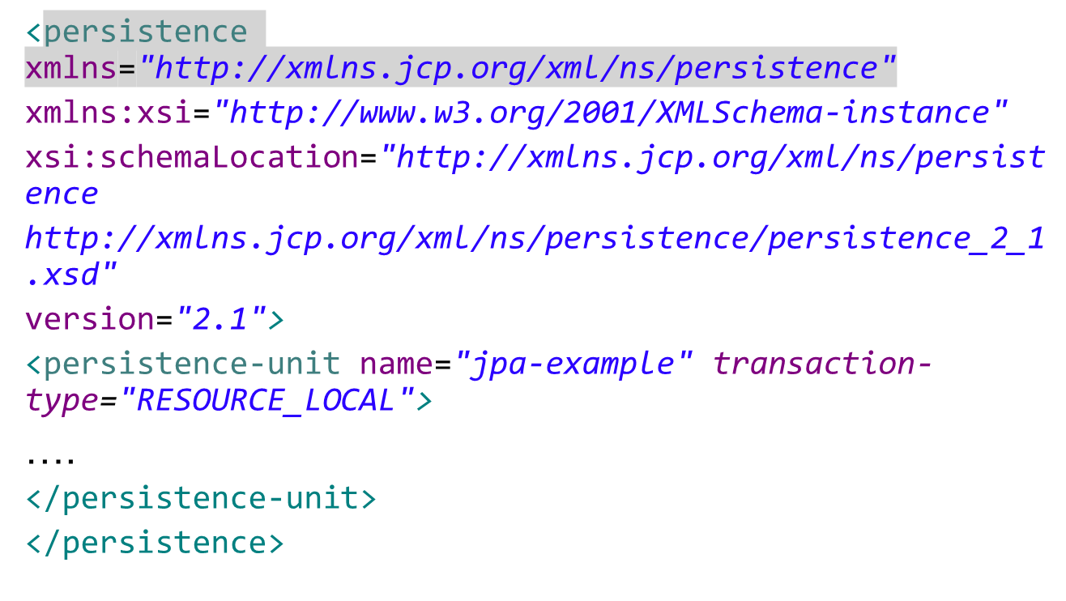
persistence.xml for MySql
Pragati Software Pvt Ltd.

Slide 79
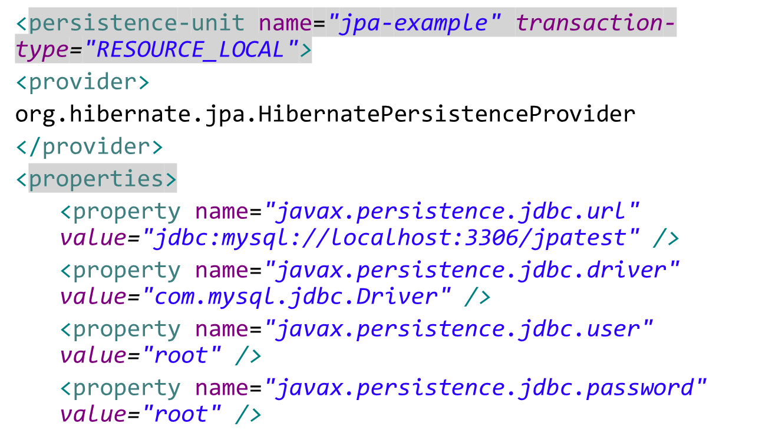
persistence-unit
Pragati Software Pvt Ltd.

Slide 80
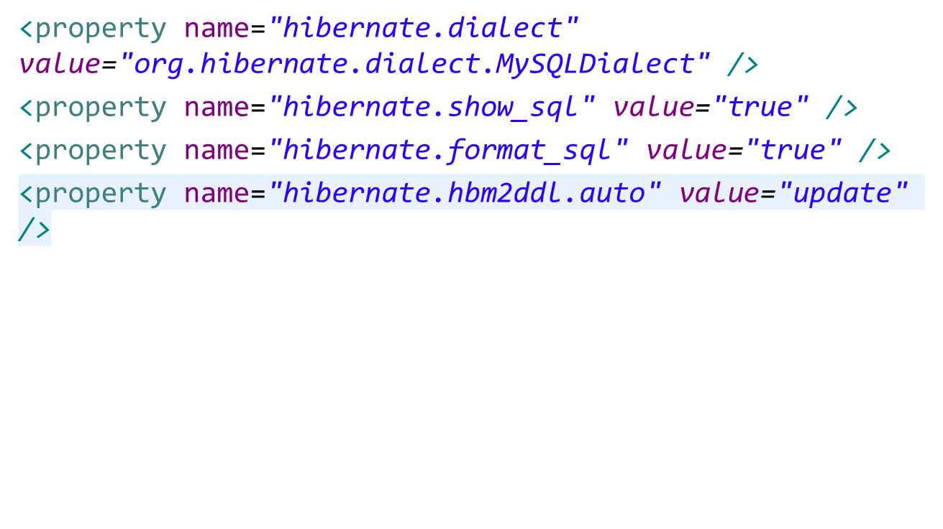
JPA 2 standard properties
Pragati Software Pvt Ltd.

Slide 81
Configuring Connection Pool
<!-- Configuring Connection Pool -->
<property name="hibernate.c3p0.min_size" value="5" />
<property name="hibernate.c3p0.max_size" value="20" />
<property name="hibernate.c3p0.timeout" value="500" />
<property name="hibernate.c3p0.max_statements" value="50" />
<property name="hibernate.c3p0.idle_test_period" value="2000" />
Pragati Software Pvt Ltd.

Slide 82
JPA 2 standard properties
javax.persistence.provider to define the provider class used
javax.persistence.transactionType to define the transaction type used (either JTA or RESOURCE_LOCAL)
javax.persistence.jtaDataSource to define the JTA datasource name in JNDI
javax.persistence.nonJtaDataSource to define the non JTA datasource name in JNDI
javax.persistence.lock.timeout pessimistic lock timeout in milliseconds (Integer or String)
Pragati Software Pvt Ltd.

Slide 83
JPA 2 standard properties
javax.persistence.query.timeout query timeout in milliseconds (Integer or String)
javax.persistence.sharedCache.mode corresponds to the share-cache-mode element
javax.persistence.validation.mode corresponds to the validation-mode element
Pragati Software Pvt Ltd.

Slide 84
JPA 2 standard properties
Persistence.createEntityManagerFactory() search classpath for any META-INF/persistence.xml files
Uses the ClassLoader.getResource("META-INF/persistence.xml")method
Pragati Software Pvt Ltd.

Slide 85
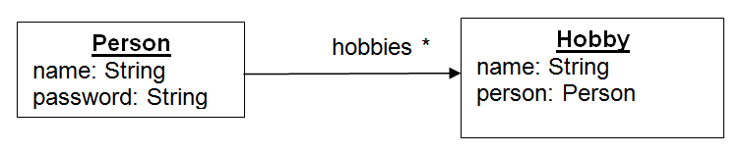
Structure Of The Application
Pragati Software Pvt Ltd.

Slide 86
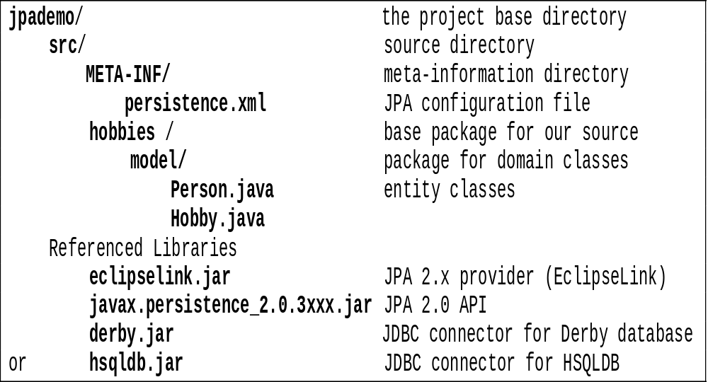
Project Structure for a JPA Project
Pragati Software Pvt Ltd.

Slide 87
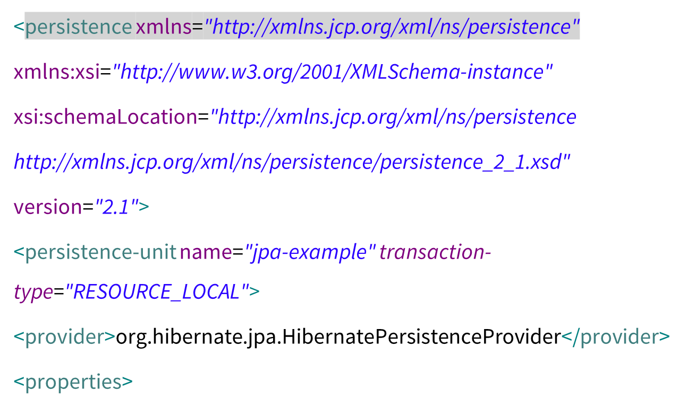
persistence.xml
Pragati Software Pvt Ltd.

Slide 88
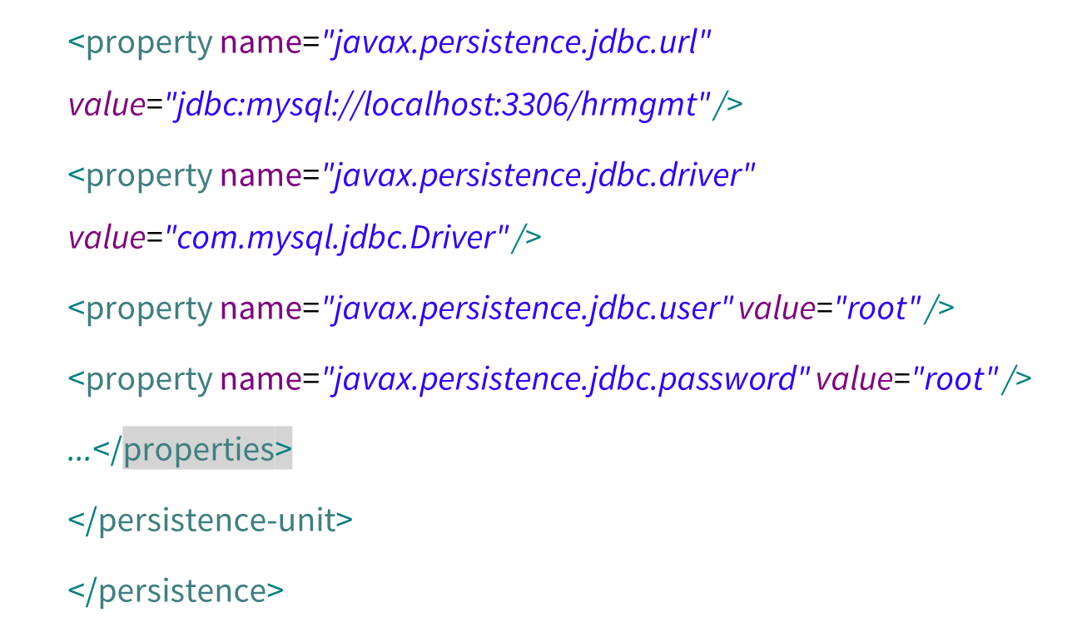
persistence.xml
Pragati Software Pvt Ltd.

Slide 89
PersistenceManager
public enum PersistenceManager {
INSTANCE;
private EntityManagerFactory emFactory;
private PersistenceManager() {
// "jpa-example" was the value of the name attribute of the
// persistence-unit element.
emFactory = Persistence.createEntityManagerFactory("jpa-example");
}
Pragati Software Pvt Ltd.

Slide 90
PersistenceManager
public EntityManager getEntityManager() {
return emFactory.createEntityManager();
}
public void close() {
emFactory.close();
}
}
Pragati Software Pvt Ltd.

Slide 91
JPA Implementation
Person ts = new Person(“Amit");
ts.addHobby( new Hobby(“Tracking") );
ts.addHobby( new Hobby(“Drawing") );
// Save Amit *and* his Hobbies to database
EntityManager em = factory.createEntityManager();
em.save( taksin );
Pragati Software Pvt Ltd.

Slide 92
Person
  @Entity
  @Table(name="people")
  public class Person {
  @Id
  @GeneratedValue(strategy = GenerationType.AUTO)
  private Integer id;
  private String name;
  private String password;
  // TODO constructors. At least a default constructor
  // TODO get/set methods for all attributes (OK to omit setId)
  // TODO toString to display person info
  // TODO equals method compares persons by id or other
  // distinct attribute
  }
Pragati Software Pvt Ltd.

Slide 93
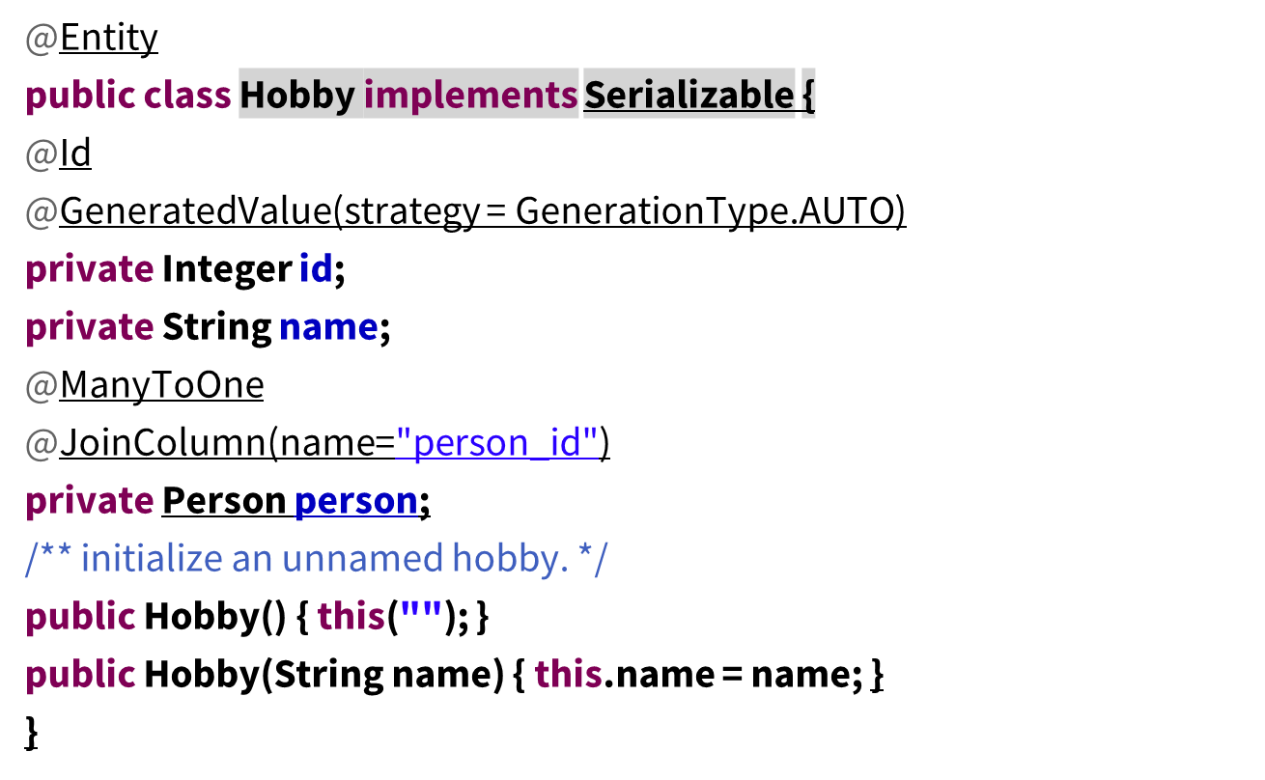
Hobby
Pragati Software Pvt Ltd.

Slide 94
Add Hobbies to Person
@OneToMany(mappedBy="person",cascade=CascadeType.ALL)
private List<Hobby> hobbies;
public List<Hobby> getHobbies() {
return hobbies;
}
public void setHobbies(List<Hobby> hobbies) {
this.hobbies = hobbies;
}
public void addHobby(Hobby hobby) {
hobby.setPerson(this);
hobbies.add(hobby);
}
Pragati Software Pvt Ltd.

Slide 95
EntityManager
EntityManagerFactory emf =
Persistence.createEntityManagerFactory(PERSISTENCE_UNIT);
EntityManager em = emf.createEntityManager();
EntityTransaction tx = em.getTransaction();
tx.begin();
em.persist( person );
tx.commit();
Pragati Software Pvt Ltd.

Slide 96
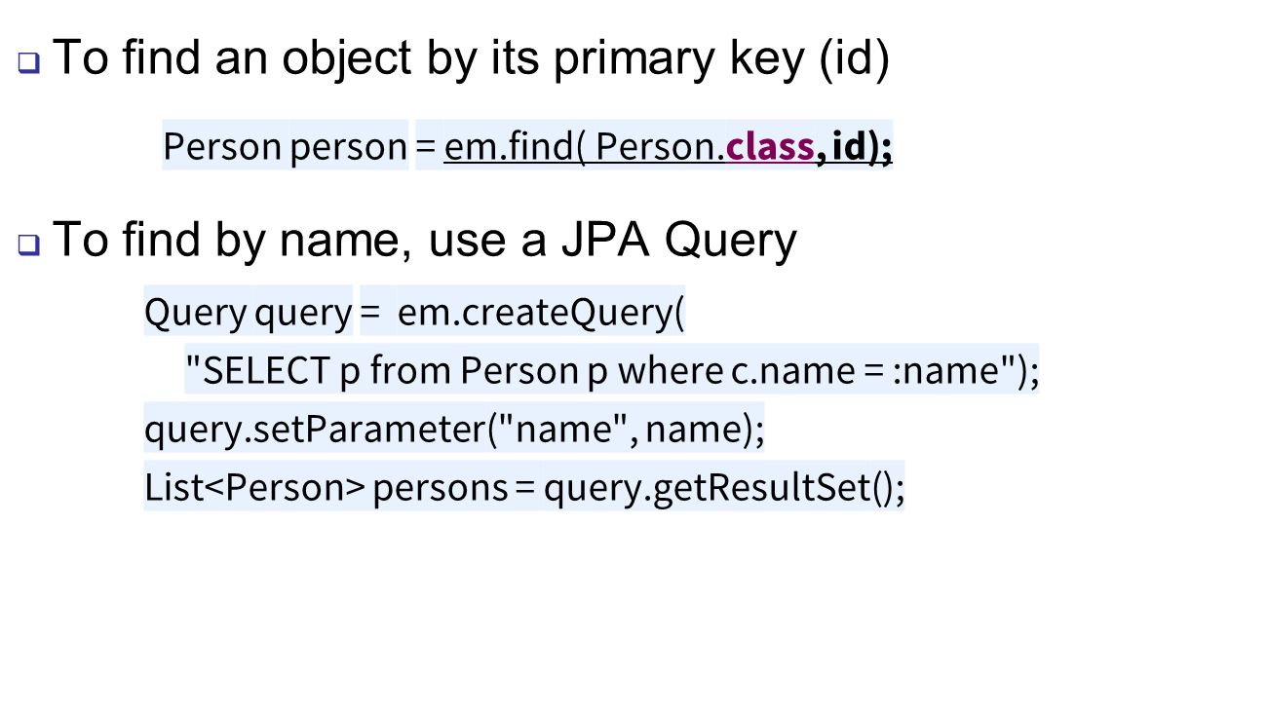
JPA Query
Pragati Software Pvt Ltd.

