Slide 1
Homeostasis
Dr. Wafa Mubarak

Slide 2
Body fluids are not static, fluids & electrolytes shift from compartment to compartment.
Why??
To maintain the body homeostasis
(Homeo: same , Stasis: state)
So homeostasis is the ability of the body to maintain a relatively stable internal environment ( i.e ECF).

Slide 3
Internal environment is the surrounding of cell. It is the interstitial fluid in which cells of the body are living .
External environment All surroundings, Physical like heat and cold, chemicals like acid and alkali biological like bacteria, viruses and others.

Slide 4
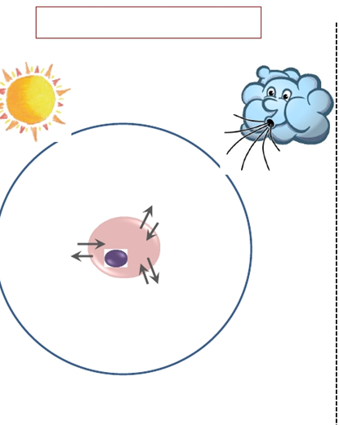
External environment
Internal environment

Slide 5
Normal cell function depends on the constancy of the internal environment
i.e.
normal volume( Water levels)
normal chemical composition
normal temperature of the tissue fluid (interstitial fluid ) .

Slide 6
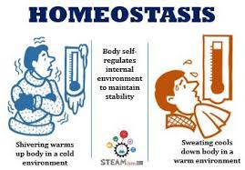

Slide 7
HOMEOSTATIC MECHANISMS
Are all the automatic reactions which take place in the body in response to changes in external and internal environments.
It tend to correct all deviations from normal.
It is a communication between neural and hormonal or local factors.

Slide 8
Neural : Reflex arc
Endocrine: direct or indirect
Local regulation: -Autocrine
-Paracrine
-Gab junction

Slide 9
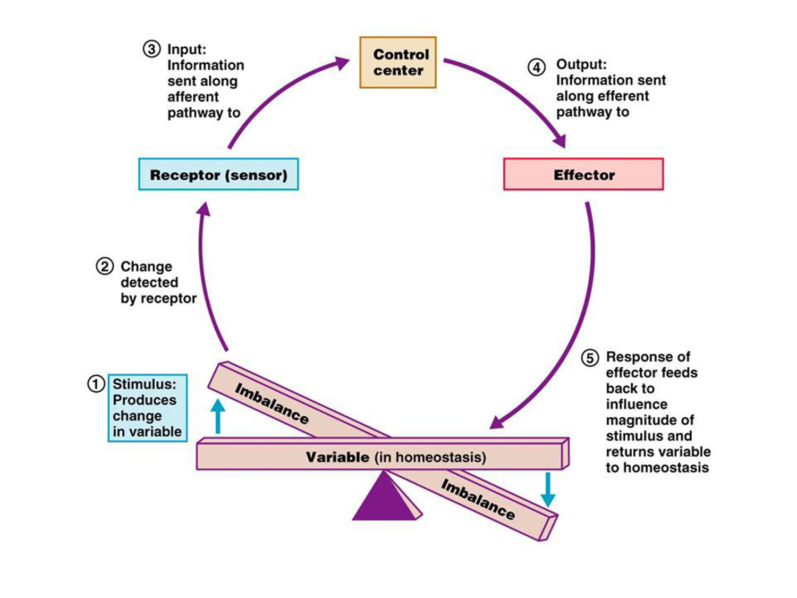
Reflex arc

Slide 10
Reflex arc is neural mechanism in homeostasis and has six(6) components
1-Stimulus
2- Receptor
3- Afferent sensory
4- CNS
5- Efferent motor or Secretory
6- Effectors

Slide 11
1-Stimulus
Any type of energy that stimulate the receptor physical energy like heat and cold ,mechanical energy like touch and pressure , chemical energy like acid and alkaline electromagnetic energy like light .
2- Receptor:
Receptors translate different types of energy, physical, chemical and other energies to electrical energy of the nervous system (Action potential).

Slide 12
3-Afferent sensory neuron
Conduct the action potential from the receptor to the central nervous system.
4-Central nervous system (CNS )
In the central nervous system: comparison between the coming information with the set point range occurs.
then correction program is formed and orders to perform the program are sent through the efferent neurons to the effectors .

Slide 13
5- Efferent motor or Secretory neurons:
Carry the correction orders in the form of action potential from CNS to the effectors.
6- Effectors:
Organs that receives the correction orders and increase or decrease activity to correct the deviation.
Feedback mechanism operation of correction is continued till the normal set point range is achieved.

Slide 14
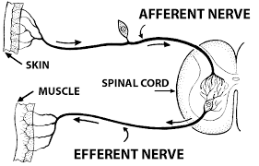

Slide 15
Endocrine system (Hormonal - slow – long duration )
Endocrine system: Ductless glands secrets chemical substance known
As hormone into the blood circulation to change the activity of distant
Cells that have receptor for the hormone.

Slide 16
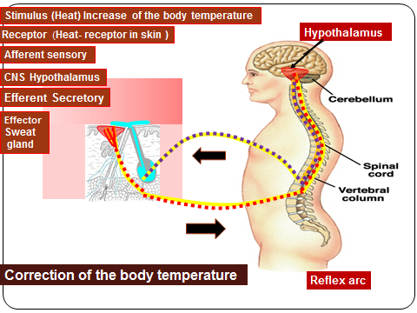

Slide 17
CONTROL MECHANISIM
Feedback mechanisms
Negative feedback
mechanisms
Positive feedback
mechanisms

Slide 18
Types of feedback mechanism
1. Negative feedback:
Effector is in opposite direction to stimulus.
It is the mechanisms that correct the deviations from the normal set point
range of the body.

Slide 19
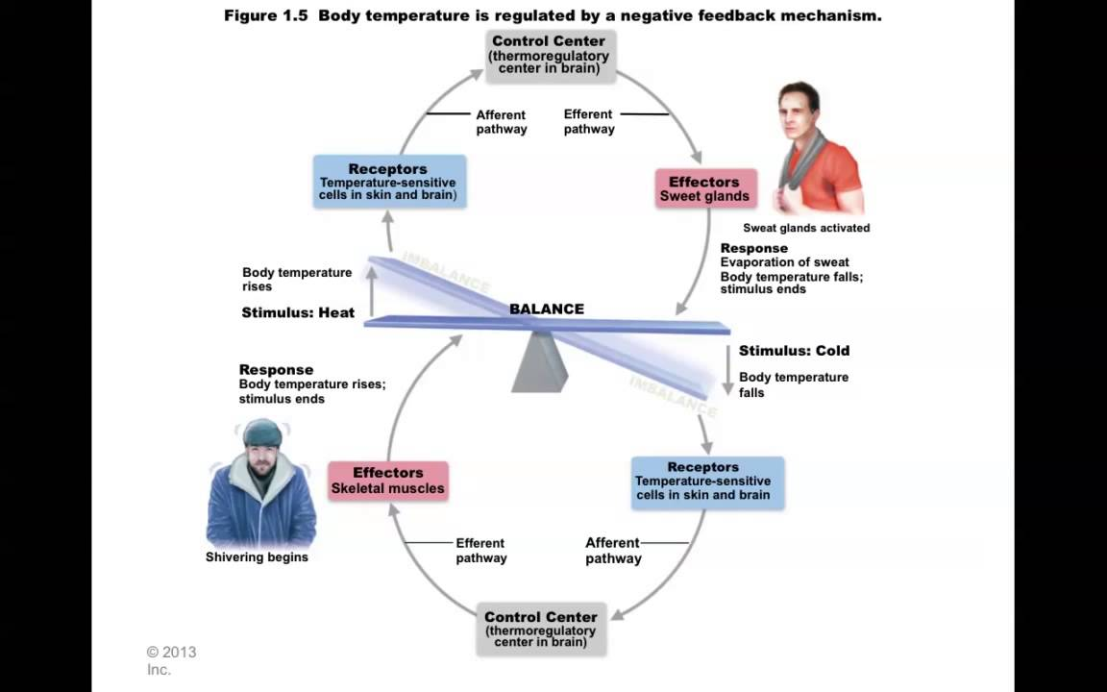

Slide 20
Normal set point range
There are normal set point range for the blood glucose level, blood pressure, electrolytes, pH and others.
The normal set point range of the arterial blood pressure for adult man is 100/60 – 140 /90 mmhg.
body temperature is 37-37.5 °C .. etc.

Slide 21
Regulations by negative feedback mechanism :
1-Regulation of body temperature
2-Regulation of arterial blood pressure
4-Regulation of respiration
5-Regulation of blood glucose level
6- Many regulations

Slide 22
2. Positive feedback:
Effector favors the same direction of the stimulus..
Example, during delivery uterine contractions increase more and more till delivery.

Slide 23
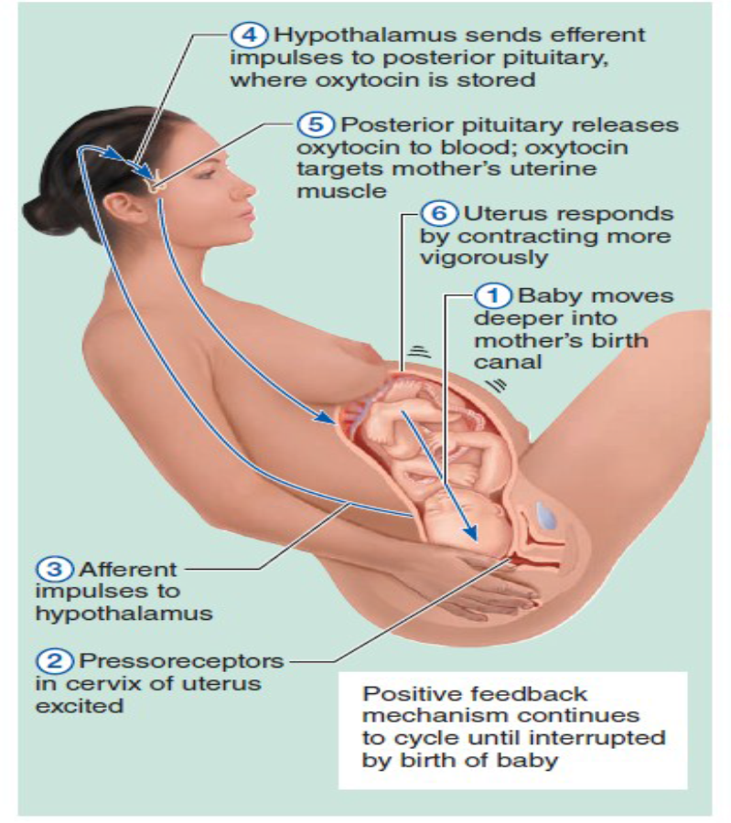

Slide 24


