Slide 1
Universal Health Coverage
By:Ibtisam Merghani Osman
MBBS, DPH, MPH, MD

Slide 2
Objectives
By the end of this session every student should be able to:
Define universal health coverage
Outline the objectives of the UHC
Outline the UHC dimensions

Slide 3
What Does UHC Means
It means, that all individuals and communities receive the health services they need without suffering financial hardship. It includes the full spectrum of essential, quality health services, from health promotion to prevention, treatment, rehabilitation, and palliative care across the life course.

Slide 4
What Does UHC Means
Ensuring equitable access for all resident in any part of the country, regardless of income level, social status, gender or religion, to affordable, appropriate , high quality and comprehensive health services( promotive, preventive, curative and rehabilitative).

Slide 5
Universal Health Coverage
Key Facts:
At least half of the worlds population don’t have full coverage of essential health services.
About 100 million people are still pushed into extreme poverty , because they have to pay to for health care.

Slide 6
Universal Health Coverage
Key Facts:
Over 800 million people ( almost 12% of the worlds population) spent at least 10% of their household budgets to pay for health care.
UHC planed to be achieved by 2030, as a part of the Sustainable Developmental Goals(SDGs).

Slide 7

SDG3 Target3.8
Achieve universal health coverage, including financial risk protection, access to quality essential health-care services and access to safe, effective, quality and affordable essential medicines and vaccines for all.

Slide 8
Objective of Universal Health Coverage
All people have access to needed services without the risk of financial hardship, by applying ruin linked to paying for health care.

Slide 9
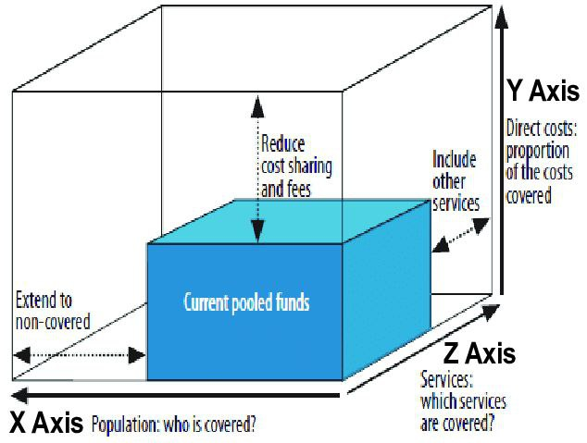
Dimensions Of Universal Health Coverage
population coverage(equity)
Service coverage
Financial risk protection

Slide 10
population coverage(equity)
Situation analysis ( uncovered population).
Determine the number of PHCs, or hospitals needed to be constructed.
The needed budget should be calculated.
Time frame.

Slide 11
Service coverage
Comprehensive ( promotive, preventive , curative and rehabilitative).
Complete the package of the services provided.
High quality patient centered- services.

Slide 12
Financial risk protection
Health insurance is a type of insurance that covers medical expenses that arise due to an illness. These expenses could be related to hospitalization costs, cost of medicines or doctor consultation fees

Slide 13

Comments

Slide 14

Thank you

