Slide 1
WHITE BLOOD CELLS
(leukocytes)

Slide 2
Characteristic of WBCs
The motile units in the blood that protect the body against invaders
A larger blood cell.
Produced in the bone marrow (Leucopoiesis)

Slide 3
Difference between WBCs And RBCs
WBCs differ from RBCs in many aspects:
1. Larger in size.
2. Irregular in shape.
3. Nucleated.
4. Many types.
5. Granules are present in some type of WBCs.
6. Lifespan is shorter.

Slide 4
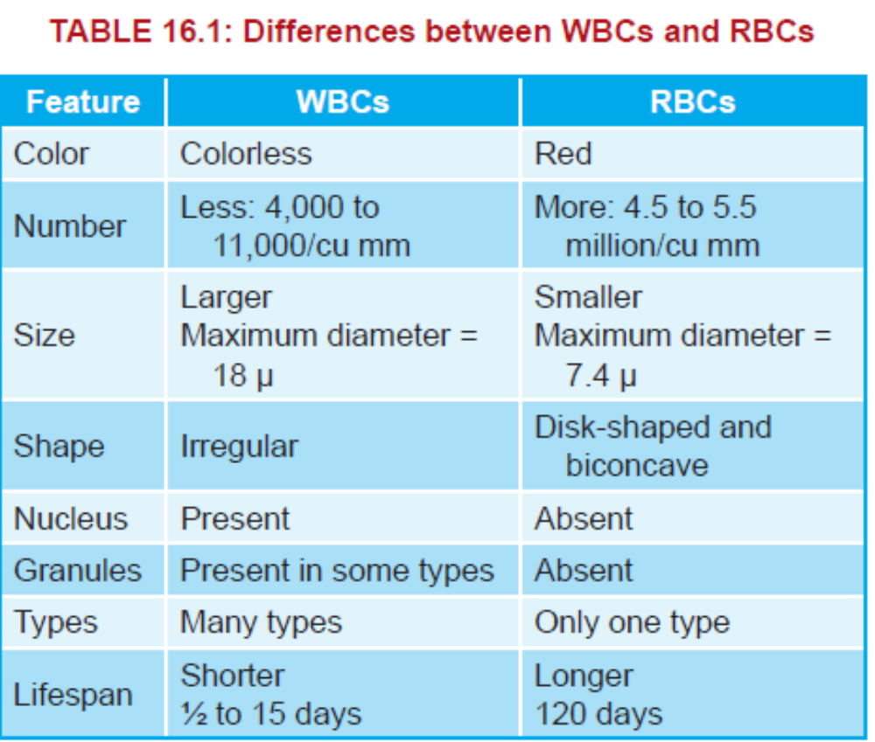

Slide 5
Normal WBCs Count
Normal count: 4000-11000/mm³
Higher count= Leukocytosis
  caused by:
  Physiologically:
  Exercise, Fever, Pregnancy
  Pathologically:
  infections, leukemia .

Slide 6
Lower count= Leucopenia
caused by
diseases of bone marrow , infection

Slide 7



Classification:
Based on the presence or absence of granules in the cytoplasm, the leukocytes are classified into two groups:
1-Granulocytes which have granules.
2- Agranulocytes which do not have
granules.

Slide 8
Granulocytes
Depending upon the staining property of granules, the granulocytes are classified into three types:
1. Neutrophils with granules taking both acidic and basic stains.
2. Eosinophils with granules taking acidic stain.
3. Basophils with granules taking basic stain.

Slide 9
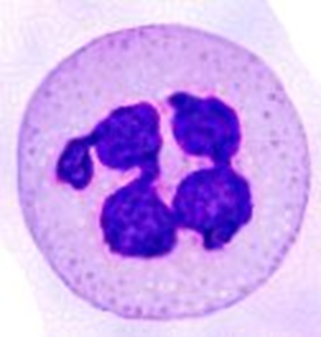
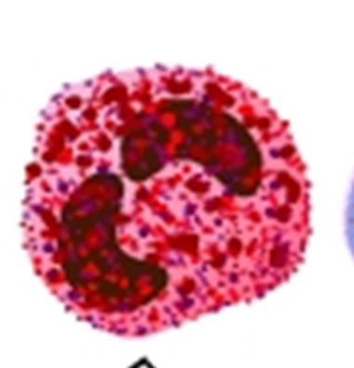
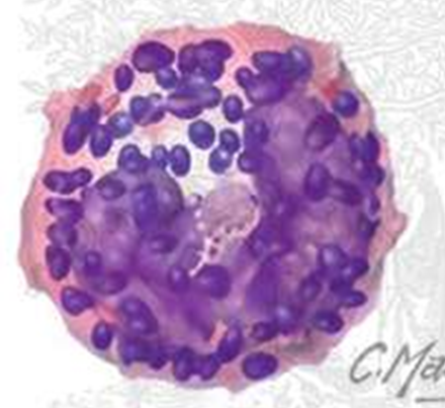
Granulocytes
Have granulated cytoplasm.
Polysegmented nucleus.
Shorter life span (Hours).

Slide 10
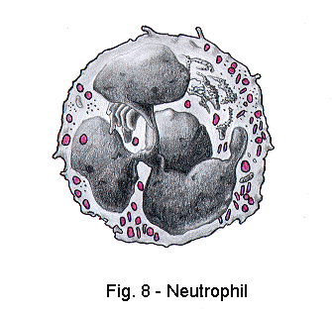
Neutrophil
Constitute 50-70% of total WBCs
Nucleus: segmented (3-5 lobes)
Cytoplasm: granulated
Granules: purple
live for 6-10 hours

Slide 11
Functions:-
phagocytosis of bacteria
Increased in:
  - Acute Bacterial infections.
  Note: Neutrophils are actively motile cells because they can move rapidly than any other cell in the body.

Slide 12
Fate of a neutrophil
Dies by:
Bacterial toxins
Enzymes released from the neutrophil itself
Dead Neutrophil + Dead Bacteria + cellular depries = PUS

Slide 13
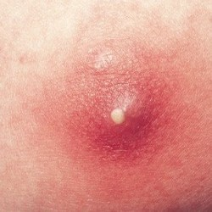
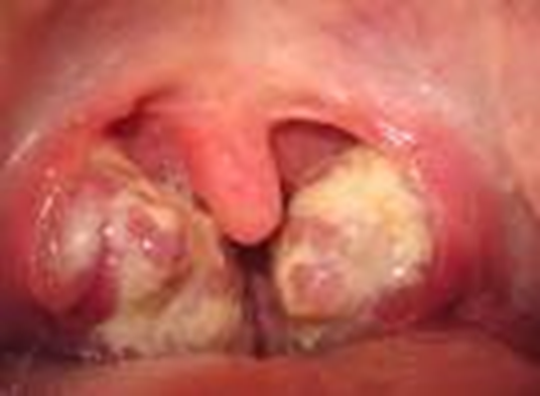
Collection of pus is called “Abscess”

Slide 14

Eosinophils
Eosinophil :
Constitute 1-4% of total WBCs
Nucleus: segmented (2-3 lobes)
Cytoplasm: granulated
Granules: - React with acidic dyes(Red)
Increase in eosinophil count (eosinophilia) is seen in:
Parasitic infections
Allergic conditions

Slide 15
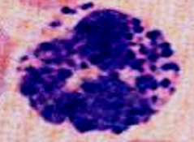
Basophils
Constitute 0-0.4% of total WBCs
Nucleus: segmented (hidden by the granules)
Large, rough and dense cytoplastmic granules that contain heparin, histamine, 5-HT
    Increased in allergic reactions
    -Half life : 12-15 days

Slide 16

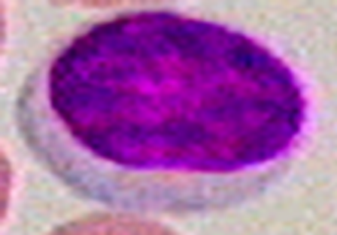
Agranulocytes
Agranulocytes have plain cytoplasm without granules.
Have one nucleus
Agranulocytes are of two types:
1. Monocytes.
2. Lymphocytes.

Slide 17
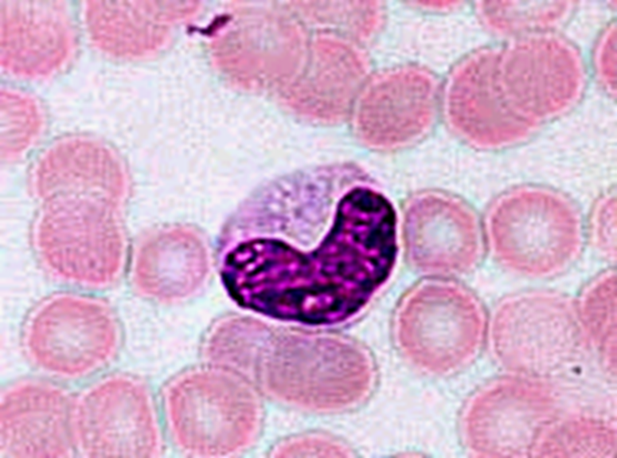
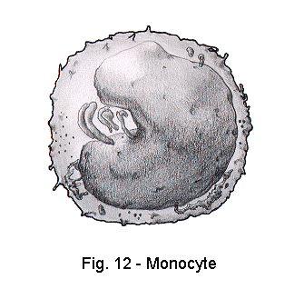
Monocytes:
Larger diameter than other types of WBCs
Constitute 2-8% of total WBCs.
Nucleus: kidney shape.
Cytoplasm: no granules.
They stay in circulation for 2-3 days, and then enter the tissues (macrophages.)

Slide 18
In the tissue:
LIVER → KUPFER CELLS
LUNG → ALVEOLAR MACROPHAGES
BRAIN → MICROGLIA
KIDNEY → MESANGIAL CELL
SKIN → LANGERHANS
BONE MARROW → OSTEOCLAST
↑ Monocytosis: Chronic bacterial infection

Slide 19
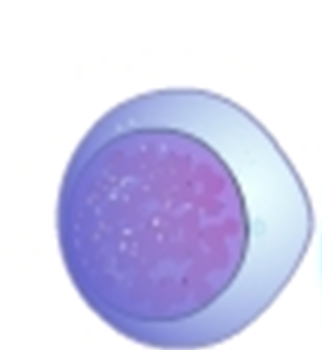

Lymphocyte
Constitute 20-40% of total WBCs
Nucleus: large, rounded
Cytoplasm : Scanty (rim), no granules
Function:
Responsible for immunity.
    T lymphocytes: cellular immunity
    B lymphocytes: humoral immunity

Slide 20
PROPERTIES OF WBCs
1. Diapedesis
Diapedesis is the process by which the leukocytes squeeze through the narrow blood vessels.
2. Amoeboid Movement
Neutrophils, monocytes and lymphocytes show amebic movement, characterized by protrusion of the cytoplasm and change in the shape.

Slide 21
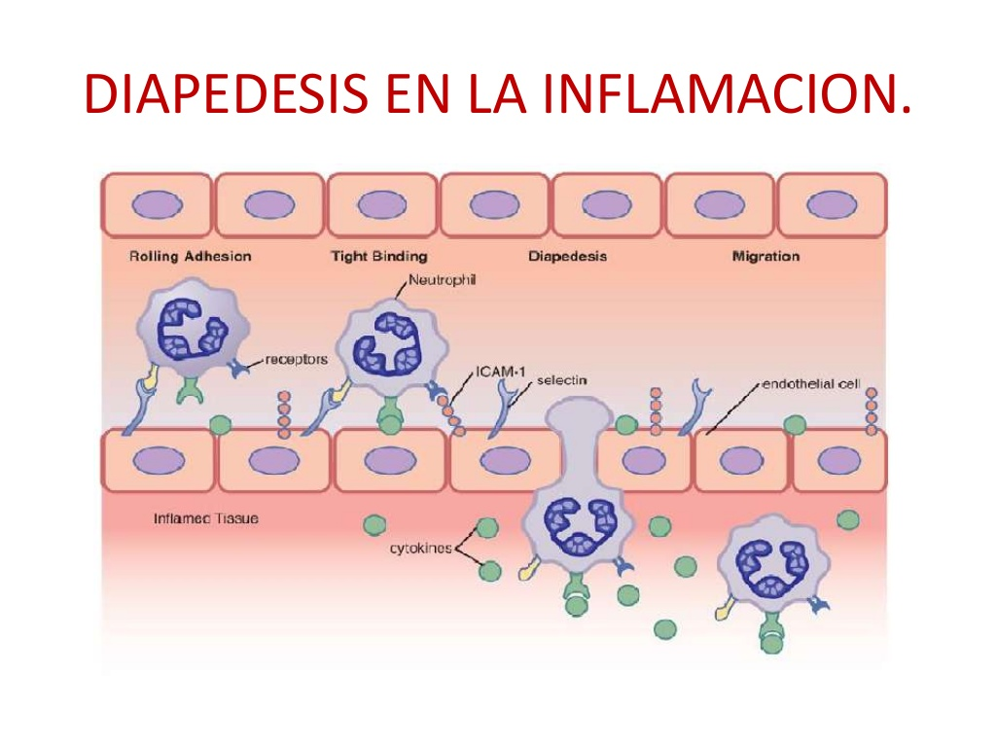

Slide 22
3-. Chemotaxis
Chemotaxis is the attraction of WBCs towards the injured tissues by the chemical substances released at the site of injury.
4. Phagocytosis
Neutrophils and monocytes engulf the foreign bodies by means of phagocytosis

Slide 23
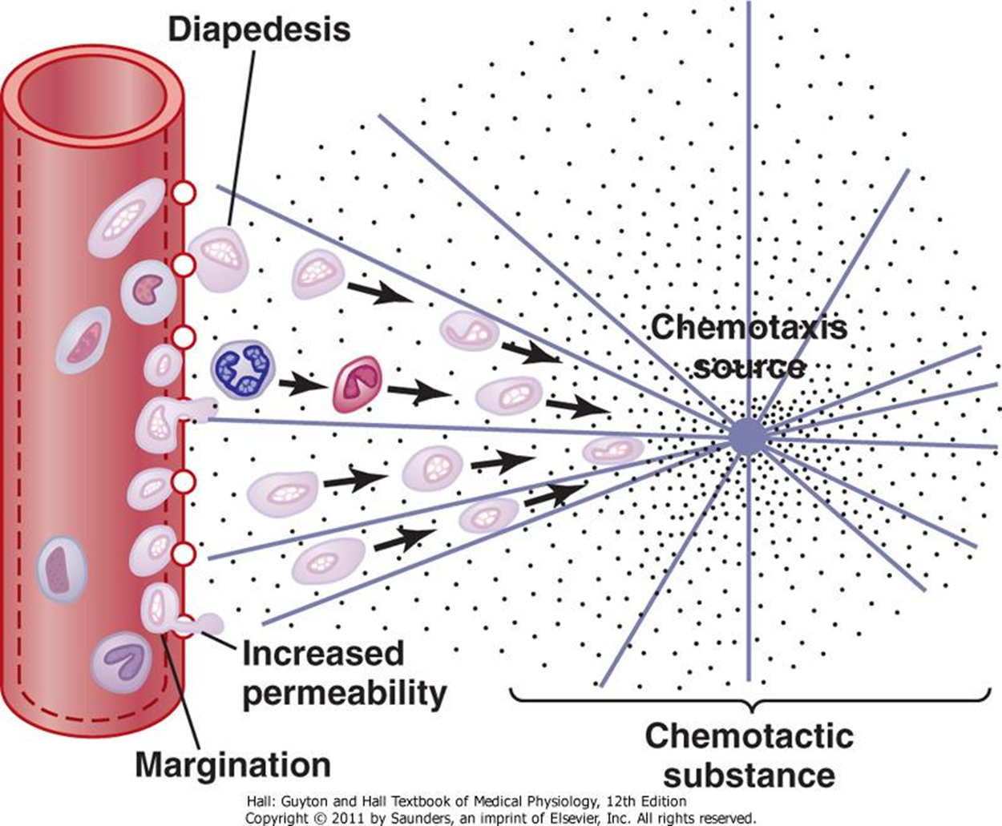

Slide 24
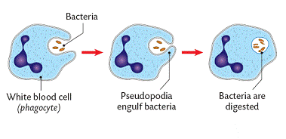
Phagocytosis

Slide 25
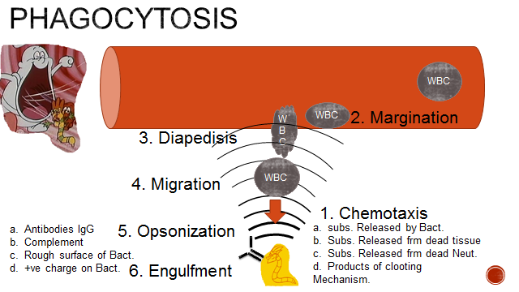

Slide 26
Steps of phagoctosis
Chemotaxis
Margination
Diapedisis
Migration
Opsonization
Engulfment
Intracellular killing and digestion

Slide 27


