Slide 1


Cardiac physiology ECG
Physioloize it to visualize it….
By: Dr. Mazin S. A. M
MBBS, Bogomolets National University….
Diploma in Research methodology and biostatistics, University of science and Technology….
Cardiology MD, Saransk city, Russian Federation….
Masters degree in human physiology, Ribat National University….
Masters degree in Molecular medicine, Khartoum University….

Slide 2
Objectives of the course!!!!
To recognize the undying need to understand and correctly interpret and ECG graphic
To recognize the value of electrophysiology and be ready to embrace it in our clinical daily lives
To recognize the most common and alarming heart rhythm disturbance from the surface ECG
To understand the basics of antidysrythmic drug use
To be able to research for the clinical needs

Slide 3
ECG. The basics: The normal ECG
The genesis of the normal electrocardiogram:-
Normal P wave
Normal QRS complex
Normal T wave
Segments and intervals calculations
The electrical axis, the normality, deviation and the calculation
The Willem Einthoven triangle
Rate
Rhythm
Axis

Slide 4
What we need to know
ECG Basics
How to Analyze a Rhythm
Normal Sinus Rhythm
Heart Dys-rythmias
Diagnosing a Myocardial Infarction

Slide 5
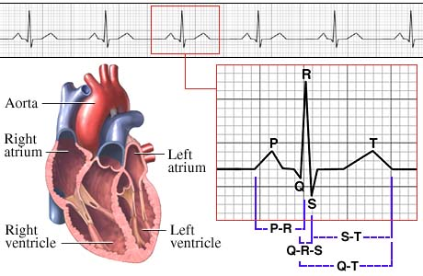
ECG my heart

Slide 6
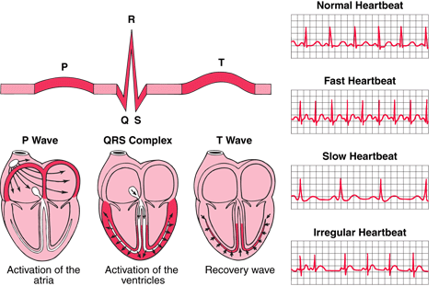
Scope of E. c. G

Slide 7
Electrophysiology
Electro-cardio-physiology (EP): is the science of elucidating, diagnosing, and treating the electrical activities of the heart
These EP studies are for:
Assess complex Dys-rythmias
Elucidate symptoms
Assess future risk of Dys-rythmias
Plan treatment

Slide 8
Main indications
Identification of Tachycardia substrate
Evaluation of unexplained syncope
Evaluation of cardiac arrest survivors
Guidance of drug therapy
Evaluation of Bradycardia

Slide 9
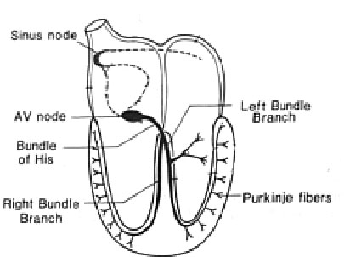
Conduction
Sinoatrial node
AV node
Bundle of His
Bundle Branches
Purkinje fibers

Slide 10
Heart pacemakers
SA Node - Dominant pacemaker with an intrinsic rate of 60 - 100 beats/minute.
AV Node - Back-up pacemaker with an intrinsic rate of 40 - 60 beats/minute.
Ventricular cells - Back-up pacemaker with an intrinsic rate of 20 - 45 bpm.

Slide 11
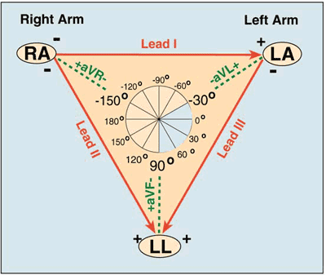
Einthoven triangle

Slide 12
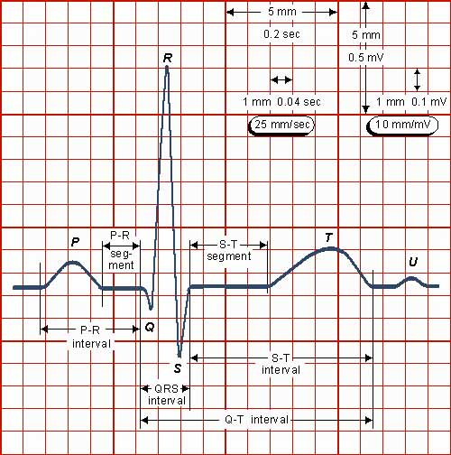

Slide 13
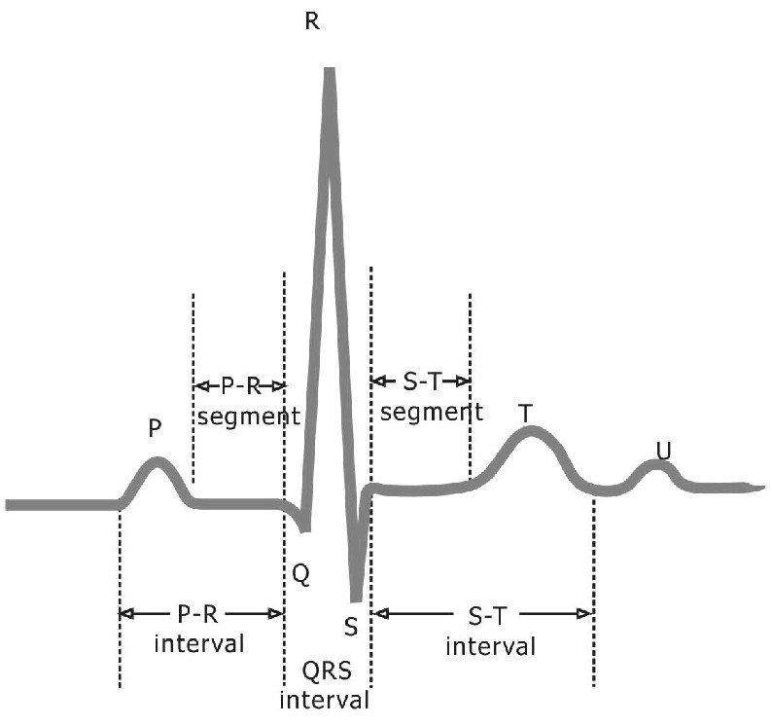

Slide 14
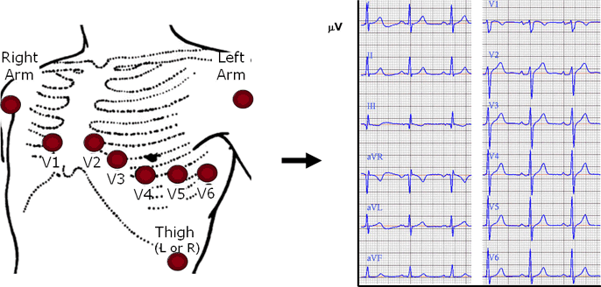

Slide 15
The P wave
It represents the Atrial activation
Can be normal and of course abnormal
Normal P wave is best evaluated from standard lead *2* or lead *V1*
Duration less than 0.12 s
Amplitude less than 0.2mV (mm)

Slide 17
P-R interval
From the onset of P-wave-onset of QRS complex
Duration 0.12-0.2 second
It represents the time needed for the impulse to reach the AV node and the physiological delay

Slide 19
QRS
Duration less than 0.12s
The complex stands for activation of septum and the ventricles (right and left)
Amplitude is affected by:-
Ventricular muscular mass
Patient build

Slide 20
T wave
It represents the repolarization of the ventricles

Slide 21
See you next time

Slide 22
Pharmacology
Choice of drugs affecting the CV course:
Drugs affecting mortality (Let the mortality difference drive you):
Antianginal drugs:
Aspirin, B-blockers, statins and ACE-inhibitors
Anti-dysrythmic drugs (targeting channels)-

Slide 23
Side effects and interactions
ACE-Inhibitors: (-pril) CAPTOPRIL
Cough
Angioedema
Proteinuria
Taste change
Orthostatic hypotension
Pregnancy contraindication
Renal failure
Indomethacin
Leukopenia

Slide 24
Beta blockers (ABCDE)
Asthma
Block (heart)
COPD
DM
Electrolytes (hyper-k-alemia)

Slide 25
Uses of calcium channel blockers C-MASH
Cerebral vasospasm
Migraines
Angina, Atrial flutter
SVT
Hypertension

Slide 26
Drugs used in AV block (DO-BLOCK AV-DAH)
Digoxin
Beta blockers
Adenosine
Verapamil
Diltiazem

Slide 27
K-increasing agents (K-BANK)
K sparing diuretics
B-blockers
ACE-inhibitors
NSAIDs
K supplements

Slide 28
Gynecomastia causing agents (DISCO)
Digoxin
Isoniazid
Spironolactone
Cimetidine
Estrogens

Slide 29
See you next time

