Slide 1

Sensory System Examination
CNS Physiology Practical Session

Slide 2
Summary
Main sensory tests:
• Light touch
• Pain
• Temperature
• Vibration
• Proprioception
• Two‑point discrimination
These tests help evaluate dorsal column and spinothalamic pathways.

Slide 3
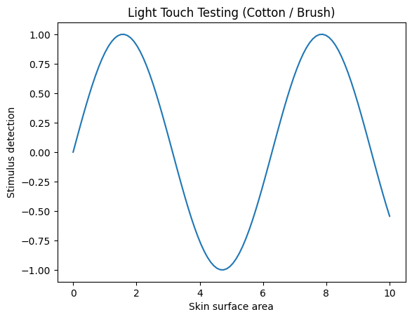
Light Touch Sensation
Test with cotton wool or soft brush.
Patient closes eyes.
Compare both sides of the body.
Assess integrity of dorsal column pathway.

Slide 4
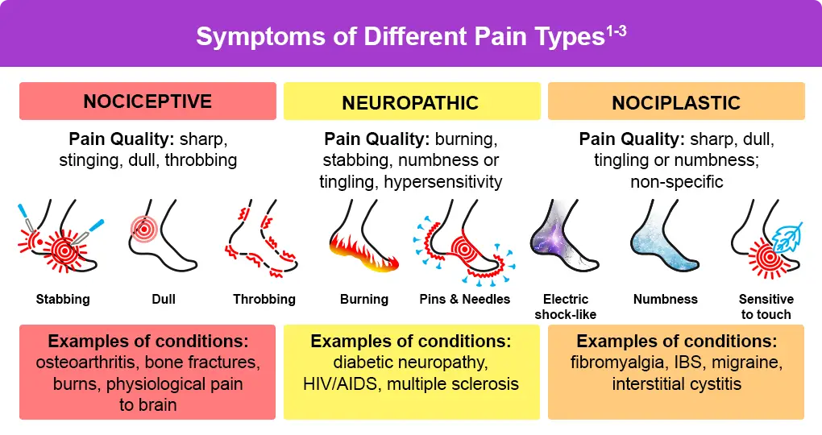
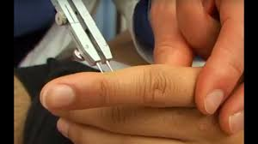
Pain Sensation
Test using sterile pin.
Ask patient to identify sharp vs dull.
Used to assess spinothalamic pathway.

Slide 5
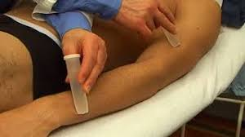
Temperature Sensation
Use warm and cold objects.
Patient distinguishes hot from cold.
Evaluates spinothalamic tract function.

Slide 6
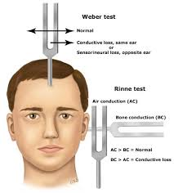
Vibration Sense
Use 128 Hz tuning fork.
Place on bony prominences.
Patient reports when vibration stops.

Slide 7
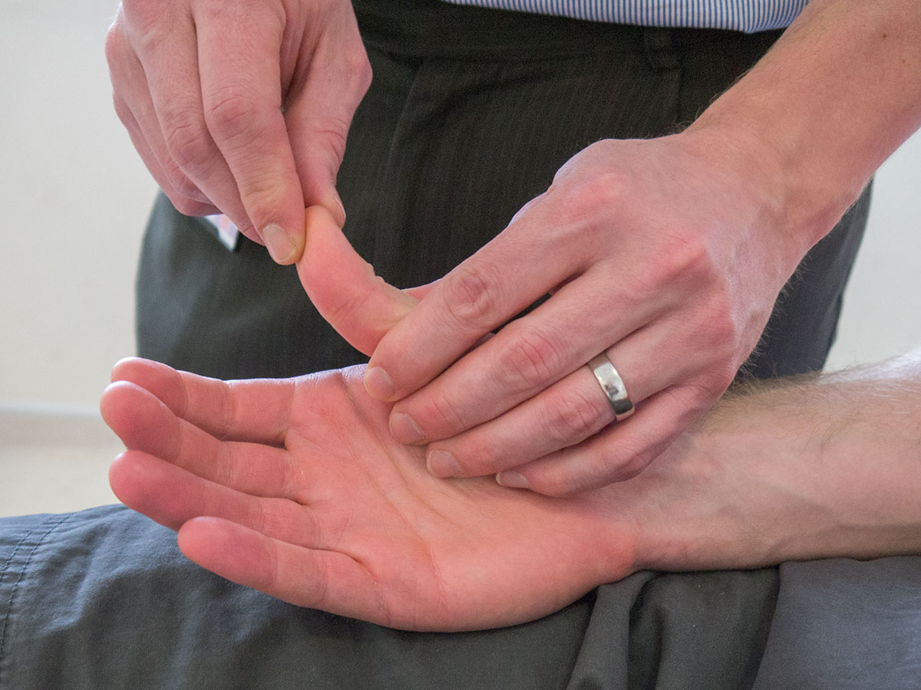
Proprioception
Move distal phalanx up or down.
Patient identifies direction.
Assesses joint position sense.

Slide 8
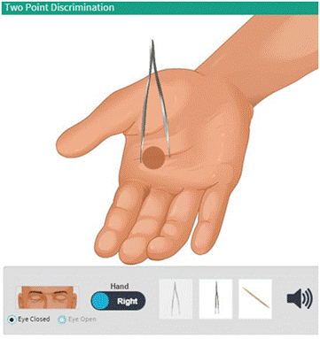
Two‑Point Discrimination
Use calipers or paper clip.
Determine minimum distance perceived as two points.
Tests cortical sensory processing.

