Slide 1
Male Internal Genitalia ANATOMY OF TESTIS, EPIDIDYMIS, PROSTATE, VAS DEFERENS, SEMINAL VESICLES
BY: M. G. HAMMAD

Slide 2
TESTIS & EPIDIDYMIS

Slide 3
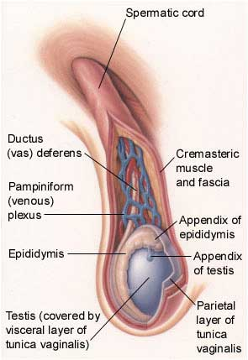
The Testis
An oval organ.
Has a thick covering of fibrous tissue called tunica albuginea.
its posterolateral surface attaches to epididymis.
The front and lateral surfaces of testis lie free in a serous space formed by tunica vaginalis.
Tunica Vaginalis is a remnant of the fetal processus vaginalis.
In hydrocele of testis the space of tunica vaginalis becomes distended with fluid.
Testis, epididymis and tunica vaginalis lie in the scrotum surrounded by thin membranes.

Slide 4
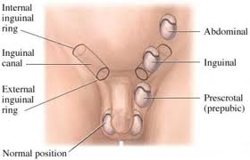
Descent of the Testes
During fetal development they are near the kidneys.
Slowly move inferiorly in the abdominal cavity.
During the 7th month they descend through the inguinal canals.
Cryptorchidism is the absence of one or both testes from the scrotum.
It is the most common birth defect regarding male genitalia.

Slide 5

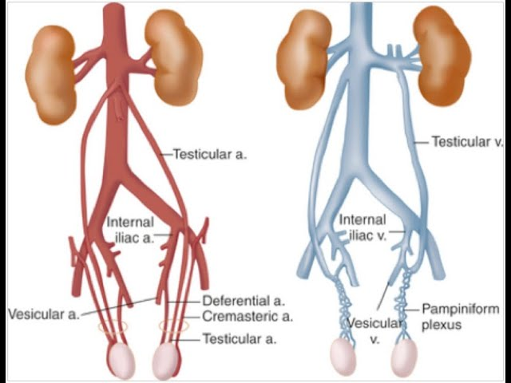
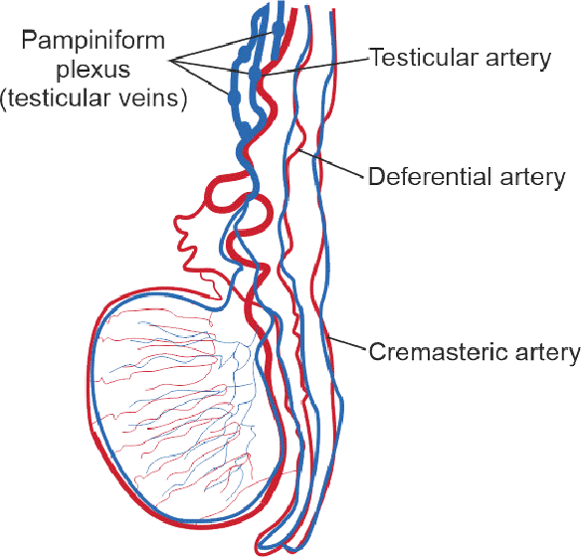
Blood Supply: Arterial Supply
By Testicular A.
Branch from the aorta.
Runs in the spermatic cord.
Gives off a branch to epididymis.
Reaches back of testis.
It divides into medial and lateral branches.

Slide 6
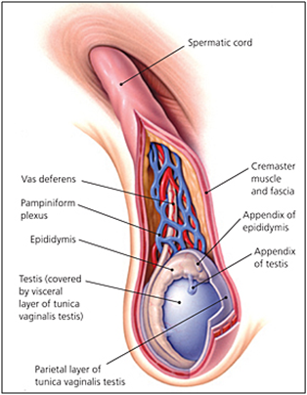
Blood Supply: Venous Drainage
By pampiniform plexus.
In the inguinal canal the plexus separated out into about four veins.
These veins join to form two veins that leave the deep inguinal ring.
Then become single (testicular veins) on psoas major on the posterior abdominal wall.
Left Testicular vein joins the renal vein.
Right Testicular vein drains directly into the inferior vena cava.

Slide 7
BLOOD SUPPLY OF TESTIS

Slide 8
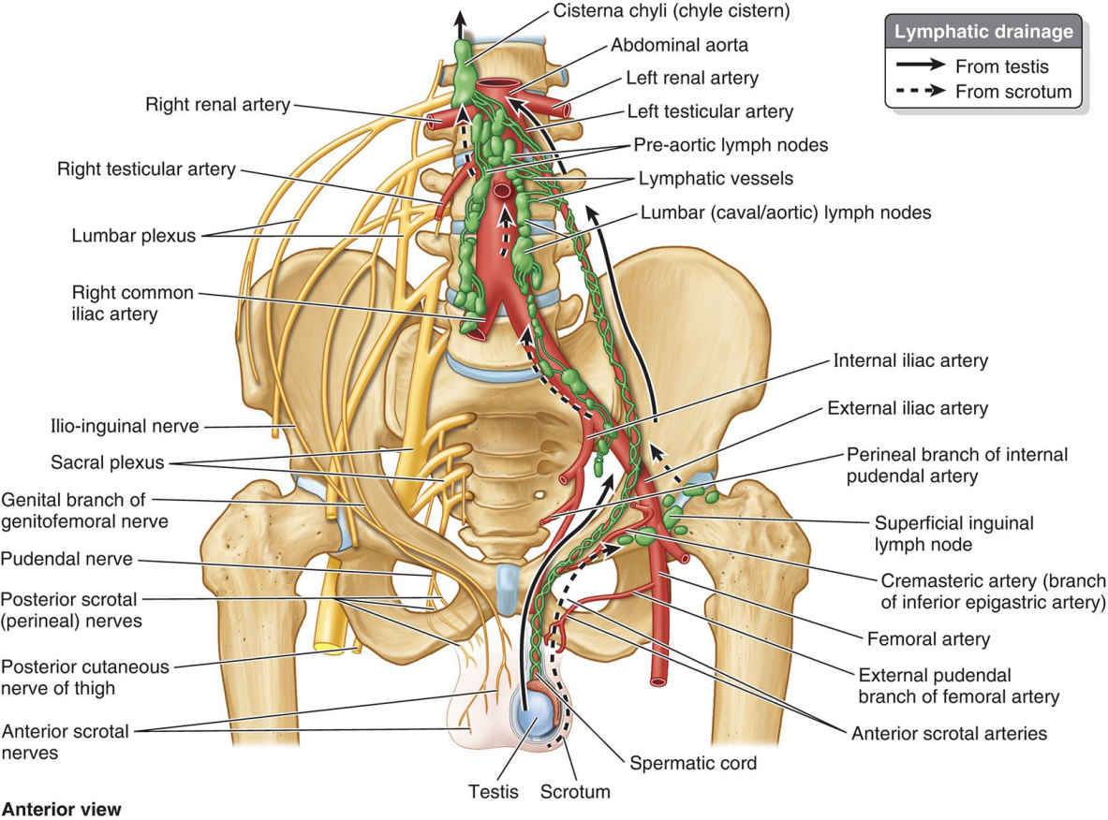
Lymph Drainage
Follow testicular arteries.
Drains into paraaortic lymph nodes (lumbar lymph nodes).

Slide 9
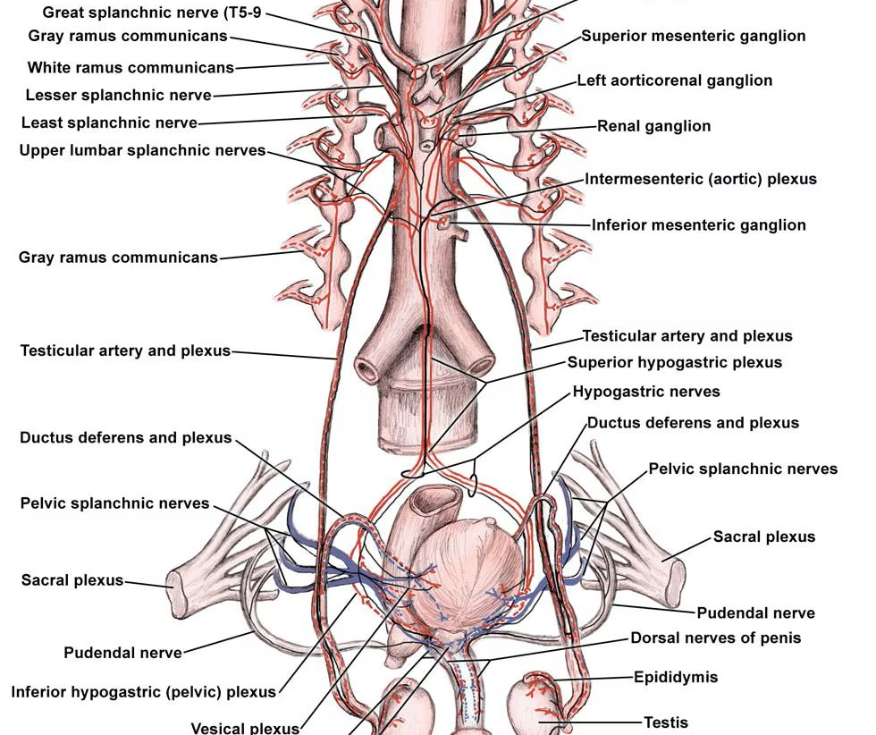
Nerve Supply
The testis is supplied by sympathetic nerves.
Neurons lie in T10 segment of the cord.
Passing in the greater or lesser splanchnic nerve to the coeliac ganglion.
Postganglionic fibers reach testis along testicular artery.
Sensory fibers ('testicular sensation') share the same sympathetic pathway.

Slide 10
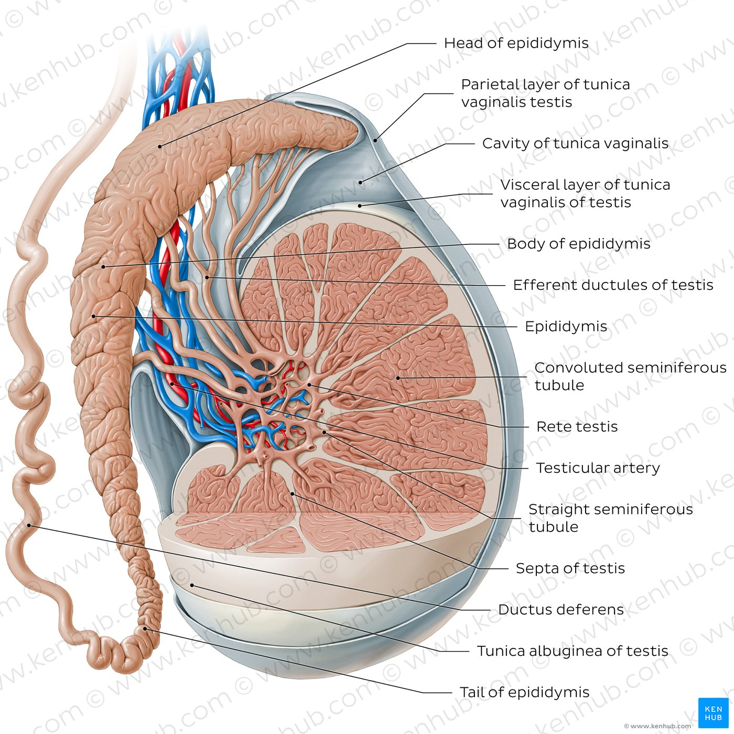
The Epididymis
Firm structure.
Attached behind the testis, with the ductus deferens to its medial side.
It consists of a single tube, 7 m long.
Highly coiled and packed together by ﬁbrous tissue.
It has:
Large head (upper pole, globus major).
Small tail (lower pole, globus minor).
Body.
A narrow slit between epididymis and testis is sinus of the epididymis.
The head receives the vasa efferentia from testis.
From the tail the ductus (vas) deferens a pears as direct continuation of the canal of the epididymis.
Vasculature of Epididymis from Testicular vessels.

Slide 11
VAS DEFERENS & SEMINAL VESICLES

Slide 12
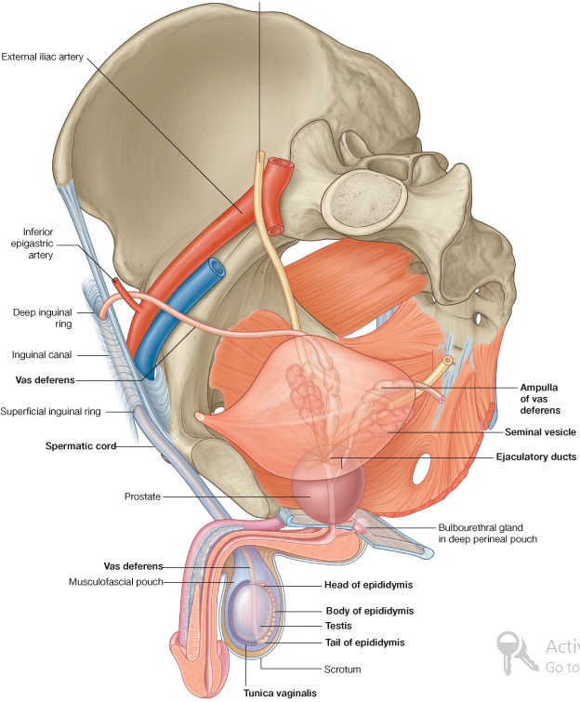
Vas Deferens
It is thick-walled tube, about 45 cm long.
It conveys mature sperm from epididymis to ejaculatory duct and urethra.
It arises from lower end or tail of epididymis and passes through inguinal canal.
It emerges from deep inguinal ring and passes around lateral margin of inferior epigastric artery.
It then passes downward and backward on lateral pelvic wall and crosses ureter in region of ischial spine.

Slide 13
Vas Deferens
Vas deferens runs medially and downward on posterior surface of bladder.
Terminal part of vas deferens is dilated to form ampulla of vas deferens.
Inferior end of ampulla narrows down and joins duct of seminal vesicle to form ejaculatory duct.

Slide 14
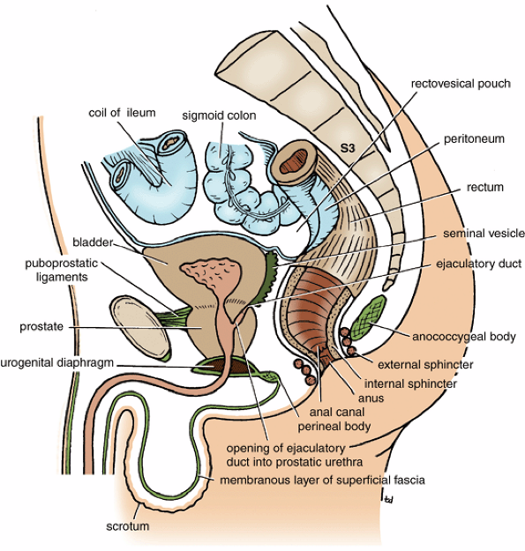
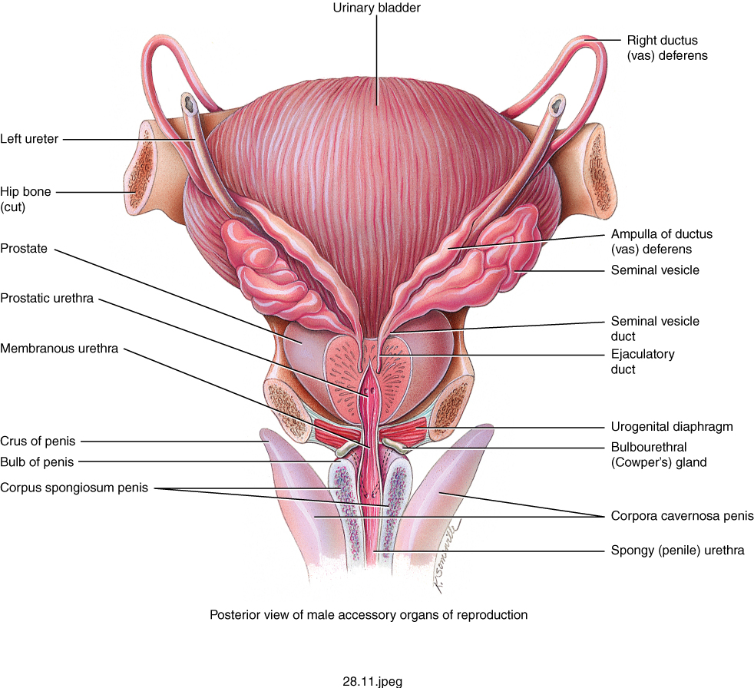
Seminal Vesicles
Lobulated organ
2 inches (5 cm) long
Lies on the posterior surface of the urinary bladder
Inferiorly: Seminal vesicle joins the vas deferens to form ejaculatory ducts on each side.
Posteriorly: Seminal vesicles are related to the rectum.
Each seminal vesicle consists of a much-coiled tube embedded in connective tissue.

Slide 15
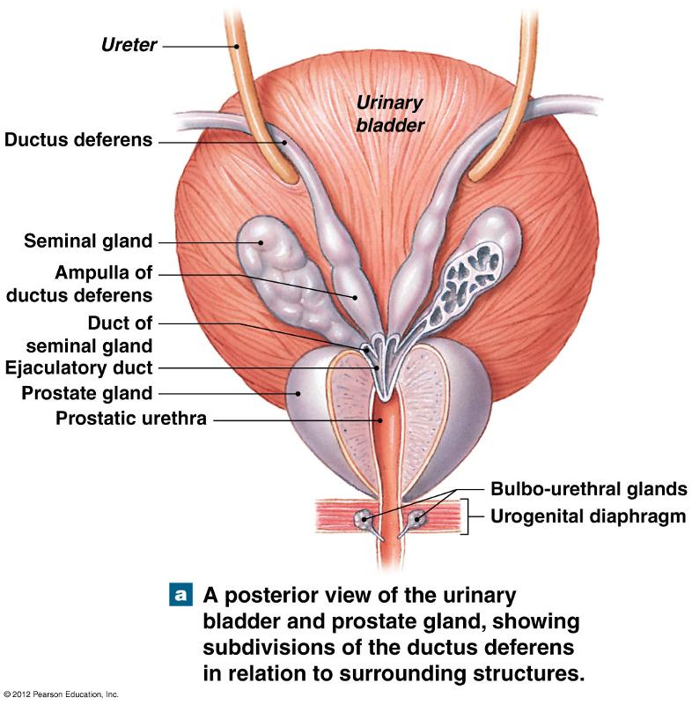

Slide 16
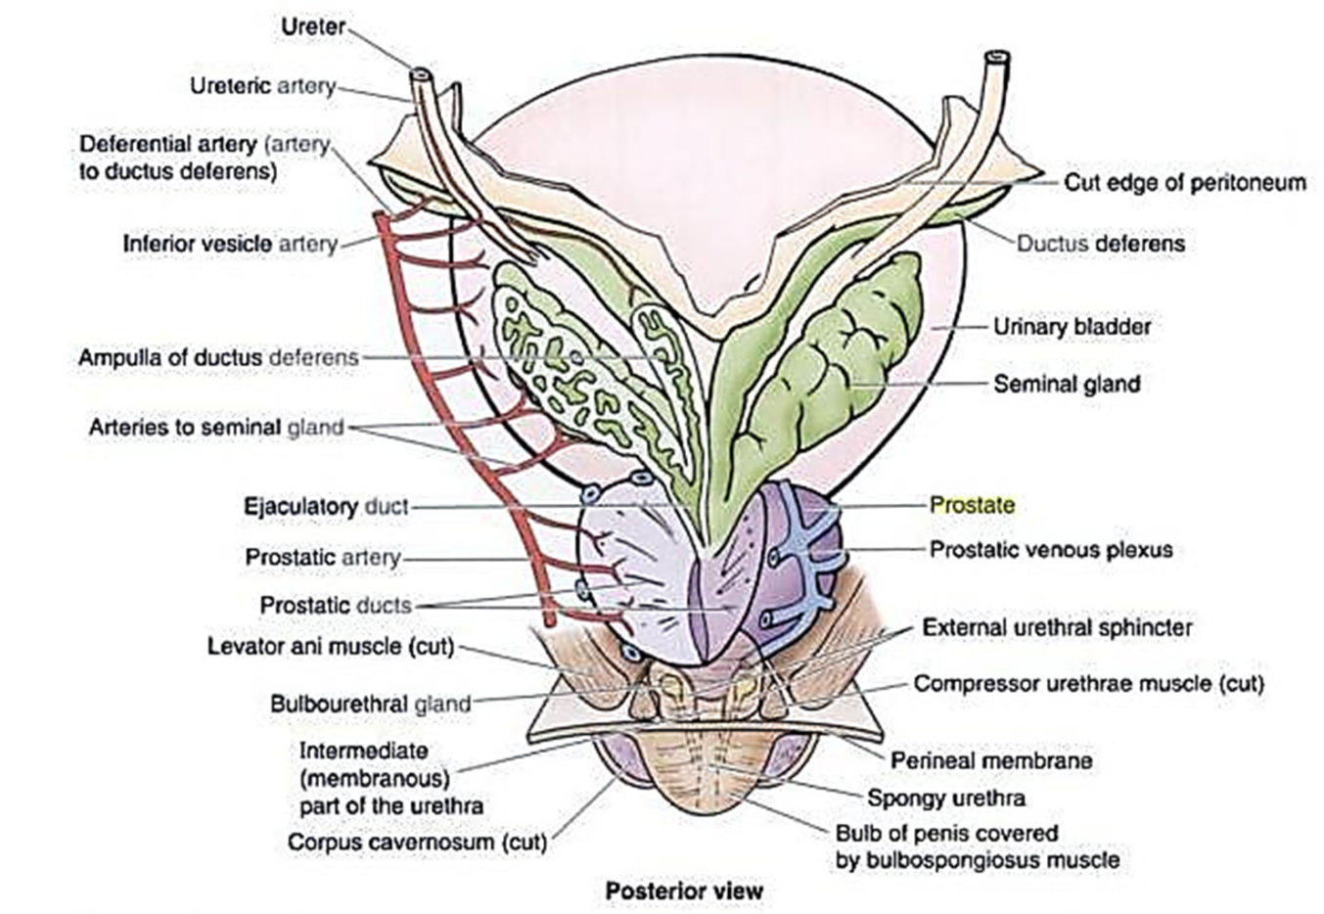
BLOOD SUPPLY OF VAS DEFERENS & Seminal Vesicles
The artery to the ductus deferens is a branch of the superior vesical (or sometimes the inferior vesical) artery.
It accompanies the ductus to the lower pole of the epididymis and anastomoses with the testicular artery.
The seminal vesicles are supplied by branches from the inferior vesicle and middle rectal arteries.
Veins corresponding to arteries.
Lymph: follows artery to nearest iliac LNs.

Slide 17
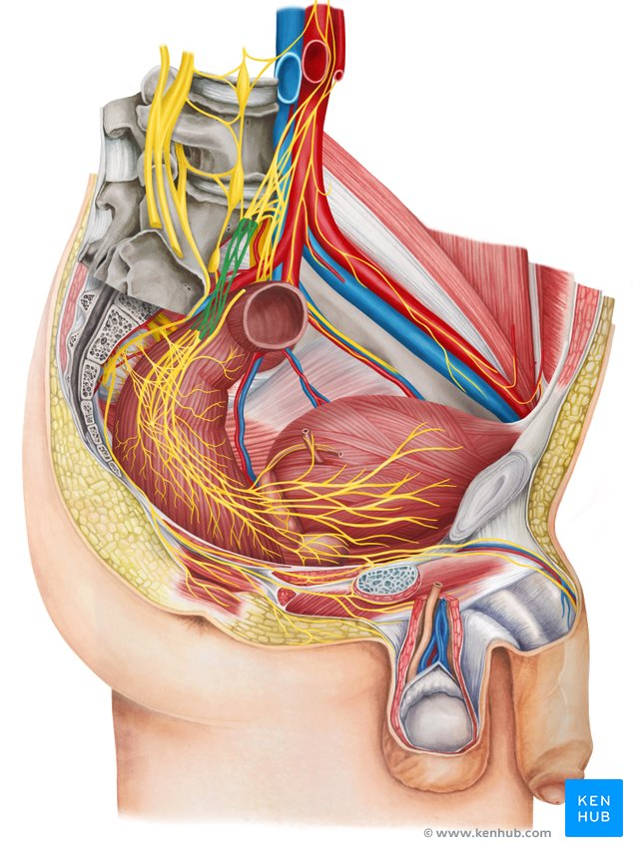
NERVE SUPPLY OF VAS DEFERENS & Seminal Vesicles
The smooth muscle of the ductus and seminal vesicles receives ﬁbers from the pelvic plexus.
The sympathetic ﬁbers from ﬁrst lumbar ganglion and are motor.

Slide 18
EJACULATORY DUCTS
Less then 1 inches (2.5 cm) long.
Formed by the union of duct of seminal vesicle and vas deferens.
Pierce posterior surface of the prostate.
Opens into the prostatic part of the urethra.

Slide 19
PROSTATIC GLAND

Slide 20
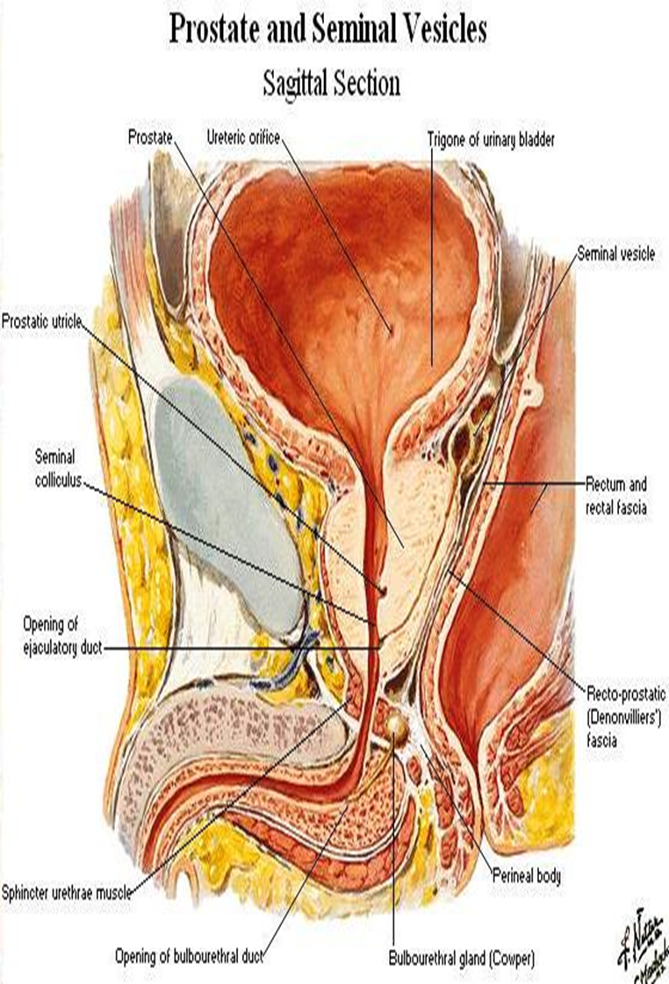
Prostatic Gland
The prostate is a fibromuscular glandular organ that surrounds the prostatic urethra .
Lies beneath the bladder and above the urogenital diaphragm.
The prostate provides about 30% of the volume of seminal ﬂuid.
Composed of 2 parts:
Glandular part : 2/3rd
Fibromuscular part: 1/3rd

Slide 21
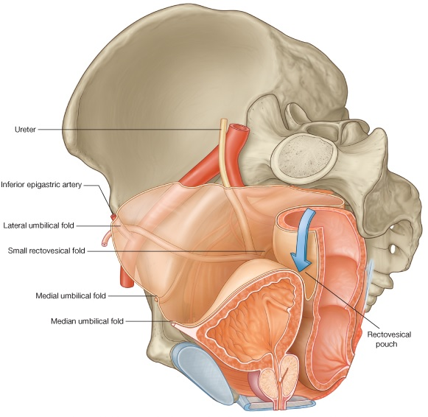
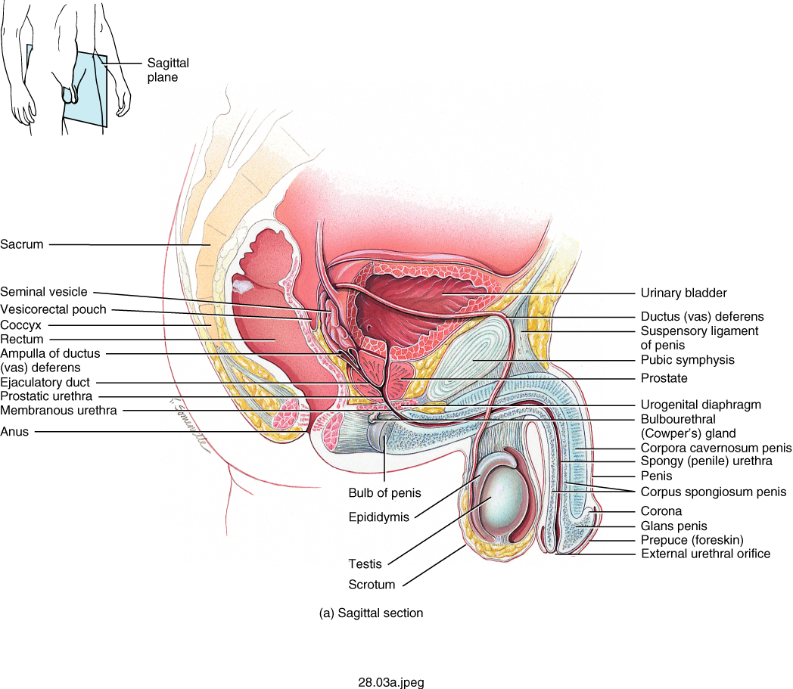
SHAPE & SIZE
Small chestnut-like organ.
It measures:
4 cm width.
3 cm long.
It has:
Base.
Apex.
Anterior, posterior and inferolateral surfaces.

Slide 22
SHAPE & SIZE
Base:
The base is the upper surface.
Fused with the neck of the bladder and perforated by the urethra.
Apex:
The lowest part.
Penetrated by prostatic urethra at its front part.

Slide 23
SHAPE & SIZE
Anterior Surface:
At the back of the retropubic space.
Connected to the bodies of the pubic bones by puboprostatic ligament.
Inferolateral Surface:
Clasped by the levator prostatae parts of levator ani.

Slide 24
SHAPE & SIZE
Posterior Surface:
Is in front of the lower rectum.
Separated from it by the rectovesical fascia.
It has a vertical median groove palpable on rectal examination.
The ejaculatory ducts pierce the posterior surface just below the bladder and pass obliquely through the gland for about 2 cm to open into the prostatic urethra about halfway down.

Slide 25
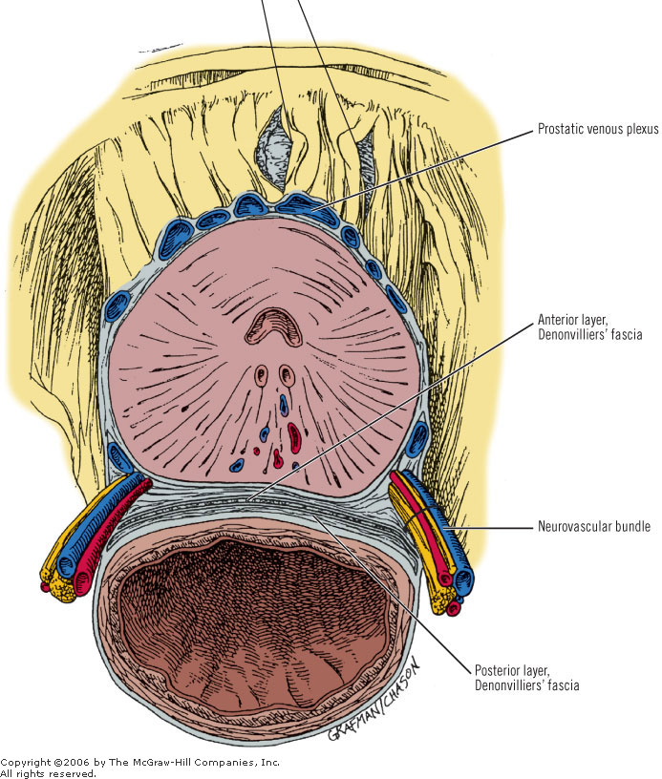
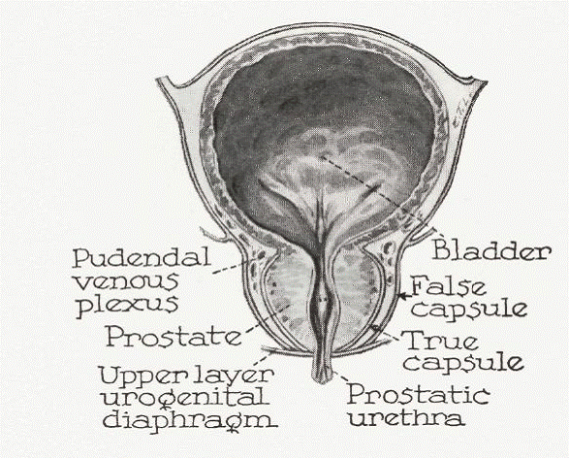
CAPSULE OF PROSTATE
Has 2 Capsules:
True Capsule:
Prostate is surrounded by a fibrous capsule which contains prostatic plexuses of nerves and veins.
False Capsule:
Visceral layer of pelvic fascia forms a fibrous prostatic sheath outside the true capsule.

Slide 26
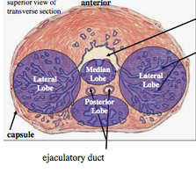
LOBES & STRUCTURES
The gland consists of acini embedded in a fibromuscular stroma.
It is incompletely divided into five lobes:
Anterior lobe.
Middle (median) lobe.
Posterior lobe.
2 Lateral lobes.

Slide 27
LOBES & STRUCTURES
Anterior lobe:
Small area in front of the urethra.
Consisting entirely of stromal tissue with few acini.

Slide 28
LOBES & STRUCTURES
Middle lobe:
Lies between the ejaculatory ducts and proximal urethra.
When affected by benign it elongates and obstructs the urethra.
Normally; it causes a swelling in urethra (uvula vesicae).
It contains glandular tissues.

Slide 29
LOBES & STRUCTURES
Posterior lobe:
Lies behind urethra and below ejaculatory ducts.
Glandular.
One of commonest sites of cancerous changes.

Slide 30
LOBES & STRUCTURES
R & L Lateral lobe:
Located at sides of urethra.
Glandular.
Are commonest sites of cancerous changes.
Enlargement of the lateral lobes may be detected on rectal examination.

Slide 31
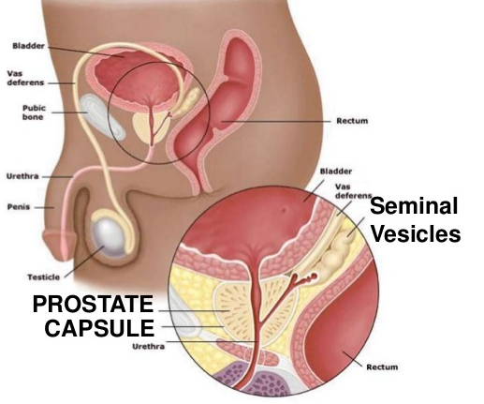
RELATION
Superior relation:
Neck of the urinary bladder.
Urethra enters the center of the base of the prostate.
Inferior relation:
Urogenital Diaphragm.
Urethra leaves prostate just above its apex on the anterior surface.

Slide 32
RELATION
Anterior relation:
Symphysis pubis.
Puboprostatic ligaments.
Pubic bone.
Posterior relation:
Rectal ampulla.
Rectovesical septum/ Recto- prostatic fascia (fascia of Denon Villiers).
Ejaculatory duct (pierces posterior surface).
Lateral relation:
Anterior fibers of the levator ani.

Slide 33
RELATION

Slide 34
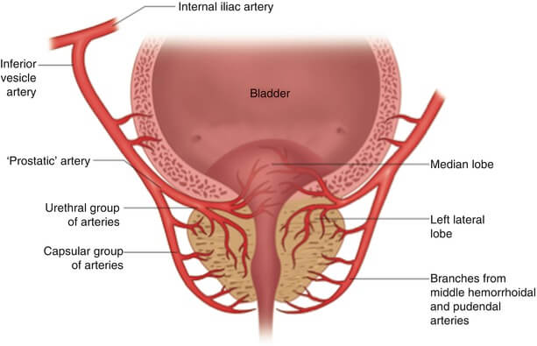
BLOOD SUPPLY
Arterial Supply
The main artery is inferior vesical artery.
Other arteries:
Middle rectal artery (main source sometimes).
Internal pudendal artery.

Slide 35
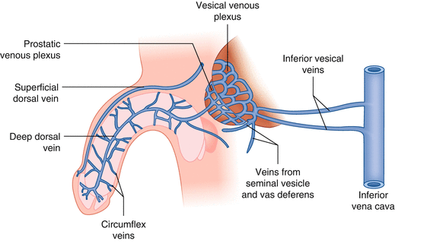
BLOOD SUPPLY
Venous Drainage
The veins run into a plexus between the true and false capsules (prostatic venous plexus).
PVP joins the vesico- prostatic plexus situated at the front and sides of the groove between bladder and prostate.
At the front, this plexus receives the deep dorsal vein of the penis.
The plexus drains backwards into the internal iliac veins.

Slide 36
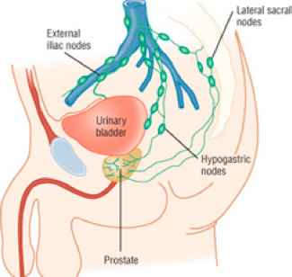
BLOOD SUPPLY
Lymph Drainage
To:
Internal iliac lymph nodes (main nodes).
Hypogastric LNs.
Lateral sacral LNs.

Slide 37
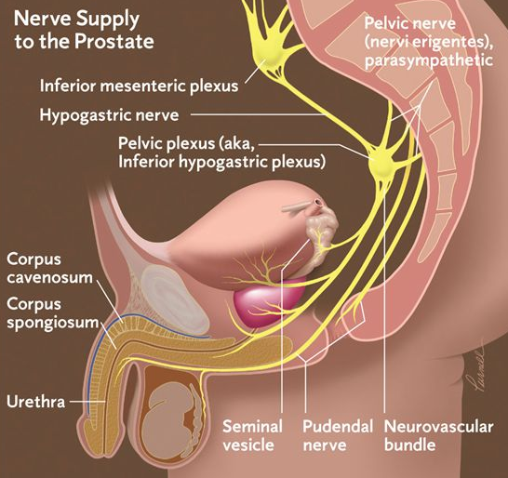
NERVE SUPPLY
Parasympathetic:
The acini receive parasympathetic (cholinergic) innervation from the pelvic splanchnic nerves.
Sympathetic:
From inferior hypogastric Plexus.
The sympathetic nerves stimulate the smooth muscle of the prostate during ejaculation.

Slide 38
THANKS

