Slide 1
GIT GITFLOW

Slide 2
Why Should I Care?

Slide 3
When developers are finished “coding”, what happens to their code? How do they keep all this code sorted? How can we avoid conflicts?
<number>

Slide 4
What is GitFlow?
GitFlow is a branching model
<number>

Slide 5
Key Benefits of GitFlow
Parallel Development
Collaboration
Release Staging Area
Support For Emergency Fixes
<number>

Slide 6
More Advantages of GitFlow
It have been widely shared and thoroughly documented by the community
It is a way to standardize the version control practices between teams and companies, and to speed up the on-boarding of new developers.
<number>

Slide 7
Your team uses GitFlow, you hire somebody, he knows GitFlow, he can contribute to the project from day 1.
<number>

Slide 8
The Main Branches
MASTER - represents what’s in production
DEVELOP - reflects a state with the latest delivered development changes for the next release
<number>

Slide 9
The Supporting Branches
Feature - branch from develop
Release - branch from develop
Hotfix - branch from master
<number>

Slide 10
How it Works?
GitFlow Implementation
<number>

Slide 11

Diagram featured by https://nvie.com/posts/a-successful-git-branching-model/
<number>

Slide 12
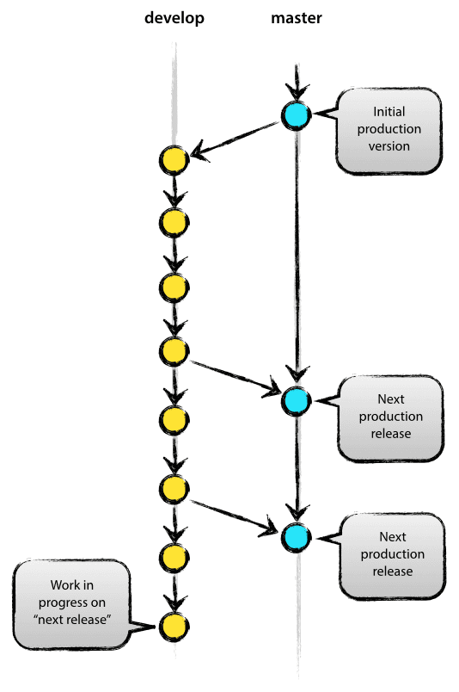
Develop and Master Branches
MASTER - the source code of HEAD always reflects a production-ready state.
DEVELOP - reflects a state with the latest delivered development changes for the next release
<number>

Slide 13
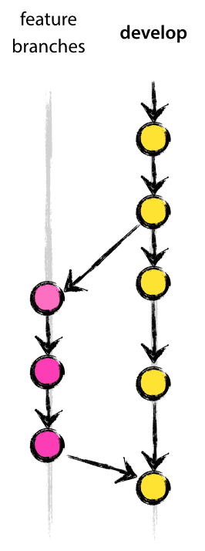
Feature Branches
May branch off from:
develop
Must merge back into:
develop
Branch naming convention:
anything except master, develop, release-*, or hotfix-*
Recommended: feature/*
<number>

Slide 14
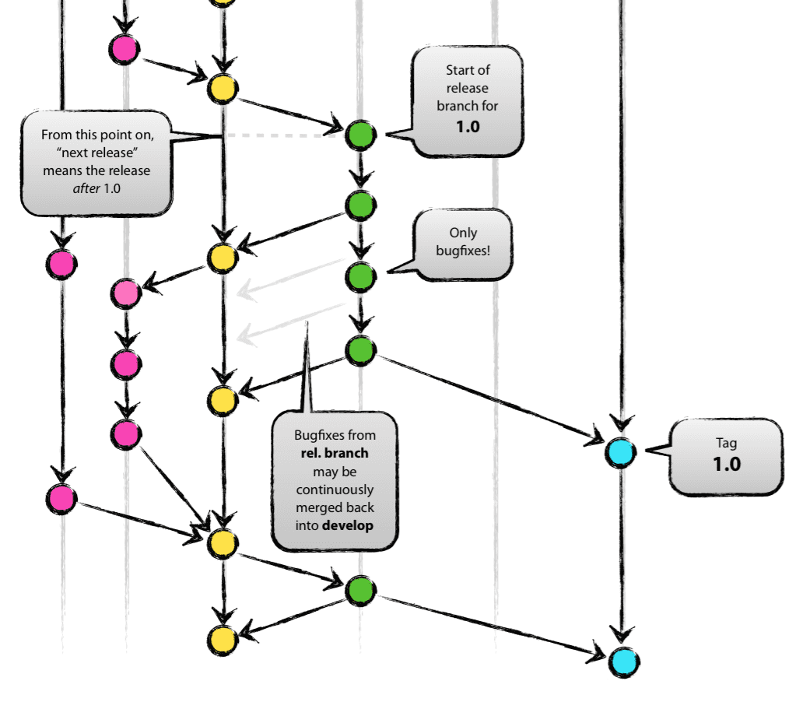
Release Branches
May branch off from:
develop
Must merge back into:
develop and master
Branch naming convention:
release-* or release/*
<number>

Slide 15
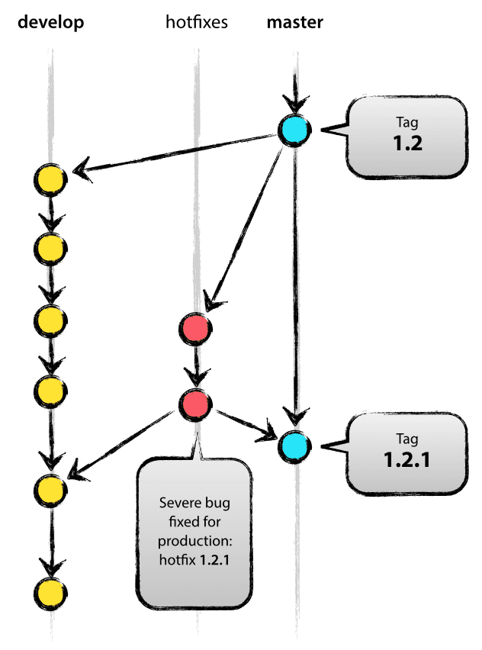
Hotfixes Branches
May branch off from:
master
Must merge back into:
develop and master
Branch naming convention:
hotfix-* or hotfix/*
<number>

Slide 16
Diagram featured by https://nvie.com/posts/a-successful-git-branching-model/
<number>

Slide 17
Semantic Versioning 2.0
<number>

Slide 18
Given a version number MAJOR.MINOR.PATCH
Major
Version when you make incompatible API changes
Minor
Version when you add functionality in a backwards -compatible manner
Patch
Version when you make backwards -compatible bug fixes
Example: v1.4.3
<number>

Slide 19
Project Release Schedule

Slide 20
Create a release plan.
The list of updates is usually the set of User Stories from Backlog/Sprint
<number>

Slide 21
Project Release Schedule
Feature Release
Every Thursday.
Friday will reserved for standby if deployment/release has issues before the weekend
Bug Fixes and Patches
Can be Everyday
<number>

Slide 22
Release Note Format
Release v1.4.3
Added
List of New Features
Changed
List of changes in existing features
Deprecated
List of soon-to-be removed features
Removed
List of removed features
Fixed
List of Issues fixed
Security
List of vulnerabilities
<number>

Slide 23
THANKS!
<number>

