Slide 1
CS-8395
Introduction
Dr. Darren pulsipher

Slide 2
Learning Objectives
Course Philosophy
Course Contents
Structure of Lecture Material
Overview of Assignments & Assessments
Setting up your Dev Environment

Slide 3

Course Philosophy
There’s a growing need for software developers who can write concurrent & parallel microservices for a range of computing platforms
  Mobile devices,
  Laptops,
  Desktops,
  Cloud environments

Slide 4
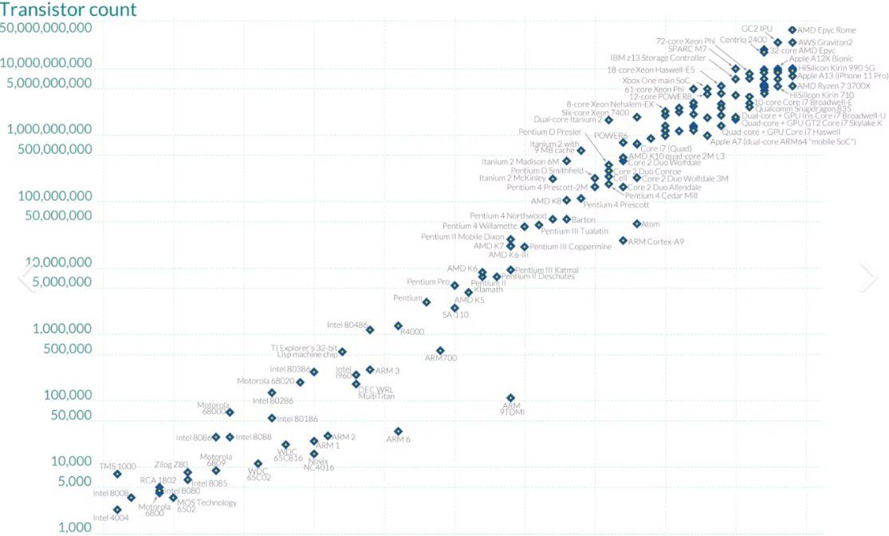
Moore’s Law
Been declared Dead Several Times
Transistor count doubles every 2 years
Created new markets
Created new programming models

Slide 5

Thinking or Doing
Effective techniques & practices for developing concurrent & parallel microservices are not best learned through generalities & platitudes
Instead, it’s better to see by example how these programs can be made
  easier to write & read,
  easier to maintain & modify,
  more efficient & resilient by applying time-proven software patterns & object-oriented, functional, & reactive design & programming techniques

Slide 6
Thursday Class time
1% for each class you attend
  10% for class attendance (extra points can be earned for attending more than 10 classes)
  Cameras must be on.
  Mouths open. (Discussion-based learning)
  Class Schedule
  - 15-minute lecture to start class
  - 1 hour – Student & Professor Engagement
    Breakout session – Small teams tackling a problem
    Questions and answers
    Sharing findings and examples.

Slide 7
Summary of Course Content
Modern Web Programing Platforms
Patterns for concurrent & Parallel Programming
Developer Tools
Generative AI

Slide 8
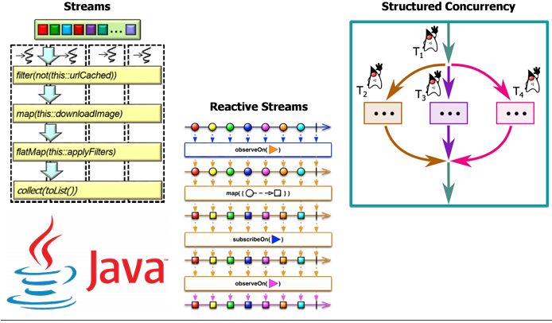
Key Frameworks
  Streams
  Reactive Streams
  Structured Concurrency

Slide 9
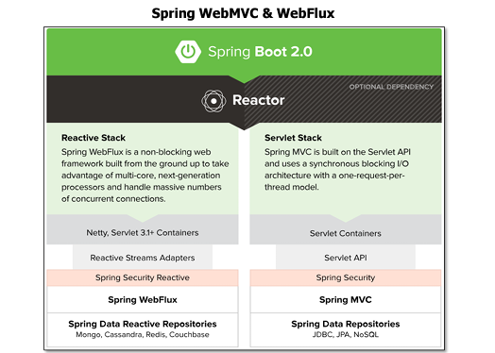
Modern Web Programming Platforms
Synchronous
  Request-Response Model
  Servlet Stack
  WebMVC (Model View Controller)
  Per thread Model
Asynchronous
  Event Driven
  Reactive Stack
  WebFlux
  Non-blocking I/O
https://spring.io/projects/spring-boot

Slide 10
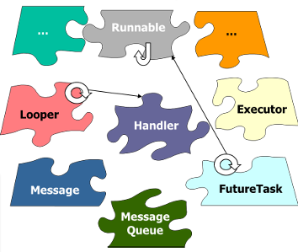
Pattern for Concurrent & Parallel Programming
Why Patterns?
  Reusability
  Maintainability
  Scalability
  Flexibility
  Best Practices
https://www.dre.vanderbilt.edu/~schmidt/POSA

Slide 11
Development Environment
Git
Intellij – Or any other IDE
Generative AI and Coding Assistant

Slide 12

Generative Artificial Intelligence
We will use GenAI in this class.
  Don’t Trust it completely.
  GenAI lies (Hallucinates) and can lead you down the wrong path
  You must understand the concepts to leverage GenAI.
  All lectures, notes, and transcripts will be available in the Repo.
  Use of RAG + LLM will be advantageous
Check out my philosophy around GenAI on my weekly podcast.
  https://embracingdigital.org/collections/en/generativeai.html

Slide 13
Structure of Lecture Material
Each Module has videos and resources that should be reviewed.
Modules should be reviewed before zoom class every week.
Experts in the field and academia have produced the videos.
The course is broken into the following three sections
  Structured Concurrency & Reactive Streams
  Sync & Async Web communication
  Software Patterns

Slide 14
Overview of Assignments & Assessments
Development Environment
Modern Concurrent & Parallel Microservices
Assessments
Grading

Slide 15
Assessment Philosophy
Goal is to make sure you understand the concepts being taught and can use them in a practical manner.
Improve Software engineering acumen by adopting Best Practices

Slide 16
Assignment Assessment
Done by me and automated tools.
Assignments must be submitted correctly and on time or they will not be reviewed.
Final Revisions must be submitted on time as well.

Slide 17

Assignment Details
- A0 – Environment & Baseline Service - Set up tools, choose your project, run two simple services in different languages.
- A1 – Components, APIs & Structured Services - Design service boundaries, create contracts, implement one service twice.
- A2 – Integration, Persistence & Resilience - Add a second service, async messaging, timeouts, retries, and resilience patterns.
- A3 – Reactive / Async Pipeline & Performance Analysis -
Build blocking vs reactive pipelines and analyze performance + scalability.
- A4 - Capstone Integration & Production Readiness - Bring it all together: observability, deployment automation, final architecture review.

Slide 18
Projects
Project 1 — Movie / Media Recommender
Project 2 — IoT Smart Home Sensor Platform
Project 3 — Online Store / Shopping Cart
Project 4 — Social News Feed / Content Aggregator
Project 5 — Food Delivery & Restaurant Ordering
Each project includes:
- synthetic datasets (small / medium / large),
- documented schemas,
- a PlantUML data model to reason about architecture,
- freedom to choose MVC, DOV, or a similar architectural style.
No starter code is provided — part of the learning is deciding how to design controllers, models, boundaries, and services.

Slide 19
Grading
Assignments (A0–A3) 40%
Final Project (A4) 25%
Final Exam – Interview 20%
Weekly Participation 10%
Midterm Exam 5%

Slide 20
Submitting Assignments
Brightspace will be used for submitting assignments.
Add the repo link as the text to be submitted.
Make sure madajaju is a viewer of your project in gitlab.
No late assignments.
Evaluations of assignments will be in Brightspace.

Slide 21
Summary
Stay on top of the modules and the assignments.
Do not fall behind.
Assignments build on top of each other.
Join the discussions in Brightspace
If you have questions
Darren.Pulsipher@vanderbilt.edu

