Slide 1



RLC PARALLEL CIRCUIT
Student: Rusu Maria Mădălina
Teacher: Mihaela Cîrlugea
Group: 2022, ETTI - UTCN

Slide 2
Content:
Code overview
Theoretical aspects
Interface
Bibliography

Slide 3
CODE OVERVIEW

Slide 4
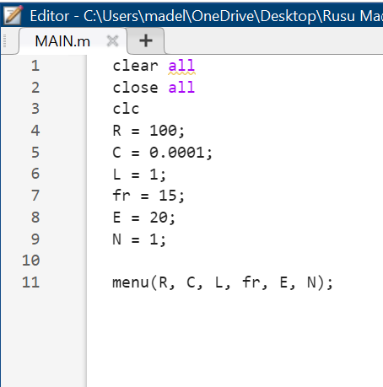
MAIN.m
clear all – clears all variables from workspace
close all – closes all open figure windows
clc – clears command window
rest of the code assignes values to the parameters of the RLC circuit
last line of code calls the function “menu”

Slide 5
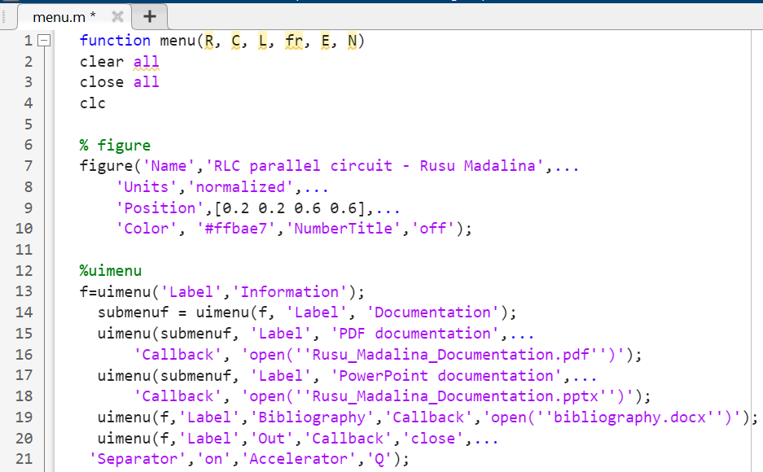
menu.m
figure – creates new figure window
uimenu – creates menu bar titled “Information”, that contains a submenu for the documentation (two formats), the bibliography and a close button.

Slide 6
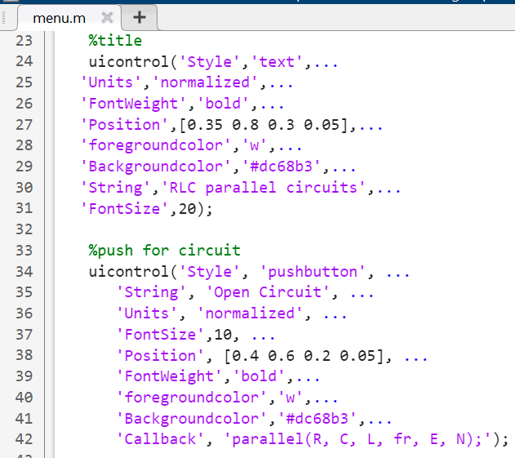
uicontrol (‘Style’ , ‘text’…) – creates a text label that contains the title of the project
uicontrol (‘Style’ , ‘pushbutton’…) – creates a pushbutton titled “Open circuit” that directs the user to the RLC circuit through the callback of the function “parallel”

Slide 7
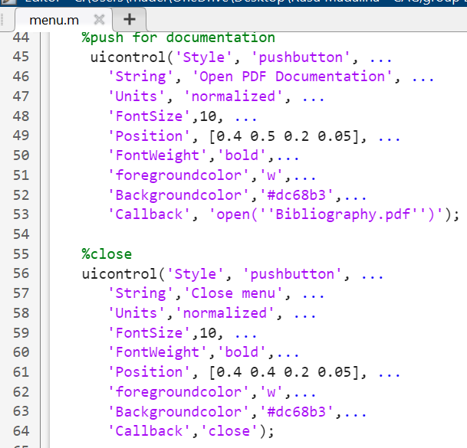
uicontrol (‘Style’ , ‘pushbutton’…) – creates a pushbutton titled “Open PDF Documentation” that directs the user to the documentation of the project
uicontrol (‘Style’ , ‘pushbutton’…) – creates a pushbutton that closes the program (through ‘Callback’,’close’)

Slide 8
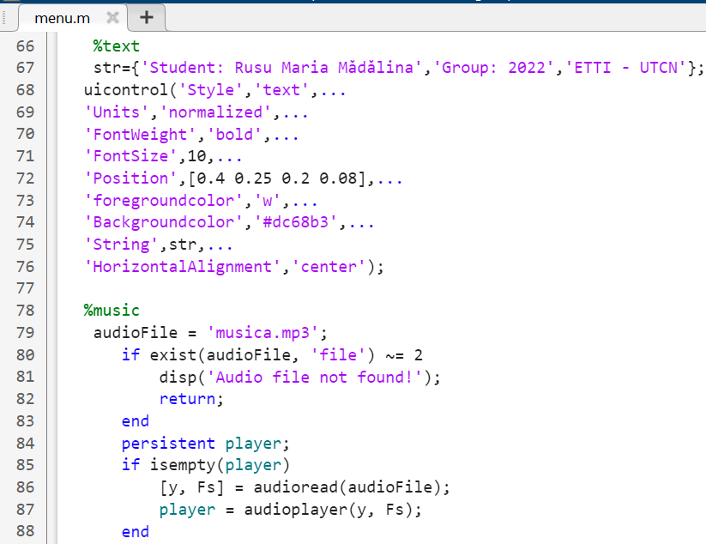
uicontrol (‘Style’ , ‘text’…) – creates a text label that contains data about the student
check audio file existence
program uses a persistent variable to ensure the audio is only loaded and the audio player object is only created once

Slide 9
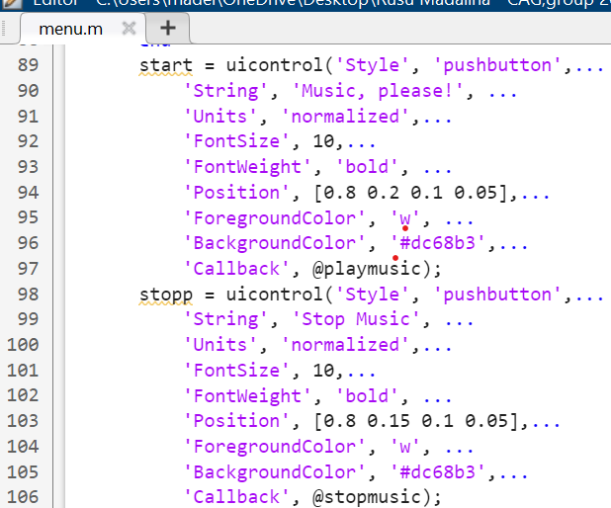
two pushbuttons titled “Music, please!” and “ Stop music” that either start or stop the music through callbacks to two different functions (@playmusic / @stopmusic)

Slide 10
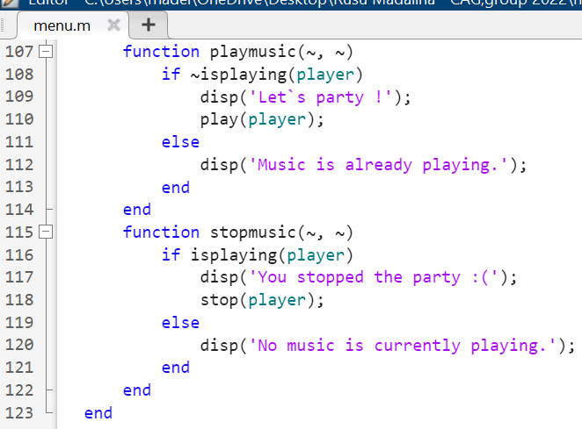
function playmusic – plays music and displays a message (depending if the audio file is already playing or not)
Function stopmusic – stops music and displays a message (depending if the audio file is already playing or not)

Slide 11
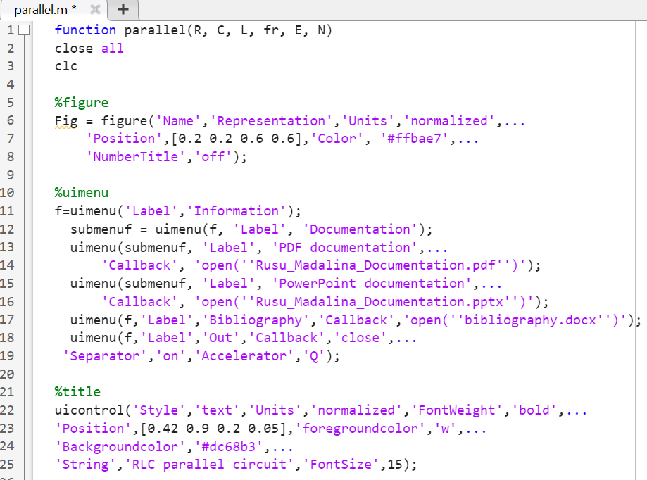
parallel.m
figure – creates new figure window
uimenu – same menu bar as before, so it can be accessed from both figures
uicontrol (‘Style’ , ‘text’…) – creates a text label that contains the title of the project

Slide 12
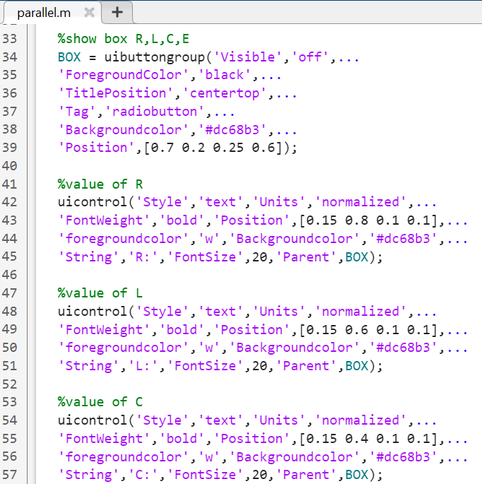
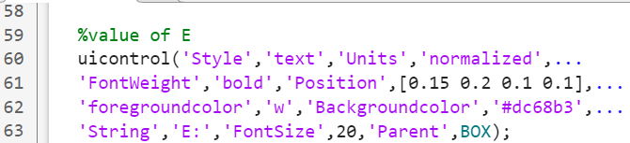
uibuttongroup – fuction used to group related components, in this case text fields, under the parent name “BOX”
Next, for each of the elements of the group, R, L, C and E, we defined text fields that cannot be modified and we assigned them to the group using: ‘Parent’ , ‘BOX’.

Slide 13
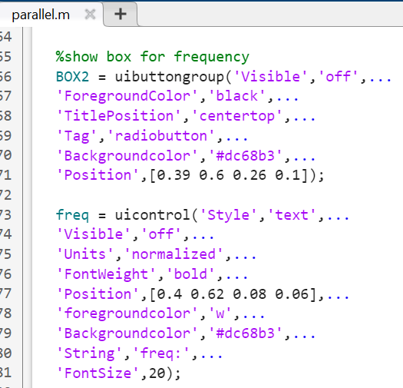
uibuttongroup – fuction used to group related components, in this case only one text field for the soul purpose of having a good page layout, under the parent name “BOX2”
Text field freq (for frequency) has been defined and assigned to the group using: ‘Parent’ , ‘BOX2’.

Slide 14
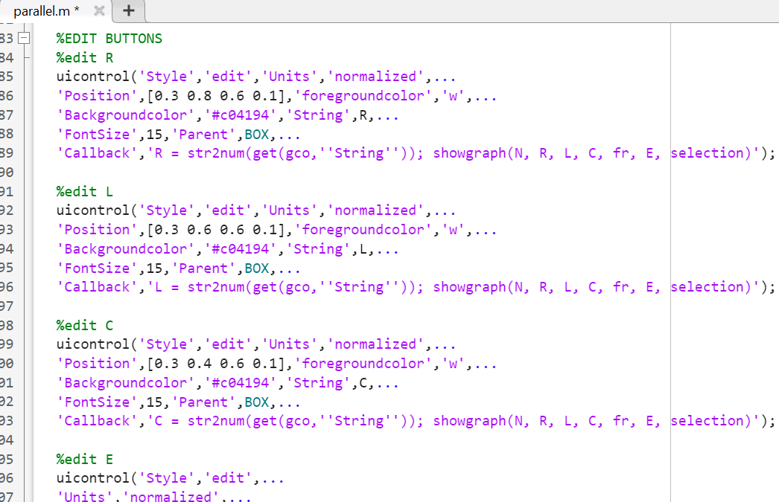
uicontrol (‘Style’ , ‘edit’…) – allows us to create editable text field for each element of both groups (R,L,C,E,f).
The callback: input is converted into a number and then stored into a variable. Then, the function “showgraph” is called which helps with visualizing the graph with the new values.

Slide 15
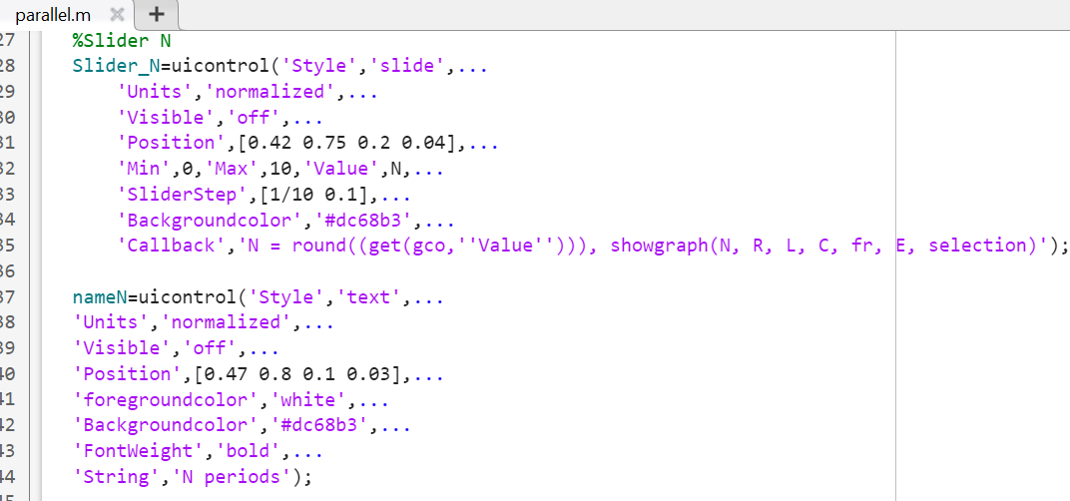
uicontrol (‘Style’ , ‘slide’…) – creates a slider between a minimum value (0) and a maximum value(10), with a step of 1. Callback: the retrieved value is rounded to the next integer on the slider. The result can be visualized on the graph by calling the function “showgraph”.
Then we create a text field for the slider.

Slide 16
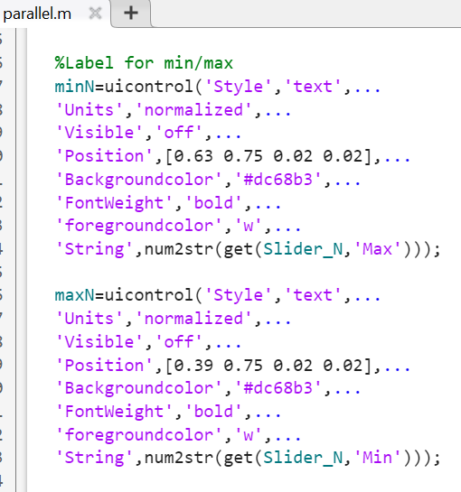
Labels for min/max of the slider are defined as text fields. They have been assigned the values of 0 and 10, and we need to convert these numerical values into string so that they can pe displayed on the interface.

Slide 17
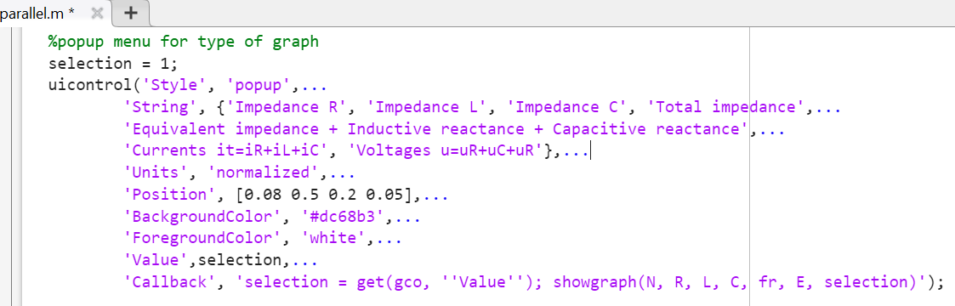
The popup menu is created using a variable called “selection” that is assigned a value based on the index selected by the user. By calling the function “showgraph”, the correct graph is being displayed based on the value of the index.

Slide 18
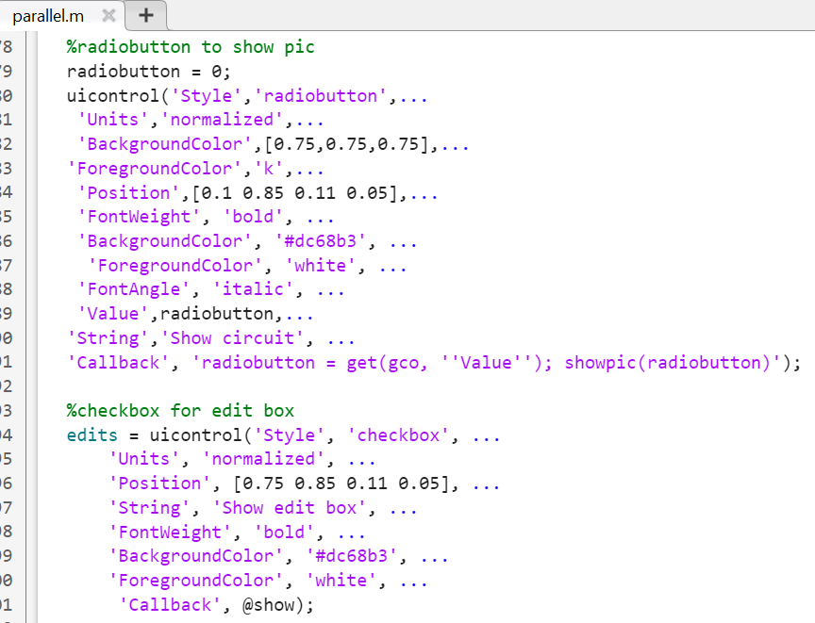
uicontrol (‘Style’ , ‘radiobutton’…) – creates a radiobutton used to display the electrical chematic of the circuit, through callback of the function “showpic”
uicontrol (‘Style’ , ‘checkbox’…) – creates a checkbox and, if it is checked, the two edit boxes previously mentioned appear on the interface

Slide 19
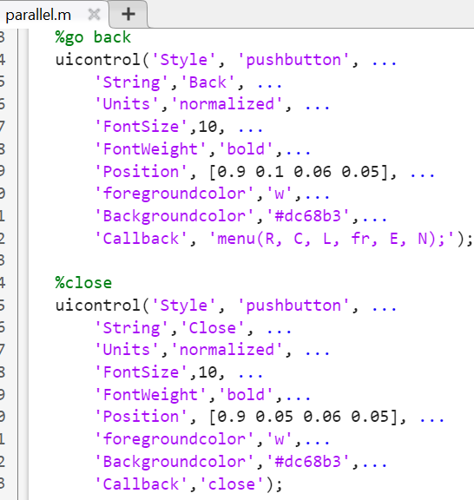
Here we created two pushbuttons: one that takes the user back to the main interface (or menu) through callback of the function “menu” and one that closes the interface completely.

Slide 20
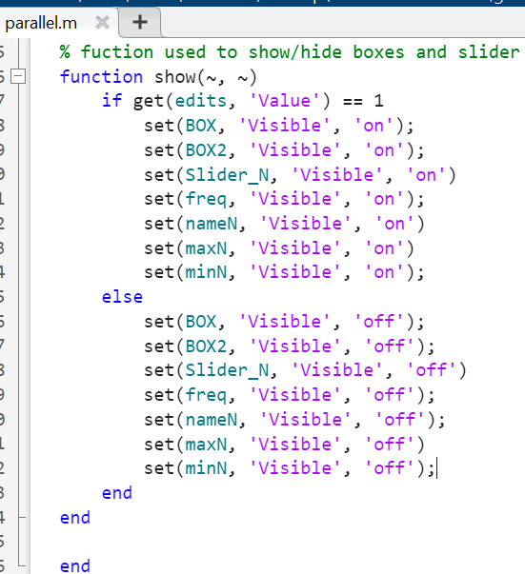
This function, called “show”, allows the program to either display or not the two text and edit boxes and the slider (with name and labels) depending weather or not the checkbox is checked or not ( has the value 0 => false, 1 =>true).

Slide 21
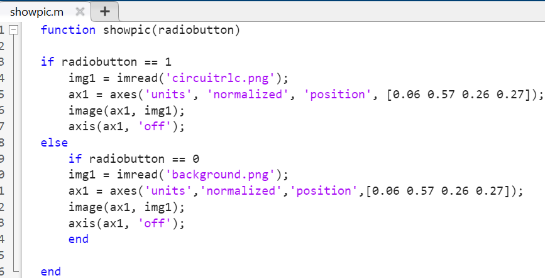
showpic.m
This function with the parameter “radiobutton” displays a picture of the circuit, if the value of the parameter is 1, or a picture of the background, for value 0. The function reads the image from the folder and then it is displayed on a certain position.

Slide 22
THEORETICAL ASPECTS
(used in showgraph.m)

Slide 23
Definitions
RLC circuits are electrical circuits consisting of a resistor (R), an inductor (L), and a capacitor (C), connected in series or in parallel. In this project, we consider a circuit where the components are connected in parallel.
RLC circuits have many applications as oscillator circuits.
An RLC circuit can be used as a band-pass filter, band-stop filter, low-pass filter or high-pass filter.

Slide 24
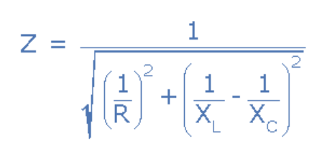
Formulas
Impedance R: Xr = R (first graph)
Impedance L: XL = 2 * pi * f * L (second graph)
Impedance C: XC = 1 ./ 2 * pi * f * C (third graph)
Total impedance of an RLC parallel circuit:
Equivalent impedance of an RLC parallel circuit:

Slide 25
INTERFACE

Slide 26
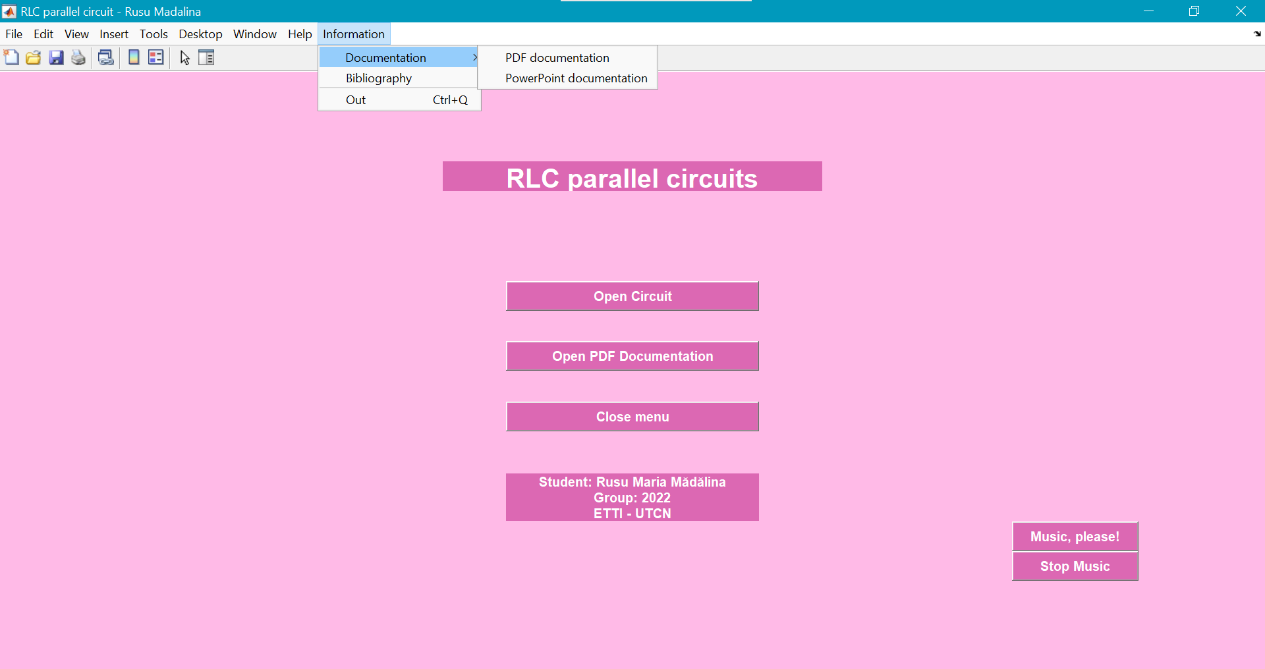
Menu bar that contains:
submenu with documentation in two formats
bibliography
close button “Out”
Text box for the title
Pushbutton to access the circuit
Pushbuttons used to start/stop the music
Pushbutton to access the documentation
Pushbutton that closes the menu
Text box for info about author

Slide 27
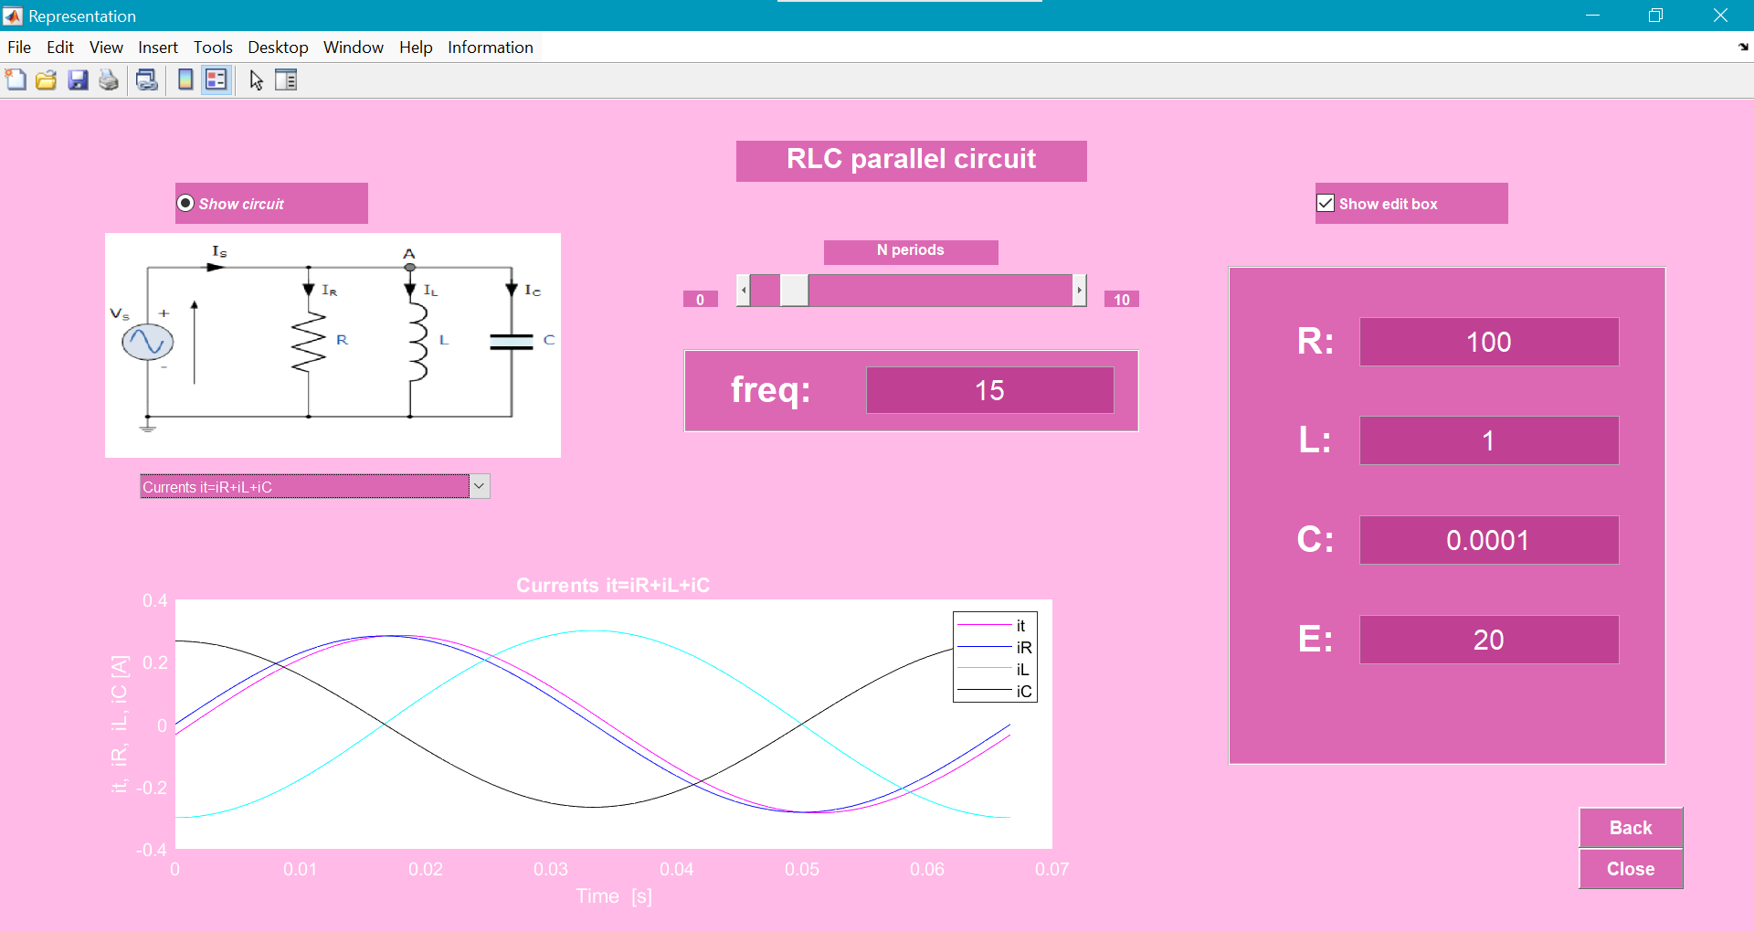
Same menu bar as before
Radiobutton that, if pressed, reveals the electrical circuit
Checkbox that shows text and edit boxes for values of R,L,C,E
Text box for the title
Slider for number of periods (between 0 and 10) (activated by checkbox
Text and edit box for f (activated by checkbox)
Popup menu to select the type of graph we want
Pushbutton that goes back to the “menu” interface
Pushbutton that closes the interface

Slide 28
BIBLIOGRAPHY

Slide 29
Laboratory “Computer Aided Graphics” - Conf. Dr. Ing. Mihaela Cîrlugea
Course “Electronic Devices” - Ș. L. Dr. Ing. Laura Ivanciu
“Matlab for students” - Conf. Dr. Ing. Mihaela Cîrlugea
“Matlab for students.GUI” - Conf. Dr. Ing. Mihaela Cîrlugea
https://www.mathworks.com/help/matlab/index.html
https://htmlcolorcodes.com/
https://www.electronics-tutorials.ws/accircuits/parallel-circuit.html
https://en.wikipedia.org/wiki/RLC_circuit
https://electronics-formulas.com/calculating-parallel-rlc-circuit/
ChatGPT – for sound button

Slide 30


THANK YOU!

