Slide 1
TESTING LAB · 4TH YEAR
Failure Mode and Effects Analysis (FMEA)
Hardware and software DFMEA: how we find failures before they exist
Faculty of Electronics, Telecommunications and Information Technologies, UPT
Case study: the CAN node (MCP2551) of a front radar (ASIL B)
Notes:
Welcome to the last lab of the series. In HW TCA we asked whether the production tests catch the manufacturing defects. In SW TCA we asked how completely we tested the code. Today we take the step before: the analysis which, in industry, decides what has to be tested and why.
FMEA means failure mode and effects analysis. In the first 30 minutes we see what it is, why and when it is done, which standards require it, the 7 steps of the AIAG-VDA method and the link with testing. Then we do the demo variant F0 together in the app, on hardware and on software, and at home each of you does your own variant and sends the report.

Slide 2
What we cover today
1
What FMEA is
DFMEA, PFMEA, FMEA-MSR
2
Why, when, on what
and who does it
3
Standards, laws, industries
AIAG-VDA, IATF 16949, ISO 26262, IEC 60812
4
The 7 AIAG-VDA steps
from planning to the report
5
Structure, functions, failures
effect – mode – cause, on HW and on SW
6
The risk
S, O, D and the action priority (AP)
7
Optimization and testing
P and D actions, PASS / FAIL, the link with TCA
8
Today's lab
demo F0, then your own variant
Notes:
The agenda has eight points. We start from the definition and the types of FMEA, then see why it is done, when and on what. We go through the standards and laws that require it and through other industries. The central part is the 7 steps: the structure, the functions, the failure net and the risk rating with S, O, D and AP. We close with the optimization, with the link between FMEA and testing, and with what you do today.

Slide 3
What FMEA is: three types
Type | What it analyses | Example on the CAN node
DFMEA (design) | The product design: the schematic, the components chosen, the layout, the requirements and the code | R4 chosen with too low a power rating; SENSOR_MAX written in another unit
PFMEA (process) | The manufacturing and assembly process | C2 missing after placement; cold solder joint on J2 (the HW TCA lab)
FMEA-MSR | Monitoring and system response in operation, in the vehicle | The radar detects bus-off and reports the fault to the ADAS ECU
Today: DFMEA, on a hardware signal and on a software function of the same CAN node.
Sources: [1] AIAG & VDA FMEA Handbook, 2019 · [2] SAE J1739:2021
Notes:
FMEA is a risk analysis done before the failure exists. The team takes every element of the product, writes what it has to do, that is the functions, asks how it might fail to do it, that is the failure modes, what happens then, that is the effects, and why it could happen, that is the causes.
The 2019 AIAG-VDA handbook has three types. DFMEA analyses the design. PFMEA analyses the manufacturing process: exactly the defects you rated in HW TCA. FMEA-MSR analyses how the system is monitored and how it reacts in operation.
Today we do a DFMEA, on two parts of the same CAN node: a hardware signal and a software function.

Slide 4
Why, when, on what and who
Why
So that failures are removed in the design, not found at the customer. A change in design is cheap; the same failure found in the field means recalls, warranty and legal liability.
When
The DFMEA starts together with the design (concept, schematic, software architecture) and is updated at every change: it is a living document, not a form filled in at the end.
On what
On the system (the radar), on subsystems and components (the CAN node, the filters, the transceiver), on software (the functions) and, as PFMEA, on the manufacturing process.
Who
A team: HW designer, SW developer, test and validation engineer, functional safety engineer, quality engineer. Today, you play all the roles.
Notes:
Why do we do FMEA? Because a failure costs more the later it is found. In design you change a value in the schematic or a constant in the code. In the field you have recalls, warranty and sometimes lawsuits.
When? From the start of the design, and it is updated at every change. FMEA is a living document: if it is done at the end, only so that it exists, it loses its point.
On what? On any level: system, component, software, process.
Who? A team with several roles. A good analysis comes from the discussion between the designer, the tester and the safety engineer. Today, each of you plays all of them.

Slide 5
How FMEA evolved
1949
MIL-P-1629, US Army
1977
FMEA enters the automotive industry
1994
SAE J1739, first edition
2018
IEC 60812, edition 3
2021
SAE J1739, current edition
1966
NASA, the Apollo programme
1980
MIL-STD-1629A
2006
IEC 60812, edition 2
2019
AIAG-VDA: 7 steps, AP
Sources: [1] AIAG & VDA, 2019 · [2] SAE J1739 · [3] IEC 60812:2018
Notes:
FMEA comes from the military: the MIL-P-1629 procedure, from 1949. In the 1960s NASA used it in the Apollo programme, and in 1977 it entered the automotive industry. In 1994 came SAE J1739, the American automotive standard.
The important step for us is 2019: the joint AIAG-VDA handbook, which harmonized the American and the German methods. It introduced the 7 steps and replaced the risk priority number, RPN, with the action priority, AP. For any industry, the general standard is IEC 60812, the 2018 edition.

Slide 6
Which standards and laws require FMEA
AIAG-VDA FMEA / SAE J1739
The method: 7 steps, the S, O, D tables and the AP table, for DFMEA, PFMEA and FMEA-MSR [1][2].
IATF 16949
The automotive quality system: requires the design risk analysis (DFMEA) among the design outputs and the PFMEA among the process outputs [4].
ISO 26262-9
Safety analyses (clause 8); FMEA is the inductive analysis used most often. For random HW failures there is FMEDA (ISO 26262-5) [5].
IEC 60812:2018
FMEA and FMECA for any industry: terms, steps, types of analysis [3].
Product liability
Directive (EU) 2024/2853 explicitly treats software as a product: an unanalysed failure becomes a legal problem [6].
Customer requirements
Vehicle manufacturers require FMEA in the contract and check it at audits and at part approval.
Sources: [1] AIAG & VDA · [2] SAE J1739 · [3] IEC 60812 · [4] IATF 16949:2016 · [5] ISO 26262:2018 · [6] Directive (EU) 2024/2853
Notes:
Which documents require FMEA? The method is described by the AIAG-VDA handbook and SAE J1739. IATF 16949, the automotive quality management system, requires the design risk analysis and the PFMEA as mandatory outputs of product and process design.
ISO 26262, the functional safety standard, requires safety analyses in part 9; FMEA is the most used inductive analysis. Note: for random hardware failures there is a quantitative form, FMEDA, from part 5, which we do not do today.
And the legal side: the new European product liability directive, from 2024, explicitly includes software. And customers require FMEA in the contract and check it at audits.

Slide 7
And in other industries
Aerospace
SAE ARP4761A (2023): the safety assessment, with FMEA; SAE AS13004: PFMEA and the control plan.
Medical
ISO 14971: risk management for medical devices; FMEA is one of the analysis techniques.
Railway
EN 50126 (RAMS): reliability, availability, maintainability and safety, with FMEA as a basic analysis.
Industry in general
IEC 61508 for functional safety; IEC 60812 for FMEA.
Telecom
There is no dedicated FMEA standard. TL 9000 is the quality system of the ICT sector; IEC 60812 is used and, for reliability, Telcordia SR-332.
Conclusion
The method is the same everywhere: functions, failures, effects, causes, risk, actions. The scales differ, and so does the standard that requires it.
Sources: SAE, ISO, CENELEC, IEC · TL 9000 (QuEST Forum) · Telcordia SR-332
Notes:
FMEA is not specific to automotive. In aerospace, ARP4761A describes the safety assessment, and AS13004 deals with PFMEA. In medical, ISO 14971 is the risk management standard. In railway, EN 50126.
For telecom, the natural question is whether it has its own standard. There is no dedicated FMEA standard: the ICT sector has TL 9000 as its quality system, and for the analysis the general standards are used, IEC 60812, plus Telcordia SR-332 for reliability prediction. That is why in the lab we use the automotive method, which is the best documented.

Slide 8
What happens if it is not done
At the audit
A missing DFMEA, or one that is not used, is an IATF 16949 nonconformity; the supplier may lose the certification and the customer.
In development
Failures are found late, at validation or at the customer, when the change is expensive and delays the launch.
In the field
Recalls, warranty and loss of the customer's trust; for safety functions, a risk for people.
Legal
Liability for defective products, which now includes software; FMEA is the evidence that the risks were analysed.
Notes:
What happens if FMEA is missing or done only on paper? At the quality audit it is a nonconformity. In development, failures show up at validation, when the change is expensive. In the field there are recalls, and for a radar that decides braking, the risk is for people.
And legally, FMEA is the evidence that the company analysed the risks. If it does not exist, the company cannot show that it did what was due.

Slide 9
The 7 steps of the AIAG-VDA method
1
Planning
2
Structure
3
Functions
4
Failures
5
Risk analysis
6
Optimization
7
Documentation
S · Severity
How severe is the effect? On the effect, from table D1: 10 safety, 9 regulations, 8 loss of the primary function … 1 no effect.
O · Occurrence
How likely is the cause, with the existing prevention? On the cause, from table D2: 10 new technology … 1 the cause is not possible by design.
D · Detection
How reliably does the existing detection find the cause before release? From table D3: 1 reliably … 10 no test exists.
Steps 1–3 prepare the analysis, steps 4–6 are the analysis itself, step 7 documents it. In the app: Step 1, the HW and SW tabs with steps 2–3, 4 and 5–6, then the Report.
Sources: [1] AIAG & VDA FMEA Handbook, 2019
Notes:
The AIAG-VDA method has 7 steps. Planning sets the intent, timing, team, tasks and tools, the 5T. Structure analysis draws the product tree. Function analysis writes what each element must do. Failure analysis builds the effect, mode, cause net. Risk analysis rates S, O and D. Optimization proposes actions. Documentation communicates the results.
Risk has three ratings from 1 to 10. Severity is rated on the effect. Occurrence is rated on the cause and takes prevention into account. Detection says how reliably we find the cause before release, with the existing tests and analyses. Note: in HW TCA you used table P2, the process table, for O. In DFMEA, table D2, the design table, is used.

Slide 10
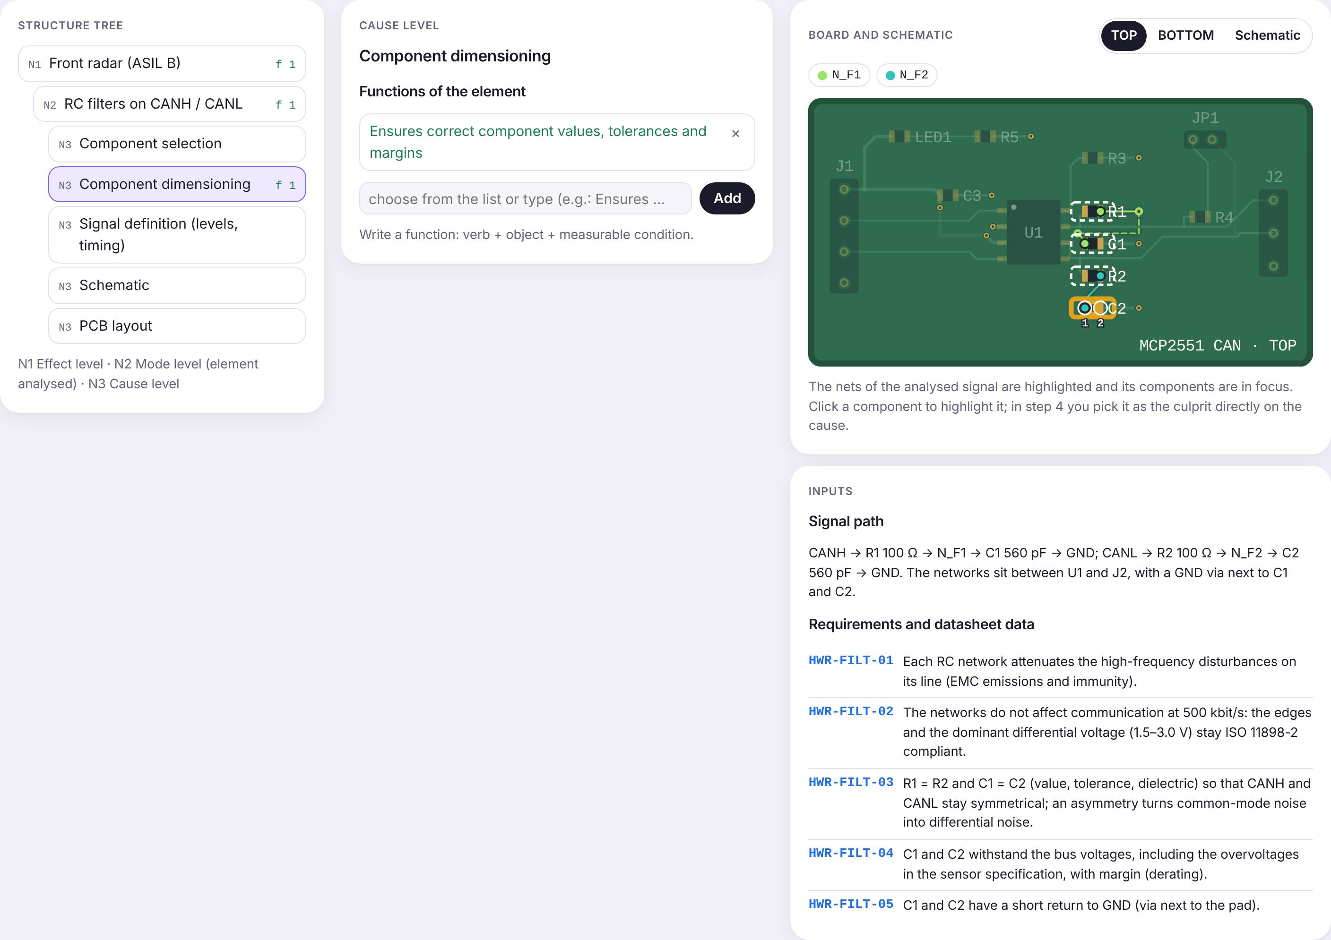
The structure: three levels
N1, the effect level: the radar, seen from the vehicle and from the ADAS ECU.
N2, the mode level: the element analysed, the HW signal or the SW function; this is where the failure modes appear.
N3, the cause level: the design cause categories. HW: component selection and dimensioning, signal definition, schematic, layout. SW: requirements, constants, logic, data types, interface.
The functions: verb + object + measurable condition, for example „Provides 120 Ω ±1 % between CANH and CANL”.
F0 HW: the structure tree, the function and the board
Sources: [1] AIAG & VDA FMEA Handbook, 2019 (steps 2 and 3)
Notes:
The structure tree has three levels. At the top is the radar: that is where the effects are seen, at vehicle level. In the middle is the element we analyse: the hardware signal or the software function of your variant. That is where the failure modes appear. At the bottom are the design cause categories.
For every element we write the functions. A good function has a verb, an object and a condition you can measure. „The filter works well” is not a function; „attenuates the high-frequency disturbances on CANH and CANL” is.
In the lab, a simplification: choose a single function per element. In industry all of them are analysed; we are checking whether you understand the rating, not a complete analysis.

Slide 11
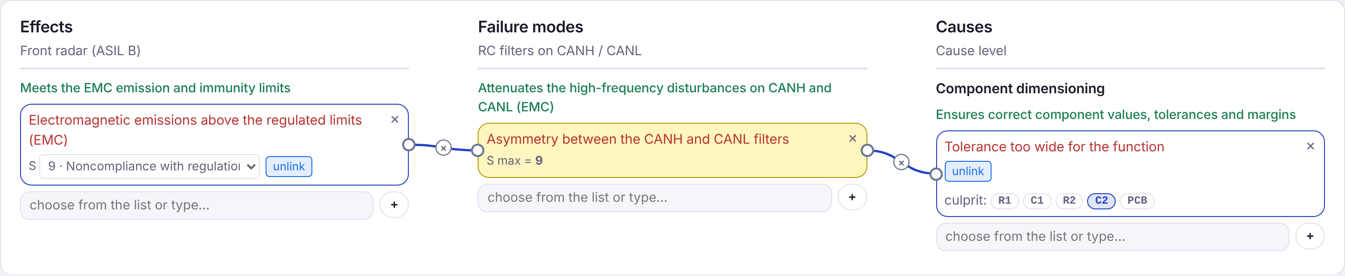
The failure net: effect – mode – cause
A failure is the negation of the function: missing, partial, intermittent, unwanted, out of limits.
The effect (N1) ← the mode (N2) ← the cause (N3): every mode is linked to at least one effect and one cause; the mode takes the highest S of the effects.
The culprit: on every cause choose the component (HW) or the requirement (SW, for the requirement causes). „C2 has too wide a tolerance” is a cause, not a mode.
F0 HW: EMC emissions above the limit ← asymmetry between the filters ← tolerance too wide (culprit C2)
Sources: [1] AIAG & VDA FMEA Handbook, 2019 (step 4)
Notes:
Step 4 is the heart of the analysis. A failure is the negation of a function: the function is missing, works partially, intermittently, does something unwanted or goes out of limits.
We link three levels. The effect, at the top, at radar level. The mode, in the middle, on the element analysed. The cause, at the bottom, in the design category. In the example in the picture: the EMC emissions exceed the limits, because the filters on CANH and CANL are not symmetrical, because C2 was chosen with too wide a tolerance.
The most common mistake: writing the cause in place of the mode. „C2 has too wide a tolerance” is a cause; the mode is what the filter does wrong. On every cause choose the culprit: the component for hardware, the requirement for software causes in the requirements category.

Slide 12
Hardware and software in the same method
HW causes in the DFMEA
Design decisions: unsuitable component, wrong value or tolerance, wrongly defined signal, schematic mistakes, layout. The manufacturing defects of the same parts belong to PFMEA and HW TCA.
SW causes
All systematic: incomplete requirement, wrong constant, wrong operator at the boundary, data type too small, wrong call or return value. Software does not wear out and is not manufactured unit by unit.
What is the same
The steps, the effect – mode – cause net, the S, O, D and AP tables, the P and D actions.
What differs
Prevention and detection: in HW calculations, simulations, tests on the prototype and EMC; in SW coding rules, reviews, requirements-based and boundary tests (SW TCA).
Notes:
The method is the same for hardware and for software; the causes and the controls differ.
In hardware, the DFMEA causes are design decisions: you chose an unsuitable part, a wrong value or tolerance, you made a mistake in the schematic or the layout. The same capacitor also appears in HW TCA, but there the cause was manufacturing: missing, soldered wrong.
In software, every cause is systematic, as we discussed in SW TCA: an incomplete requirement, a wrong constant, a wrong operator at the boundary. Prevention in software means coding rules and reviews, and detection means requirements-based and boundary tests, exactly what you measured in SW TCA.

Slide 13
The risk: S, O, D and the action priority
Rating | What it rates | Rated on | Table
S | The severity of the effect | On the effect (N1); the mode takes the maximum | D1
O | The likelihood of the cause, with the existing prevention | On the cause (N3) | D2
D | How reliably and how early the detection finds the cause or the mode | On the mode – cause link | D3
AP | Action priority: H needed, M recommended, L optional | Follows from S, O, D; not chosen | AP
D also depends on timing: a proven test, but done after tooling release, has D 5–7.
Sources: [1] AIAG & VDA FMEA Handbook, 2019 (tables D1, D2, D3, AP)
Notes:
For every mode – cause link we rate the risk. Severity comes from the effects: the mode takes the highest severity of the effects linked to it. Occurrence is rated on the cause and takes prevention into account: how new the design is, how much experience exists, how proven the controls are. Detection is rated on the detection controls: the existing tests and analyses.
A detail that matters: D depends on timing. A very good EMC test, but planned after the tooling has been ordered, still has D 7. The detection exists, but comes too late to change the design cheaply.
AP is not chosen. It follows from the table.

Slide 14
Why action priority (AP), not RPN
120
Case | S | O | D | RPN | AP
A: safety effect | 9 | 4 | 3 | 108 | H
B: minor effect | 3 | 6 | 6 | 108 | L
C: primary function | 8 | 2 | 5 | 80 | M
distinct values out of the 1000 possible S × O × D combinations [7]
The same RPN can hide completely different risks (A and B).
AP is a lookup table that gives priority to severity: H, M or L [1].
At S 9–10 with O 4–5, D 2–4 leaves AP H: in practice only prevention (a lower O) lowers the risk.
Sources: [1] AIAG & VDA FMEA Handbook, 2019 (AP table) · [7] Bowles, RAMS 2003
Notes:
For a long time risk was calculated as a product: RPN equals S times O times D. Bowles showed in 2003 that the 1000 combinations give only 120 distinct values, and the same number can mean very different things. Cases A and B have the same RPN, 108, but A is a safety effect and B a minor one.
That is why the AIAG-VDA handbook replaced RPN with AP, a table that gives priority to severity. An important consequence: at high severity and moderate occurrence, a better test is not enough. The risk drops only if we change the design, that is the prevention.

Slide 15
Optimization: P and D actions
P action (prevention)
Changes the design and lowers O: another component, another tolerance, a design rule, constants generated from the specification.
D action (detection)
Adds or moves a test and lowers D: EMC pre-compliance test on the prototype, a boundary test in software.
PASS or FAIL
When the action is done, it has a result. FAIL means the test found the failure: the detection worked, but the failure exists. A corrective P action follows and O is re-rated.
The residual risk
If after the revision the risk is still H or M, an additional action (P or D) is proposed and the remaining risk is justified.
Sources: [1] AIAG & VDA FMEA Handbook, 2019 (step 6)
Notes:
Where AP comes out H or M, we propose actions. Every action has a type, a responsible person and a due date. A prevention action changes the design and lowers the occurrence. A detection action adds or moves a test and lowers the detection.
Mind the result. If the proposed test FAILs, it means it found the failure. The detection worked, but the failure exists. An even better test is not enough: a design change is needed, so a P action, and the occurrence is re-rated.
If after all this the risk is still H or M, we propose an additional action and write why we accept the remaining risk.

Slide 16
FMEA and testing
DFMEA
causes, prevention and detection controls
Verification plan
the tests come from the detection controls
Tests
on the prototype, EMC, requirements-based software tests
Result
PASS / FAIL
Back into the FMEA
new O and D, corrective actions
›
›
›
›
HW TCA: the same components, but manufacturing causes; the question is what AOI, AXI, ICT and FT catch.
SW TCA: shows how complete the software tests used as detection in the SW DFMEA are.
A low D on „requirements-based testing” only makes sense if the tests cover the code and the boundaries.
Sources: [1] AIAG & VDA FMEA Handbook, 2019 · ISO 26262-6:2018
Notes:
How is FMEA linked to testing? The detection controls in the DFMEA are in fact the tests in the design verification plan: the EMC test, the measurements on the prototype, the software tests. The tests are done, and the result, PASS or FAIL, goes back into the FMEA and changes O and D.
The previous labs cover the test side of the same elements. In HW TCA you asked whether the production tests catch the manufacturing defects of the components. In SW TCA you measured how complete the software tests are. Today you see where these tests come from: from the risk analysis.

Slide 17
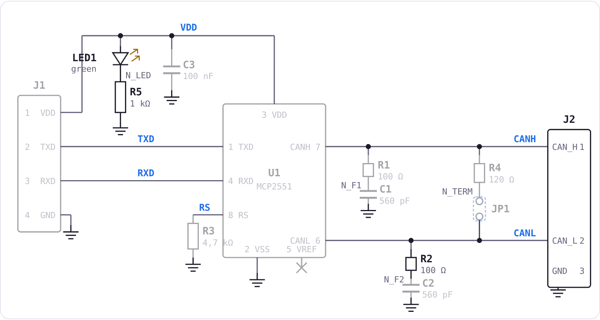
The case study: demo variant F0 and your variants
HW · F0: the RC filters on CANH / CANL
R1/C1 and R2/C2, 100 Ω / 560 pF. The function: attenuates the high-frequency disturbances (EMC), without affecting communication at 500 kbit/s.
SW · F0: sensor_value_plausible(), the azimuth angle
Rejects values outside ±60.0° and jumps larger than 2.0° per cycle. A signal used only in the demo.
Variants F1–F6
Each has a HW signal (TXD, RXD, VDD, CANH / CANL, RS, the termination) and a SW function from the SW TCA lab.
The CAN module with the MCP2551, as in the HW TCA lab
Sources: Microchip DS21667F (MCP2551); ISO 11898-2:2024
Notes:
We work on the same CAN node as in the previous labs. We do the demo F0 together. On hardware we analyse the RC filters on CANH and CANL, which are not in any of your variants. On software we analyse the plausibility function for the azimuth angle, a signal that nobody gets at home either.
Variants F1 to F6 each have a hardware signal and a software function from the SW TCA lab.

Slide 18
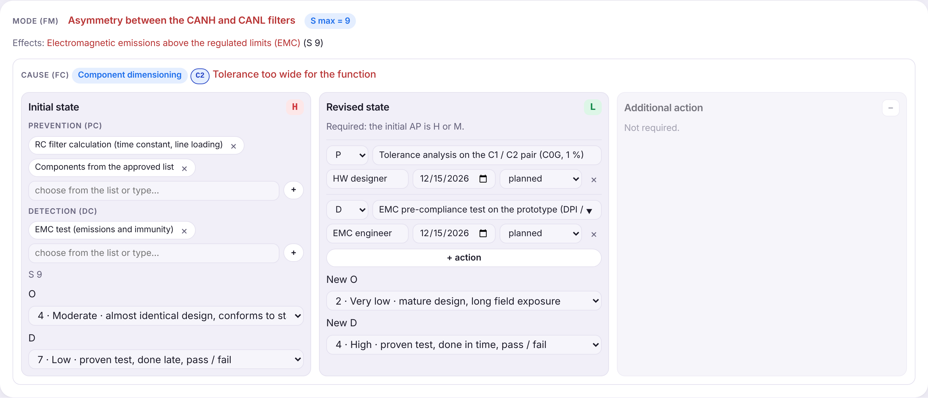
Demo F0 (HW): the asymmetry between the filters
The chain: EMC emissions above the regulated limits (S 9) ← asymmetry between the CANH and CANL filters ← tolerance too wide on C2.
The initial state: prevention: RC filter calculation, components from the approved list (O 4); detection: EMC test after tooling release (D 7). AP H.
Actions: [P] tolerance analysis on C1 / C2 (C0G, 1 %), [D] EMC pre-compliance test on the prototype. New O 2, new D 4, AP L. If the test FAILs: a corrective P action.
The initial state (AP H) and the revised state (AP L)
Sources: [1] AIAG & VDA FMEA Handbook, 2019 · ISO 11898-2:2024
Notes:
The first example, on hardware. If C1 and C2 do not have the same value, the filters on the two lines are no longer symmetrical, and the common-mode noise turns into differential noise. The result is at vehicle level: EMC emissions above the regulated limits, so severity 9.
The existing prevention is good, so O 4, but the EMC test is done late, after tooling release: D 7. AP comes out H. We propose two actions: the tolerance analysis, that is prevention, and an early pre-compliance test, on the prototype, that is detection. The risk drops to L.
And the FAIL scenario: if the pre-compliance test finds the problem, praising the test is not enough. The design has to change.

Slide 19
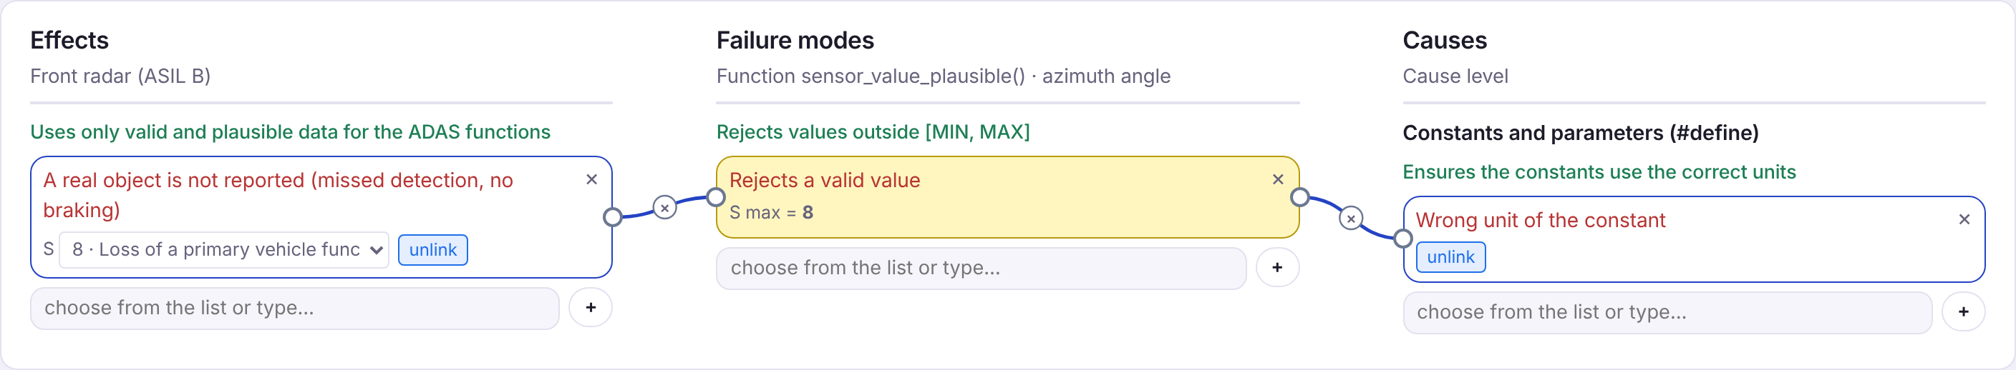
Demo F0 (SW): the constant written in another unit
The chain: a real object is not reported (S 8, loss of the primary function, at sensor level) ← rejects a valid value ← SENSOR_MAX = 60 instead of 600 (tenths of a degree).
The initial state: code review against the sensor specification (O 4); requirements-based testing and boundary tests (D 3). AP M.
P action: constants generated automatically from the sensor specification: new O 2, AP L. The boundary test from SW TCA (600 / 601) would have caught the cause.
F0 SW: effect – mode – cause for the constant SENSOR_MAX
Sources: [1] AIAG & VDA FMEA Handbook, 2019 · ISO 26262-6:2018, table 8
Notes:
The second example, on software. The function checks whether the azimuth angle is within range, plus or minus 60 degrees, in tenths of a degree. If someone writes SENSOR_MAX equal to 60, in degrees, the function rejects every object more than 6 degrees off-axis. The radar loses real objects: at sensor level, the loss of the primary function, severity 8.
The existing prevention is the code review, so O 4. The detection is good: requirements-based and boundary tests, D 3. AP comes out M. The prevention action: the constants are generated automatically from the sensor specification, so the unit mistake can no longer occur, and the risk drops to L.
The link with SW TCA: a boundary test, with 600 and 601, would have failed immediately.

Slide 20
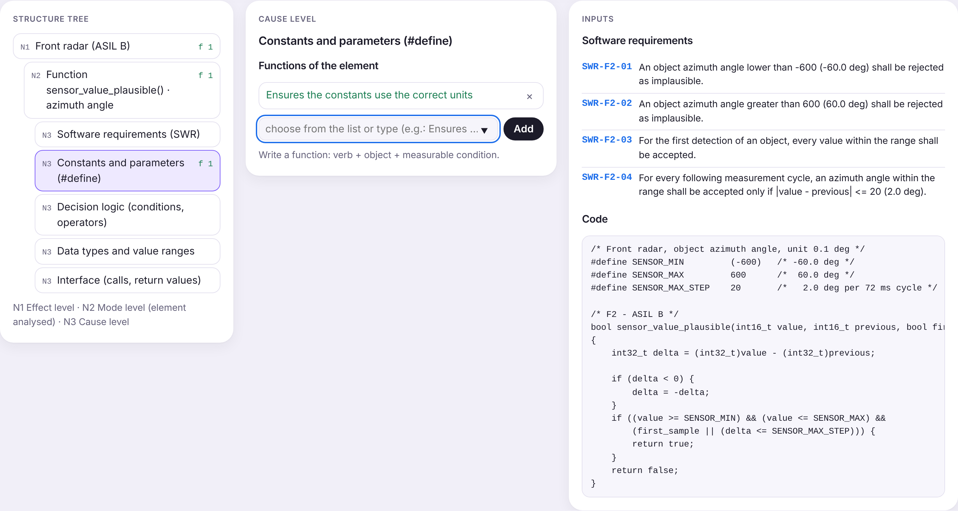
What you do in today's lab
1
Step 1 read the 5T of the variant
2
Steps 2–3 one function per element: N1, N2 and the N3 categories used
3
Step 4 effects (with S), modes, causes, links and the culprit
4
Step 5 prevention and detection, O and D; AP follows from the table
5
Step 6 P or D actions for H and M; on FAIL, a corrective P action
6
Limits at most 3 modes, 3 effects and 2 causes per mode
7
Report the checks without errors, the conclusion, then send the report
F0 SW: the structure tree and the code analysed
The app: madalinatolontan1-ai.github.io/sw-tca-lab/fmea/
Notes:
Now the practical part. Open the app and load variant F0. We do it together, first on hardware, then on software, step by step: the structure and the functions, the failure net, then the risk and the actions. At every step the app has the context, the steps with the example on F0 and the AIAG-VDA tables.
Remember the simplification: one function per element and few modes and causes. It is not industry practice, but we are interested in how you rate, not in the volume.
At home, each of you loads the variant you received, from F1 to F6, does both analyses and sends the report. By sending it you agree that the data in the report may be used for a case study; names are not used anywhere. After sending, an anonymous 5-question questionnaire about the app appears.

Slide 21
Where it is used and which careers it opens
FMEA / quality engineer
Moderates the team, keeps the DFMEA and PFMEA up to date, prepares the IATF 16949 audits.
HW designer
Applies the prevention actions: components, tolerances, layout, worst-case calculations.
SW developer
Implements the requirements and the coding rules; answers for the software causes.
Test and validation engineer
Turns the detection controls into tests and brings the results back into the FMEA.
Functional safety engineer
Links FMEA to ISO 26262: FMEDA, safety analyses, ASIL.
Reliability engineer
Analyses field failures and feeds them back into the analysis.
Notes:
As graduates, you will meet FMEA in almost every role in automotive electronics. The quality or FMEA engineer moderates the analysis. Hardware designers and software developers apply the actions. Test engineers turn the detection into tests, and functional safety engineers link the analysis to ISO 26262. All these roles are in demand at automotive electronics companies, including here, in Timișoara.

Slide 22
References
[1] AIAG & VDA, FMEA Handbook, 1st ed., 2019.
[2] SAE J1739:2021, Potential Failure Mode and Effects Analysis (FMEA).
[3] IEC 60812:2018, Failure modes and effects analysis (FMEA and FMECA).
[4] IATF 16949:2016, Automotive quality management system standard.
[5] ISO 26262:2018, Road vehicles — Functional safety, parts 5, 6 and 9.
[6] Directive (EU) 2024/2853 on liability for defective products.
[7] J. B. Bowles, „An Assessment of RPN Prioritization in a Failure Modes Effects and Criticality Analysis”, Proc. RAMS, 2003, doi:10.1109/RAMS.2003.1182019.
[8] SAE ARP4761A (2023); SAE AS13004; ISO 14971:2019; EN 50126; IEC 61508.
[9] TL 9000 Quality Management System; Telcordia SR-332.
[10] Microchip, MCP2551 High-Speed CAN Transceiver, DS21667F, 2010; ISO 11898-2:2024.
Notes:
The complete reference list. The standards are not free; you can find them in the faculty library. The AIAG-VDA handbook is the reference for everything we did today.

