Slide 1
TESTING LAB · 4TH YEAR
Production Test Coverage Analysis (HW TCA)
How well production tests catch the manufacturing defects of an automotive circuit board
Faculty of Electronics, Telecommunications and Information Technologies, UPT
Case study: the CAN node (MCP2551) of a front radar
Notes:
Welcome. Today we talk about an analysis that every company producing automotive electronics carries out: production test coverage analysis, HW TCA for short (Test Coverage Analysis, hardware).
The question it answers is simple: if a board leaves the assembly line with a defect, do we have a test that catches it before it reaches the customer? And if not, how large is the risk?
In the first 30 minutes we cover the theory: what the analysis is, what it is used for, which standards and laws require it, what happens when it is missing and how it relates to testing. Then you work individually in the web app, on the CAN module of the front radar we use in all the labs.

Slide 2
Today's topics
1
Why we test in production
from the SMT line to the customer
2
What test coverage analysis is
what a passed test proves
3
PCOLA/SOQ/FAM and test methods
AOI, AXI, ICT, boundary scan, FT
4
Risk: analysis and assessment
S, O, D and action priority
5
Standards and laws
AIAG-VDA, ISO 26262, IATF 16949, IPC, EU
6
Real consequences
recalls documented by NHTSA
7
Other industries
aerospace, medical, rail, telecom
8
Today's lab and careers
the method step by step
Notes:
The agenda has eight points. We start from the production flow, to see where defects appear and where we look for them. Then we define coverage analysis and the PCOLA/SOQ/FAM model, the common language of test engineers.
We link the analysis to risk: severity, occurrence, detection and the action priority of the AIAG-VDA method. We look at the standards and laws behind it and at a few real cases in which electronics defects reached the customer. At the end we look at other industries, at careers and at what you do in the lab.

Slide 3
From the assembly line to the customer
Assembly
paste, SMT placement, reflow, THT
AOI / AXI
optical and X-ray inspection
ICT
in-circuit test, needles on test points
FT
functional test through the connectors
EOL
end-of-line: the final test at the end of the line
Customer
the escaped defect reaches the vehicle
›
›
›
›
›
Each test stage looks for different defect types.
Early stages catch assembly defects best; late stages catch functional defects [6].
A defect that passes all stages is an “escape”: it reaches the customer.
Image placeholder:
SMT line / test stations (photo or diagram)
Sources: [6] Smith, IPC APEX (iNEMI data, 2000)
Notes:
The slide shows a typical flow. The board is assembled: solder paste is printed, SMT components are placed, the board goes through the reflow oven, then the THT components are mounted. Then come the inspections: AOI, optical, and AXI, X-ray, for hidden solder joints. Then ICT, the in-circuit test: a fixture with needles touches the test points and measures the components one by one. Then FT, the functional test, which powers the board and checks its functions through the connectors. At the end of the line, after final assembly of the product, comes EOL, end-of-line: the final test of the complete product before packing and shipping.
A paper presented at IPC APEX, citing iNEMI data from 2000, says it clearly: early stages are best at catching assembly process defects, late stages are best at catching functional defects. That is why we combine methods.
What no stage catches is called an escape and reaches the customer. Today's analysis estimates exactly that risk.

Slide 4
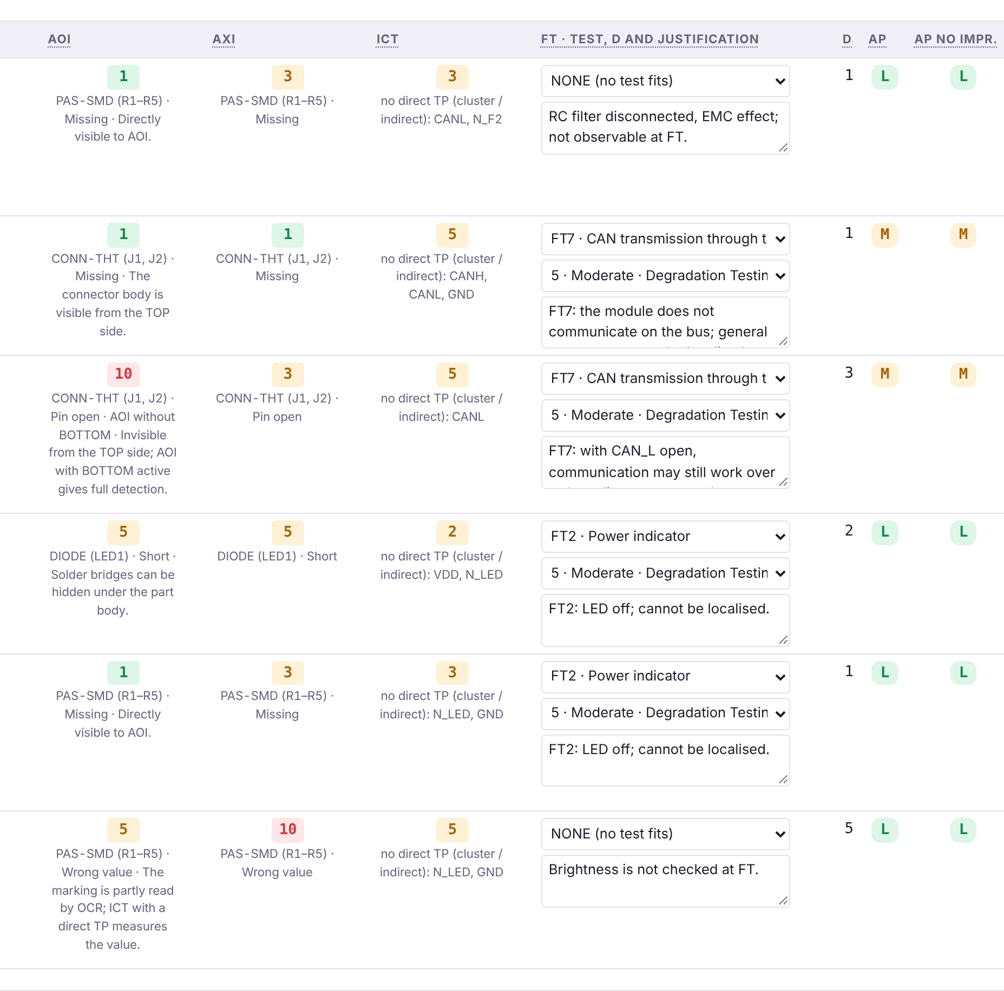
What test coverage analysis (TCA) is
“What does it mean when a board test passes?” [1]
Coverage: an indication of the quality of a test suite [4].
The right question: which defects would have been caught if present, not how many nodes have a test.
Beware of percentages: “99%” opens coverage may really mean ~40% [2].
TCA result: a detection D for each defect and method, then the residual risk.
Detection per method in the HW TCA app (variant H0)
Sources: [1] Hird et al., ITC 2002 · [2] Tegethoff et al., ITC 1996 · [4] US 6,948,140 B2
Notes:
The definition comes from the people who founded the field. The Agilent patent on characterizing board test coverage says that board test coverage is an indication of the quality of a test suite.
The reference paper, Hird, Parker and Follis, ITC 2002, asks the question in the title: what does it mean when a test passes? If a resistance measurement passes, we know the resistor is present, has the right value and is neither open nor shorted. We know nothing about what we did not measure.
A 1996 paper, “when is 99% really 40%”, shows that the percentage of accessible nodes can greatly overestimate real coverage. That is why in TCA we do not count tests; for every possible defect we ask: does any method catch it, and how reliably? The result is a D value for each defect and method, and from it the remaining risk.

Slide 5
The PCOLA/SOQ/FAM model
Component
(PCOLA)
P
Presence
part is there
C
Correctness
right part
O
Orientation
polarity
L
Live
works at all
A
Alignment
on the pads
Connection
(SOQ)
S
Shorts
bridges
O
Opens
breaks
Q
Quality
joint quality
Function
(FAM)
F
Feature
function exists
A
At-speed
at real speed
M
Measurement
performance
Sources: [1] Hird et al., ITC 2002 (PCOLA/SOQ) · [5] Ley, ASSET InterTech (iNEMI PCOLA/SOQ/FAM framework)
Notes:
PCOLA/SOQ is the model introduced by Hird and his Agilent colleagues in 2002. Each letter is a property a test can verify.
For the component: P, presence; C, correctness, that is the part with the right value; O, orientation or polarity; L, live, the part works at a basic level; A, alignment on the pads.
For the connection: S, shorts; O, opens; Q, solder joint quality.
Later, iNEMI added the functional part, FAM: F, the feature exists; A, it works at real speed; M, the measured performance meets the requirement.
The model gives us a common language: when I say ICT covers S and O for a resistor, everyone knows what I mean.

Slide 6
What each test method catches
Method | P | C | O | L | A | S | O | Q | FAM
AOI (optical) | ● | ◐ | ● | ○ | ● | ◐ | ◐ | ◐ | ○
AXI (X-ray) | ● | ○ | ◐ | ○ | ● | ● | ◐ | ● | ○
ICT (in-circuit) | ● | ● | ◐ | ◐ | ○ | ● | ● | ○ | ○
Boundary scan | ◐ | ◐ | ◐ | ◐ | ○ | ● | ● | ○ | ○
FT (functional) | ◐ | ◐ | ◐ | ● | ○ | ◐ | ◐ | ○ | ●
● good coverage · ◐ partial, depends on the component and on access · ○ weak or none. Indicative table: real values depend on the board, on test point access and on the test program.
Sources: [1] Hird et al., ITC 2002 · [3] Parker, ITC 2003 · [5] Ley (boundary scan does not cover FAM)
Notes:
The table is indicative and summarizes the cited literature. The main idea: no method covers everything.
Visual inspections, AOI and AXI, are good at presence, orientation and alignment. AXI also sees hidden joints, for example under BGA packages or THT joints, and therefore shorts and joint quality. AOI can read a component's marking, but not the value of an unmarked capacitor.
ICT measures components electrically and catches shorts and opens very well, provided it has needle access to the nets.
Boundary scan, analysed by Parker in 2003, covers digital interconnects well but, as Ley points out, says nothing about function.
The functional test is the only one that sees the function at real speed, but it often cannot tell where the defect is.
In the lab you will have exactly these methods and you will give each one a D value.

Slide 7
Design for testability: test points
ICT needs access: without a test point on the net, the component cannot be measured directly.
Decided at design time: TCA is done before the final layout, so test points can still be added.
Dedicated tools: TestWay Express flags untestable components and missing test points before PCB production [8].
The market: ASTER Technologies (TestWay) was acquired by Siemens in January 2026 [7].
Image placeholder:
ICT bed-of-nails fixture / test points on a board
Sources: [7] Siemens, 13 Jan 2026 · [8] Control.com, 2026
Notes:
ICT can only measure what its needles touch. If a net has no test point, the components on it cannot be measured directly. That is why coverage analysis is done in the design phase: if we find that an important defect is not caught, we can still add a test point to the layout.
There are dedicated commercial tools. TestWay Express, from ASTER Technologies, simulates how testable a design is and flags untestable components and missing test points before the board is produced. In January 2026 Siemens announced the acquisition of ASTER, and TestWay is to be integrated into the Xpedition and Valor tools. This shows how important the topic has become for the industry.
In the lab we do not use TestWay, which is commercial, but a web app built on the same principles: you tick test points on nets and see how ICT detection changes.

Slide 8
Risk: analysis, evaluation, residual risk
Identification
what can go wrong?
Analysis
how severe, how often, how detectable?
Evaluation
compare with criteria: accept or act?
Treatment
actions: test point, new test, design
Residual risk
what remains, documented
›
›
›
›
Risk assessment = identification + analysis + evaluation [10].
Residual risk is the risk remaining after treatment [11].
FMEA is one of the risk assessment techniques [12].
Image placeholder:
the risk management process (ISO 31000)
Sources: [10] ISO 31000:2018 · [11] ISO Guide 73:2009 · [12] IEC 31010:2019
Notes:
A few definitions, so we use the terms correctly.
ISO 31000 defines risk assessment as the overall process of risk identification, risk analysis and risk evaluation. Risk analysis means understanding the risk: how severe the effect is, how often it occurs, how well we detect it. Risk evaluation means comparing the result with criteria and deciding whether to accept or act.
Then comes treatment: actions that reduce the risk. In our case: we add a test point, a new functional test, or we change the design.
What remains after treatment is the residual risk, defined in ISO Guide 73. It must be documented: why it remains and why we accept it.
IEC 31010 lists FMEA among the risk assessment techniques. HW TCA uses the same logic, applied to production tests.
Presenter note: check the clause numbers in the licensed text of the standards.

Slide 9
S, O, D in the AIAG-VDA method
1
Planning
2
Structure
3
Function
4
Failure
5
Risk analysis
6
Optimization
7
Documentation
S · Severity
How serious is the effect? 10 = safety, 9 = regulations, 8 = loss of primary function … 1 = no effect.
O · Occurrence
How likely is the cause, given the prevention in the process (table P2, PFMEA)? 10 = no prevention … 1 = eliminated by design.
D · Detection
How reliably do we detect the defect before it reaches the customer? 1 = certain … 10 = cannot detect.
The AIAG-VDA handbook (2019) defines 7 steps and 1–10 scales for S, O and D, for DFMEA, PFMEA and FMEA-MSR [14]. SAE J1739 is the equivalent standard, 2021 edition [15]. HW TCA: S on the effect (DFMEA scale), O from table P2 of the process FMEA, D from the test methods.
Sources: [14] AIAG & VDA FMEA Handbook, 2019 · [15] SAE J1739_202101 · [16] IEC 60812:2018
Notes:
Our analysis uses the FMEA language of the automotive industry. The 2019 AIAG-VDA handbook, which harmonized the American AIAG method with the German VDA method, has seven steps: planning, structure analysis, function analysis, failure analysis, risk analysis, optimization and results documentation.
Risk is described by three ratings from 1 to 10. Severity S is rated on the effect: 10 means a safety impact, 9 non-compliance with regulations, 8 loss of a primary function. Occurrence O is rated on the cause and takes prevention into account. In HW TCA, O comes from table P2 of the process FMEA: it depends on the type of prevention control on the assembly line and on how effective it is. An automatic SMT process, with a presence check on the nozzle, SPI and reel scanning, usually has O 2; manual insertion and wave soldering of the THT connectors have O 4–5. Detection D says how reliably we catch the defect: 1 almost certainly, 10 not at all.
In HW TCA, S comes from the effect class, O is low for a mature SMT technology, and D comes from each test method. The American equivalent is SAE J1739, 2021 edition; for other industries, IEC 60812.

Slide 10
Why action priority (AP), not RPN
120
Case | S | O | D | RPN | AP
A: safety effect | 9 | 4 | 3 | 108 | H
B: minor effect | 3 | 6 | 6 | 108 | L
C: primary function | 8 | 2 | 5 | 80 | M
distinct values out of the 1000 possible S × O × D combinations [17]
The same RPN can hide completely different risks (A and B).
AP is a lookup table that puts severity first: H, M or L [14].
In the lab, risk is judged only with the AP table, with D = the minimum over the methods.
Sources: [14] AIAG & VDA FMEA Handbook, 2019 (AP table) · [17] Bowles, RAMS 2003
Notes:
For a long time risk was calculated as a product: RPN = S × O × D. The problem is mathematical. Bowles showed in 2003 that the 1000 possible combinations produce only 120 distinct values, and the same number can mean very different things.
Look at the table. Cases A and B have the same RPN, 108. But A is a safety effect, S 9, while B is a minor effect. The AP table in the AIAG-VDA handbook gives H, high priority, for A and L, low, for B. Case C has a lower RPN, 80, but AP M, because it concerns the loss of the primary function.
That is why the 2019 AIAG-VDA handbook replaced RPN with action priority. In the lab we only work with AP. The combined detection of a defect is the minimum of the test methods' detections, that is the best method that catches it. This assumes all tests run on every board.

Slide 11
How the standards connect
ISO 26262:2018
functional safety · ASIL · Part 7: production control plan [13]
IATF 16949:2016
automotive QMS · core tools · control plan, error-proofing [18]
Laws and regulations
PLD (EU) 2024/2853 · (EU) 2018/858 · UNECE R10 [21][22][23]
AIAG-VDA FMEA / SAE J1739
DFMEA, PFMEA · S, O, D · AP [14][15]
APQP 3 / Control Plan 1 (2024)
control plan · test specification [19]
IPC-A-610J / J-STD-001J
acceptance criteria · automotive addendum 2025 [9]
HW TCA
PCOLA/SOQ/FAM · D for AOI, AXI, ICT, FT [1]
Residual risk
documented and accepted · ISO 31000, ISO Guide 73 [10][11]
Sources: [13] ISO 26262-7:2018 · [18] IATF 16949:2016, AIAG · [19] AIAG APQP/CP 2024 · [9] IPC
Notes:
The diagram shows how the standards connect to our analysis.
At the top are the high-level requirements. ISO 26262 sets what must be safe: the ASIL level and, in Part 7, a production control plan for safety-related elements. IATF 16949 is the quality management system for automotive suppliers and requires the core tools: APQP, FMEA, control plan, MSA, SPC, PPAP. Clause 8.5.1.1 requires the control plan and 10.2.4 error-proofing. On the right, the laws: liability for defective products, vehicle type approval and electromagnetic compatibility.
In the middle: FMEA produces the prevention and detection controls, which go into the control plan and the test specification, following APQP 3rd edition and Control Plan 1st edition, 2024. IPC-A-610J and J-STD-001J give the solder joint acceptance criteria, including an automotive addendum from 2025.
At the bottom: HW TCA quantifies the detection of each test, and what cannot be covered becomes documented residual risk.
You can replace this diagram with one of your own.

Slide 12
Which standard governs HW TCA?
Not an ISO 26262 metric
HW TCA measures which manufacturing defects the production tests catch. It belongs to IATF 16949 (control plan), PFMEA (AIAG-VDA), IPC-A-610 and customer-specific requirements, which usually set the target and the calculation method [18][14][9].
Where ISO 26262 reaches production
Through Part 7: the production control plan and the safety-related special characteristics must be ensured by production tests. The standard defines no “detectable defects / total” calculation [13].
Do not confuse it with diagnostic coverage
DC in ISO 26262-5 measures how well safety mechanisms detect a fault that appears in operation, in the vehicle (e.g. error frames, CAN timeout). HW TCA is about manufacturing: an MCP2551 soldered the wrong way round is caught at ICT or FT.
Sources: [13] ISO 26262-7:2018 · ISO 26262-5:2018 · [18] IATF 16949:2016 · [14] AIAG-VDA FMEA · [9] IPC-A-610J
Notes:
A question I often get: which standard requires this analysis? The correct answer: not ISO 26262.
Production test coverage analysis belongs to manufacturing quality. IATF 16949 requires the control plan, PFMEA gives the detection of each control, IPC-A-610 gives the solder joint acceptance criteria, and the customer, the vehicle manufacturer, usually sets the coverage target and the calculation method.
ISO 26262 reaches production only through Part 7: the production control plan and the safety-related special characteristics must be ensured by tests. But the standard defines no calculation of the detectable-defects-over-total kind.
And beware of a common confusion: diagnostic coverage in ISO 26262-5 is something else. It measures how well the product's safety mechanisms detect a fault that appears in operation, in the vehicle, for example through error frames or a CAN timeout. Production test coverage is about manufacturing: a transceiver soldered the wrong way round must be caught at ICT or at the functional test, before the board leaves the factory.

Slide 13
How FMEA and coverage analysis evolved
1949
MIL-P-1629, US Army
1967
SAE ARP926
1980
MIL-STD-1629A
2002
PCOLA/SOQ, Agilent (ITC)
2021
SAE J1739, current edition
1966
NASA, Apollo programme
1977
Ford brings FMEA to automotive
1994
SAE J1739, first edition
2019
AIAG-VDA: 7 steps, AP
2026
Siemens acquires ASTER (TestWay)
Image placeholder: evolution of the standards (e.g. your own diagram or edition covers)
Sources: [20] Acta Natura et Scientia, 2026 · [15] SAE J1739 · [1] Hird et al. · [7] Siemens
Notes:
The method is not new. The US military published procedure MIL-P-1629 in 1949. NASA used it for Apollo, with its own standard from 1966. SAE published ARP926 in 1967, and Ford brought FMEA into the automotive industry in the 1970s; a recent historical review gives 1977. MIL-STD-1629A appeared in 1980 and is still used although it was cancelled in 1998.
In automotive, SAE J1739 appeared in 1994. In 2019 AIAG and VDA harmonized their methods in a single handbook, with seven steps and action priority instead of RPN. The current SAE J1739 edition is from 2021.
In amber are milestones in coverage analysis: the PCOLA/SOQ model in 2002 and Siemens' acquisition of ASTER in 2026.
If needed, you can add the AIAG handbook editions (1993–2008) here after checking them in the AIAG catalogue.

Slide 14
Laws and regulations
Product liability (EU)
Directive (EU) 2024/2853 replaces 85/374/EEC; it applies to products placed on the market after 9 December 2026 and covers software and components [21].
General product safety
Regulation (EU) 2023/988 (GPSR) [22].
Vehicle type approval
Regulation (EU) 2018/858: approval and market surveillance [22].
Electromagnetic compatibility
UNECE R10: this is why, in the lab, EMC effects get S = 9 (regulatory non-compliance) [23].
Recalls in the US
TREAD Act (2000) and 49 CFR Part 573: manufacturers report defects and recalls to NHTSA [24].
What it means for us
A defect that escapes testing becomes a legal and financial problem, not just a technical one.
Sources: [21] EUR-Lex, Dir. (EU) 2024/2853 · [22] Reg. (EU) 2023/988, 2018/858 · [23] UNECE R10 · [24] 49 CFR 573
Notes:
Why would a company do all this analysis? First of all, because of liability.
The new European Product Liability Directive, 2024/2853, replaces the 1985 directive and applies to products placed on the market after 9 December 2026. An important novelty: it explicitly covers software and components.
The General Product Safety Regulation and the vehicle type-approval regulation complete the EU framework. For automotive electronics, UNECE Regulation No. 10 on electromagnetic compatibility also matters. That is why, in the lab, a defect that only affects EMC gets severity 9: regulatory non-compliance.
In the US, after the TREAD Act of 2000, manufacturers report defects to NHTSA under 49 CFR Part 573. The real cases on the next slide come from there.
Note: check the role of the Romanian authority (RAR) in recalls on its website before mentioning it.

Slide 15
When the defect reaches the customer
12.3 M
vehicles covered by NHTSA investigation EA19-001 (ZF-TRW airbag units) [25]
2.59 M
Toyota Corolla and Matrix, recall 20V-024 (2020) [25]
1.43 M
FCA vehicles, recall 16V-668 (2016) [25]
Takata
“the largest and most complex safety recall in U.S. history” [26]
Cause in EA19-001: an ASIC (DS84) in the airbag control unit was not sufficiently protected against electrical overstress [25].
Toyota's remedy: a noise filter between the unit and the wiring harness, that is a design change [25].
Cost grows at every stage: the “×10 per stage” rule is a heuristic, not a law; the economic model of board test is in Davis [27].
Sources: [25] NHTSA ODI EA19-001; reports 16V-668, 20V-024 · [26] NHTSA Takata · [27] Davis, JETTA 1994
Notes:
A few real cases, all publicly documented by the US authority NHTSA.
The most relevant for us is investigation EA19-001, opened in 2019: the airbag control units made by ZF-TRW could suffer electrical overstress in a crash, caused by crash-induced transients. The affected component was an ASIC called DS84. The investigation covered about 12.3 million vehicles and led to recalls by several manufacturers: for example FCA, 16V-668, about 1.43 million vehicles, and Toyota, 20V-024, almost 2.6 million. Toyota's remedy was a noise filter, that is a design change.
Takata is, according to NHTSA, the largest and most complex safety recall in US history.
An often-quoted rule says a defect costs ten times more at every stage it escapes. Present it as a heuristic, not a law; for the economics of board test, the serious reference is Davis, 1994.

Slide 16
In other industries too
Aerospace
SAE ARP4761A (2023), RTCA DO-254 for hardware, SAE AS13004 for PFMEA [29].
Medical
ISO 14971:2019: risk management for medical devices [29].
Rail
EN 50126: reliability, availability, maintainability, safety (RAMS) [29].
Industrial and defence
IEC 61508 (generic functional safety); MIL-STD-1629A (FMECA) [29].
Telecom
TL 9000 R6.3 (QMS for ICT), Telcordia SR-332 Issue 4 (reliability prediction), ETSI GS NFV-REL 001, ITU-T E.800 [28].
Conclusion for telecom
Quality and reliability standards exist, but the public texts we checked contain no explicit FMEA requirement [28].
Sources: [28] tl9000.org; Telcordia; ETSI; ITU-T · [29] SAE, RTCA, ISO, CENELEC, IEC, DoD
Notes:
Risk and coverage analyses are not specific to automotive.
In aerospace, SAE ARP4761A, from 2023, describes the safety assessment process, DO-254 covers airborne electronic hardware, and AS13004 covers PFMEA and control plans. In medical, ISO 14971 is the risk management standard for medical devices. In rail, EN 50126 covers RAMS. For industry in general, IEC 61508 is the basic functional safety standard; ISO 26262 is derived from it.
For telecom, the question at the start was whether standards exist. Yes: TL 9000, version R6.3 from 2021, is the quality management system for the ICT sector, built on ISO 9001. Telcordia SR-332 covers reliability prediction for electronic equipment. ETSI has resilience specifications for virtualized networks, with failure modes, and ITU-T E.800 defines quality-of-service terms. But the public texts we checked contain no explicit FMEA requirement. In telecom, FMEA is good practice, not an obligation from the standard.

Slide 17
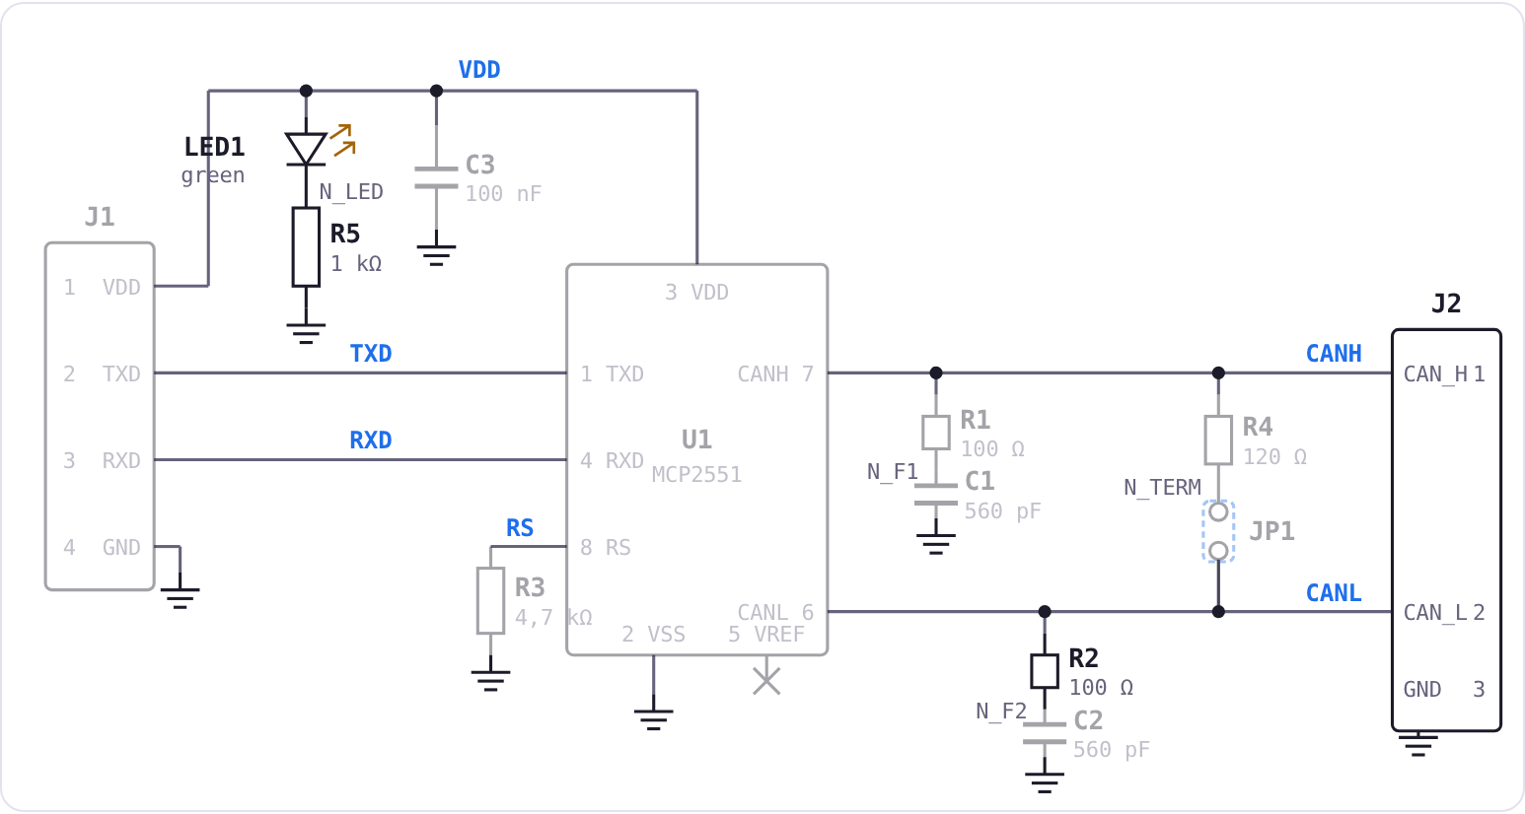
The case study: the front radar's CAN module
The radar
Generic automotive front radar: 0.20–250 m, ~72 ms cycle, CAN at 500 kbit/s (typical values). ASIL B is a lab assumption.
The MCP2551 transceiver
VDD 4.5–5.5 V; IDD ≤ 75 mA dominant, ≤ 10 mA recessive; recessive 2.0–3.0 V; dominant differential 1.5–3.0 V [30].
The module
J1, U1, C3, R3 (RS), R4 + JP1 (termination), R1/C1 and R2/C2 (RC filters), J2, LED1 + R5. No test points: you add them.
The module schematic in the app (SCHEMATIC button)
Sources: [30] Microchip DS21667F; ISO 11898-2:2024
Notes:
The case study is the same in all the labs. A front radar sends its list of detected objects over CAN. The radar is a generic one, with values typical of a long-range automotive radar: range from 0.2 to 250 metres, a cycle of about 72 milliseconds, CAN at 500 kbit/s. Treating it as ASIL B is a lab assumption, not information about a specific product.
The CAN node uses a module with the MCP2551 transceiver. From the Microchip datasheet we take the limits: supply 4.5–5.5 V, maximum current 75 mA dominant and 10 mA recessive, bus voltages of 2–3 V recessive and 1.5–3 V differential dominant. The physical layer is described by ISO 11898-2, 2024 edition.
The module has 13 components and, importantly, no test points. You will add them as an improvement.

Slide 18
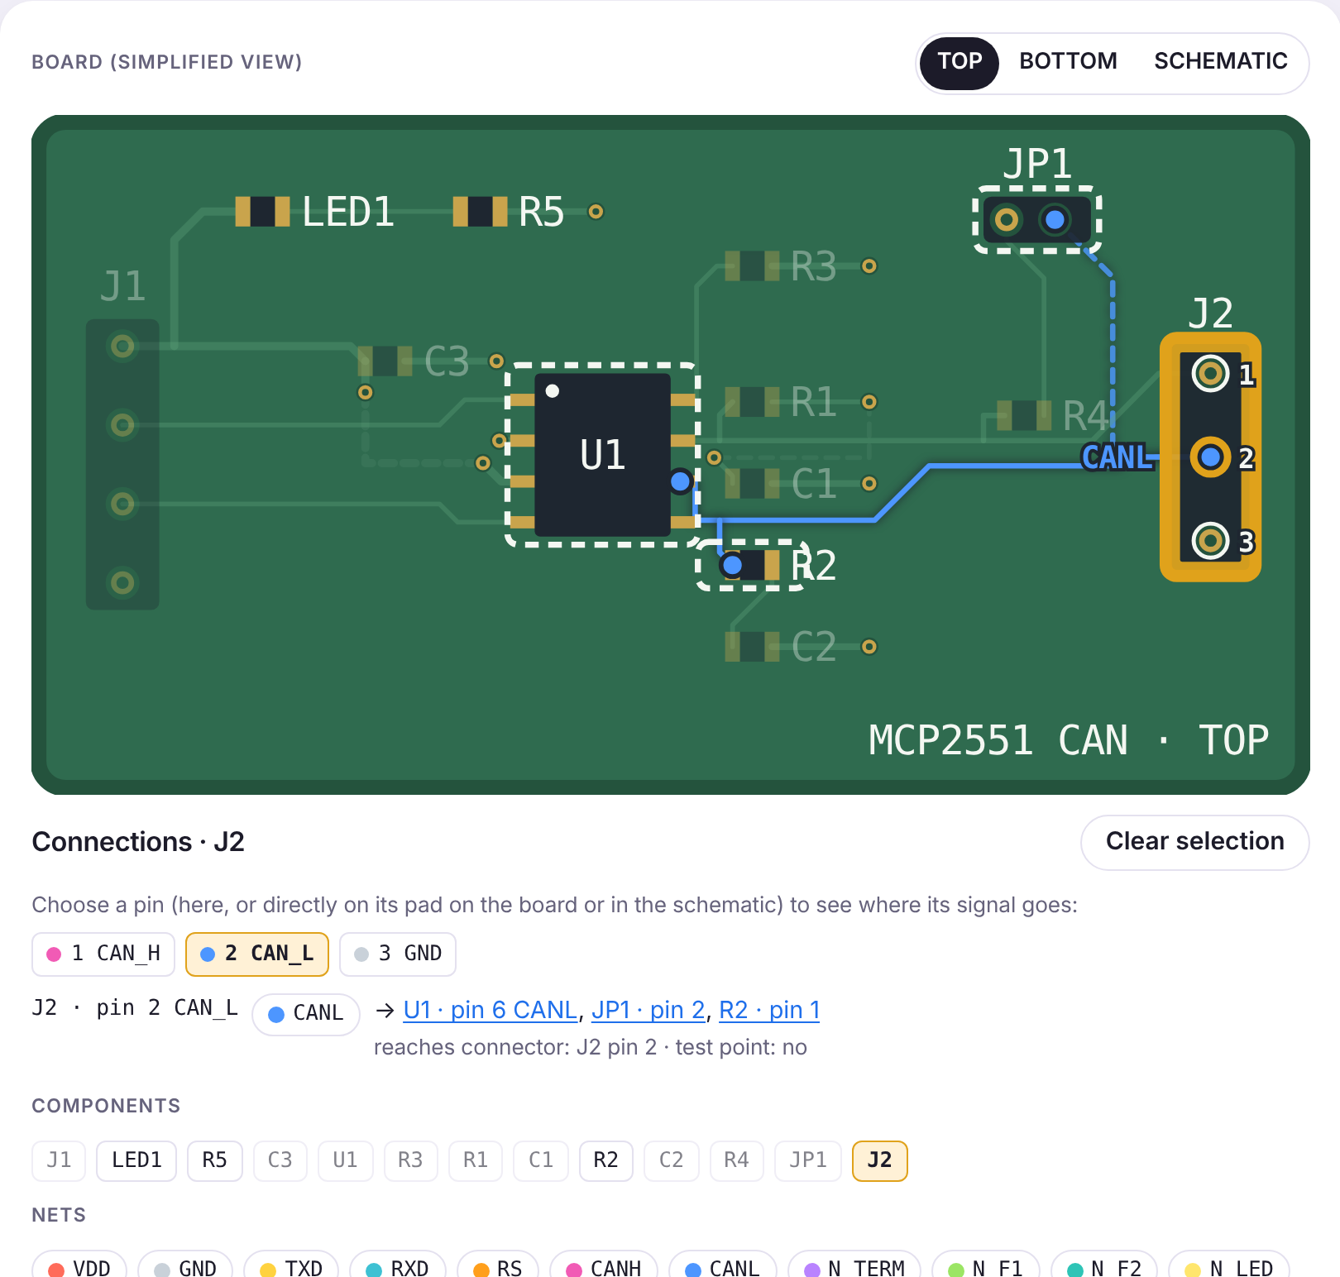
What you do in today's lab
1
Severity choose the effect class (E1–E10); S follows from it
2
Occurrence table P2: type and effectiveness of the prevention (automatic SMT 2, THT 4–5)
3
AOI, AXI, ICT D comes from the detection rules, with the reason shown
4
FT follow the pin's net, choose test FT1–FT8 or NONE, D from 1 to 10 and the justification
5
AP D = minimum over methods; AP from the AIAG-VDA table
6
Improvements test points, BOTTOM-side AOI, new FT tests
7
Residual risk where AP stays H or M: document it and send the report
The interactive board: J2 pin 2 and the CANL net
The app: madalinatolontan1-ai.github.io/sw-tca-lab/hw/
Notes:
Now the practical part. In the lab we do the H0 variant together, with 6 failure modes. At home, each of you does your own variant, from H1 to H6, with 12 failure modes of the module.
For each mode: choose the effect class, and the severity follows from it. For the occurrence, read the typical prevention shown under the list and place it in table P2: on an automatic SMT process O is usually 2, for the THT connectors 4–5. For AOI, AXI and ICT, the app calculates the detection from the detection rules and shows you the reason. For the functional test, click the pin of the component, on the board or in the schematic: the app draws that pin's net and shows, in the Connections panel, whether it reaches a connector, meaning the functional test can see it, and whether it has a test point. Then choose from the FT1–FT8 list the test that catches the defect, or NONE, choose D from 1 to 10 on the AIAG-VDA detection scale, whose descriptions appear in the list, and write why.
The combined detection is the minimum over the methods, and AP follows from the table. Then propose improvements: test points, AOI on the bottom side or new functional tests, and watch the risk go down. Where AP stays H or M, document the residual risk. At the end, send the report from the app. By sending it you agree that the data in the report may be used for a case study; names are not used anywhere. After sending, an anonymous 5-question questionnaire about the app appears.

Slide 19
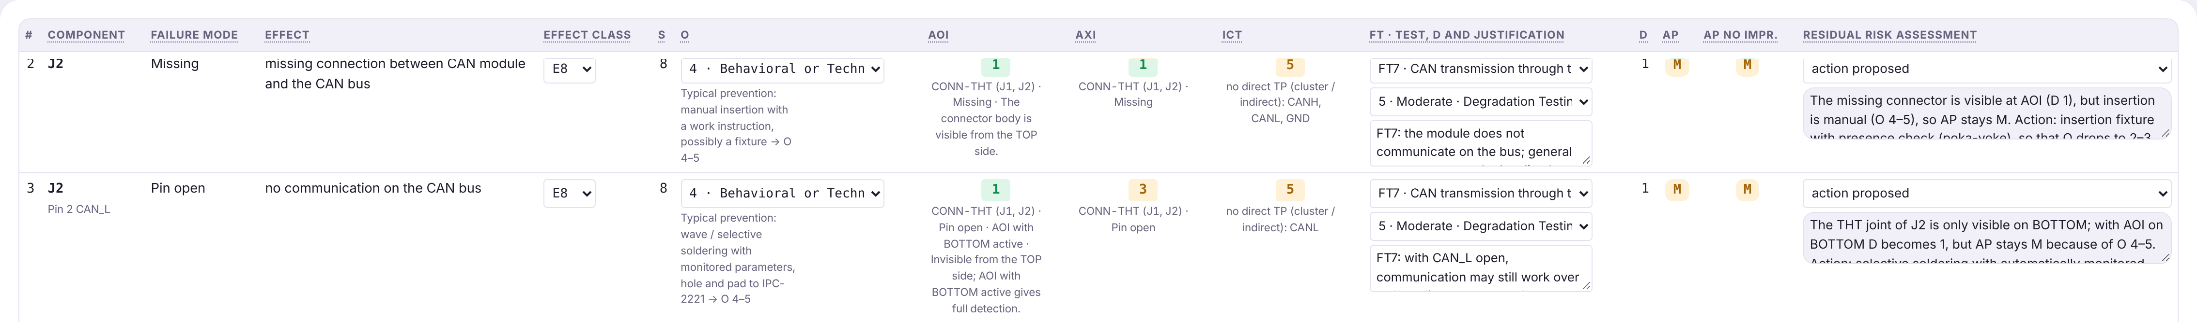
Example on H0: why J2 stays M
J2 pin 2 (CAN_L), pin open: E8 (S 8), O 4 (wave or selective soldering, behavioural control), minimum D 3 (AXI), so AP M.
AOI on BOTTOM: D becomes 1, but AP stays M. At S 8 and O 4–5, the AP table gives M for any D.
What lowers the risk: only better prevention at the THT operation (a lower O). Otherwise the residual risk is documented: action proposed or risk accepted, with the reason.
The J2 rows of the H0 sheet, after the improvements, with the residual risk assessment
Sources: [14] AIAG & VDA FMEA Handbook, 2019 (table P2, AP table)
Notes:
An example we do together. J2 is a THT connector: it is inserted by hand and wave or selective soldered, so the prevention is behavioural, and in table P2 the occurrence comes out 4. Pin 2 open stops communication: class E8, severity 8. AOI does not see the joint on the bottom side, AXI sees it partly, so the minimum D is 3 and AP comes out M.
If we enable AOI on the bottom side too, D becomes 1. But AP stays M: at severity 8 and occurrence 4 or 5, the AP table gives M for any detection. The important message: detection does not solve everything. The risk drops only if we improve prevention, for example selective soldering with automatically monitored parameters or an insertion fixture with a presence check. Otherwise, we document the residual risk.

Slide 20
Where it is used and which careers it opens
Test engineer (ICT / FCT)
develops production test programs and fixtures.
DfT / coverage engineer
analyses testability and coverage from the design phase.
Quality engineer
FMEA, control plan, IATF 16949.
Reliability engineer
prediction, endurance tests, failure analysis.
Functional safety engineer
ISO 26262, ASIL, hardware metrics.
Technical risk analyst
FMEA, TCA, risk assessment and documentation.
Image placeholder: certifications (IPC CIS/CIT, ASQ CRE/CQE, functional safety engineer) or employer logos
Sources: [31] ASQ (CRE, CQE); IPC (CIS, CIT)
Notes:
Today's analyses appear in automotive, aerospace, medical, rail, industrial and telecommunications, wherever a failure is costly.
As graduates you will meet them in several roles: test engineer, who writes the ICT and FCT programs; DfT or coverage engineer, who works with the designers so the board is testable; quality engineer, who owns the FMEA and the control plan; reliability engineer; functional safety engineer on ISO 26262; technical risk analyst.
There are also recognized certifications: IPC CIS and CIT for the assembly standards, ASQ for reliability and quality engineer, and functional safety engineer programmes at certification bodies.
You can add examples of regional employers here, with links to their careers pages.

Slide 21
References (1/2)
[1] K. Hird, K. P. Parker, B. Follis, “Test Coverage: What Does It Mean When a Board Test Passes?”, Proc. IEEE ITC, 2002, pp. 1066–1074, doi:10.1109/TEST.2002.1041863.
[2] M. V. Tegethoff, K. P. Parker, K. Lee, “Opens Board Test Coverage: When is 99% Really 40%?”, Proc. ITC, 1996, pp. 333–339.
[3] K. P. Parker, “Defect Coverage of Boundary-Scan Tests: What does it mean when a Boundary-Scan test passes?”, Proc. ITC, 2003, pp. 1268–1276.
[4] K. P. Parker, K. Hird, E. Ramos, “Methods and apparatus for characterizing board test coverage”, US 6,948,140 B2, Agilent Technologies.
[5] A. W. Ley, “Defect Coverage for Non-intrusive Board Tests”, ASSET InterTech, smtnet.com/library/files/upload/defect_coverage_for_NBT.pdf.
[6] M. Smith, “Integrated Electrical Test within the Production Line”, IPC APEX, electronics.org/system/files/technical_resource/E5&S03_01.pdf.
[7] Siemens, “Siemens acquires Aster Technologies”, 13 Jan 2026, news.siemens.com/en-us/siemens-acquires-aster-technologies/.
[8] Control.com, “Siemens acquires Aster to strengthen PCB design and testing”, 2026.
[9] IPC-A-610J and IPC J-STD-001J (2024); J-STD-001JA/IPC-A-610JA Automotive Addendum (2025).
[10] ISO 31000:2018, Risk management — Guidelines, iso.org/standard/65694.html.
[11] ISO Guide 73:2009, Risk management — Vocabulary, iso.org/standard/44651.html.
[12] IEC 31010:2019, Risk management — Risk assessment techniques.
[13] ISO 26262:2018, Road vehicles — Functional safety, Parts 1, 5 and 7.
[14] AIAG & VDA, FMEA Handbook, 1st ed., 2019, aiag.org.
[15] SAE J1739_202101, Potential Failure Mode and Effects Analysis (FMEA), doi:10.4271/J1739_202101.
[16] IEC 60812:2018, Failure modes and effects analysis (FMEA and FMECA).
Notes:
The full reference list. The ISO, IEC, SAE, IPC and AIAG standards are paid; you can find them in the faculty library or at ASRO, the Romanian standards body. The ITC papers are in IEEE Xplore.

Slide 22
References (2/2)
[17] J. B. Bowles, “An Assessment of RPN Prioritization in a Failure Modes Effects and Criticality Analysis”, Proc. RAMS, 2003, pp. 380–386, doi:10.1109/RAMS.2003.1182019.
[18] IATF 16949:2016; AIAG, “Core Tools and IATF 16949:2016 Overview”, blog.aiag.org/core-tools-and-iatf-169492016-overview.
[19] AIAG, APQP 3rd ed. and Control Plan 1st ed., 2024, go.aiag.org/apqp-cp.
[20] “The Origin and Development of FMEAs in the North American Automotive Industry: A History Review”, Acta Natura et Scientia 7(1), 2026, doi:10.61326/actanatsci.v7i1.370.
[21] Directive (EU) 2024/2853 on liability for defective products, eur-lex.europa.eu/eli/dir/2024/2853/oj.
[22] Regulation (EU) 2023/988 (GPSR); Regulation (EU) 2018/858, eur-lex.europa.eu.
[23] UNECE, Regulation No. 10 (electromagnetic compatibility), unece.org.
[24] TREAD Act, Pub. L. 106-414 (2000); 49 CFR Part 573, ecfr.gov.
[25] NHTSA ODI, EA19-001 (static.nhtsa.gov/odi/inv/2019/INOA-EA19001-2536.PDF); reports 16V-668 and 20V-024.
[26] NHTSA, Takata Recall Spotlight, nhtsa.gov/takata-recall-spotlight/state-takata-recalls.
[27] B. Davis, “Economic modeling of board test strategies”, J. Electronic Testing 5, 1994, pp. 157–169, doi:10.1007/BF00972076.
[28] TL 9000 R6.3 (2021), tl9000.org; Telcordia SR-332 Issue 4 (2016); ETSI GS NFV-REL 001 V1.1.1 (2015); ITU-T E.800 (09/2008).
[29] SAE ARP4761A (2023); RTCA DO-254; SAE AS13004; ISO 14971:2019; EN 50126; IEC 61508:2010; MIL-STD-1629A (1980).
[30] Microchip, MCP2551 High-Speed CAN Transceiver, DS21667F, 2010; ISO 11898-2:2024, iso.org/standard/85120.html.
[31] ASQ, CRE and CQE certifications, asq.org; IPC, CIS and CIT certifications, electronics.org.
Notes:
The second part of the reference list. The NHTSA cases have free public documents on static.nhtsa.gov; EU acts are on EUR-Lex.

