Slide 1
TESTING LAB · 4TH YEAR
Software Test Coverage Analysis (SW TCA)
How completely the software functions of an automotive module have been tested
Faculty of Electronics, Telecommunications and Information Technologies, UPT
Case study: the firmware of the CAN node of a front radar (ASIL B)
Notes:
Welcome. In the last lab we asked whether the production tests catch the manufacturing defects of a board. Today we move to software and ask a different question: how completely have we tested the code?
In the first 30 minutes we go through the theory: why software is tested differently, what the automotive standards require, what statement, branch and MC/DC mean, why 100% coverage does not mean code without mistakes and how tests are written from the requirements. I will also show you a demonstration with the real tools, gcov and gcovr. Then we do variant V0 together in the app, and at home each of you does your own variant and sends the report.
You do not need automotive experience. If you can read an if in C, you have everything you need.

Slide 2
What we cover today
1
Why software is different
systematic faults, not random ones
2
Where testing fits
the V-model and the test levels
3
The real rules
ISO 26262-6 and Automotive SPICE
4
Coverage metrics
statement, branch, MC/DC, functions, calls
5
100% does not mean no mistakes
tests come from the requirements
6
Demonstration
gcov and gcovr in Codespaces
7
Other industries and consequences
aviation, railway, telecom, the Toyota case
8
Today's lab
V0 together, your own variant at home
Notes:
The agenda has eight points. We start from the basic difference between hardware and software, then see where software testing happens in the development process. We go through what the standards require, with the real tables of ISO 26262-6. The central part is the coverage metrics, explained on the functions of the lab. Then the most important message of the day: complete coverage does not guarantee correct code. I show you the real tools, we look at other industries and at a real case, and we close with what you do in the lab.

Slide 3
Software does not break, it is written wrong
 | HW TCA (last lab) | SW TCA (today)
Type of fault | random, from manufacturing | systematic: a mistake in the requirement, design or code
Where it exists | only on some units | identical in every unit
When it is tested | every board, in production | once per version, in development, plus regression
The question | which test catches each defect? | which code and which requirements have the tests exercised?
A gap means | a defect escaping on some units | untested code, a possible fault in every unit
Standard | AIAG-VDA FMEA, IPC, ISO 26262-5 | ISO 26262-6, Automotive SPICE
ISO 26262 treats every software fault as a systematic fault. Random faults exist only in hardware.
Sources: [1] ISO 26262-6:2018
Notes:
The board from the last lab was designed correctly, but every manufactured unit could have its own random defect. That is why every board goes through AOI, ICT and the functional test.
Software is not manufactured unit by unit. Every module shipped has exactly the same program. If a programmer wrote greater than or equal instead of greater than, the mistake is in every module, from day one. ISO 26262 calls this a systematic fault: a mistake of specification, design or code. For software, every fault is systematic.
The consequence: there is no production test for software, because all units are identical. The only defence is the verification done once, in development, and repeated at every change. The question changes: how completely have we tested the code? Is there a line that no test has executed? If there is, any mistake in it is certain to reach the customer.

Slide 4
Where testing fits: the V-model
Software requirements
what it must do
Software testing
ISO 26262-6 cl. 11 · ASPICE SWE.6
Software architecture
components and interfaces
Integration testing
cl. 10 · SWE.5 · functions and calls
Units and code
C functions
Unit verification
cl. 9 · SWE.4 · statement, branch, MC/DC
Sources: [1] ISO 26262-6:2018 · [4] VDA QMC, Automotive SPICE 4.0
Notes:
In the automotive industry, software is developed according to the V-model. On the left we write what we build: the software requirements, the architecture, then the units, that is the C functions. On the right, every level has a matching verification level.
Structural coverage, that is how much of the code was executed, is measured at the bottom: in unit verification, clause 9 of ISO 26262-6, with statement, branch and MC/DC, and at integration, clause 10, with function and call coverage. I marked these two levels in yellow: that is where you work today. Functions F1, F2 and F3 are units, and can_rx_handler is the integration level.
Automotive SPICE has equivalent processes: SWE.4, SWE.5 and SWE.6.

Slide 5
The real rules: what ISO 26262-6 requires
Metric | ASIL A | ASIL B | ASIL C | ASIL D
Statement coverage (table 9) | ++ | ++ | + | +
Branch coverage (table 9) | + | ++ | ++ | ++
MC/DC (table 9) | + | + | + | ++
Function coverage (table 12) | + | + | ++ | ++
Call coverage (table 12) | + | + | ++ | ++
++ highly recommended · + recommended. Entries 1a–1c are alternatives: a suitable combination, with a justification. Table 12 at ASIL A and B: only a recommendation (10.4.5, „ASIL (A), (B)”). Lab, ASIL B: target 100% statement and branch, MC/DC as an extra step.
Sources: [1] ISO 26262-6:2018, tab. 9 and 12, values checked in [2] Vector and [3] LDRA
Notes:
These are the real values of ISO 26262-6, 2018 edition. The standard is not free, so I checked them in the reproductions published by the test tool vendors, Vector and LDRA.
Table 9 is for units. At ASIL B, the level of our radar, statement and branch are double plus, highly recommended, and MC/DC is plus. Double plus means, in practice, mandatory: if you do not apply it, you write a justification, and the safety assessor reads it. Note: entries 1a, 1b and 1c are alternatives, marked with a letter after the number. The standard asks for a combination suited to the ASIL, with a justification, not necessarily all three.
Notice that at ASIL C and D statement drops to plus. Not because it matters less, but because branch coverage includes it: if you went through every branch, you executed every statement.
Table 12 is for integration: function and call coverage. Clause 10.4.5 says „ASIL (A), (B), C and D”: the brackets mean that at A and B it is only a recommendation. We do it in the lab as good practice.
One more thing: the standard does not require 100%. It requires a defined and justified target. 100% is industry practice and our target in the lab.
In the app, the first question in F1 asks you for exactly the ASIL B row of this table.

Slide 6
How tests are written and what you do with the gaps
Tests come from the requirements
ISO 26262-6, table 8: requirements analysis (++), equivalence classes and boundary values (++ at ASIL B), error guessing (+).
Gaps are closed
Clause 9.4.4: if coverage is insufficient, additional tests or a justification are written. No target, without a justification, means insufficient. 100% is the practice, not the ISO requirement.
Everything is traceable
Automotive SPICE: every test has PASS/FAIL criteria and is linked to a requirement, both ways. The assessor picks a requirement and follows the path to the result.
Sources: [1] ISO 26262-6:2018, tab. 8, cl. 9.4.4 · [4] Automotive SPICE PAM 4.0, SWE.4–SWE.6
Notes:
Three rules you apply today.
The first: tests are written from the requirements, not from the code. Table 8 of the standard gives the methods: requirements analysis, equivalence classes, boundary values and error guessing from experience. At ASIL B the first three are double plus.
The second: after you run the tests, you measure the coverage. If it is not complete, clause 9.4.4 says what you do: either you write new tests, or you write a justification. The standard does not set a percentage, but it says explicitly that the lack of a target, without a justification, is insufficient. In practice 100% is required, with every uncovered line justified.
The third comes from Automotive SPICE, the model vehicle manufacturers use to assess their suppliers: every test has a PASS or FAIL criterion and is linked to the requirement it verifies. In the app, that is why every test has the Requirement column.

Slide 7
Statement coverage: every statement, at least once
can_err_state_t can_error_state(uint16_t tec,
uint16_t rec)
{
if (tec > 255) {
return CAN_STATE_BUS_OFF;
}
if ((tec > 127) || (rec > 127)) {
return CAN_STATE_ERROR_PASSIVE;
}
return CAN_STATE_ERROR_ACTIVE;
}
The rule: a test follows a single path through the function.
Every return is the end of a different path, so at least 3 tests.
A single test (tec = 300) covers only the first branch: the function returns at once.
TEC, REC (uint16_t) and the thresholds 127 / 255 come from ISO 11898-1. Bus-off is checked first.
Test | tec | rec | result
T1 | 300 | 0 | BUS_OFF
T2 | 200 | 0 | ERROR_PASSIVE
T3 | 0 | 0 | ERROR_ACTIVE
Sources: [8] ISO 11898-1 (fault confinement)
Notes:
We explain the metrics on function F3 of the lab. It decides the state of the CAN controller from the two error counters: TEC, for transmission, and REC, for reception. The rules come from the CAN standard: above 127 the node becomes error passive, and if TEC goes past 255 it disconnects from the bus, bus-off.
The first metric, statement coverage: has every statement been executed at least once?
Mind a common mistake: a single test with tec 300 is not enough. The function enters the first if, returns and exits. The rest is never executed. Every return is the end of a different path, so you need three tests: one for each state. With them, statement coverage is 100%.
Two details. The order matters: bus-off is checked first, otherwise tec 300 would come out error passive. And the type matters: tec and rec are uint16_t. If they were uint8_t, with a maximum of 255, the condition tec greater than 255 would never be true, and the bus-off return would be dead code. No test would cover it, and the coverage analysis would show a requirement or design problem, not a missing test.

Slide 8
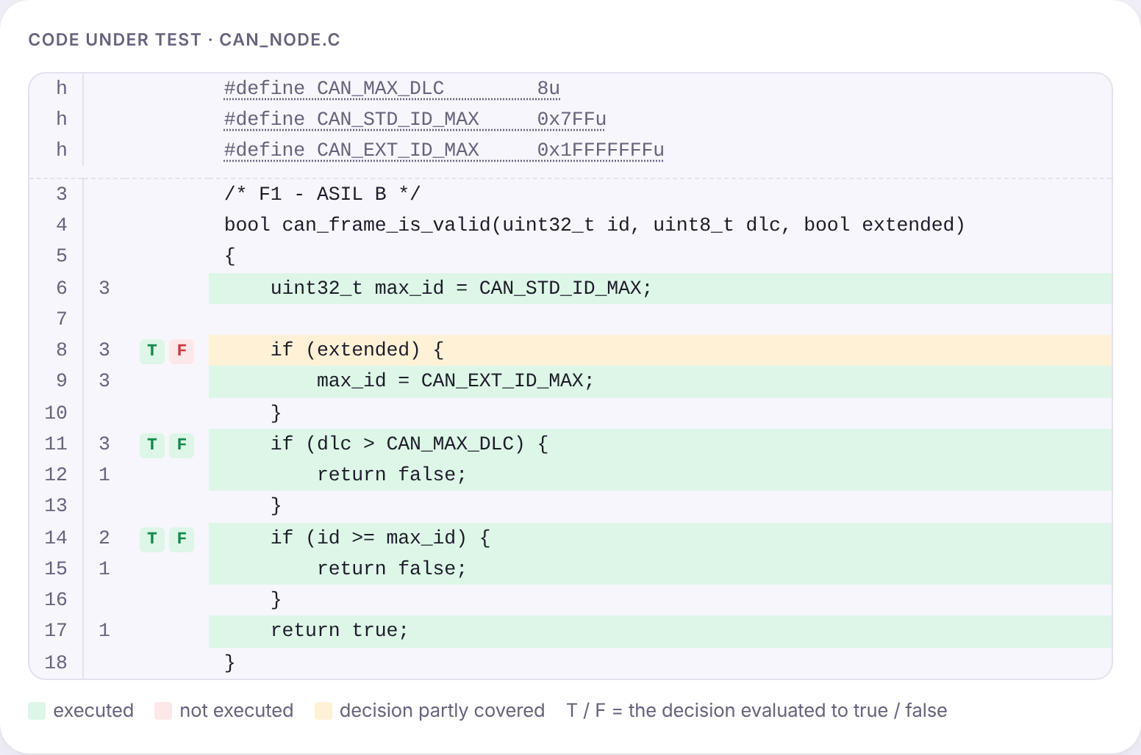
Branch coverage: every decision, both true and false
uint32_t max_id = 0x7FF;
if (extended) {
max_id = 0x1FFFFFFF;
}
if (dlc > 8) {
return false;
}
if (id > max_id) {
return false;
}
return true;
Test | id | dlc | extended
T1 | 0x100 | 9 | true
T2 | 0x20000000 | 8 | true
T3 | 0x100 | 8 | true
Function F1 of the lab (validating a CAN frame, ISO 11898-1). Screenshot of the SW TCA Lab app, variant V0.
Notes:
Function F1 checks a CAN frame: DLC at most 8 and the identifier within the range of the frame type, 11 bits for a standard frame, 29 bits for an extended one.
With these three tests, all have extended equal to true. Every statement is executed, so statement coverage is 100%. But look at the highlighted if: it has no else. The false branch has no statement of its own, so statement coverage does not see it. The case of standard frames, the most used ones, was not tested at all.
Branch coverage requires every decision to be true once and false once. In the screenshot on the right, the app shows exactly that: next to line 8, the F label is red. A test with extended equal to false is missing. That is why branch coverage includes statement coverage, but not the other way round.

Slide 9
Conditions and MC/DC
if ((tec > 127) || (rec > 127))
A = tec > 127
B = rec > 127
Branch coverage does not see the conditions: with T2 and T3, B was never true.
Condition coverage requires every condition T and F, but can miss the false branch.
MC/DC: every condition changes the result on its own. T3–T2 shows A, T3–T4 shows B.
N + 1 tests: the theoretical minimum (unique-cause), not an ISO requirement.
Test | tec | rec | A | B | A || B
T3 | 0 | 0 | F | F | F
T2 | 200 | 0 | T | F | T
T4 | 0 | 200 | F | T | T
Sources: [5] Hayhurst et al., NASA/TM-2001-210876 · [9] FAA DOT/FAA/AR-01/18 · [1] ISO 26262-6:2018, tab. 9
Notes:
The second decision in F3 has two conditions: A, tec greater than 127, and B, rec greater than 127. Branch coverage only looks at the result of the decision. With T2 and T3, the decision was both true and false, but B was never true. If the programmer had wrongly written rec greater than 1270, the tests would pass.
Condition coverage requires every condition to be true once and false once. The trap: with the tests A true B false and A false B true, both conditions were both T and F, but the decision was always true. Condition coverage does not include branch coverage.
MC/DC requires both, plus something more: every condition has to show that, on its own, it changes the result. Look for pairs of tests in which only one condition changes and the result changes too. T3 and T2 differ only in A: the result goes from F to T. T3 and T4 differ only in B. Three tests for two conditions. The theoretical minimum, for the form called unique-cause: N plus 1 tests for N conditions, instead of every combination. For 10 conditions, 11 tests instead of 1024. Note, it is not an ISO 26262 requirement: the standard only lists MC/DC and does not define the form. The forms come from aviation, from an FAA report. The app uses unique-cause with short-circuit evaluation, which the FAA calls unique-cause plus masking. MC/DC was born in aviation and is required there at the most critical level.

Slide 10
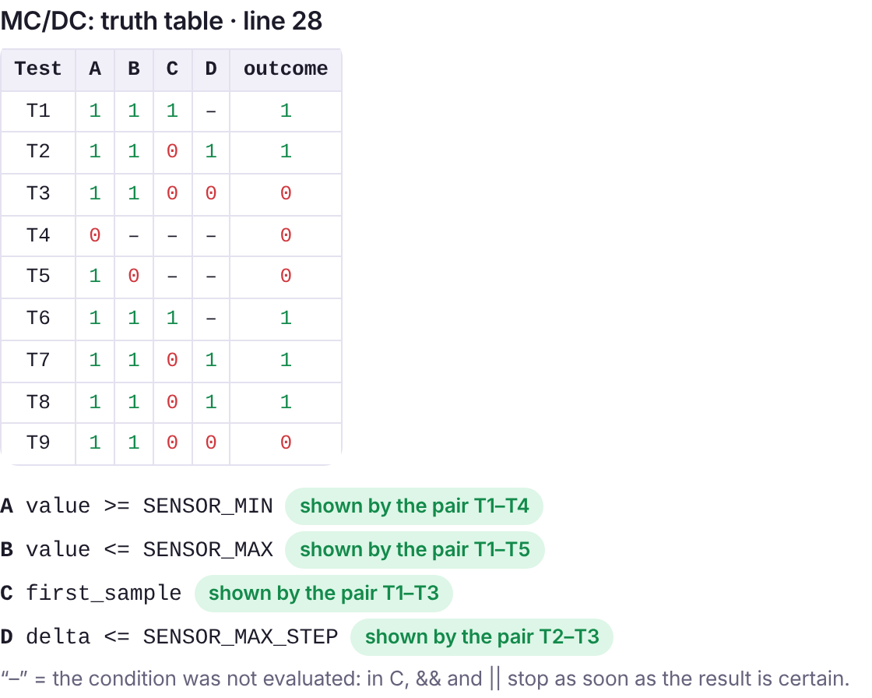
MC/DC on F2: four conditions, five tests
The decision: A && B && (C || D), that is within range and (first detection or small jump).
For AND: start from „all true” and make one false at a time.
For OR: start from „all false” and make one true at a time.
„–” means the condition was not evaluated: in C, && and || stop when the result is certain.
Masking MC/DC: T1–T3 shows C even though D differs, because in T1 D was not evaluated.
Screenshot of the SW TCA Lab app, variant V0 · [7] GCC 14, -fcondition-coverage (masking MC/DC)
Notes:
F2 checks whether a distance measured by the radar is plausible. The decision has four conditions: A, the value is above the minimum; B, below the maximum; C, it is the first detection of the object; D, the jump from the previous measurement is small. The result is A and B and, C or D.
The table on the left is exactly what you see in the app. Every test is a row, every condition a column: 1 true, 0 false, and the dash means that the condition was not even evaluated. In C, the AND and OR operators stop when the result is already certain: if A is false, B no longer matters.
The practical rule: for AND, start from the case where everything is true and break one condition at a time; for OR, start from everything false.
A detail: the pair T1–T3 demonstrates C, even though D differs between them. That is correct, because in T1 D was not evaluated. T1 is the example test the app adds: first detection, a value from the middle of the range. This is called masking MC/DC and it is the form accepted in aviation and used by GCC 14.

Slide 11
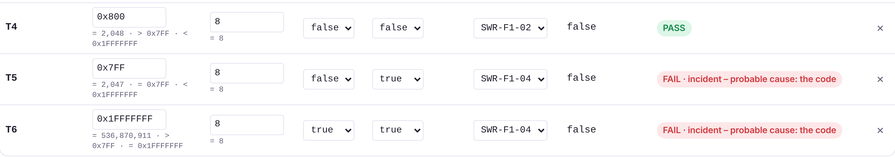
The most important point of the day
100% coverage does not mean code without mistakes
Coverage shows that a line ran, not that it gave the correct result.
The values matter: you can go through every branch without touching the wrong boundary.
Missing code has no coverage: a requirement that was never implemented gives no red line.
The right order: tests from the requirements → coverage → analysis of the gaps.
Screenshot of the SW TCA Lab app, variant V0 (the planted mistake: id >= max_id)
Notes:
If you remember one thing from today, it is this: coverage measures how completely the tests exercised the code, not how correct the code is.
Three reasons. One, coverage says that a line ran, not that the result was the correct one. Two, the values chosen matter: you can go through every branch with middle values and never touch the boundary where the mistake is. Three, missing code has no coverage: if a requirement was never implemented, no line turns red.
On the right, variant V0. I planted a mistake in F1: greater than or equal instead of greater than for the identifier. The first four tests give 100% on every metric and all pass. Only the boundary tests, written from the requirement, the identifier 0x7FF that must be accepted, fail. Coverage does not give you the value 0x7FF; the requirement does. Hence the order: tests from the requirements, then coverage, then the gaps.

Slide 12
Test design techniques, on the bus-off requirement
Requirements analysis
„BUS_OFF when TEC > 255”: you take the expected result from the requirement, not from the code. If the requirement does not say what happens, you have found a problem in the requirement.
Equivalence classes
TEC 0…127 → active · 128…255 → passive · 256…65535 → bus-off. One value from each class.
Boundary values (BVA)
The general testing technique (ISTQB). Exactly on the boundary and just after it (tab. 8, note b): 127 / 128 and 255 / 256 for TEC, 127 / 128 for REC. This is where > instead of >= mistakes live.
Error guessing
0, 65535 (the maximum of uint16_t), negative values, overflows, a difference of exactly zero.
Sources: [1] ISO 26262-6:2018, tab. 8
Notes:
The four techniques of table 8, applied to the bus-off requirement of F3.
Requirements analysis: the expected result comes from the requirement. If the requirement does not say clearly what happens, you cannot write the test: the problem is in the requirement, not in the code.
Equivalence classes: split the input range into groups handled the same way. For TEC: up to 127 active, between 128 and 255 passive, above 255 bus-off. One value from each.
Boundary values: mistakes live at the edges, greater than instead of greater than or equal. Boundary value analysis, BVA, is the classic software testing technique, the same as in ISTQB and in any testing course, not something specific to automotive. Test the value exactly on the boundary and the one just after it: 127 and 128, 255 and 256. In the app, the „Boundary values (BVA)” metric must reach 100% in F1, F2 and F3. Note b of table 8 asks for values that approach the boundary and cross it; a threshold is fully tested only with both. At home, each of you has such a mistake planted in F3, and only these tests catch it.
Error guessing: from experience. Zero, the maximum value of the type, overflows.

Slide 13
Demonstration: gcov and gcovr, real tools
# in Codespaces, on the lab repository
make report SET=f1_statement
make report SET=f1_branch
make report SET=f1_branch BUG=1
make report SET=f1_limits BUG=1
make serve
#####: 42: return CAN_STATE_ERROR_PASSIVE;
branch 1 taken 0%
--coverage: the compiler adds counters to the program.
#####: a line not executed, the first thing you look for.
branch N taken 0%: a branch not taken.
BUG=1: the same mistake as in V0; the tests pass, coverage is complete.
f1_limits: the boundary tests find it.
GCC 14 also measures MC/DC (-fcondition-coverage).
In real projects the tool has a confidence level TCL (ISO 26262-8, cl. 11).
Sources: [7] GCC 14, Instrumentation Options · repository: github.com/madalinatolontan1-ai/sw-tca-lab
Notes:
Now the demonstration with the real tools. I open the lab repository in GitHub Codespaces: it is free, it runs in the browser and nothing needs installing. You can do it at home too.
We run them in turn: f1_statement shows 100% statement, but one branch not taken. f1_branch also covers the branches. With BUG equal to 1 we compile the code with the planted mistake, the same as in V0: coverage stays complete and every test passes. f1_limits adds the boundary tests from the requirement and two tests fail.
How to read the report: the number on the left is how many times the line ran; five hashes mean a line not executed; branch taken 0% means a branch not taken. make serve opens the gcovr HTML report.
Note: GCC 14 added MC/DC measurement. The lab app does the same calculations, in the browser.
The app is a teaching simulator. In a real project, the coverage tool is assessed according to ISO 26262-8, clause 11. It does not insert mistakes into the code, but it can report coverage wrongly and hide a missing test, so it has impact TI2. Together with the likelihood that its error is caught, TD1 to TD3, this gives the confidence level, TCL1 to TCL3; at TCL2 and TCL3 the tool is qualified, usually with the vendor's kit. In addition, it must be shown that the instrumentation does not change the results: note 4 of 9.4.4.

Slide 14
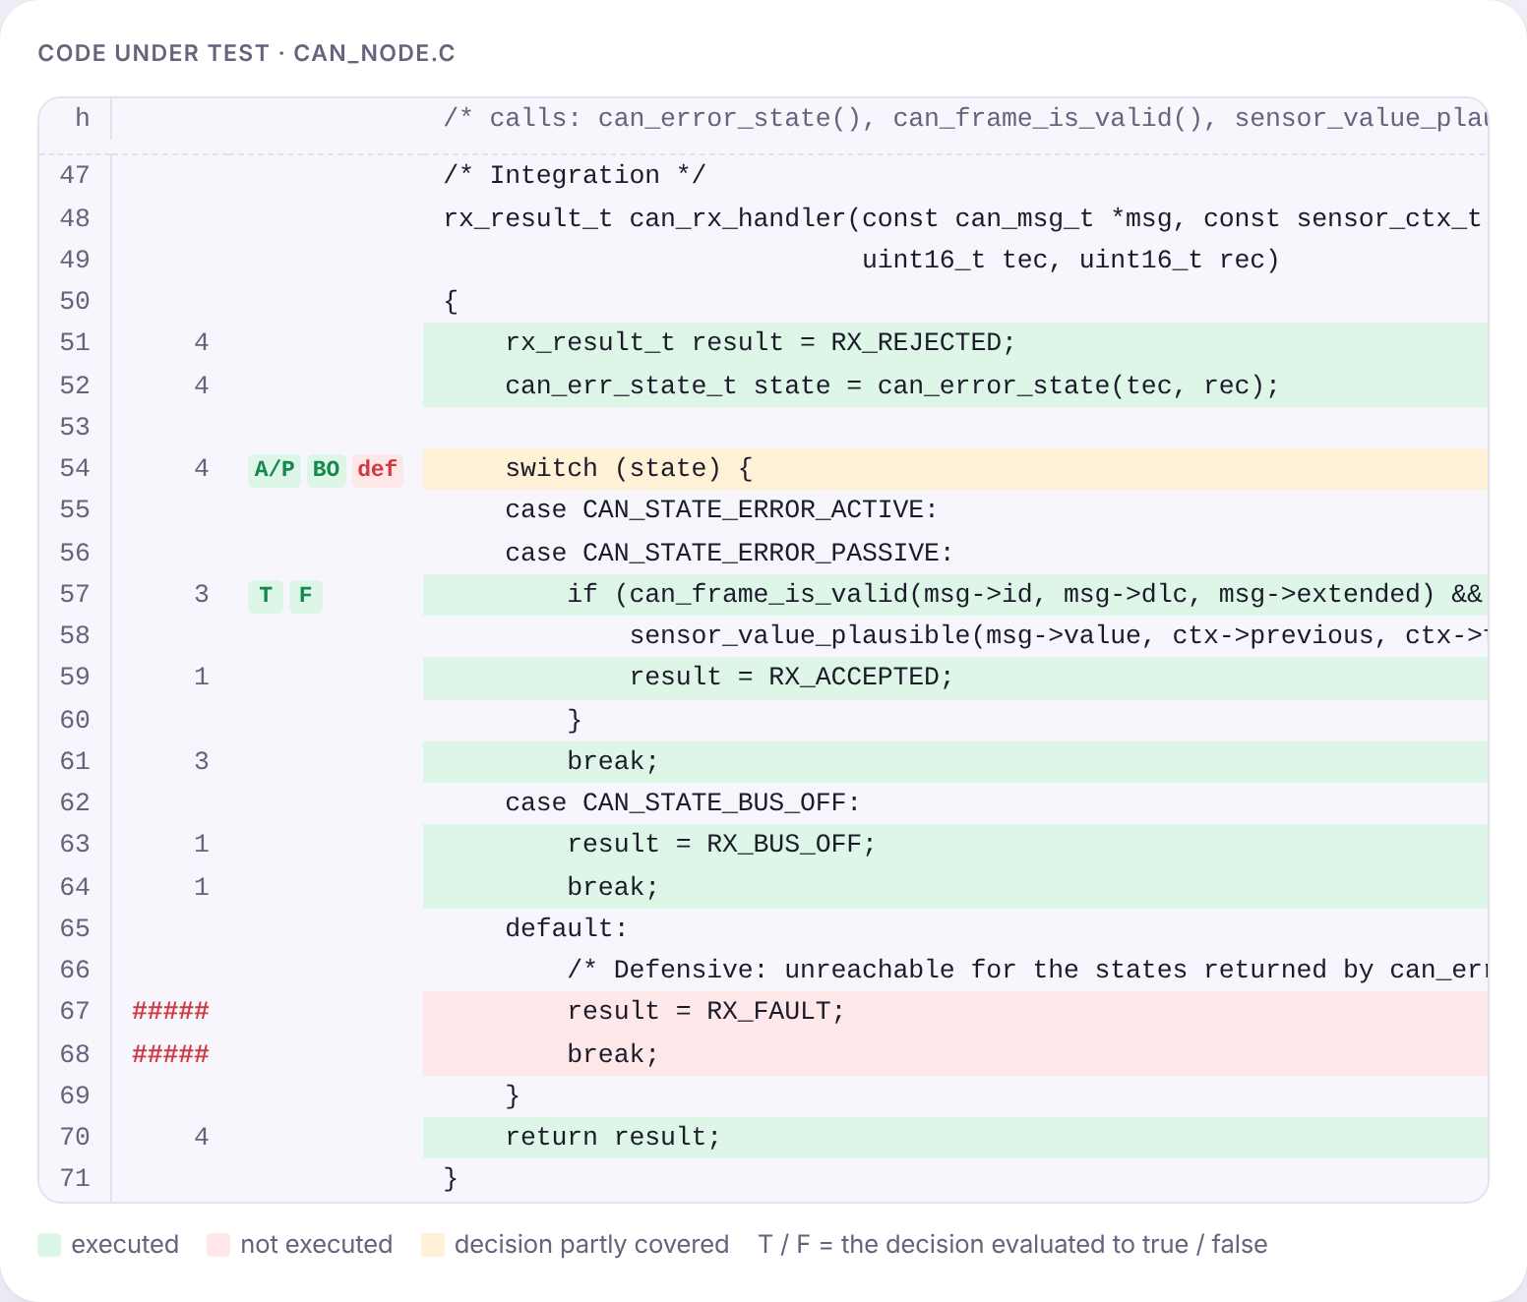
Integration: functions, calls and code that cannot be reached
Function coverage: every function called at least once.
Call coverage: every call site executed (here C1, C2, C3).
default: cannot be reached, F3 returns only three states.
It is defensive code (MISRA C: every switch has a default), so it is not deleted.
Justification or test: 9.4.4 accepts both; the test = fault injection (tab. 7, 1l): corrupted state → RX_FAULT.
Screenshot of the SW TCA Lab app, variant V0 · [1] ISO 26262-6:2018, tab. 7, tab. 12, cl. 9.4.4
Notes:
At integration you work on can_rx_handler, the function that receives a frame and calls the other three. Here the metrics are different: whether every function was called and whether every call site was executed.
With four tests you reach 100% functions and calls. But lines 67 and 68, the default case of the switch, stay red. It is not an oversight: F3 returns only the three states handled explicitly, so no test can get there. It is defensive code, required by the MISRA C coding rules, which protects the program if the variable were corrupted in memory.
What you do: you do not delete it, you justify it. That is what clause 9.4.4 requires. The justification says why it cannot be reached, why that is acceptable and how it could still be verified.
The second way, also accepted by 9.4.4: a fault-injection test, method 1l of table 7, recommended at ASIL B. A stub of the function can_error_state, or the debugger, forces the state to an invalid value, for example 0xFF, and the test checks that the function returns RX_FAULT. In the app you describe this test in the justification field.

Slide 15
And in other industries
Standard | Field | What it requires on coverage
ISO 26262-6 | automotive | methods recommended per ASIL, a justification for every gap
DO-178C | aviation | mandatory objectives, 100%: MC/DC at level A, decisions at B, statements at C
IEC 61508-3 | industry | the parent standard of ISO 26262, tables per SIL 1–4
EN 50128 / EN 50716 | railway | statements, branches, compound conditions, by SIL
IEC 62304 | medical | does not set a metric; requires acceptance criteria for units
ETSI, 3GPP, TL 9000 | telecom | we found no code coverage requirement; conformance tests are black box
Sources: [6] RTCA DO-178C · IEC 61508-3:2010 · EN 50716:2023 · IEC 62304:2015 · ETSI TTCN-3
Notes:
Code coverage is not only an automotive requirement. In aviation, DO-178C is stricter: there they are not recommendations, but mandatory objectives, with 100%. Level A, where a failure leads to a catastrophe, requires MC/DC. In fact MC/DC was born in aviation, in 1992, and was taken over by the automotive industry.
IEC 61508 is the general standard from which ISO 26262 was derived. Railway has EN 50128, replaced by EN 50716. In medical, IEC 62304 does not set a particular metric.
And telecommunications, which concern you directly: we did not find a standard that requires code coverage. ETSI and 3GPP define conformance tests, which check the protocol from the outside, not the code. There, coverage is an internal company practice. That is why we use the automotive standards as the reference.

Slide 16
What happens when the evidence is missing
7,134
violations of 35 MISRA C rules found by NASA (2011)
81,514
MISRA C:2004 violations reported by the plaintiffs' expert (2013)
67
functions with cyclomatic complexity above 50, practically untestable
2013
verdict against Toyota, Bookout v. Toyota
Toyota unintended acceleration, 2009–2011: NASA found no electronic defect, but could not rule out the software either.
The lesson is not „a bug caused the accidents”: without verification evidence, the manufacturer cannot show that the product is safe.
Today: recalls for software errors (airbag, braking, engine) appear every year in the NHTSA reports.
Sources: [10] Koopman, Toyota UA case study (2014); M. Barr, testimony in Bookout v. Toyota (2013); NASA NESC (2011)
Notes:
A real, often cited case. Between 2009 and 2011, Toyota recalled millions of vehicles for unintended acceleration. NASA, at the request of the US authority NHTSA, analysed the throttle control software. It did not find an electronic defect that would explain the incidents, but it could not rule out the software either. Checking only 35 MISRA C rules, it found more than 7,000 violations.
In the 2013 Bookout trial, the plaintiffs' expert, Michael Barr, reported more than 81,000 MISRA violations, 67 functions so complex that they are practically untestable, and unprotected critical variables. The jury decided against Toyota.
Mind how we present the case: it was not proven that a particular bug caused the accidents. The lesson is different: when there is no evidence that the software was verified systematically, the manufacturer cannot demonstrate that it is safe. Exactly this evidence is what today's analysis produces.

Slide 17
Who does this in industry
Software test / verification engineer
writes the test specifications from the requirements, runs the tests, analyses the coverage, writes the justifications.
Embedded software developer
writes the code and the unit tests, follows the MISRA C rules, fixes the faults found.
Functional safety engineer
sets the ASIL and the verification strategy, builds the safety argument.
ASPICE / safety assessor
checks the traceability, the coverage reports and the justifications, often from an independent organisation.
Sources: [11] ZVEI, Best Practice Guideline: Software for Safety-Related Automotive Systems (2025)
Notes:
Who does this analysis in industry? The software test or verification engineer: they write the tests from the requirements, run them, analyse the coverage and write the justifications. That is exactly what you do today.
The developer writes the code and often the unit tests too, following the coding rules. The functional safety engineer decides the ASIL and which verifications are needed. The assessor, internal or from an independent organisation, checks the evidence.
All four are roles in demand at automotive electronics companies, including here, in Timișoara.

Slide 18
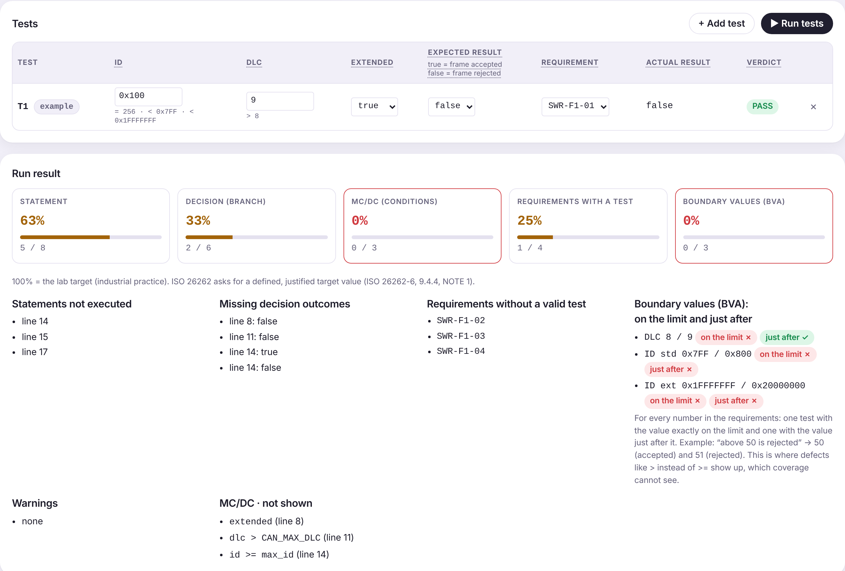
Today's lab
V0, together
step by step, in the app
F1
statement, branch, the mistake
F2
MC/DC and the boundaries
F3 and integration
requirements, functions, calls, justification
At home
your own variant V1–V6, send the report
›
›
›
›
The app: madalinatolontan1-ai.github.io/sw-tca-lab/sw/
The lab guide has the complete solution of V0 and every explanation.
At home: the mistake of your variant is in F3; only the boundary tests catch it.
Notes:
What we do now. Open the app and load variant V0. We do it together, step by step: first F1, where we see why statement is not enough and find the planted mistake; then F2, with MC/DC; then F3 and the integration, with the justification of the code that cannot be reached. The lab guide has the whole solution, so you can redo it.
At home, each of you loads the variant you received, from V1 to V6, and redoes the steps. Your variant has a different signal in F2 and a mistake in F3, which only the boundary tests written from the requirement catch. The report generated by the app is what you send: in the Report tab you see which steps are complete and fill in the conclusion, what coverage shows and what it does not. In the incident report, the app retests the proposed fix. The first time you load your own variant, an initial test of 5 questions appears, and when you send, the final test with the same questions; they are not graded and you can skip them. By sending the report from the app you agree that its data may be used, pseudonymised, in a study about these labs; names are not used anywhere. If you do not agree, download the report and upload it to the Virtual Campus; attendance counts the same. After sending, an anonymous questionnaire of 13 statements about the app appears.

Slide 19
Sources
[1] ISO 26262-6:2018, Road vehicles — Functional safety — Part 6: Product development at the software level (tables 8, 9, 12; clause 9.4.4).
[2] Vector, Following the ISO 26262-6:2018 Guidelines with VectorCAST (whitepaper).
[3] LDRA, Implementing ISO 26262 second edition (whitepaper).
[4] VDA QMC, Automotive SPICE Process Assessment Model 4.0 (2023).
[5] K. J. Hayhurst et al., A Practical Tutorial on Modified Condition/Decision Coverage, NASA/TM-2001-210876 (2001).
[6] RTCA DO-178C, Software Considerations in Airborne Systems and Equipment Certification (2011).
[7] GCC, Instrumentation Options: -fcondition-coverage (GCC 14).
[8] ISO 11898-1, Road vehicles — Controller area network (CAN) — Part 1.
[9] J. J. Chilenski, An Investigation of Three Forms of the Modified Condition Decision Coverage (MCDC) Criterion, DOT/FAA/AR-01/18 (2001).
[10] P. Koopman, A Case Study of Toyota Unintended Acceleration and Software Safety (2014); M. Barr, expert testimony, Bookout v. Toyota (2013).
[11] ZVEI, Best Practice Guideline: Software for Safety-Related Automotive Systems (2025).
[12] ISO 26262-8:2018, Part 8: Supporting processes (clause 11, confidence in the use of software tools); ISO/IEC/IEEE 29119-1:2022 (incident, test oracle).
Notes:
The sources are also in the lab guide, with links. The ISO standards and DO-178C are not free; you can find them through the university library. The rest are free, and the NASA tutorial on MC/DC is the best place to start reading.

