Slide 1
Fortrex Database Engine
BY
REVANTH(COE16B013)
PARAS VARSHNEY(COE16B036)
GUIDED BY
PROF.RAGUNATHAN.T

Slide 2
Motivation
The main moto for developing this application is to provide the user with rich graphical user interface(GUI ) experience while dealing with the database services.
To provides user with greater comfort dealing with the issues of the database querying.
To make a layman user/student to understand how interesting and fun it is to play with databases rather than worrying with syntax.

Slide 3
Technologies used
This project will be developed in java language using the jdbc(java database connection) , jsp(java server page) as server scripting language
web designing languages like html5(hypertext markup language ) , css(cascading style sheet), bootstrap ,javascript , ajax, jqueries.
apache tomcat local server, mysql database.

Slide 4
What is it actually?
This project is a tool for accessing the database and write the queries onto the database server by using graphical interfaces like(forms, buttons, droplists, etc) to give the user a learning platform with ease.
This database application will also help a layman to use the benefits of maintaining secured database for his work without having any knowledge of the database management system.

Slide 5
Main Functions
The main functionalities of the application include:
creation of the tables,
dropping the tables,
joining the tables,
user can use insert queries,
select queries, update queries,
delete rows, truncate values ,
define the datatypes of the attributes,

Slide 6
MAIN FUNCTION(CONT…)
constraints on the attributes,
define keys.
User can do all these thing by just selecting the options rather than writing long queries.

Slide 7
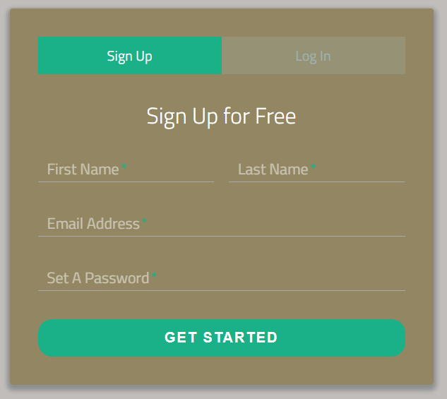
SignUp Page

Slide 8
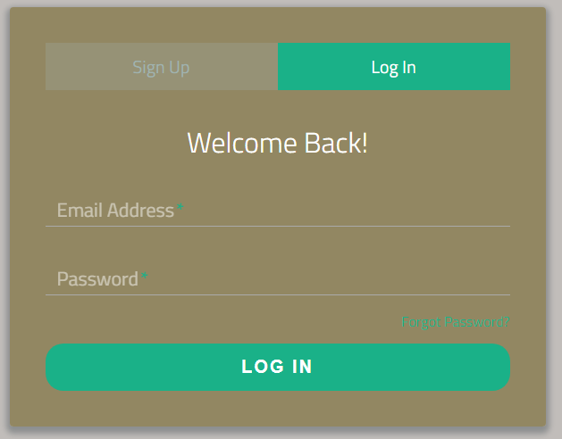
Login Page

Slide 9
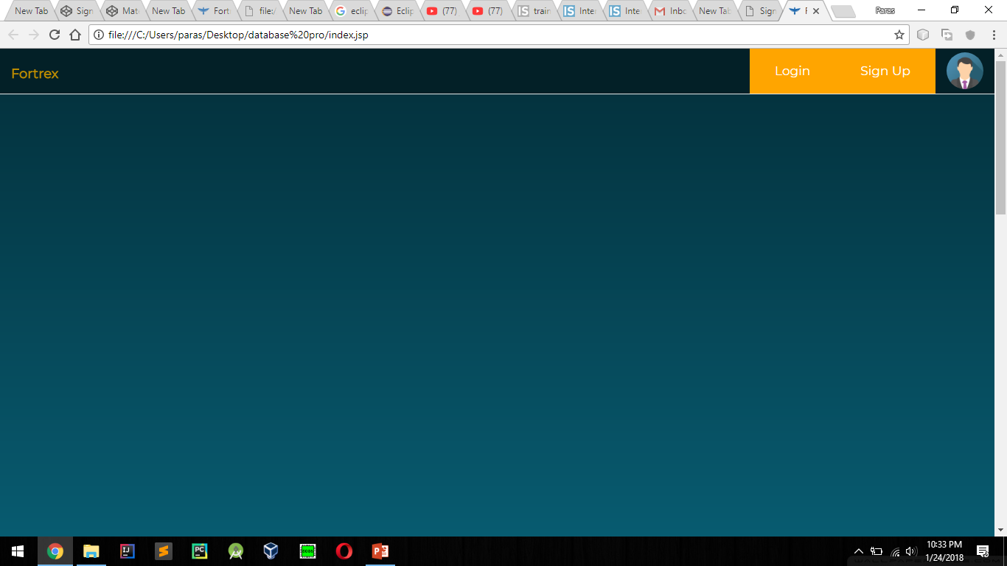

Slide 10
THANK YOU

