Slide 1
Data Analytics & Visualization (24DSB3101 ) Comparative Study of Customer Segmentation Techniques Using Clustering Algorithms Assistant Submitted by: Dhanusha-240030159 Nandini– 2420030325 Lekha-2420030334
Group Number : 3 Section: 7 Under the Guidance of: Mrs.Swapnika

Slide 2
Contents
Abstract
Problem statement
objectives
Literature survey
Research Gap Identification
Innovation
Creativity
Novelty
Feasibility
Project WorkFlow
Project Plan

Slide 3
Abstract
Abstract
Customer segmentation is an important technique in data analytics that helps businesses understand customer behavior and develop targeted marketing strategies. The proposed Customer Segmentation Analytics Dashboard provides an interactive platform for comparing multiple clustering algorithms, including K-Means, Mini-Batch K-Means, DBSCAN, OPTICS, BIRCH, Spectral Clustering, and Fuzzy C-Means (FCM). The system is developed using Python and Streamlit, allowing users to upload customer datasets, preprocess the data, apply different clustering techniques, and analyze their performance. The clustering results are evaluated using Silhouette Score, Davies–Bouldin Index, and execution time to determine the most suitable algorithm for a given dataset. The dashboard also provides interactive visualizations, customer segment profiles, business insights, and options to download the clustered dataset and analysis report. By providing a comparative analysis of different clustering approaches, the proposed system helps identify effective customer segmentation techniques and supports data-driven business decision-making.

Slide 4
Problem Statement
Businesses collect large amounts of customer data, but identifying meaningful customer groups can be challenging. Different clustering algorithms may produce different segmentation results. This project develops an interactive dashboard to compare multiple clustering techniques. Performance metrics and visualizations are used to identify the most suitable algorithm. The system provides customer insights to support better data-driven business decisions.

Slide 5
Literacy survey
Research Paper | Techniques Used | Purpose | Limitation
Customer Segmentation Using K-Means (2021) | K-Means | Groups customers based on behavior. | Uses only one algorithm.
Customer Segmentation Using Machine Learning (2022) | K-Means, DBSCAN | Identifies customer segments. | Limited algorithm comparison.
Comparative Study of Clustering Algorithms (2023) | K-Means, DBSCAN, Hierarchical | Compares clustering performance. | Few algorithms considered.
Advanced Customer Segmentation (2024) | K-Means, BIRCH, DBSCAN | Improves customer grouping. | Limited interactive analysis.
Customer Segmentation with Clustering (2025) | K-Means, OPTICS, FCM | Analyzes different customer groups. | No complete dashboard.

Slide 6
Research Gap Identification
From the literature survey, the following research gaps were identified: • Many systems do not provide comprehensive performance comparisons using multiple metrics. • Most solutions lack an interactive and user-friendly dashboard. • Limited systems provide both customer segment visualization and business insights in one platform.
Existing studies compare only a limited number of clustering algorithms.
.
Innovation
The proposed system introduces:
• Evaluation using multiple performance metrics and execution time. • Interactive visualizations for easy understanding of customer segments. • Automatic customer segment profiles and business insights. • A user-friendly Streamlit dashboard with dataset and report download options.
Comparison of multiple clustering algorithms in a single platform.

Slide 7
Objectives
Objectives
The main objectives of this project are:
• To develop an interactive Customer Segmentation Analytics Dashboard using Python and Streamlit. apply multiple clustering algorithms such as K-Means, Mini-Batch K-Means, DBSCAN, OPTICS, BIRCH, Spectral Clustering, and Fuzzy C-Means (FCM). • To analyze customer datasets for effective segmentation and then comparing clustering algorithms using Silhouette Score, Davies–Bouldin Index, Calinski–Harabasz Index, and execution time. • To identify the most suitable clustering algorithm for a given customer dataset, then visualize customer clusters and generate meaningful customer segment profiles. • To provide business insights that support data-driven decision-making then allowing users to download the clustered dataset and analysis report.

Slide 8
Creativity
The project combines multiple machine learning techniques with an interactive and user-friendly analytics platform.
Key creative features include:
• Multiple clustering algorithms in one dashboard and Interactive cluster visualizations. • Algorithm performance comparison withAutomatic customer segment profiling. • Business insights and recommendations with Dataset and report download options then Simple and responsive Streamlit interface.

Slide 9
INNOVATION/ Novelty
The uniqueness of this project lies in integrating:
• Multiple clustering algorithms in a single platform. • Seven techniques including K-Means, DBSCAN, OPTICS, BIRCH, Spectral Clustering, Mini-Batch K-Means, and FCM. Multiple evaluation metrics for accurate algorithm comparison adding on a metric of comparision like execution time. • Interactive customer segment visualizations and profiles. • A complete interactive dashboard instead of a standalone clustering model.
Adding an summary section which describes a final decision
This combination makes customer segmentation easier to compare, understand, and apply for data-driven business decisions.

Slide 10
Feasibility
The project is feasible because:
Technical Feasibility • Uses open-source technologies such as Python, Streamlit, and Scikit-learn. • Clustering algorithms and evaluation metrics are readily available through Python libraries. • Can be developed using standard software tools.
Operational Feasibility • Easy to use through an interactive dashboard. • Suitable for students, researchers, and business users. • Can run on a normal laptop.

Slide 11
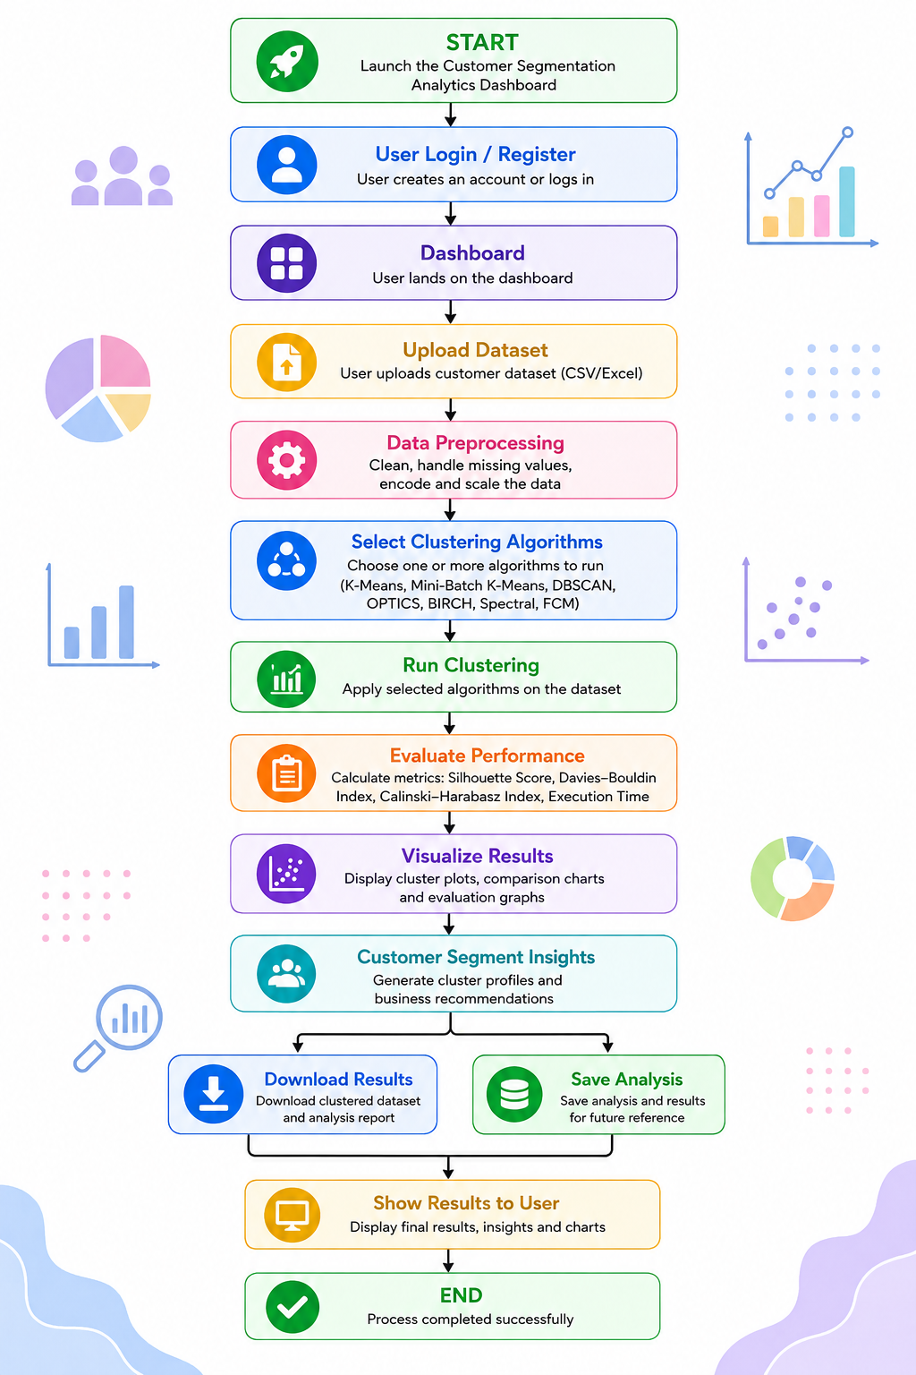
Project workflow
Flow Chart

Slide 12
Project plan
Phase | Activity | Description
Phase 1 | Project Planning & Research | Define the project title, problem statement, objectives, literature survey, research gap, innovation, feasibility, and project plan.
Phase 2 | Methodology & System Development | Define methodology and system design, select tools and technologies, collect and preprocess data, and implement clustering algorithms and the dashboard.
Phase 3 | Results & Performance Evaluation | Analyze clustering results, compare algorithms using evaluation metrics, prepare results, and generate customer segment insights.
Phase 4 | Documentation & Final Preparation | Prepare the project report, research paper, PPT, GitHub repository, project analysis report, and demonstration video.
Phase 5 | Testing & Final Submission | Perform complete system testing, fix errors, validate results, conduct the final project demonstration, and submit all required project documents and research paper proof

Slide 13
Thankyou

