Slide 1

AI-DRIVEN SMART VEHICLE BREAKDOWN ASSISTANCE AND AUTONOMOUS SERVICE COORDINATION SYSTEM
SOA Project Review-2
 | Under the Guidance of Dr. NEELIMA GOGGINENI, Associate Professor, Department of Computer Science and Engineering, KLH CSE Bowrampet Campus
Team Members Name Roll Number R. Dhanusha 2420030159 M. Lekha Sri 2420030334

Slide 2
Outline of Project Work
Introduction
Problem Statement & Objectives
Project Design & Architecture
Methodology Adopted
Technical Soundness
Technical Implementation
Feasibility & Project Plan
Conclusion & Future Work

Slide 3
Introduction
The AI-Driven Smart Vehicle Breakdown Assistance and Autonomous Service Coordination System is a service-oriented platform that helps stranded drivers get timely roadside help. A driver raises an SOS request with live location, vehicle details, and a short description or photo of the problem. The system uses AI to diagnose the likely fault, assess urgency, and decide what kind of help is required, such as a mechanic, tow truck, battery jump-start, tyre repair, or fuel delivery.
Instead of depending on a call-centre operator, an autonomous coordination layer selects the most suitable nearby service provider using distance, estimated arrival time, skills, availability, and rating, and dispatches the job automatically. If the provider rejects the request or does not respond in time, the job is re-assigned without manual intervention. The driver receives live tracking and status notifications until the vehicle is fixed. The system is built from independent REST services (user, diagnosis, location, dispatch, tracking, and notification) so that each can be developed, tested, and scaled separately.

Slide 4
Problem Statement
Drivers stranded on the road often cannot identify the cause of the breakdown, so they cannot describe it clearly or decide which kind of help to request.
Conventional roadside assistance relies on call-centre operators following fixed scripts and manually choosing providers, which is slow and prone to error.
Finding a nearby, suitable, and available mechanic or tow truck is uncertain, especially at night, on highways, or in unfamiliar areas.
Drivers get little real-time visibility of whether help has been assigned and when it will arrive.
When a provider declines or is delayed, the request has to be handled again manually, which increases waiting time.
A unified platform is needed that combines AI diagnosis, automatic provider selection, dispatch, tracking, and notifications; the proposed system addresses this through autonomous, service-based coordination.

Slide 5
Objectives
Design an AI-based diagnosis service that identifies the likely breakdown type and urgency from driver input and optional vehicle data.
Automatically find and rank nearby service providers using distance, ETA, skill match, availability, and rating.
Build an autonomous coordination workflow that assigns jobs and re-dispatches when a provider rejects or times out.
Provide real-time location tracking and ETA to the driver throughout the service.
Send status alerts through SMS, push, and email at every stage of the request.
Apply Service-Oriented Architecture with independent REST services behind an API gateway for maintainability and scalability.
Store requests, diagnoses, dispatch jobs, and service history for traceability and analysis.

Slide 6
Project Design
The system follows a Service-Oriented Architecture in which independent services communicate through REST APIs and events.
API Gateway: single entry point that routes REST requests, authenticates users (JWT), and validates input.
User Service: handles registration, login, driver profile, and vehicle details.
Diagnosis Service: AI module that classifies the breakdown type and urgency from symptom text, photo, and optional OBD-II codes.
Location Service: captures GPS location, searches nearby providers, and calculates distance and ETA.
Dispatch Service (AI Orchestrator): ranks providers, assigns the job, and re-dispatches on rejection or timeout.
Tracking Service: maintains job status and live provider location for the driver.
Notification Service: sends SMS, push, and email updates and records delivery status.
Database: stores users, vehicles, requests, diagnoses, providers, jobs, and notifications.
The modular design keeps responsibilities separate, so each service can be developed, tested, and scaled independently.

Slide 7
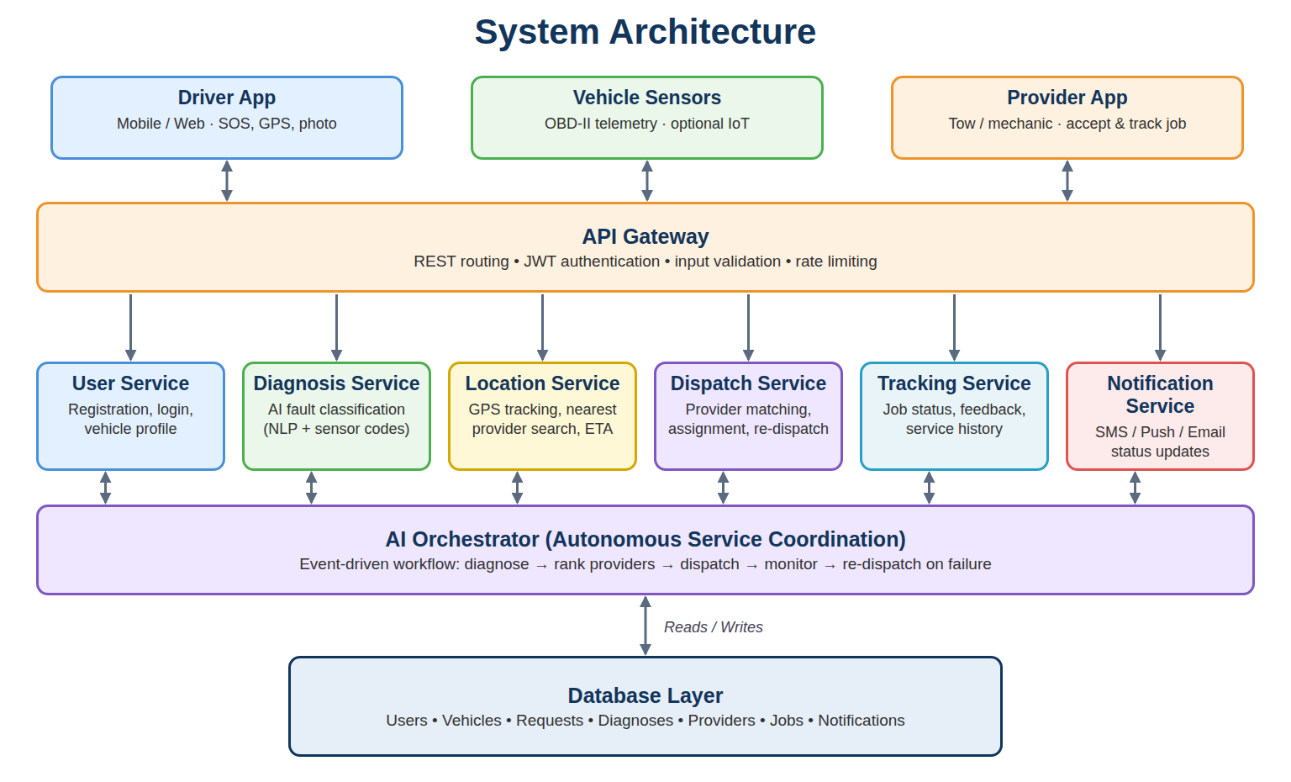

Slide 8
Methodology Adopted
Service-Oriented Architecture with independent REST services (user, diagnosis, location, dispatch, tracking, notification) behind an API gateway.
Each request captures GPS coordinates, vehicle details, and a symptom description or photo, with optional OBD-II fault codes.
Diagnosis: NLP-based text classification, plus rule-based mapping of OBD-II codes, predicts the breakdown category and urgency.
Location: GPS tracking and nearest-provider search using distance calculation (Haversine) and estimated arrival time.
Dispatch: a weighted score over distance, ETA, skill match, rating, and availability selects the provider; a reject or timeout triggers automatic re-dispatch.
Event-driven coordination: the orchestrator publishes events (request created, provider assigned, job accepted, completed) consumed by tracking and notification.
Agile, incremental development so each service is built, integrated, and tested step by step.
Unit, API, integration, and end-to-end testing validate the complete workflow.

Slide 9
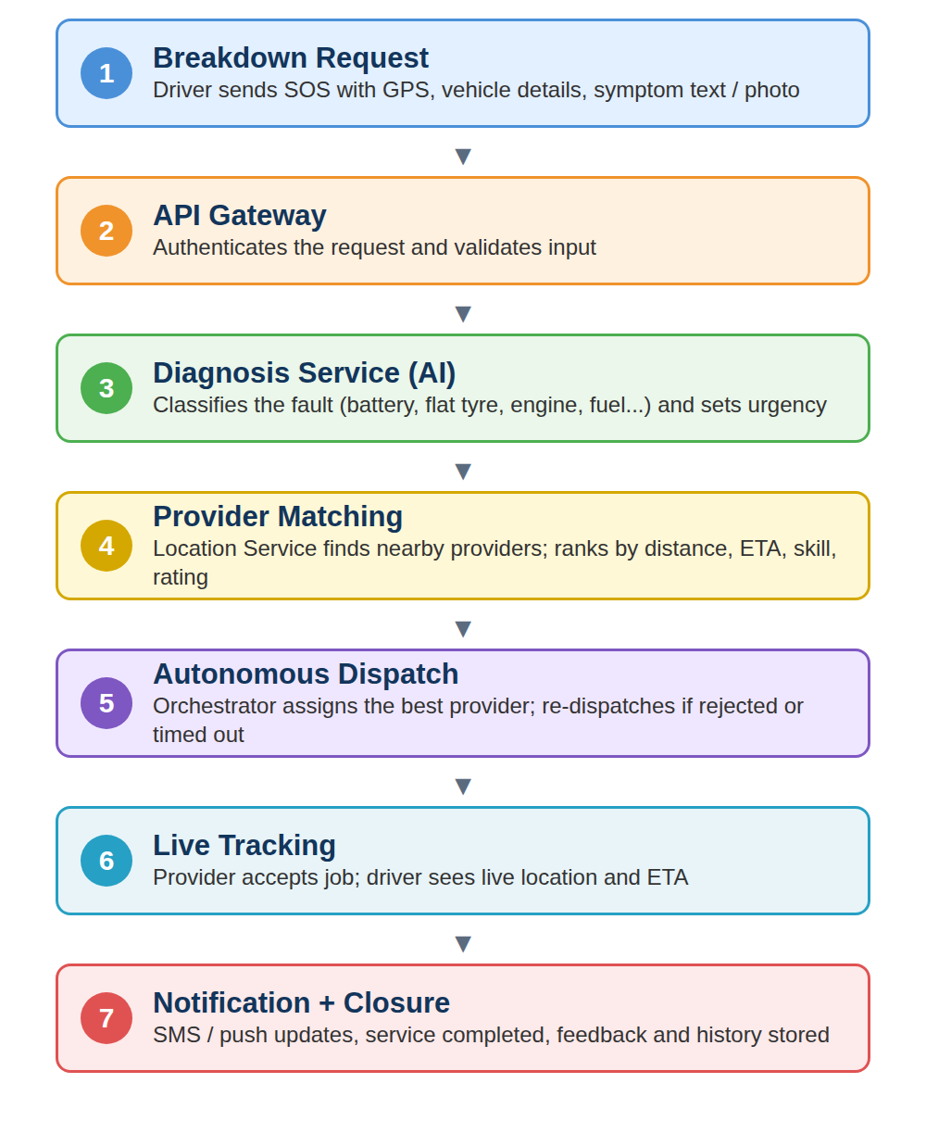
Technical Soundness of the Project
Loose coupling: each service has one responsibility and interacts only through REST APIs and events.
Fault isolation: a failure in one service (e.g., Notification) does not stop diagnosis or dispatch.
Reliable dispatch: timeouts and automatic re-dispatch ensure a request is never left unassigned.
Auditable AI: diagnosis returns category, urgency, and confidence, with a rule-based fallback when confidence is low.
Security: JWT authentication, input validation, and controlled sharing of location data.
Traceability: requests, diagnoses, dispatch jobs, and notifications are stored.
Scalability: services such as Location and Dispatch can be scaled independently.
Integration testing verifies SOS, diagnosis, dispatch, tracking, and notification as one workflow.

Slide 10
Technical Implementation
Driver App (Web/Mobile): SOS button, live location capture, request form, and tracking screen.
API Gateway: routes REST calls, applies JWT authentication and validation.
Diagnosis Service: analyses symptom text, photo, and OBD-II codes; returns fault category, urgency, and confidence.
Location Service: receives GPS updates, finds nearby providers, and computes distance and ETA.
Dispatch Service / AI Orchestrator: scores providers, assigns the job, and handles accept, reject, timeout, and re-dispatch.
Tracking Service: manages the job status lifecycle and live location for the driver.
Notification Service: sends SMS, push, and email alerts and stores delivery status.
Database: users, vehicles, requests, diagnoses, providers, jobs, and notifications.
Service Flow: Driver → API Gateway → Diagnosis → Location → Dispatch → Provider → Tracking → Notification → Driver

Slide 11
Feasibility and Project Plan
Technical Feasibility
Can be built with standard web technologies: REST APIs, microservices, a relational database with location support, a maps/GPS API, a machine-learning text classifier, and an SMS or push notification gateway.
Operational Feasibility
Simple one-tap SOS request, automatic diagnosis and dispatch, live tracking, and clear status updates make the system easy for drivers and service providers to use.
Project Plan
Phase 1: Requirement Analysis and Problem Definition
Phase 2: Architecture and Database Design
Phase 3: User and Location Service Development
Phase 4: Diagnosis Service (AI Model) Development
Phase 5: Dispatch, Orchestration, and Tracking Services
Phase 6: Notification Integration and Dashboard
Phase 7: Unit, API, and Integration Testing
Phase 8: Documentation, Demonstration, and Final Review

Slide 12
Conclusion & Future Work
Conclusion
The proposed system provides a unified, service-oriented solution for breakdown assistance. AI diagnosis, automatic provider selection, autonomous dispatch, live tracking, and notifications reduce driver waiting time and remove the dependence on manual call-centre coordination.
Future Work
Real-time traffic-aware ETA and route optimisation.
Integration with live OBD-II / IoT vehicle telemetry for predictive breakdown alerts.
Learning-based provider ranking that improves from feedback and past jobs.
Voice and multilingual SOS requests.
In-app payments and service cost estimation.
Cloud deployment with monitoring and automatic scaling.
References
Datta, S. K., & Bonnet, C. (2017). An IoT Framework for Intelligent Roadside Assistance System. IEEE ICCE-TW 2017.
US Patent 10,692,384. Data Processing System with Machine Learning Engine to Provide Roadside Assistance Functions.
Auto Rental News. HGS Axle SmartBot Automates Dispatch for Faster Roadside Assistance.

