Slide 1

HOUSE RENTAL MANAGEMENT
Mini Project Presentation
GLA University
Department of CEA
Presented By:
Amit Kumar(181500084)
Bhagat Singh(181500189)
Madan Mohan(181500354)
Mohan Agrawal(181500385)
Udit Aggarwal(181500765) Submitted To: Ms. Harvindar Kaur

Slide 2
Introduction
It is web based application that provide the interface to user for view the houses as per the requirement.
It gives a dashboard to owner & tenant for management their details.
The focus of this project is to managing the house for low income, medium and high incomes articles or what is commonly known as affordable housing.

Slide 3
Problem Statement
Rental has become a problem for most of the person because of growing population. People migrate from one city to other cities for finding job, but in beginning, everyone needs house that can only be available with the help of rent.
Increased number of tenants and landlords makes management difficult especially for the landlords who are losing huge sum of money through tenants who evade rent.
Housing is a major problem in Kenya especially in Nairobi city. Millions of people are living in sprawling slams and also in other informal settlement around Nairobi (UN-Habitat, 2008).

Slide 4
Objective
The primary object of this Online House Rental System is to provide houses to the people without wasting a lot of time to seek the house on other places.
To produce a web-based system that allows the vendors and tenants to register and book a house for rent to effectively manage their business.
Every individual would be able to find the houses of their types.

Slide 5
Benefits
Time saving:
Costumers do not need to roam across cities for finding their desired house.
Convenient: Costumers just need a fast internet access to find the houses of their choices. And It is very easy to book their desired house from their house at one click.
Services: We provide houses with great services like CCTV surveillance, Barrier at gate, Parking facility and various other services at a single call.

Slide 6
Modules
Authentication/Login
Searching
Owner Dashboard
Tenant Dashboard
Home Dashboard
Transaction

Slide 7
System Requirements
1. Hardware Requirements:
PC with 4GB RAM, 500 GB HDD
I3 Processor
2. Software Requirements:
XAMPP web server 1.0.0.0
VS code editor 1.46.1.0
GitHub Repository

Slide 8
Languages Used
HTML5
CSS
JavaScript
PHP 7.1.33.0
My SQL database

Slide 9
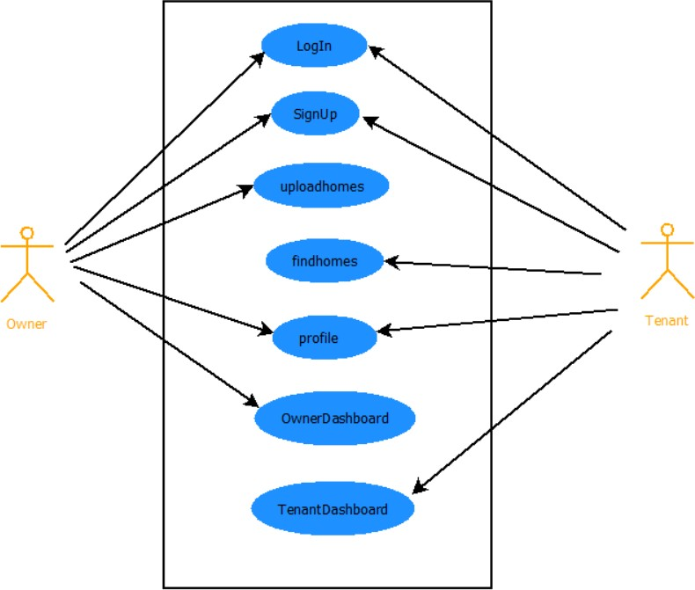
Software Design
Use Case Diagram:

Slide 10
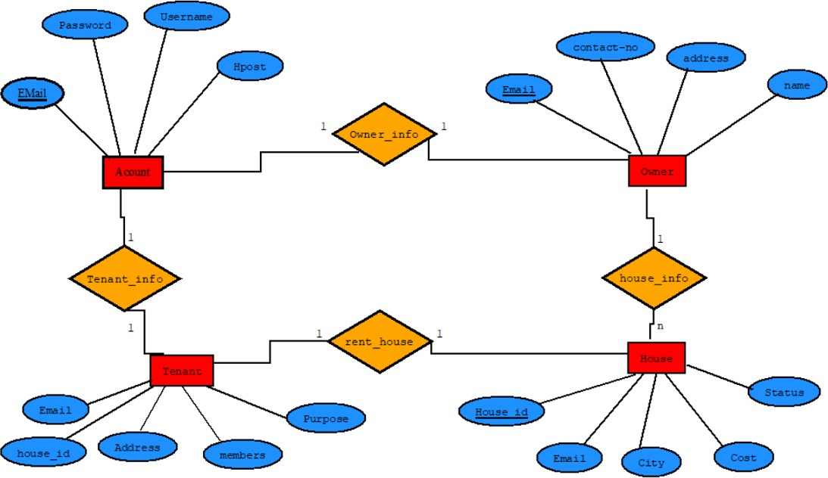
Software Design
ER Diagram:

Slide 11
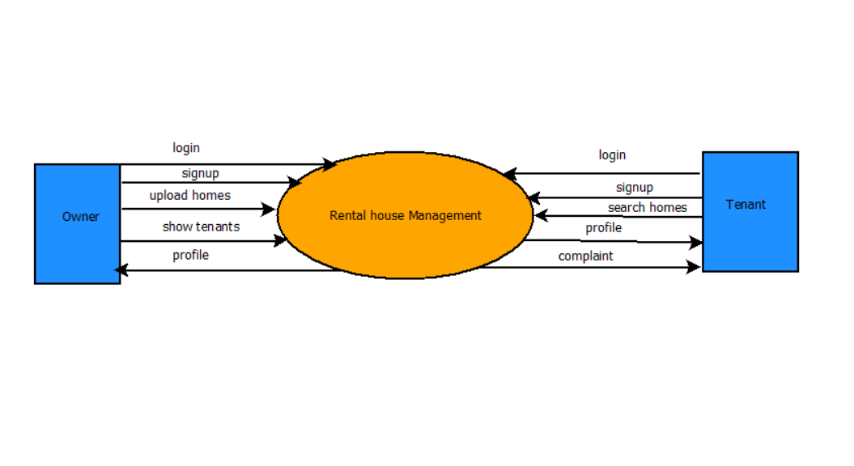
Software Design
DFD Level-0 Diagram:

Slide 12
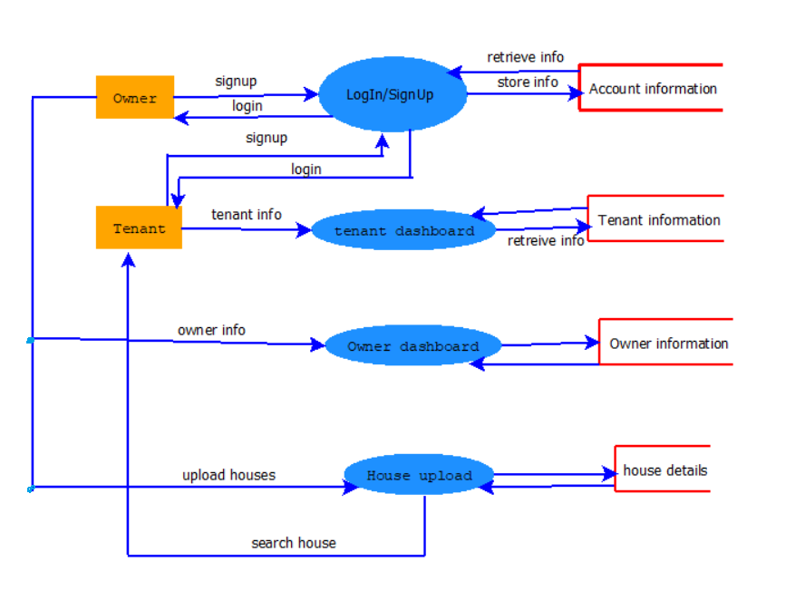
Software Design
DFD Level-1 Diagram:

Slide 13
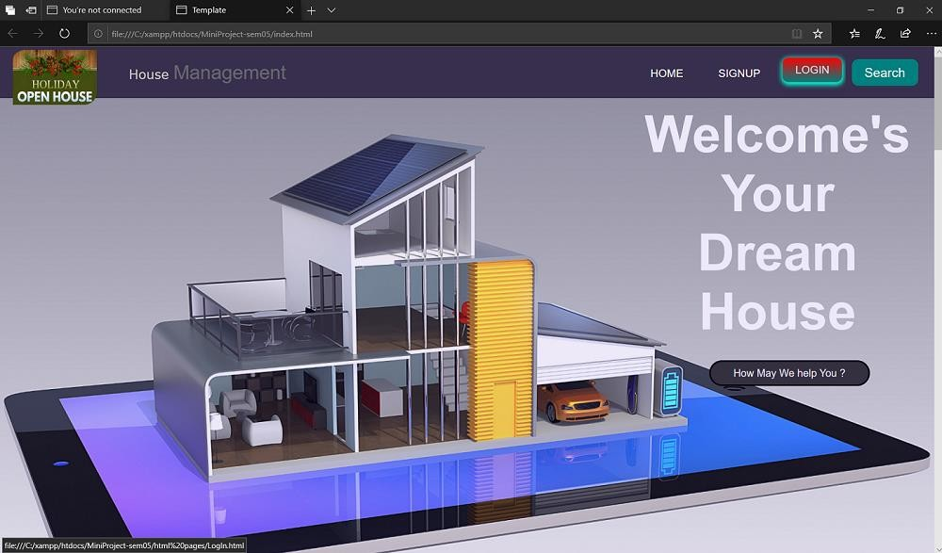
Implementation
1. Home Page:

Slide 14
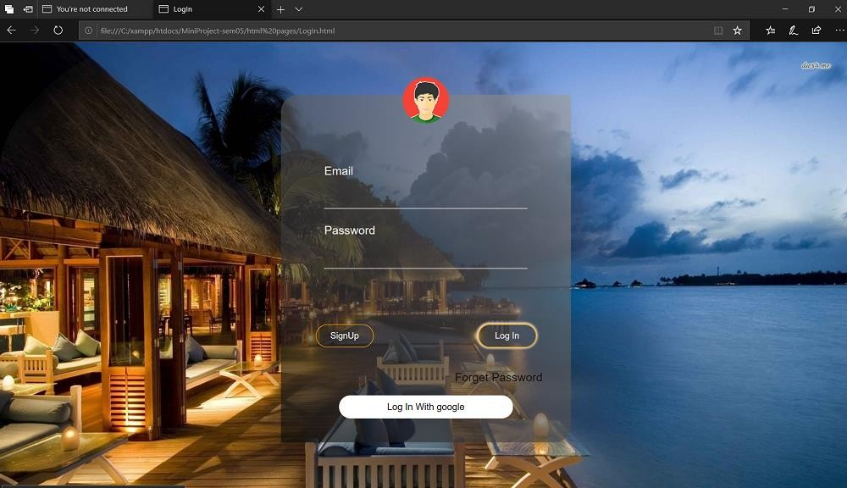
Implementation
2. Login Pages:

Slide 15
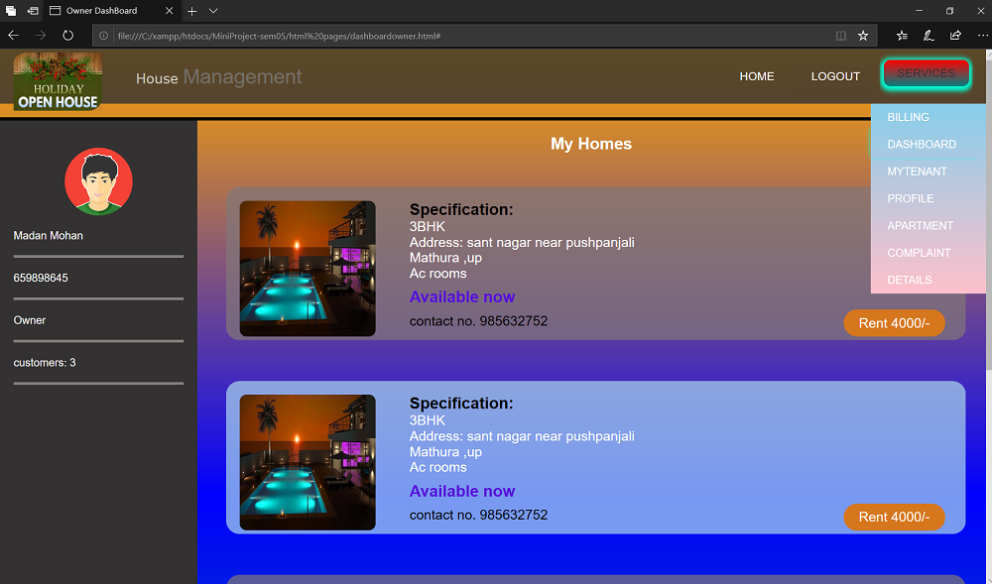
Implementation
3. Owner Dashboard:

Slide 16
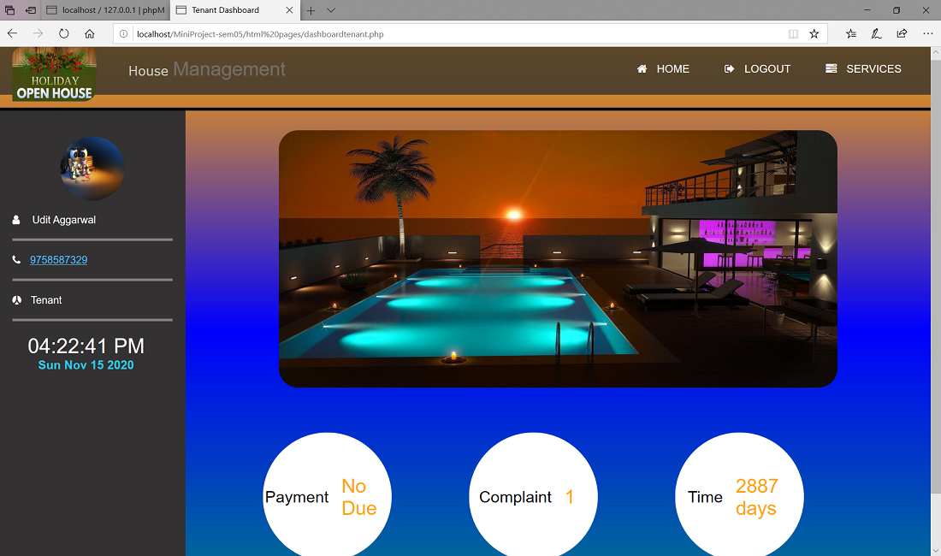
Implementation
4. Tenant Dashboard:

Slide 17
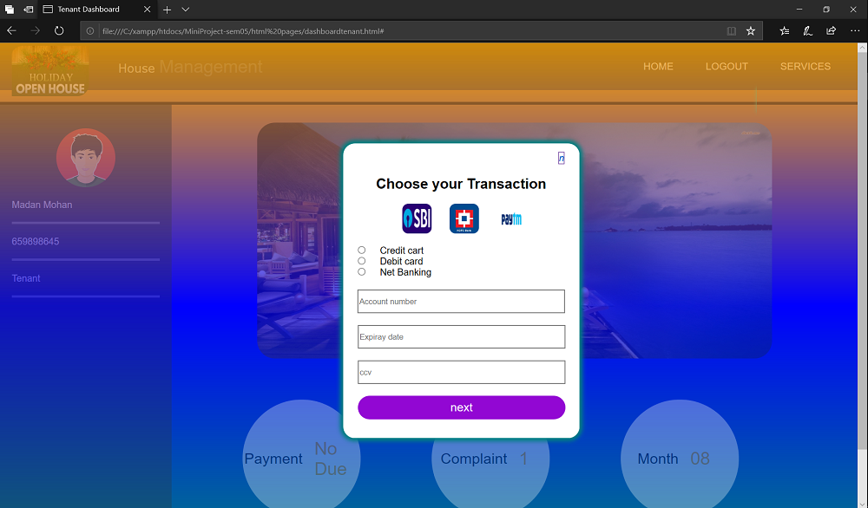
Implementation
5. Transaction:

Slide 18
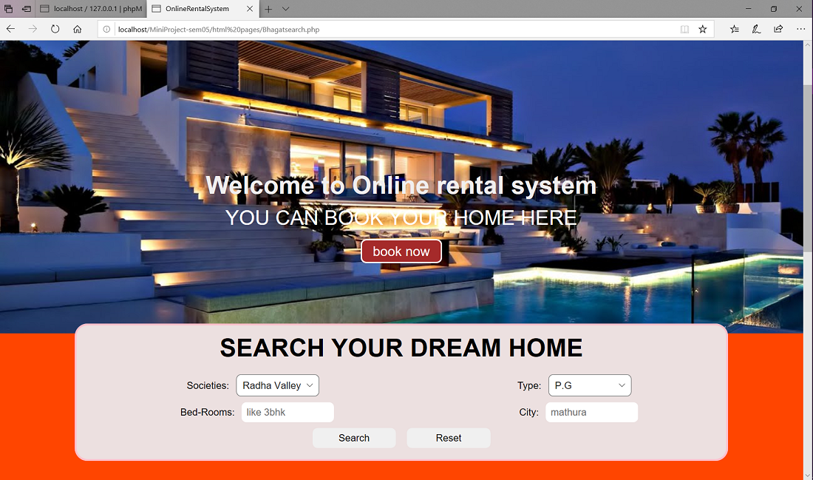
Implementation
6. Searching:

Slide 19
Conclusion
We learned a lot through this project. This project has sharpened our concept of Mysql database and the software-hardware interface.
After the completion of project, customer can view all the houses of different sizes and styles. An individual can find houses at their desired location. An individual can book their desired house by net banking from their house at one click.

Slide 20
THANK YOU

