Slide 1

Assignment system using cloud
Computer Engineering & Application
B.Tech 3rd year project
Group-5
Presented by:
1. Madan mohan(181500354)
2. Udit Aggarwal(181500765)
3. Mohan Agrawal(181500385) To: Mr. Saurabh singhal

Slide 2
Introduction
1. It is a desktop application written in java language.
2. This application gives better accessibility of document via internet.
3. It’s also provide security to your document by cloud service provider.
4. We use S3(simple storage service) of Amazon to store the documents.

Slide 3
Introduction
5. It is a platform where teachers can give work to students.
6. Here, we can also ask questions from teachers.

Slide 4
Objective
It gives new approach to doing the work at home.
This application mainly develop for college purpose, where students can submit their work without wasting much more time.

Slide 5
Scope
This application can be used by colleges and schools.
It is also helpful in pandemic situation like covid-19.
It can be used like Google drive to maintain the applications.

Slide 6
Requirement
Software:
Eclipse Ide 2019-06(4.12)
Xampp 7.1.33
Jdk 12.0.2
Hardware:
Pc with at least 4GB RAM,500 GB HDD

Slide 7
Technologies
Programming language:
Java 8
Technology:
Java Swing(Java library)
Cloud Service:
S3(Simple storage service)

Slide 8
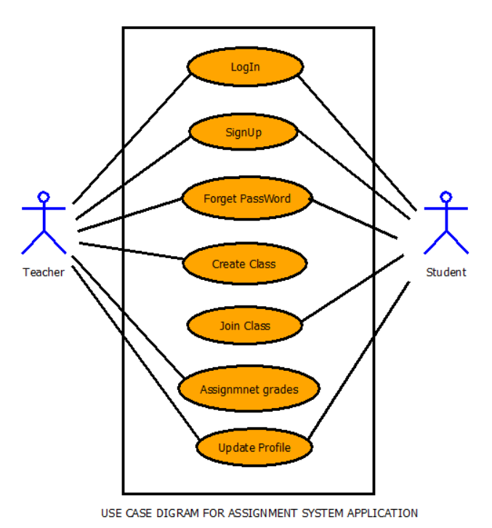
Software Design
Use case diagram:

Slide 9
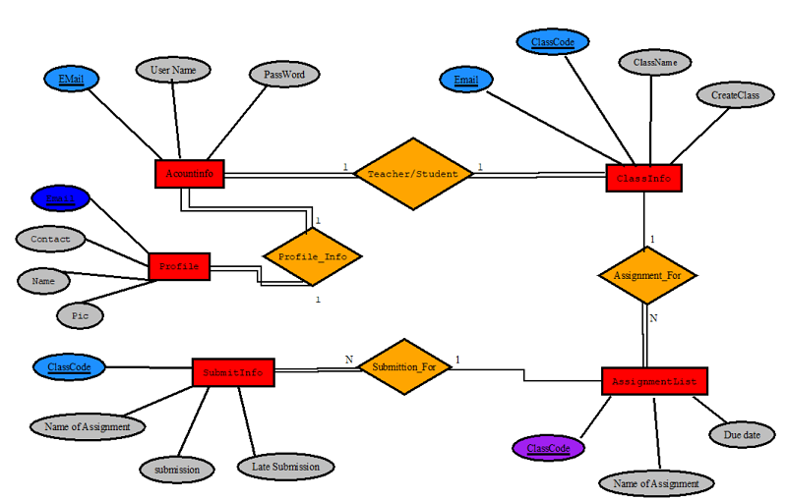
Software Design
ER- diagram:

Slide 10
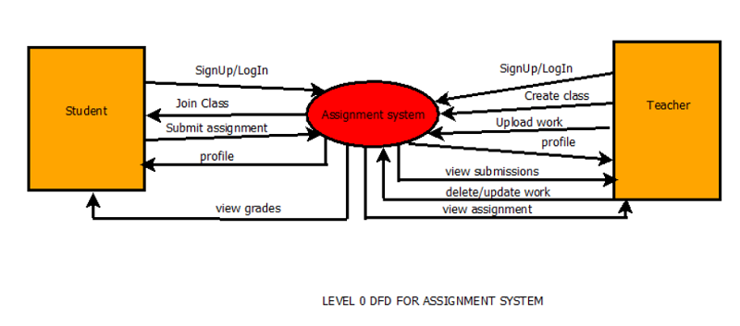
Software Design
DFD level-0 diagram:

Slide 11
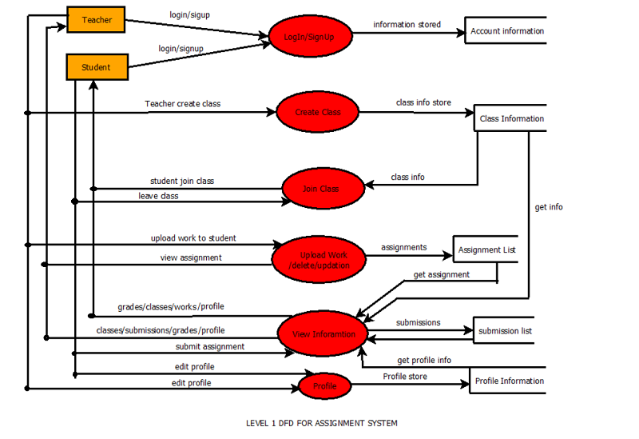
Software Design
DFD level-1 diagram:

Slide 12
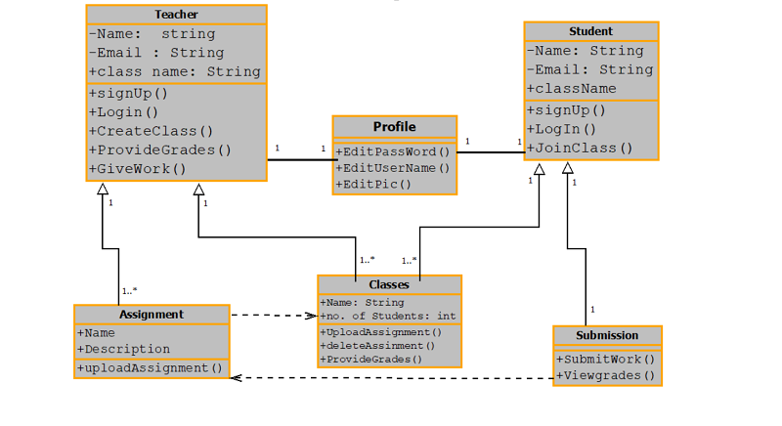
Software Design
Class diagram

Slide 13
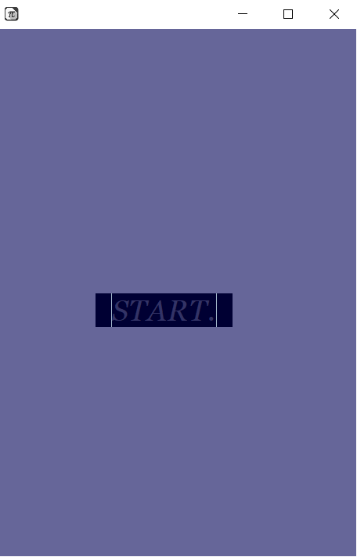
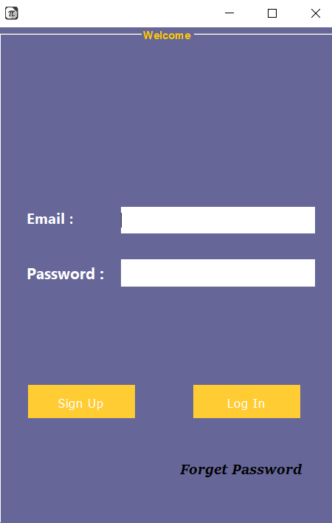
GUI
Start Screen
Authentication
next

Slide 14
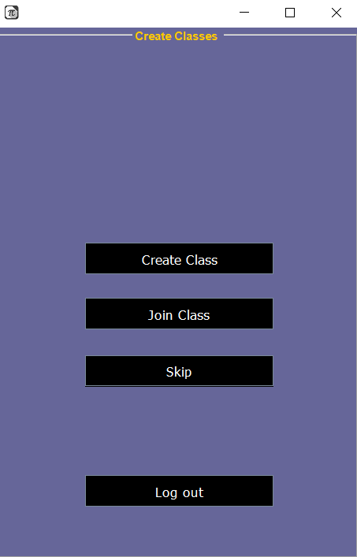
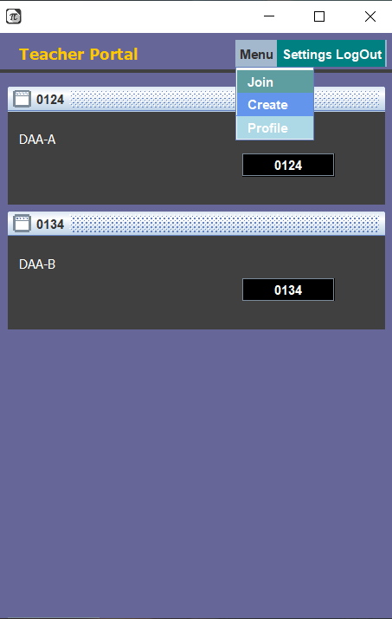
GUI
DashBoard
ClassList/Teacher Panel

Slide 15
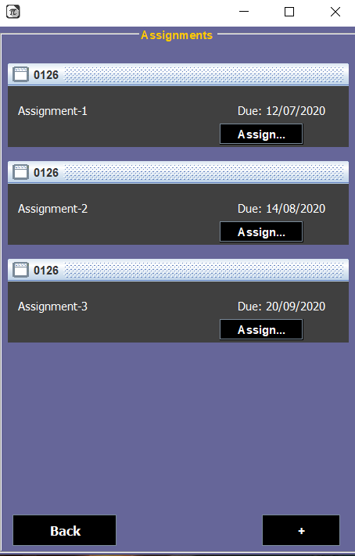
GUI
Assignments

Slide 16
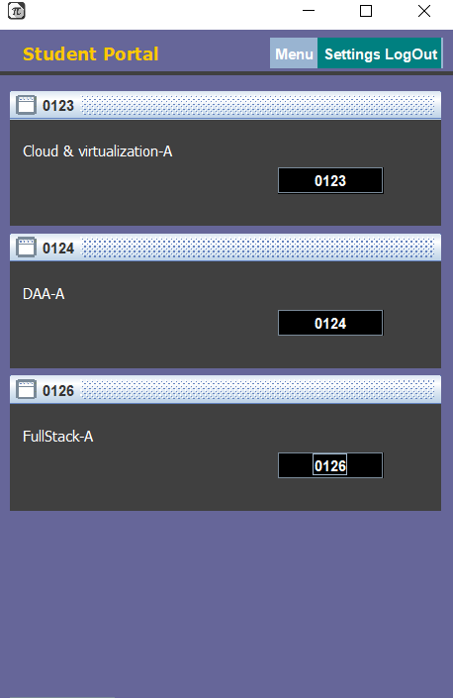
GUI
Student Panel

Slide 17
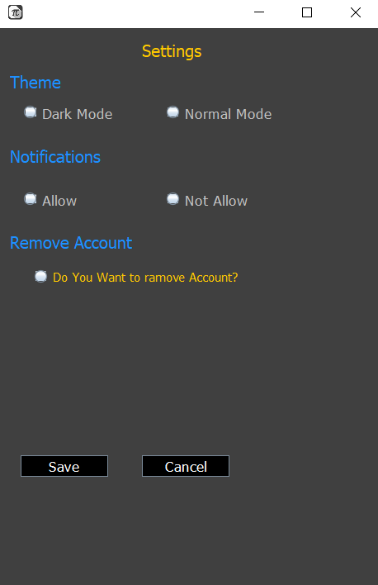
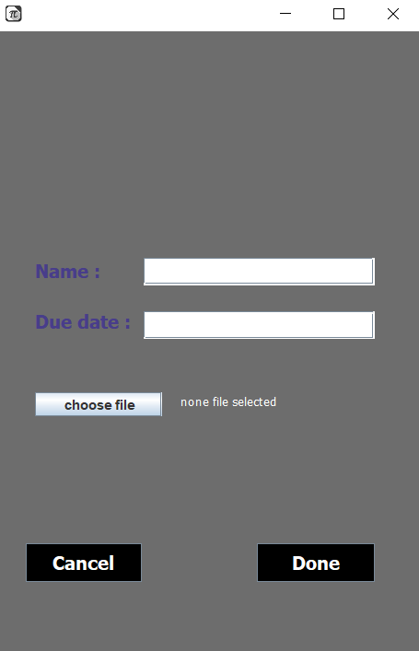
GUI
Settings
Upload Assignment

Slide 18
Coding Section
1. Authentication:
login()
signup()
forget()
2. Teacher information:
createClass()
editProfile()
grade()
assignment()
myclass()

Slide 19
Coding Section
1. Student information:
JoinClass()
editprofile()
submit()
viewClass()

Slide 20
THE END

