Slide 1
NirikshAmrita
Agentic Shift Handover & Clinical Early Warning Surveillance Platform
Designed for Patient Safety and Escalation at Amrita Hospital, Faridabad
Team Members: Madan.M, Anna Clara Mathew, K.L.C Aditya

Slide 2
CORE PROBLEM
Clinical Context & Patient Safety Problem
Dangers of Gradual Physiological Deterioration
• In hospital wards, patients rarely deteriorate suddenly. Their vitals (respiratory rate, SpO2, blood pressure) decline gradually across shifts. Standard tracking fails to flag these trends.
Shift Handover Vulnerability
• During nurse shift rotations, patient information is often handed over in a fragmented, rushed, or unstandardized manner, leading to missed warnings.
Oversight & Alarm Fatigue Guidelines (WHO & Joint Commission)
• WHO's Patient Safety Action Plan 2021-2030 and Joint Commission alerts state that medical warnings must be prioritized, actionable, and auditable, rather than just generating noisy alarms.

Slide 3
AGENTIC PHILOSOPHY
Why We Need Agentic AI Workflows
Passive Dashboards vs. Active Surveillance
• Normal dashboards only list numbers. An agentic system actively monitors vitals, calculates Early Warning Scores (NEWS2), and takes ownership of alert closures.
Escalation Closure Tracking
• The Escalation Agent checks if alerts are acknowledged. If no action is logged within defined time windows (e.g. 15 minutes), alerts are escalated to higher supervisors.
Clinical Accountability Audit Logs
• Every nurse action, alert acknowledgment, response latency, and escalation path is logged to a secure audit database to improve ward operations and legal accountability.

Slide 4
TECHNOLOGY STACK
Project Technical Architecture
Frontend Framework
• Vite + React 19 + TanStack Start (for high-speed hydration) + TailwindCSS for premium styling.
Backend Core engine
• FastAPI (Python 3.10) + SQLAlchemy ORM + SQLite database.
AI & Language Intelligence Layer
• Google Gemini API (using gemini-2.5-flash for OCR, handovers, and translation).
Real-time surveillance Pipeline
• WebSockets for live telemetry broadcast and audio alert syncing.

Slide 5
DESIGN RATIONALE
Why We Selected This Technical Stack
FastAPI for Concurrency & Speed
• FastAPI offers asynchronous concurrency out of the box, letting the backend handle live telemetry streams, validation, and Gemini calls simultaneously with sub-second latency.
React & TanStack for Dynamic Clinical Views
• Clinical views must never lag. React's state management coupled with TanStack's cache-hydration speeds up navigation between patient telemetry grids.
Gemini 2.5 Flash for Multimodal Vision & Translation
• Gemini 2.5 Flash is selected for its high speed, low cost, and ability to handle both multimodal images (telemetry OCR) and multi-language translation (SBAR handovers).
SQLite for Low-Overhead Local Storage
• SQLite handles transactional clinical entries without requiring external server dependencies during hospital presentations.

Slide 6
DEVELOPMENT STAGE 1
Stage 1: Core Database, API & NEWS2 Ingest
Database Schemas & ORM Setup
• Initialize SQLAlchemy tables (Patient, VitalRecord, NEWS2Score). Set up patient profiles with clinical flags (COPD, diabetes, hypertension).
NEWS2 Calculator
• Calculate Early Warning Scores instantly as vitals are inputted. Dynamically adjust parameters if the patient has a diagnosed COPD history.
Clinical Typo Validation Agent
• A rules-based validation agent checks input ranges (e.g. catching BP entered as 800/60) to keep the database clean and safe.

Slide 7
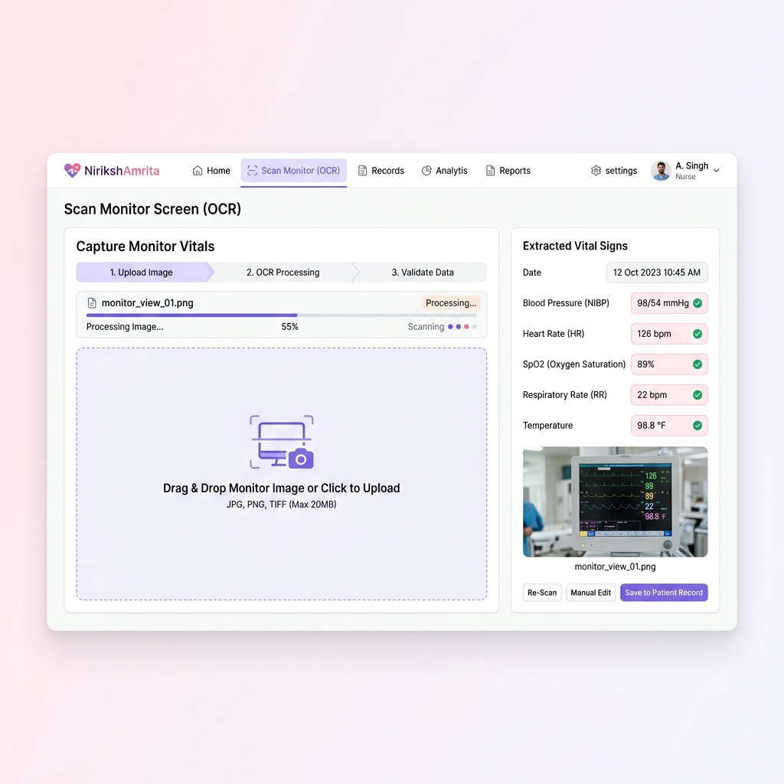
DEVELOPMENT STAGE 2
Stage 2: Gemini Multimodal Telemetry OCR Ingestion
ICU Monitor Screen Reader
• Using gemini-2.5-flash to read screenshots of bedside telemetry monitors, extracting BP, HR, SpO2, RR, and temperature values.
Eliminating Hardware Integration Hurdles
• Instead of writing expensive, device-specific drivers, nurses can capture or upload a photo to populate the database.
Visual Scanner Overlay
• Includes a mock laser scanning animation with a progress loader to show the flow clearly during presentations.

Slide 8
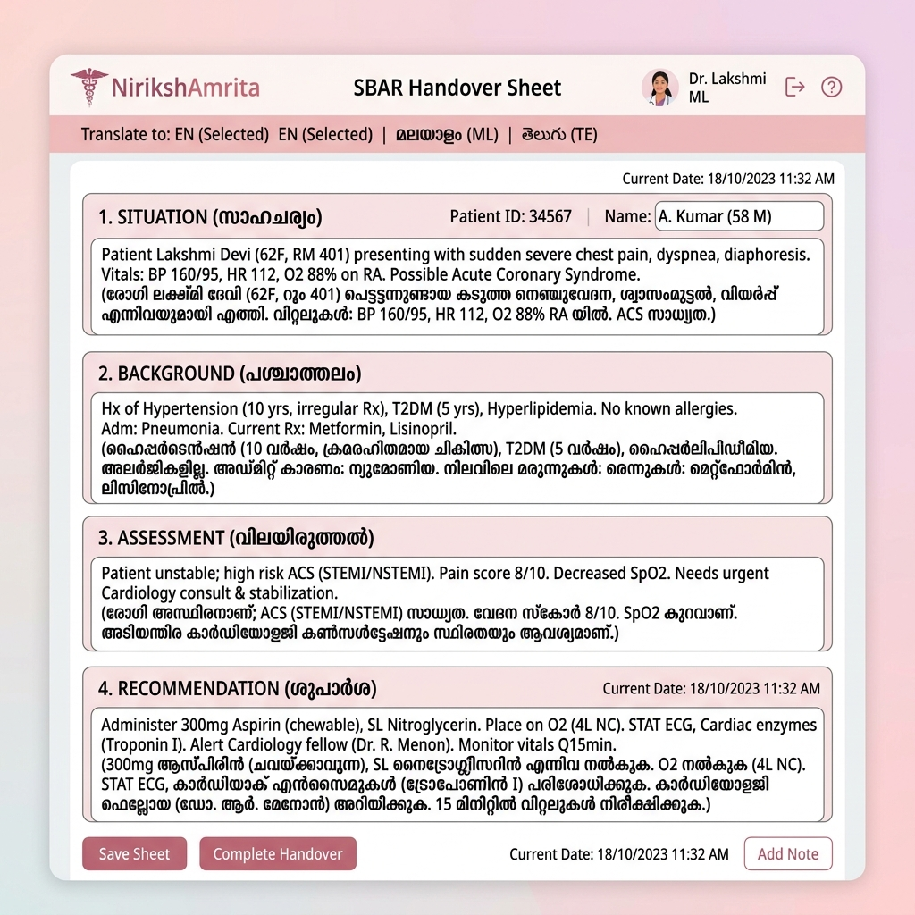
DEVELOPMENT STAGE 3
Stage 3: Trend Reasoning & SBAR Handover Summaries
Cross-Shift Trend Calculations
• Calculates changes across the last 6 rounding entries (e.g. SBP drops >10% or HR increases over 3 consecutive shifts).
Auto-Generated SBAR Handover
• Feeds vital trends and context to Gemini to generate Situation, Background, Assessment, and Recommendation reports.
Telemetry Line Graphs
• Renders historical vital parameters (BP, HR, SpO2, Glucose) in clean, interactive line charts.

Slide 9
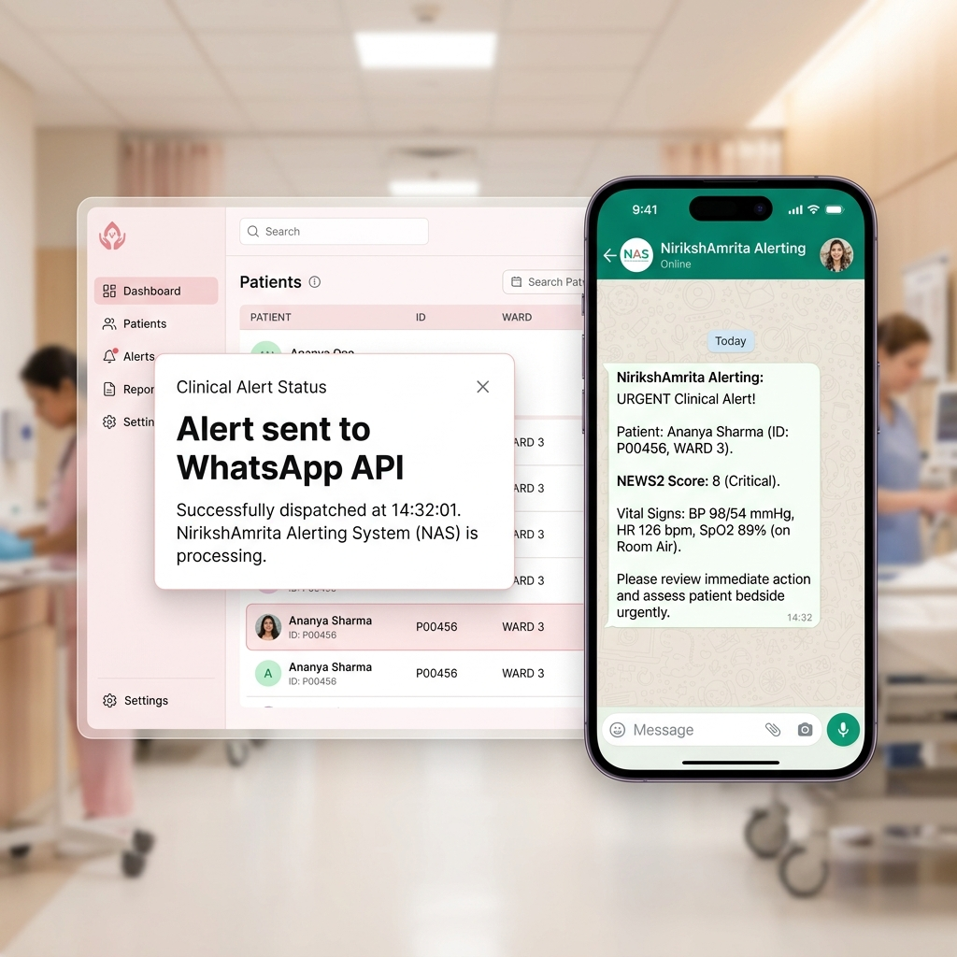
DEVELOPMENT STAGE 4
Stage 4: Outbound WhatsApp Alerts & Simulator
Direct Out-of-App Warning Gateway
• Sends WhatsApp alerts directly to the duty doctor's phone when a patient's NEWS2 score indicates orange or red risk.
Actionable SLA Closure Protocols
• The escalation runner alerts the supervisor if the ward nurse does not acknowledge a red alert within 15 minutes.
On-Screen Smartphone Mockup
• Features a floating iPhone mockup that simulates the WhatsApp chat and lock-screen alerts the doctor receives.

Slide 10
DEVELOPMENT STAGE 5
Stage 5: Ward Risk Heatmap & Command Center
Ward-Level Risk Prioritization Heatmap
• Displays a grid of all beds colored by their active NEWS2 risk level (Red, Orange, Yellow, Green), giving supervisors a bird's-eye view.
Oversight Tooltip Cards
• Hovering over a bed cell opens a small tooltip showing the patient's name, active warning description, and last actions taken.
Command Center Metrics
• Tracks average acknowledgment time, active alerts, occupancy logs, and rosters to monitor clinical workflow efficiency.

Slide 11
SAFETY & INNOVATIONS
Extra Clinical Innovations & Safety Rules
Malayalam & Telugu SBAR Translation
• Permits shift-handover summaries to be translated into regional languages in real-time, removing communication barriers.
Clinical RAG Assistant Chatbot
• A patient-specific chatbot widget that allows nurses to query historical records, trends, and warning rationales.
Deterioration Projections (AI Predictions)
• Uses regression modeling on vitals history to forecast boundaries breaches and alert nurses before they occur.
Presentation Demonstration Mode
• A toggle switch that runs the OCR scanner, populates abnormal values, and triggers the WhatsApp overlay, simplifying live presentations.

