Slide 1
NirikshAmrita
Agentic Shift Handover & Clinical Early Warning Surveillance Platform
Designed for Patient Safety and Escalation at Amrita Hospital, Faridabad
Team Members: Madan.M, Anna Clara Mathew, K.L.C Aditya

Slide 2
CLINICAL PROBLEM STATEMENT
Clinical Surveillance Limitations & Shift Handovers
Physiological Deterioration Latency
• In acute care settings, patients undergo gradual, multi-parameter physiological decline rather than sudden onset decompensation. Isolated point-in-time checks fail to capture progressive decline across shifts.
Information Fragmentation During Rotations
• Ward handovers are statistically high-risk windows for information loss. Critical parameters (e.g. oxygen desaturation, rising glucose) are often poorly communicated or missed.
Alarm Fatigue & Clinical Prioritization (Joint Commission Compliance)
• Standard clinical dashboards generate noisy, unprioritized alerts, causing cognitive overload for ward nurses. Systems must deliver explainable, prioritized warnings to prevent alarm desensitization.

Slide 3
CLINICAL SAFETY FLOWCHART
NirikshAmrita Agentic Workflow Process Flowchart
Step 1 Ingestion
Step 2 Validation
Step 3 NEWS2 Scoring
Step 4 Escalation
Step 5 Handover
OCR camera scan reads bedside monitor digit values.
Typo filtering agent checks parameters ranges.
EWS agent computes clinical risks score.
Bypasses client to alert Dr. Ramesh on WhatsApp.
AI generates SBAR note translated in Malayalam.

Slide 4
AGENTIC DESIGN PHILOSOPHY
The Paradigm Shift: Passive Dashboards vs. Agentic Surveillance
Active Task Ownership & Closure Tracking
• Conventional systems rely entirely on user observation. An agentic system actively calculates early warning scores (NEWS2) and tracks alert acknowledgment until closure.
Escalation SLAs & Resource Routing
• Integrates active escalation loops. If a nurse fails to acknowledge a critical flag within a set time (e.g., 15 minutes), the system escalates the warning to supervisors.
Explainable Audit Trails
• Maintains legally auditable logs of response times, actions taken, and escalation paths, providing hospital quality assurance boards with complete visibility.

Slide 5
TECHNICAL STACK
System Technical Stack & Core Integrations
Frontend Layer
• React 19, Vite, TanStack Start (for fast server-side hydration), TailwindCSS for custom glassmorphism styles, and Recharts for physiological trend lines.
Backend & Ingestion APIs
• FastAPI (Python 3.10) for async concurrency, SQLite for transactional database records, and SQLAlchemy Object-Relational Mapping (ORM).
AI Inference Layer
• Google Gemini API (using gemini-2.5-flash for vision parsing, handover summaries, and translation).
Surveillance Protocols
• WebSockets for real-time telemetry broadcasts and audio alert synchronization.

Slide 6
SYSTEM RATIONALE
Technical Rationale & Architectural Decisions
Asynchronous Processing (FastAPI)
• Enables high-concurrency ingestion of telemetry payloads without blocking computational agents. Async I/O prevents server lag when querying databases or external APIs.
Optimistic State Synchronization (React & TanStack)
• Ensures clinical dashboards maintain absolute synchronicity with backend state changes, providing nurses with real-time updates without interface delays.
Multimodal Cognition (Gemini 2.5 Flash)
• Selected for its low-latency image tokenization and contextual reasoning, powering real-time digitization of monitor screens and multilingual translation layers.
ACID-Compliant Local Storage (SQLite & SQLAlchemy)
• Provides secure, transactional database records with low overhead, ensuring reliable local deployments during clinical simulations.

Slide 7
STAGE 1 CORE INGESTION
Stage 1: Core Database, Ingestion API & NEWS2 Core
Clinical Data Models
• Define patient profiles with specific comorbidity flags (COPD, diabetes, hypertension) to customize warning thresholds.
NEWS2 Calculator Agent
• Calculates clinical risk scores instantly upon vital entry. Dynamically adapts scoring ranges if the patient has a diagnosed COPD history.
Physiological Range Validation
• Validation scripts filter out entry errors (e.g. BP entered as 800/60) before saving records, keeping database logs clean and accurate.

Slide 8
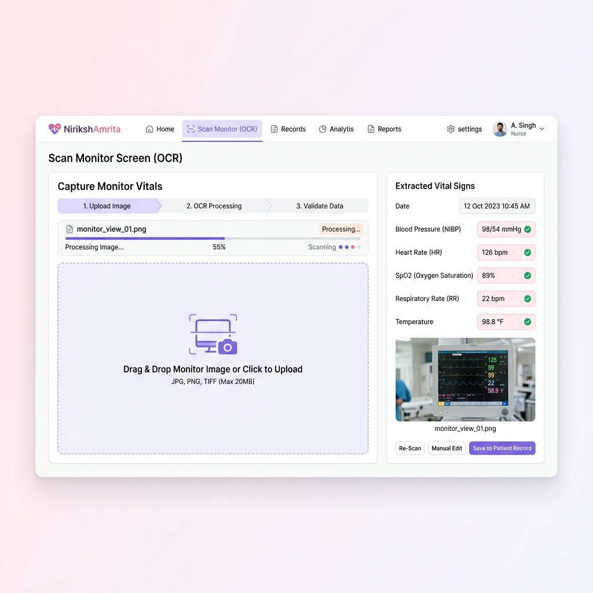
STAGE 2 VISION INGESTION
Stage 2: Gemini Multimodal Telemetry OCR Ingestion
Vision OCR Ingestion
• Sends bedside monitor photos directly to gemini-2.5-flash to extract heart rate, blood pressure, SpO2, RR, and temperature values.
Low-Cost Telemetry Parsing
• Bypasses complex physical hardware integration by letting nurses scan the monitor screen directly to populate the forms.
Scanning UI Components
• Features a scanning line animation and a progress loader to show the ingestion status clearly.

Slide 9
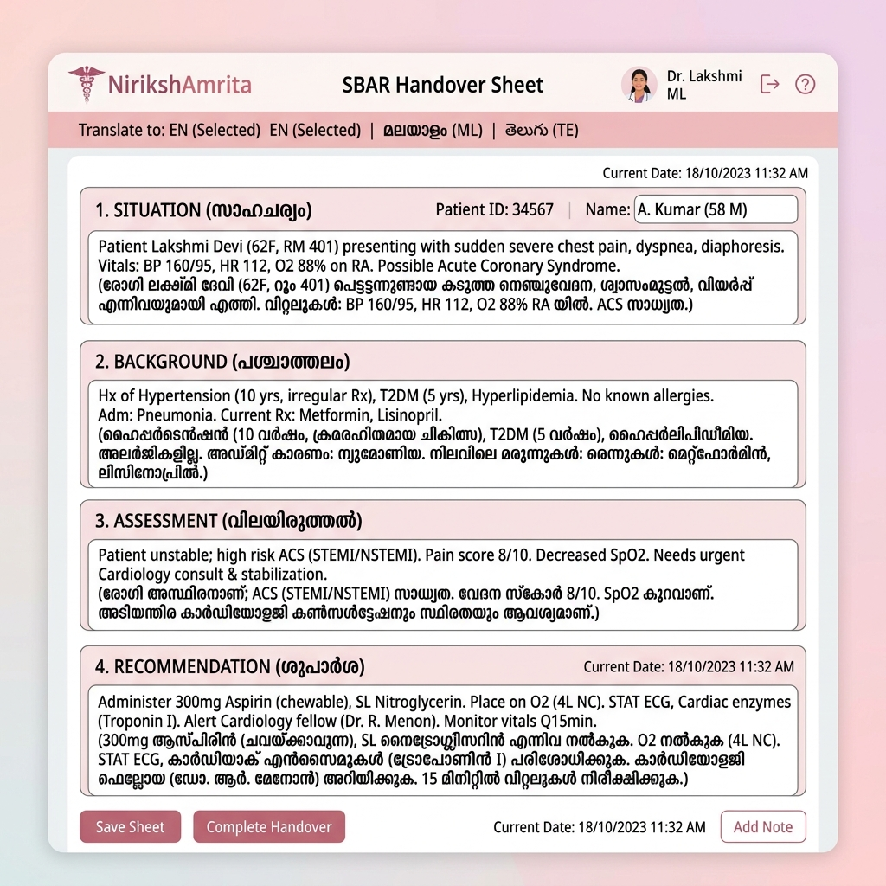
STAGE 3 CLINICAL REASONING
Stage 3: Cross-Shift Trend Reasoning & SBAR Note
Shift-Wise Trend Calculations
• Analyzes the last 6 vital entries to identify gradual patient deterioration (e.g. SBP drops >10% or HR increases over 3 consecutive shifts).
AI-Generated SBAR Summaries
• Processes patient history and trend data to write structured Situation, Background, Assessment, and Recommendation reports.
Dynamic Line Graphs
• Renders historical parameter records (pulse, blood pressure, SpO2) in clean Recharts line charts.

Slide 10
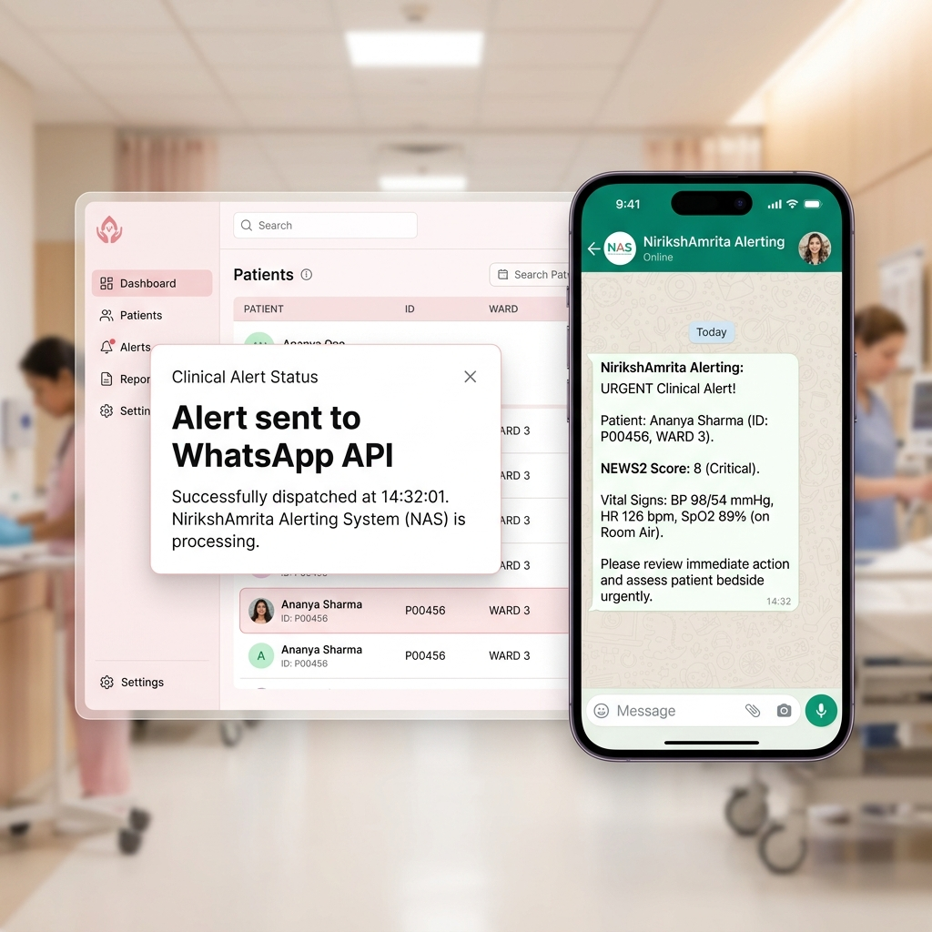
STAGE 4 ACTION & ALERTING
Stage 4: Outbound WhatsApp Alerts & Simulator
Out-of-App Warning Gateway
• Sends WhatsApp alerts directly to the duty doctor's phone when a patient's NEWS2 score indicates orange or red risk.
Actionable SLA Closure Protocols
• Alerts escalate to supervisors if the ward nurse does not acknowledge a red alert within 15 minutes.
On-Screen Smartphone Mockup
• Features a floating iPhone mockup that simulates the WhatsApp chat and lock-screen alerts the doctor receives.

Slide 11
STAGE 5 OVERSIGHT COMMAND
Stage 5: Ward Risk Heatmap & Command Center
Ward-Level Risk Heatmap
• Displays a grid of all beds colored by their active NEWS2 risk level (Red, Orange, Yellow, Green), giving supervisors a bird's-eye view.
Interactive Tooltip Cards
• Hovering over a bed cell opens a small tooltip showing the patient's name, active warning description, and last actions taken.
Surveillance Analytics Metrics
• Tracks average acknowledgment time, active alerts, occupancy logs, and rosters to monitor clinical workflow efficiency.

Slide 12
CLINICAL INNOVATIONS
Integrated System Innovations & Safety Policies
Malayalam & Telugu SBAR Translation
• Permits shift-handover summaries to be translated into regional languages in real-time, removing communication barriers.
Clinical RAG Assistant Chatbot
• A patient-specific chatbot widget that allows nurses to query historical records, trends, and warning rationales.
Deterioration Projections (AI Predictions)
• Uses regression modeling on vitals history to forecast boundaries breaches and alert nurses before they occur.
Presentation Demonstration Mode
• A toggle switch that runs the OCR scanner, populates abnormal values, and triggers the WhatsApp overlay, simplifying live presentations.

