Slide 1
Active RDMA
15-712: Advanced Operating Systems & Distributed Systems
Chris Fallin, Anshul Madan, Filipe Militão

Slide 2
Introduction & Motivation
Classic tradeoff in distributed systems:
RPC style semantics:
Static interface accessible through RPC calls
Calls can be optimized
Remote DMA style semantics:
Increased flexibility by exposing data structures
High separation of data and (running) code

Slide 3
Propose & Prototype
A middle ground: Active RDMA
Keep the flexibility of RDMA…
… but enable data-code locality with code migration (active code).
client
server
code
Memory
NETWORK

Slide 4
RDMA traffic
Operation: p->next->next->val
client
server
READ
READ
READ

Slide 5
Active RDMA traffic
Operation: p->next->next->val
client
server
LOAD CODE
(init)
EXECUTE CODE
READ
READ
READ

Slide 6
Contributions
Run active code directly on the NIC
low-level interface for remote code
reference implementation of Active RDMA
Simulation infrastructure:
modified Bochs x86 + Java JVM + timing model
Initial evaluation of the concept:
distributed (in-memory) FS vs NFS
performance impact: grep + ﬁnd + copy

Slide 7
Related Work
Active Networks
customization at the network/routing level
Active Disks
execute code at the disk controller
mostly data processing
Mobile Code
higher level abstraction
sandboxing and security
Notes:
- primarily proposed for customization at the network or routing layer
- more generic than active disks (any distributed system with shared state at the server).
- focus on performance benefits than mobile code (runs on the NIC).

Slide 8
Active RDMA Architecture
client
server
Memory
code
NETWORK
code

Slide 9
Active RDMA - primitives
Existing RDMA primitives like read, write, CAS
Our extensions:
Load ( bytecode )
Execute( md5, args )

Slide 10
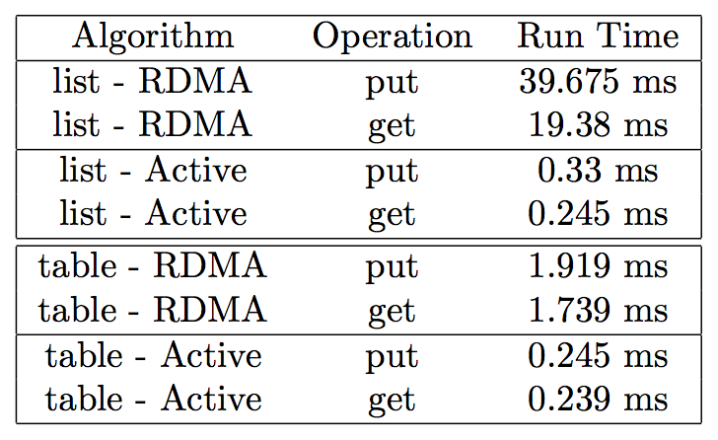
Initial Test Applications
Linked List
Locking Service
Hash table

Slide 11
Active RDMA File System (ARFS)
ARFS Client
CLIENT
NETWORK
ARFS Active Code
Alloc
Hashtable
Inode+Data
SERVER
Hashtable
Inode+Data
Memory

Slide 12
ARFS Architecture
Uses other Active code as libraries:
Alloc()
Hash table : Path → Address
Inode store : Address → Data blocks
FS interface :
Hash table + Inode store
→ hierarchical data store

Slide 13
Evaluation Methodology
Active RDMA FS (ARFS) vs. NFS
ARFS-rdma, ARFS-active variants
Tests:
Andrew Benchmark
Stream-Read
Stream-Write
Find, Grep:
system utilities
active versions

Slide 14
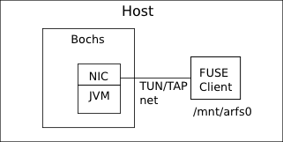
Simulation
Bochs full-system simulator
JVM “coprocessor” in NIC model
UDP/IP stack in NIC model
Client: FUSE (userspace)
Benchmarks run on host
Wallclock time + synthetic timing statistics

Slide 15
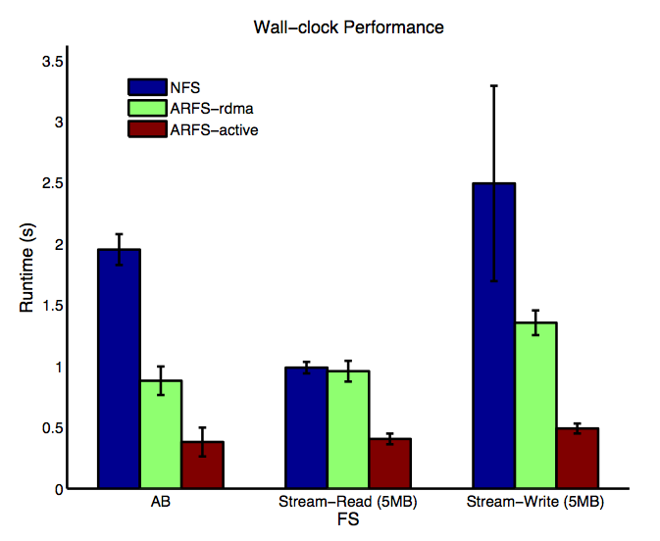
Basic Benchmarks

Slide 16
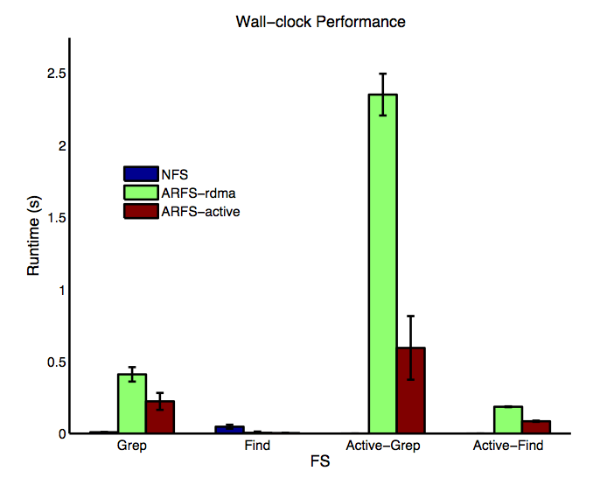
Find and Grep

Slide 17
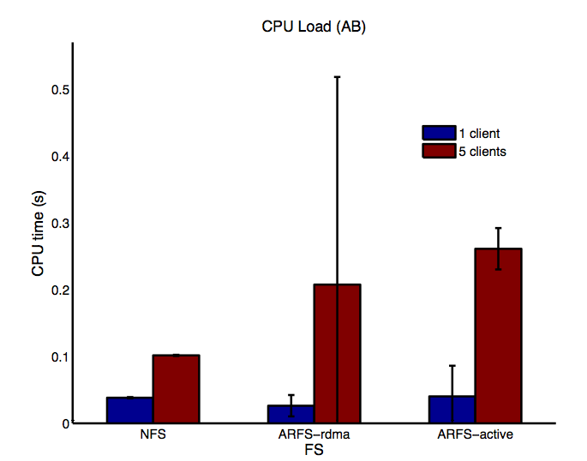
CPU Load Scaling Behavior

Slide 18
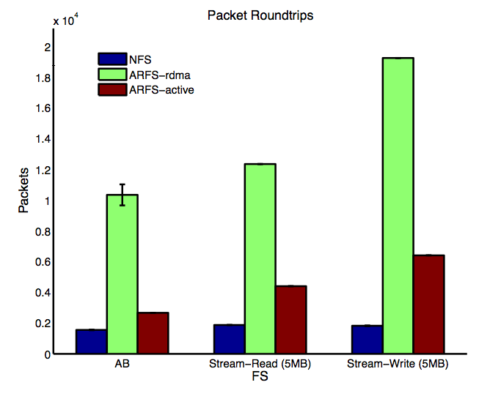
Packet Roundtrips

Slide 19
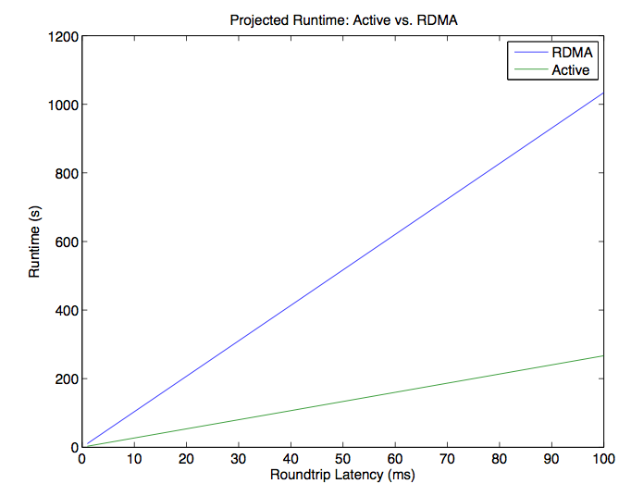
Synthetic Runtime: RDMA vs. Active

Slide 20
Future Work
Better methodology
Acceptable but tractable: pace JVM appropriately, model network delay, run client in separate Bochs
Better: Extend cycle-accurate simulated domain to clients and network, build cycle-accurate model of active code coprocessor (real ISA, cache coherence with main CPU, …)
Best: prototype in a real system
Active code (i) in server kernel or (ii) on real NIC (FPGA?)
Clients with in-kernel filesystem

Slide 21
Future Work II
Implementation: more robust (optimized IO path, robust error handling, …)
Server-side architecture:
Sync with main host CPU (at least for on-disk FS)
consider tradeoffs between coprocessor and main processor
Dynamic active code generation
Grep: regex compiler? (after basic optimizations)
More complex data queries, custom adapters, …

Slide 22
Summary & Conclusion
Designed Active RDMA interface and presented reference implementation
Built proof-of-concept in-memory network filesystem
Evaluated performance in simulation
Showed a few active code-specific applications
Lessons learned:
Getting API right is hard (underwent a few changes)
Define basic services, build in layers
Getting accurate simulation/timing for client/server setups is HARD
Underwhelming prototype performance, but interesting possibilities for future

