Slide 1
Analysis of Algorithms &
Orders of Growth
Notes:
Discrete Mathematics and its Applications
26年 11月 8日
(c)2001-2002, Michael P. Frank

Slide 2
Analysis of Algorithms
An algorithm is a finite set of precise instructions for performing a computation or for solving a problem.
What is the goal of analysis of algorithms?
  To compare algorithms mainly in terms of running time but also in terms of other factors (e.g., memory requirements, programmer's effort etc.)
What do we mean by running time analysis?
  Determine how running time increases as the size of the problem increases.
Notes:
Discrete Mathematics and its Applications
26年 11月 8日
(c)2001-2002, Michael P. Frank

Slide 3
Example: Searching
Problem of searching an ordered list.
  Given a list L of n elements that are sorted into a definite order (e.g., numeric, alphabetical),
  And given a particular element x,
  Determine whether x appears in the list, and if so, return its index (position) in the list.
Notes:
Discrete Mathematics and its Applications
26年 11月 8日
(c)2001-2002, Michael P. Frank

Slide 4
Search alg. #1: Linear Search
procedure linear search
(x: integer, a₁, a₂, …, a_{n}: distinct integers)
i := 1
while (i ≤ n ∧ x ≠ a_{i})
i := i + 1
if i ≤ n then location := i
else location := 0
return location {index or 0 if not found}
Notes:
Discrete Mathematics and its Applications
26年 11月 8日
(c)2001-2002, Michael P. Frank

Slide 5
Search alg. #2: Binary Search
Basic idea: On each step, look at the middle element of the remaining list to eliminate half of it, and quickly zero in on the desired element.
<x
<x
<x
>x
Notes:
Discrete Mathematics and its Applications
26年 11月 8日
(c)2001-2002, Michael P. Frank

Slide 6
Search alg. #2: Binary Search
procedure binary search
(x:integer, a₁, a₂, …, a_{n}: distinct integers)
i := 1 {left endpoint of search interval}
j := n {right endpoint of search interval}
while i<j begin {while interval has >1 item}
m := ⎣(i+j)/2⎦ {midpoint}
if x>a_{m} then i := m+1 else j := m
end
if x = a_{i} then location := i else location := 0
return location
Notes:
Discrete Mathematics and its Applications
26年 11月 8日
(c)2001-2002, Michael P. Frank

Slide 7
Is Binary Search more efficient?
Number of iterations:
  For a list of n elements, Binary Search can execute at most log₂ n times!!
  Linear Search, on the other hand, can execute up to n times !!
Average Number of Iterations
Length | Linear Search | Binary Search
10 | 5.5 | 2.9
100 | 50.5 | 5.8
1,000 | 500.5 | 9.0
10,000 | 5000.5 | 12.0
Notes:
Discrete Mathematics and its Applications
26年 11月 8日
(c)2001-2002, Michael P. Frank

Slide 8
Is Binary Search more efficient?
Number of computations per iteration:
  Binary search does more computations than Linear Search per iteration.
Overall:
  If the number of components is small (say, less than 20), then Linear Search is faster.
  If the number of components is large, then Binary Search is faster.
Notes:
Discrete Mathematics and its Applications
26年 11月 8日
(c)2001-2002, Michael P. Frank

Slide 9
How do we analyze algorithms?
We need to define a number of objective measures.
(1) Compare execution times?
Not good: times are specific to a particular computer !!
(2) Count the number of statements executed?
Not good: number of statements vary with the programming language as well as the style of the individual programmer.
Notes:
Discrete Mathematics and its Applications
26年 11月 8日
(c)2001-2002, Michael P. Frank

Slide 10
Example (# of statements)
Algorithm 1 Algorithm 2
arr[0] = 0; for(i=0; i<N; i++)
arr[1] = 0; arr[i] = 0;
arr[2] = 0;
...
arr[N-1] = 0;
Notes:
Discrete Mathematics and its Applications
26年 11月 8日
(c)2001-2002, Michael P. Frank

Slide 11
How do we analyze algorithms?
(3) Express running time as a function of the input size n (i.e., f(n)).
  To compare two algorithms with running times f(n) and g(n), we need a rough measure of how fast a function grows.
  Such an analysis is independent of machine time, programming style, etc.
Notes:
Discrete Mathematics and its Applications
26年 11月 8日
(c)2001-2002, Michael P. Frank

Slide 12
Computing running time
Associate a "cost" with each statement and find the "total cost“ by finding the total number of times each statement is executed.
Express running time in terms of the size of the problem.
Algorithm 1 Algorithm 2
Cost Cost
arr[0] = 0; c1 for(i=0; i<N; i++) c2
arr[1] = 0; c1 arr[i] = 0; c1
arr[2] = 0; c1
...
arr[N-1] = 0; c1
----------- -------------
c1+c1+...+c1 = c1 x N (N+1) x c2 + N x c1 =
(c2 + c1) x N + c2
Notes:
Discrete Mathematics and its Applications
26年 11月 8日
(c)2001-2002, Michael P. Frank

Slide 13
Computing running time (cont.)
Cost
sum = 0; c1
for(i=0; i<N; i++) c2
for(j=0; j<N; j++) c2
sum += arr[i][j]; c3
------------
c1 + c2 x (N+1) + c2 x N x (N+1) + c3 x N x N
Notes:
Discrete Mathematics and its Applications
26年 11月 8日
(c)2001-2002, Michael P. Frank

Slide 14
Comparing Functions Using
Rate of Growth
Consider the example of buying elephants and goldfish:
Cost: cost_of_elephants + cost_of_goldfish
Cost ~ cost_of_elephants (approximation)
The low order terms in a function are relatively insignificant for large n
n⁴ + 100n² + 10n + 50 ~ n⁴
i.e., n⁴ + 100n² + 10n + 50 and n⁴ have the same rate of growth
Notes:
Discrete Mathematics and its Applications
26年 11月 8日
(c)2001-2002, Michael P. Frank

Slide 15
Rate of Growth ≡Asymptotic Analysis
Using rate of growth as a measure to compare different functions implies comparing them asymptotically.
If f(x) is faster growing than g(x), then f(x) always eventually becomes larger than g(x) in the limit (for large enough values of x).
Notes:
Discrete Mathematics and its Applications
26年 11月 8日
(c)2001-2002, Michael P. Frank

Slide 16
Example
Suppose you are designing a web site to process user data (e.g., financial records).
Suppose program A takes f_{A}(n)=30n+8 microseconds to process any n records, while program B takes f_{B}(n)=n²+1 microseconds to process the n records.
Which program would you choose, knowing you’ll want to support millions of users?
A
Notes:
Discrete Mathematics and its Applications
26年 11月 8日
(c)2001-2002, Michael P. Frank

Slide 17
Visualizing Orders of Growth
On a graph, as
you go to the
right, a faster
growing
function
eventually
becomes
larger...
f_{A}(n)=30n+8
Value of function →
f_{B}(n)=n²+1
Increasing n →
Notes:
Discrete Mathematics and its Applications
26年 11月 8日
(c)2001-2002, Michael P. Frank

Slide 18
Big-O Notation
We say f_{A}(n)=30n+8 is order n, or O(n).
It is, at most, roughly proportional to n.
f_{B}(n)=n²+1 is order n², or O(n²). It is, at most, roughly proportional to n².
In general, an O(n²) algorithm will be slower than O(n) algorithm.
Warning: an O(n²) function will grow faster than an O(n) function.
Notes:
Discrete Mathematics and its Applications
26年 11月 8日
(c)2001-2002, Michael P. Frank

Slide 19
More Examples …
We say that n⁴ + 100n² + 10n + 50 is of the order of n⁴ or O(n⁴)
We say that 10n³ + 2n² is O(n³)
We say that n³ - n² is O(n³)
We say that 10 is O(1),
We say that 1273 is O(1)
Notes:
Discrete Mathematics and its Applications
26年 11月 8日
(c)2001-2002, Michael P. Frank

Slide 20
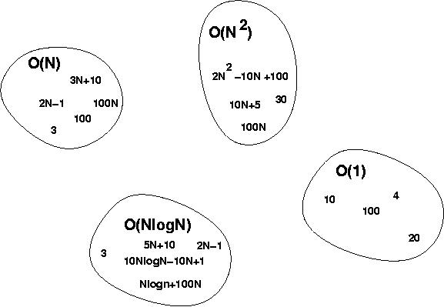
Big-O Visualization
Notes:
Discrete Mathematics and its Applications
26年 11月 8日
(c)2001-2002, Michael P. Frank

Slide 21
Computing running time
Algorithm 1 Algorithm 2
Cost Cost
arr[0] = 0; c1 for(i=0; i<N; i++) c2
arr[1] = 0; c1 arr[i] = 0; c1
arr[2] = 0; c1
...
arr[N-1] = 0; c1
----------- -------------
c1+c1+...+c1 = c1 x N (N+1) x c2 + N x c1 =
(c2 + c1) x N + c2
O(n)
Notes:
Discrete Mathematics and its Applications
26年 11月 8日
(c)2001-2002, Michael P. Frank

Slide 22
Computing running time (cont.)
Cost
sum = 0; c1
for(i=0; i<N; i++) c2
for(j=0; j<N; j++) c2
sum += arr[i][j]; c3 ------------
c1 + c2 x (N+1) + c2 x N x (N+1) + c3 x N x N
O(n²)
Notes:
Discrete Mathematics and its Applications
26年 11月 8日
(c)2001-2002, Michael P. Frank

Slide 23
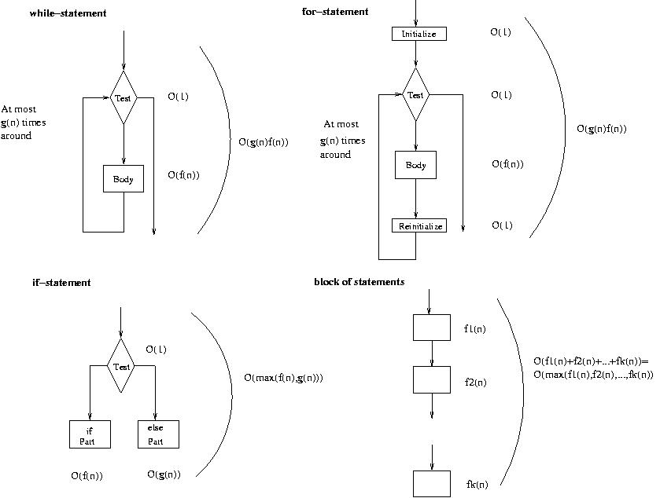
Running time of various statements
while-loop
for-loop
Notes:
Discrete Mathematics and its Applications
26年 11月 8日
(c)2001-2002, Michael P. Frank

Slide 24
Examples
i = 0;
while (i<N) {
X=X+Y; // O(1)
result = mystery(X); // O(N), just an example...
i++; // O(1)
}
The body of the while loop: O(N)
Loop is executed: N times
N x O(N) = O(N²)
Notes:
Discrete Mathematics and its Applications
26年 11月 8日
(c)2001-2002, Michael P. Frank

Slide 25
Examples (cont.’d)
if (i<j)
for ( i=0; i<N; i++ )
X = X+i;
else
X=0;
Max ( O(N), O(1) ) = O (N)
O(N)
O(1)
Notes:
Discrete Mathematics and its Applications
26年 11月 8日
(c)2001-2002, Michael P. Frank

Slide 26
Asymptotic Notation
O notation: asymptotic “less than”:
  f(n)=O(g(n)) implies: f(n) “≤” g(n)
Ω notation: asymptotic “greater than”:
  f(n)= Ω (g(n)) implies: f(n) “≥” g(n)
Θ notation: asymptotic “equality”:
  f(n)= Θ (g(n)) implies: f(n) “=” g(n)
Notes:
Discrete Mathematics and its Applications
26年 11月 8日
(c)2001-2002, Michael P. Frank

Slide 27
Definition: O(g), at most order g
Let f,g are functions R→R.
We say that “f is at most order g”, if:
∃c,k: f(x) ≤ cg(x), ∀x>k
  “Beyond some point k, function f is at most a constant c times g (i.e., proportional to g).”
“f is at most order g”, or “f is O(g)”, or “f=O(g)” all just mean that f∈O(g).
Sometimes the phrase “at most” is omitted.
Notes:
Discrete Mathematics and its Applications
26年 11月 8日
(c)2001-2002, Michael P. Frank

Slide 28
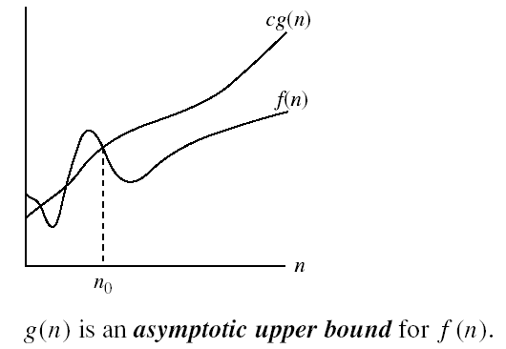
Big-O Visualization
k
Notes:
Discrete Mathematics and its Applications
26年 11月 8日
(c)2001-2002, Michael P. Frank

Slide 29
Points about the definition
Note that f is O(g) as long as any values of c and k exist that satisfy the definition.
But: The particular c, k, values that make the statement true are not unique: Any larger value of c and/or k will also work.
You are not required to find the smallest c and k values that work. (Indeed, in some cases, there may be no smallest values!)
However, you should prove that the values you choose do work.
Notes:
Discrete Mathematics and its Applications
26年 11月 8日
(c)2001-2002, Michael P. Frank

Slide 30
“Big-O” Proof Examples
Show that 30n+8 is O(n).
  Show ∃c,k: 30n+8 ≤ cn, ∀n>k .
    Let c=31, k=8. Assume n>k=8. Then
    cn = 31n = 30n + n > 30n+8, so 30n+8 < cn.
Show that n²+1 is O(n²).
  Show ∃c,k: n²+1 ≤ cn², ∀n>k: .
    Let c=2, k=1. Assume n>1. Then
    cn² = 2n² = n²+n² > n²+1, or n²+1< cn².
Notes:
Discrete Mathematics and its Applications
26年 11月 8日
(c)2001-2002, Michael P. Frank

Slide 31
Big-O example, graphically
Note 30n+8 isn’t
less than n
anywhere (n>0).
It isn’t even
less than 31n
everywhere.
But it is less than
31n everywhere to
the right of n=8.
cn =
31n
30n+8
30n+8
∈O(n)
Value of function →
n
n>k=8 →
Increasing n →
Notes:
Discrete Mathematics and its Applications
26年 11月 8日
(c)2001-2002, Michael P. Frank

Slide 32
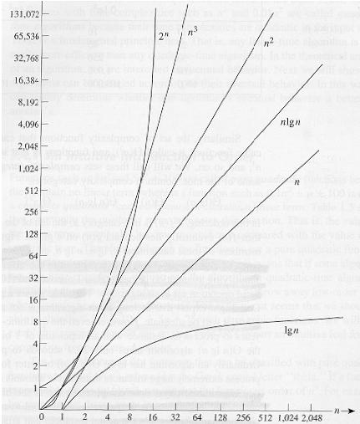
Common orders of magnitude
Notes:
Discrete Mathematics and its Applications
26年 11月 8日
(c)2001-2002, Michael P. Frank

Slide 33
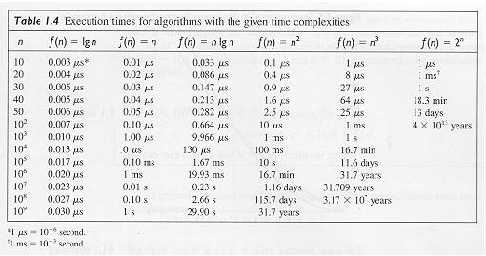
Notes:
Discrete Mathematics and its Applications
26年 11月 8日
(c)2001-2002, Michael P. Frank

Slide 34
Order-of-Growth in Expressions
“O(f)” can be used as a term in an arithmetic expression .
E.g.: we can write “x²+x+1” as “x²+O(x)” meaning “x² plus some function that is O(x)”.
Formally, you can think of any such expression as denoting a set of functions:
“x²+O(x)” :≡ {g | ∃f∈O(x): g(x)= x²+f(x)}
Notes:
Discrete Mathematics and its Applications
26年 11月 8日
(c)2001-2002, Michael P. Frank

Slide 35
Useful Facts about Big O
Constants ...
∀c>0, O(cf)=O(f+c)=O(f−c)=O(f)
Sums:
- If g∈O(f) and h∈O(f), then g+h∈O(f).
- If g∈O(f₁) and h∈O(f₂), then
g+h∈O(f₁+f₂) =O(max(f₁,f₂))
(Very useful!)
Notes:
Discrete Mathematics and its Applications
26年 11月 8日
(c)2001-2002, Michael P. Frank

Slide 36
More Big-O facts
Products:
If g∈O(f₁) and h∈O(f₂), then gh∈O(f₁f₂)
Big O, as a relation, is transitive:
f∈O(g) ∧ g∈O(h) → f∈O(h)
Notes:
Discrete Mathematics and its Applications
26年 11月 8日
(c)2001-2002, Michael P. Frank

Slide 37
More Big O facts
∀ f,g & constants a,b∈R, with b≥0,
  af = O(f) (e.g. 3x² = O(x²))
  f+O(f) = O(f) (e.g. x²+x = O(x²))
  |f|^{1-b} = O(f) (e.g. x⁻¹ = O(x))
  (log_{b} |f|)ª = O(f) (e.g. log x = O(x))
  g=O(fg) (e.g. x = O(x log x))
  fg ≠ O(g) (e.g. x log x ≠ O(x))
  a=O(f) (e.g. 3 = O(x))
Notes:
Discrete Mathematics and its Applications
26年 11月 8日
(c)2001-2002, Michael P. Frank

Slide 38
Definition: Ω(g), at least order g
Let f,g be any function R→R.
We say that “f is at least order g”, written Ω(g), if ∃c,k: f(x) ≥ cg(x), ∀x>k
  “Beyond some point k, function f is at least a constant c times g (i.e., proportional to g).”
  Often, one deals only with positive functions and can ignore absolute value symbols.
“f is at least order g”, or “f is Ω(g)”, or “f= Ω(g)” all just mean that f∈ Ω(g).
Notes:
Discrete Mathematics and its Applications
26年 11月 8日
(c)2001-2002, Michael P. Frank

Slide 39
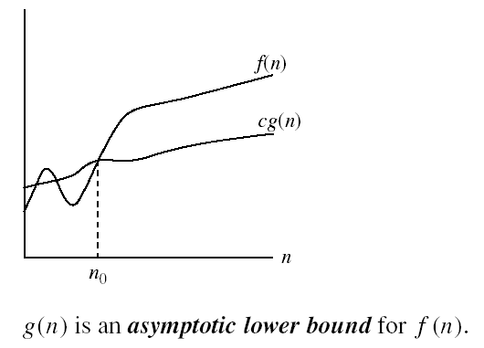
Big- Ω Visualization
Notes:
Discrete Mathematics and its Applications
26年 11月 8日
(c)2001-2002, Michael P. Frank

Slide 40
Definition: Θ(g), exactly order g
If f∈O(g) and g∈O(f) then we say “g and f are of the same order” or “f is (exactly) order g” and write f∈Θ(g).
Another equivalent definition:
∃c₁c₂,k: c₁g(x)≤f(x)≤c₂g(x), ∀x>k
“Everywhere beyond some point k, f(x) lies in between two multiples of g(x).”
Θ(g) ≡ O(g) ∩ Ω(g)
(i.e., f∈O(g) and f∈Ω(g) )
Notes:
Discrete Mathematics and its Applications
26年 11月 8日
(c)2001-2002, Michael P. Frank

Slide 41

Big- Θ Visualization
Notes:
Discrete Mathematics and its Applications
26年 11月 8日
(c)2001-2002, Michael P. Frank

Slide 42
Common orders of magnitude
Notes:
Discrete Mathematics and its Applications
26年 11月 8日
(c)2001-2002, Michael P. Frank

Slide 43
Algorithmic and Problem Complexity
Notes:
Discrete Mathematics and its Applications
26年 11月 8日
(c)2001-2002, Michael P. Frank

Slide 44
Algorithmic Complexity
The algorithmic complexity of a computation is some measure of how difficult it is to perform the computation.
Measures some aspect of cost of computation (in a general sense of cost).
Notes:
Discrete Mathematics and its Applications
26年 11月 8日
(c)2001-2002, Michael P. Frank

Slide 45
Problem Complexity
The complexity of a computational problem or task is the complexity of the algorithm with the lowest order of growth of complexity for solving that problem or performing that task.
E.g. the problem of searching an ordered list has at most logarithmic time complexity. (Complexity is O(log n).)
Notes:
Discrete Mathematics and its Applications
26年 11月 8日
(c)2001-2002, Michael P. Frank

Slide 46
Tractable vs. Intractable Problems
A problem or algorithm with at most polynomial time complexity is considered tractable (or feasible). P is the set of all tractable problems.
A problem or algorithm that has more than polynomial complexity is considered intractable (or infeasible).
Note
  n^{1,000,000} is technically tractable, but really impossible. n^{log log log n} is technically intractable, but easy.
  Such cases are rare though.
Notes:
Discrete Mathematics and its Applications
26年 11月 8日
(c)2001-2002, Michael P. Frank

Slide 47
Dealing with Intractable Problems
Many times, a problem is intractable for a small number of input cases that do not arise in practice very often.
  Average running time is a better measure of problem complexity in this case.
  Find approximate solutions instead of exact solutions.
Notes:
Discrete Mathematics and its Applications
26年 11月 8日
(c)2001-2002, Michael P. Frank

Slide 48
Unsolvable problems
It can be shown that there exist problems that no algorithm exists for solving them.
Turing discovered in the 1930’s that there are problems unsolvable by any algorithm.
Example: the halting problem
  Given an arbitrary algorithm and its input, will that algorithm eventually halt, or will it continue forever in an “infinite loop?”
Notes:
Discrete Mathematics and its Applications
26年 11月 8日
(c)2001-2002, Michael P. Frank

Slide 49
NP and NP-complete
NP is the set of problems for which there exists a tractable algorithm for checking solutions to see if they are correct.
NP-complete is a class of problems with the property that if any one of them can be solved by a polynomial worst-case algorithm, then all of them can be solved by polynomial worst-case algorithms.
  Satisfiability problem: find an assignment of truth values that makes a compound proposition true.
Notes:
Discrete Mathematics and its Applications
26年 11月 8日
(c)2001-2002, Michael P. Frank

Slide 50
P vs. NP
We know P⊆NP, but the most famous unproven conjecture in computer science is that this inclusion is proper (i.e., that P⊂NP rather than P=NP).
It is generally accepted that no NP-complete problem can be solved in polynomial time.
Whoever first proves it will be famous!
Notes:
Discrete Mathematics and its Applications
26年 11月 8日
(c)2001-2002, Michael P. Frank

Slide 51
Questions
Find the best big-O notation to describe the complexity of following algorithms:
  A binary search algorithm.
  A linear search algorithm.
  An algorithm that finds the maximum element in a finite sequence.
Notes:
Discrete Mathematics and its Applications
26年 11月 8日
(c)2001-2002, Michael P. Frank

Slide 52
Time Complexity
We can use Big-O to find the time complexity of algorithms (i.e., how long they take in terms of the number of operations performed).
There are two types of complexity normally considered.
Worst-case complexity. The largest number of operations needed for a problem of a given size in the worst case. The number of operations that will guarantee a solution.
Average-case complexity. The average number of operations used to solve a problem over all inputs of a given size.

Slide 53
Complexity of the Linear Search Algorithm
Worst-case complexity
The algorithm loops over all the values in a list of n values.
  At each step, two comparisons are made. One to see whether the end of the loop is reached, and one to compare the search element x with the element in the list.
  Finally, one more comparison is made outside the loop.
  If x is equal to list element a_{i}, then 2i + 1 comparisons are made.
  If x is not in the list, then 2n + 2 comparisons are made. (2n comparisons to determine that x is not in the list, an additional comparison is used to exit the loop and one comparison is made outside the loop.
  The worst-case complexity is thus 2n and is O(n).

Slide 54
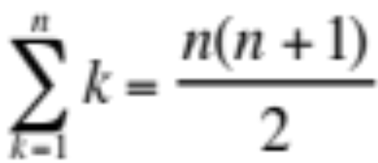
Complexity of the Linear Search Algorithm
Average-case complexity
The algorithm loops over all the values in a list of n values.
  If x is the ith term of the list, 2 comparisons will be used at each of the i steps of the loop, and one outside the loop , so that a total of 2i+1 comparisons are needed.
  On average, the number of comparisons is
  3 + 5 + 7 +….+ (2n+1) = 2(1 + 2 + 3 + …… + n) + n = 2[n (n+1)/2] + 1 = n + 2
    n n n
    What’s the numerator?
    2( )
Average case is O(n)

