Slide 1

Subject : Inverting Matrices
Université Abdelhamid Ibn Badis de Mostaganem Faculté des Sciences Exactes et l‘Informatique Département de Mathématiques et d’Informatique
Master 1 ISI
Module : Techniques de programmation avancées
Presented by :
Madani Mohamed El-Habib
2021/2022

Slide 2
Work plans
HOW TO DESIGN ALGORITHMS
DYNAMIC PROGRAMMING
MULTITHREADED ALGORITHMS
INVERTING MATRICES
HOW IT WORKS
EXECUTION

Slide 3
HOW TO DESIGN ALGORITHMS
1
Planning the correct algorithm for a given application is a major innovation.
The design of the algorithm is incremental by asking yourself questions to guide your staring process.
Do I really understand the problem?
Can I find a simple algorithm for my problem?

Slide 4
DYNAMIC PROGRAMMING
2
Is to solve a problem by splitting it into sub-problems, then solving sub-problems, From smallest to large by storing intermediate results.

Slide 5
MULTITHREADED ALGORITHMS
3
Multithread Algorithms execute multiple operations at the same time in order to minimize the execution time.

Slide 6
INVERTING MATRICES
4
Inverse of Matrix for a matrix A is A-1. The inverse of a 2 × 2 matrix can be calculated using a simple formula. Further, to find the inverse of a 3 × 3 matrix, we need to know about the determinant and adjoint of the matrix. The inverse of matrix is another matrix, which on multiplying with the given matrix gives the multiplicative identity.
The inverse of matrix is used of find the solution of linear equations through the matrix inversion method. Here, let us learn about the formula, methods, and terms related to the inverse of matrix.

Slide 7
HOW IT WORKS
5
Inverse of Matrix Formula
The inverse of matrix can be computed using the inverse of matrix formula, by dividing the adjoint of a matrix by the determinant of the matrix. The inverse of a matrix can be calculated by following the given steps:
Step 1: Calculate the minor for the given matrix.
Step 2: Turn the obtained matrix into the matrix of cofactors.
Step 3: Then, the adjugate, and
Step 4: Multiply that by reciprocal of determinant.

Slide 8
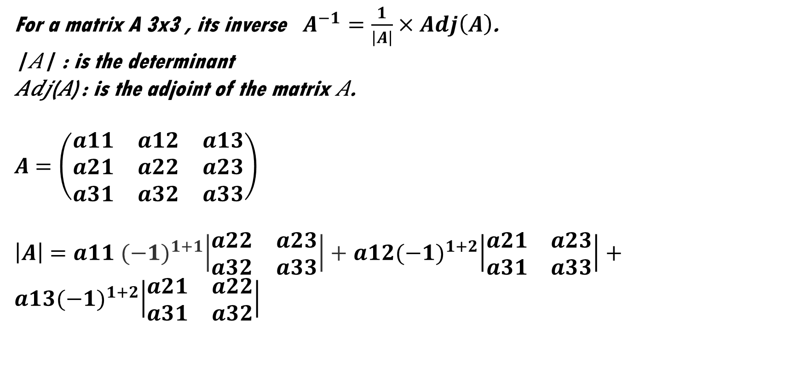
HOW IT WORKS
5
With The Law
For a matrix A 3x3 , its inverse $A^{−1}=\frac{1}{\left|A\right|}×Adj\left(A\right)$.
|𝐴| : is the determinant
𝐴𝑑𝑗(𝐴) : is the adjoint of the matrix 𝐴.
$A$ $=\left(\begin{matrix}a11 & a12 & a13 \\ a21 & a22 & a23 \\ a31 & a32 & a33\end{matrix}\right)$
$\left|A\right|$ $=a11$ ${(−1)}^{1+1}\left|\begin{matrix}a22 & a23 \\ a32 & a33\end{matrix}\right|+$ $a12{(−1)}^{1+2}\left|\begin{matrix}a21 & a23 \\ a31 & a33\end{matrix}\right|+a13{(−1)}^{1+2}\left|\begin{matrix}a21 & a22 \\ a31 & a32\end{matrix}\right|$

Slide 9
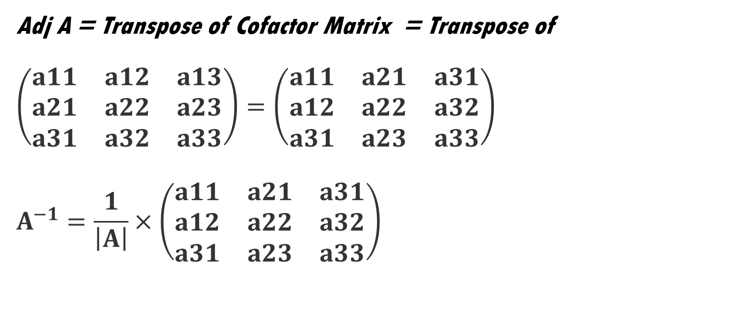
HOW IT WORKS
5
With The Law
Adj A = Transpose of Cofactor Matrix = Transpose of
$$\left(\begin{matrix}a11 & a12 & a13 \\ a21 & a22 & a23 \\ a31 & a32 & a33\end{matrix}\right)=\left(\begin{matrix}a11 & a21 & a31 \\ a12 & a22 & a32 \\ a31 & a23 & a33\end{matrix}\right)$$
$$A^{−1}=\frac{1}{\left|A\right|}×\left(\begin{matrix}a11 & a21 & a31 \\ a12 & a22 & a32 \\ a31 & a23 & a33\end{matrix}\right)$$

Slide 10
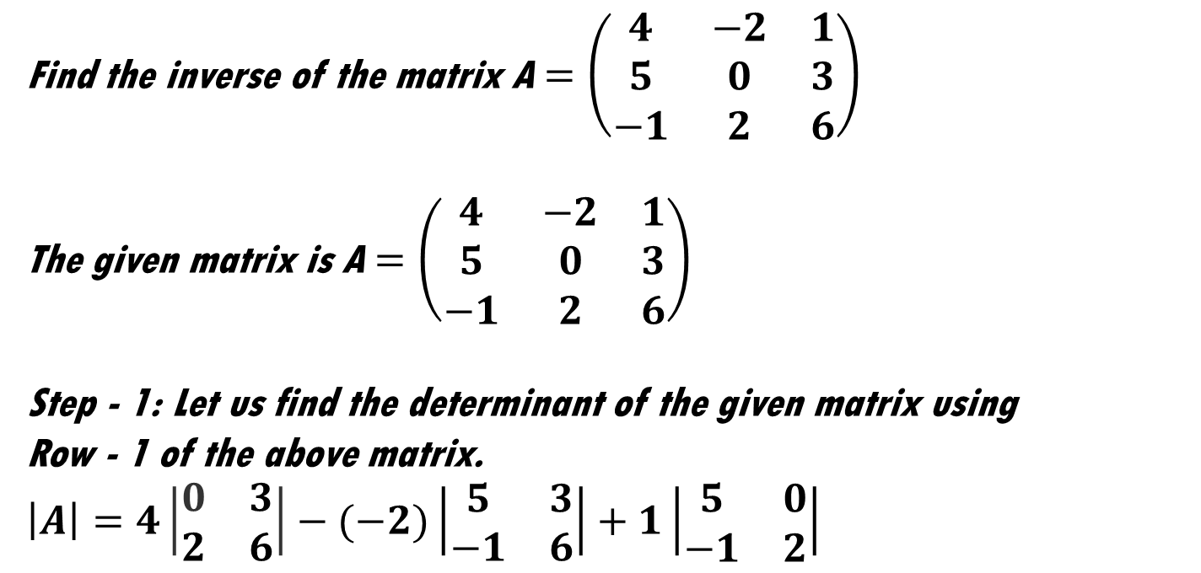
HOW IT WORKS
5
With The Example
Find the inverse of the matrix A $=\left(\begin{matrix}4 & −2 & 1 \\ 5 & 0 & 3 \\ −1 & 2 & 6\end{matrix}\right)$
The given matrix is A $=\left(\begin{matrix}4 & −2 & 1 \\ 5 & 0 & 3 \\ −1 & 2 & 6\end{matrix}\right)$
Step - 1: Let us find the determinant of the given matrix using
Row - 1 of the above matrix.
$$\left|A\right|=4\left|\begin{matrix}0 & 3 \\ 2 & 6\end{matrix}\right|−(−2)\left|\begin{matrix}5 & 3 \\ −1 & 6\end{matrix}\right|+1\left|\begin{matrix}5 & 0 \\ −1 & 2\end{matrix}\right|$$

Slide 11
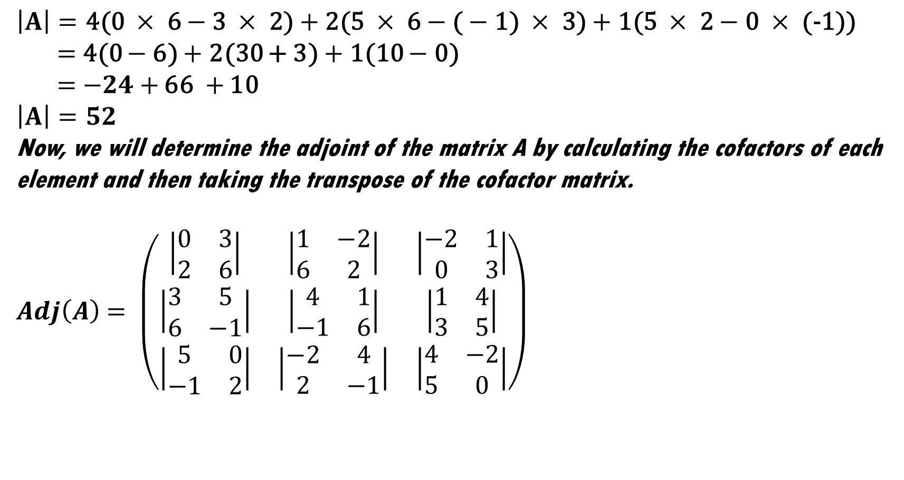
HOW IT WORKS
5
With The Example
$$\left|A\right|=\text{4(0 }×\text{ 6}−\text{3 }×\text{ 2}\text{)}+\text{2(5 }×\text{ 6}−\text{(}−\text{1) }×\text{ 3)}+\text{1(5 }×\text{ 2}−\text{0 }×\text{ (−1))}$$
$=$ 4(0 $−$6) $+$ 2(30 + 3) $+$ 1(10 $−$ 0)
$=$ $−24+$ 66 $+$ 10
$$\left|A\right|=52$$
Now, we will determine the adjoint of the matrix A by calculating the cofactors of each element and then taking the transpose of the cofactor matrix.
$Adj\left(A\right)$ $= \left(\begin{matrix}\left|\begin{matrix}0 & 3 \\ 2 & 6\end{matrix}\right| & \left|\begin{matrix}1 & −2 \\ 6 & 2\end{matrix}\right| & \left|\begin{matrix}−2 & 1 \\ 0 & 3\end{matrix}\right| \\ \left|\begin{matrix}3 & 5 \\ 6 & −1\end{matrix}\right| & \left|\begin{matrix}4 & 1 \\ −1 & 6\end{matrix}\right| & \left|\begin{matrix}1 & 4 \\ 3 & 5\end{matrix}\right| \\ \left|\begin{matrix}5 & 0 \\ −1 & 2\end{matrix}\right| & \left|\begin{matrix}−2 & 4 \\ 2 & −1\end{matrix}\right| & \left|\begin{matrix}4 & −2 \\ 5 & 0\end{matrix}\right|\end{matrix}\right)$

Slide 12
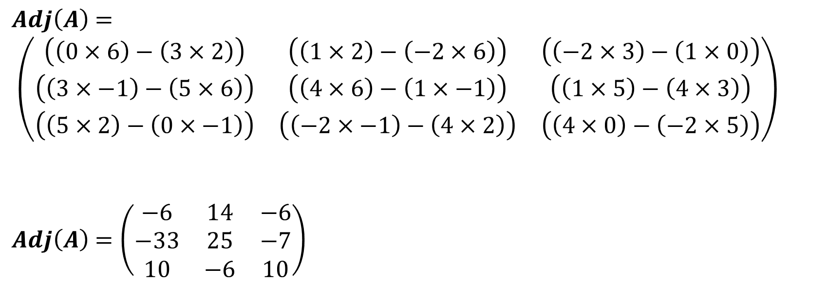
HOW IT WORKS
5
With The Example
$Adj\left(A\right)$ $= \left(\begin{matrix}\left(\left(0×6\right)−\left(3×2\right)\right) & \left(\left(1×2\right)−\left(−2×6\right)\right) & \left(\left(−2×3\right)−\left(1×0\right)\right) \\ \left(\left(3×−1\right)−\left(5×6\right)\right) & \left(\left(4×6\right)−\left(1×−1\right)\right) & \left(\left(1×5\right)−\left(4×3\right)\right) \\ \left(\left(5×2\right)−\left(0×−1\right)\right) & \left(\left(−2×−1\right)−\left(4×2\right)\right) & \left(\left(4×0\right)−\left(−2×5\right)\right)\end{matrix}\right)$
$Adj\left(A\right)$ $=\left(\begin{matrix}−6 & 14 & −6 \\ −33 & 25 & −7 \\ 10 & −6 & 10\end{matrix}\right)$

Slide 13
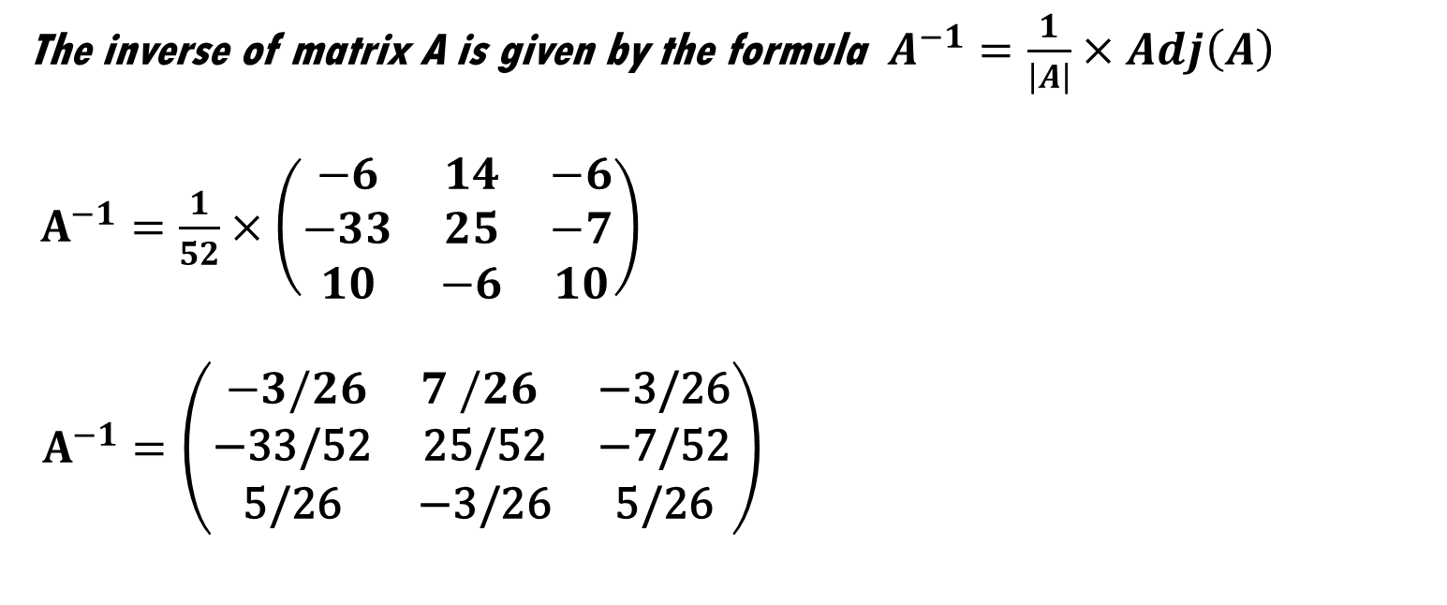
HOW IT WORKS
5
With The Example
The inverse of matrix A is given by the formula $A^{−1}=\frac{1}{\left|A\right|}×Adj\left(A\right)$
$A^{−1}$ $=\frac{1}{52}×\left(\begin{matrix}−6 & 14 & −6 \\ −33 & 25 & −7 \\ 10 & −6 & 10\end{matrix}\right)$
$A^{−1}=\left(\begin{matrix} −3/26 & 7 /26 & \text{−3/26} \\ \text{−33/52} & \text{25/52} & \text{−7/52} \\ \text{5/26} & \text{−3/26} & \text{5/26}\end{matrix}\right)$

Slide 14
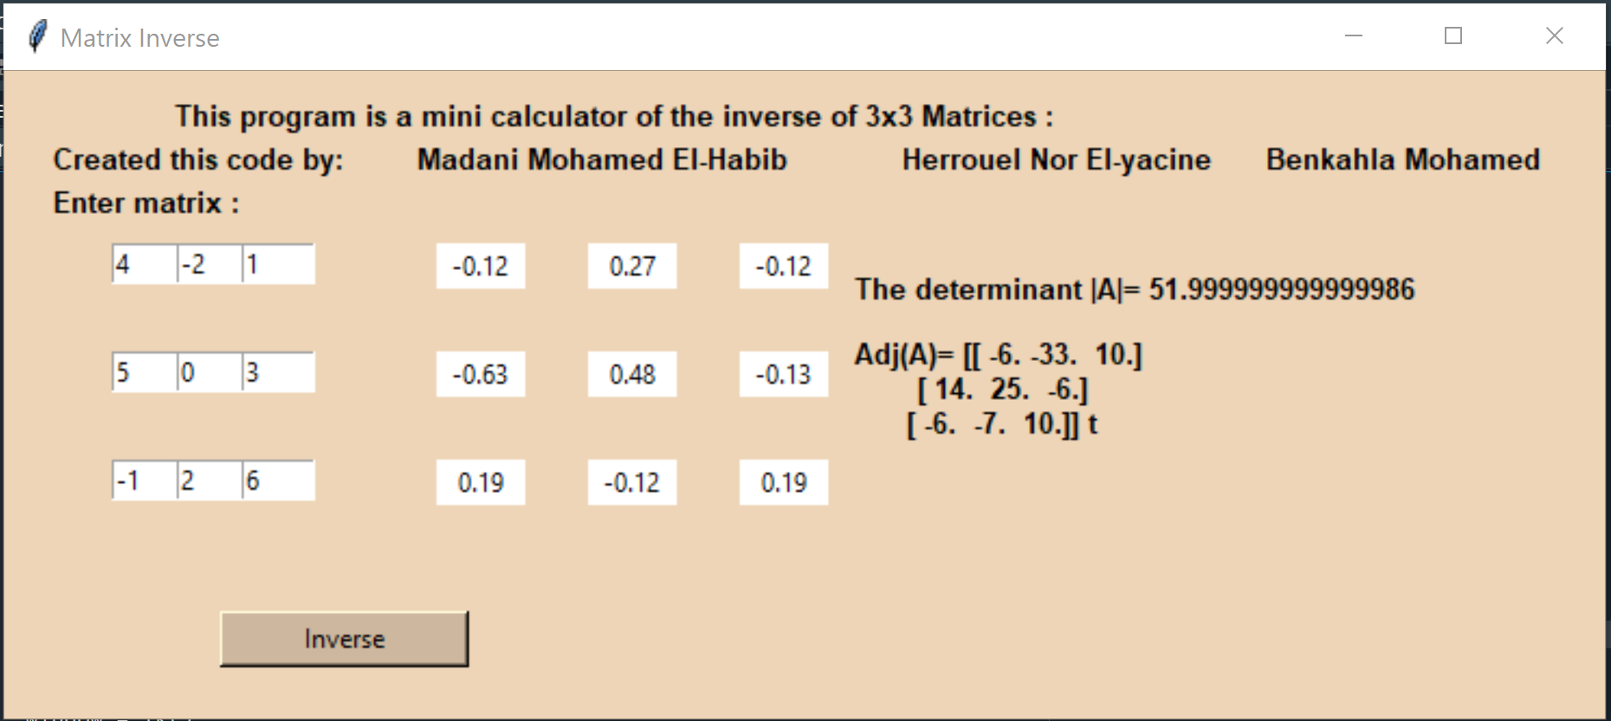
EXECUTION
6
With The Interface
𝑨𝒅𝒋 (𝑨) write in transposed matrix form

Slide 15
THE END
THANKS

