Slide 1
Book1
File created on: 3/10/2024 12:21:45 AM

Slide 2
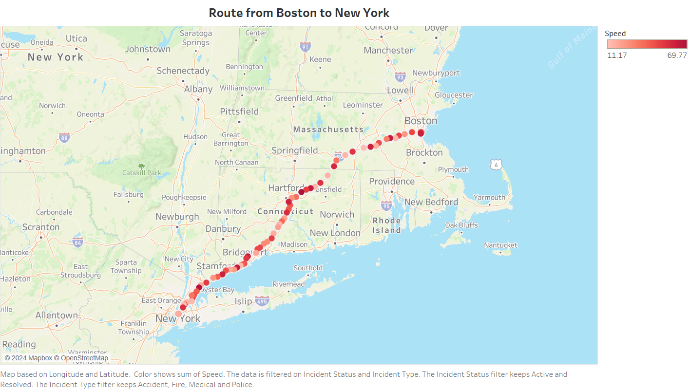

Slide 3
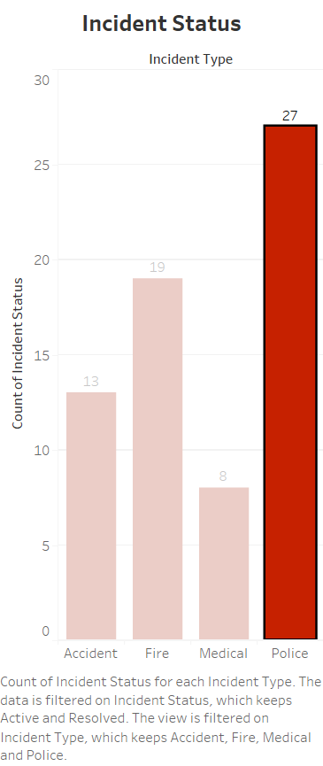

Slide 4


Slide 5
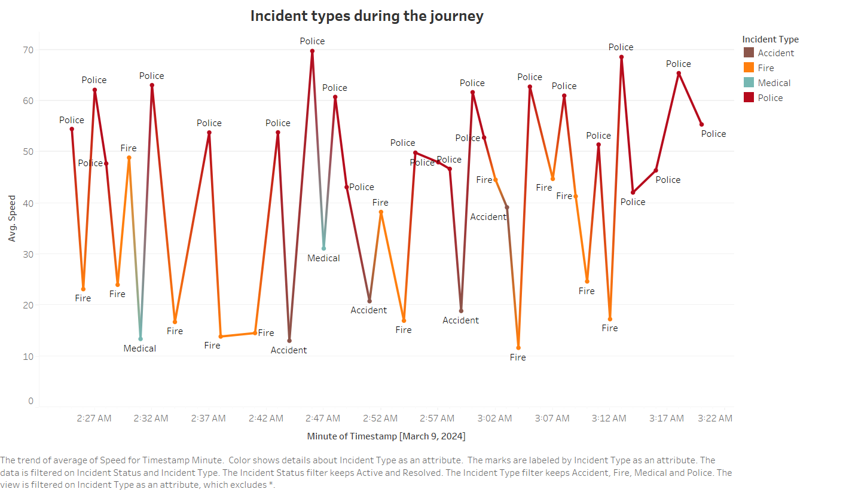

Slide 6
