Slide 1

CAR REPAIR MASTER
Under the guidance of
Mr. S. S. Sontakke
2015BCS011- Shubham Madankar
2016BTECS00205- Pravin Lambture

Slide 2
Outline
Introduction
Project Statement
Objectives
Project Profile
Website Screenshots

Slide 3
Introduction
Many times we have to repair our car and we go to workshop. But there may be a chance that there can be many customers. So we have to wait for the service.
Since time is money, we have to save this time by booking a visit for our own service as per our convenience.
For that we have build the pre booking system to book customer visit.

Slide 4
Project Statement
Build a platform to manage the pre booking of customer visit for service to the mechanic workshop.

Slide 5
Objective
To save the time of customers.
Providing digital platform for booking a pre visit.
Reduce the paper work.

Slide 6
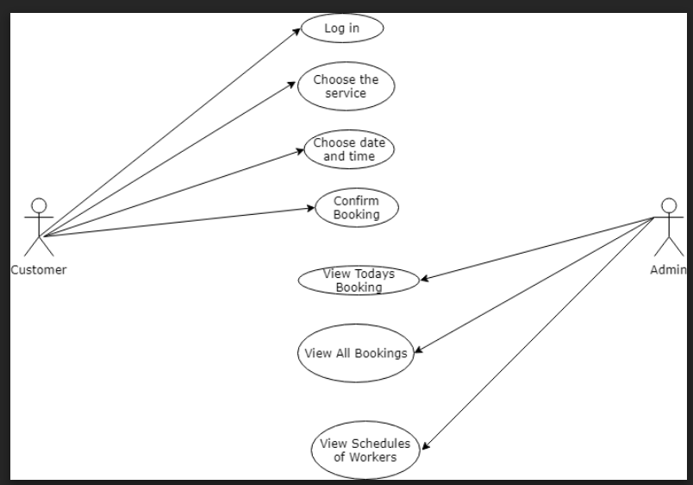
Use Case Diagram

Slide 7
Project Profile
Project Name | CAR REPAIR MASTER
Platform | Website
Front End | HTML, CSS, BootStrap, Javascript
Back End | Php, MySQL

Slide 8
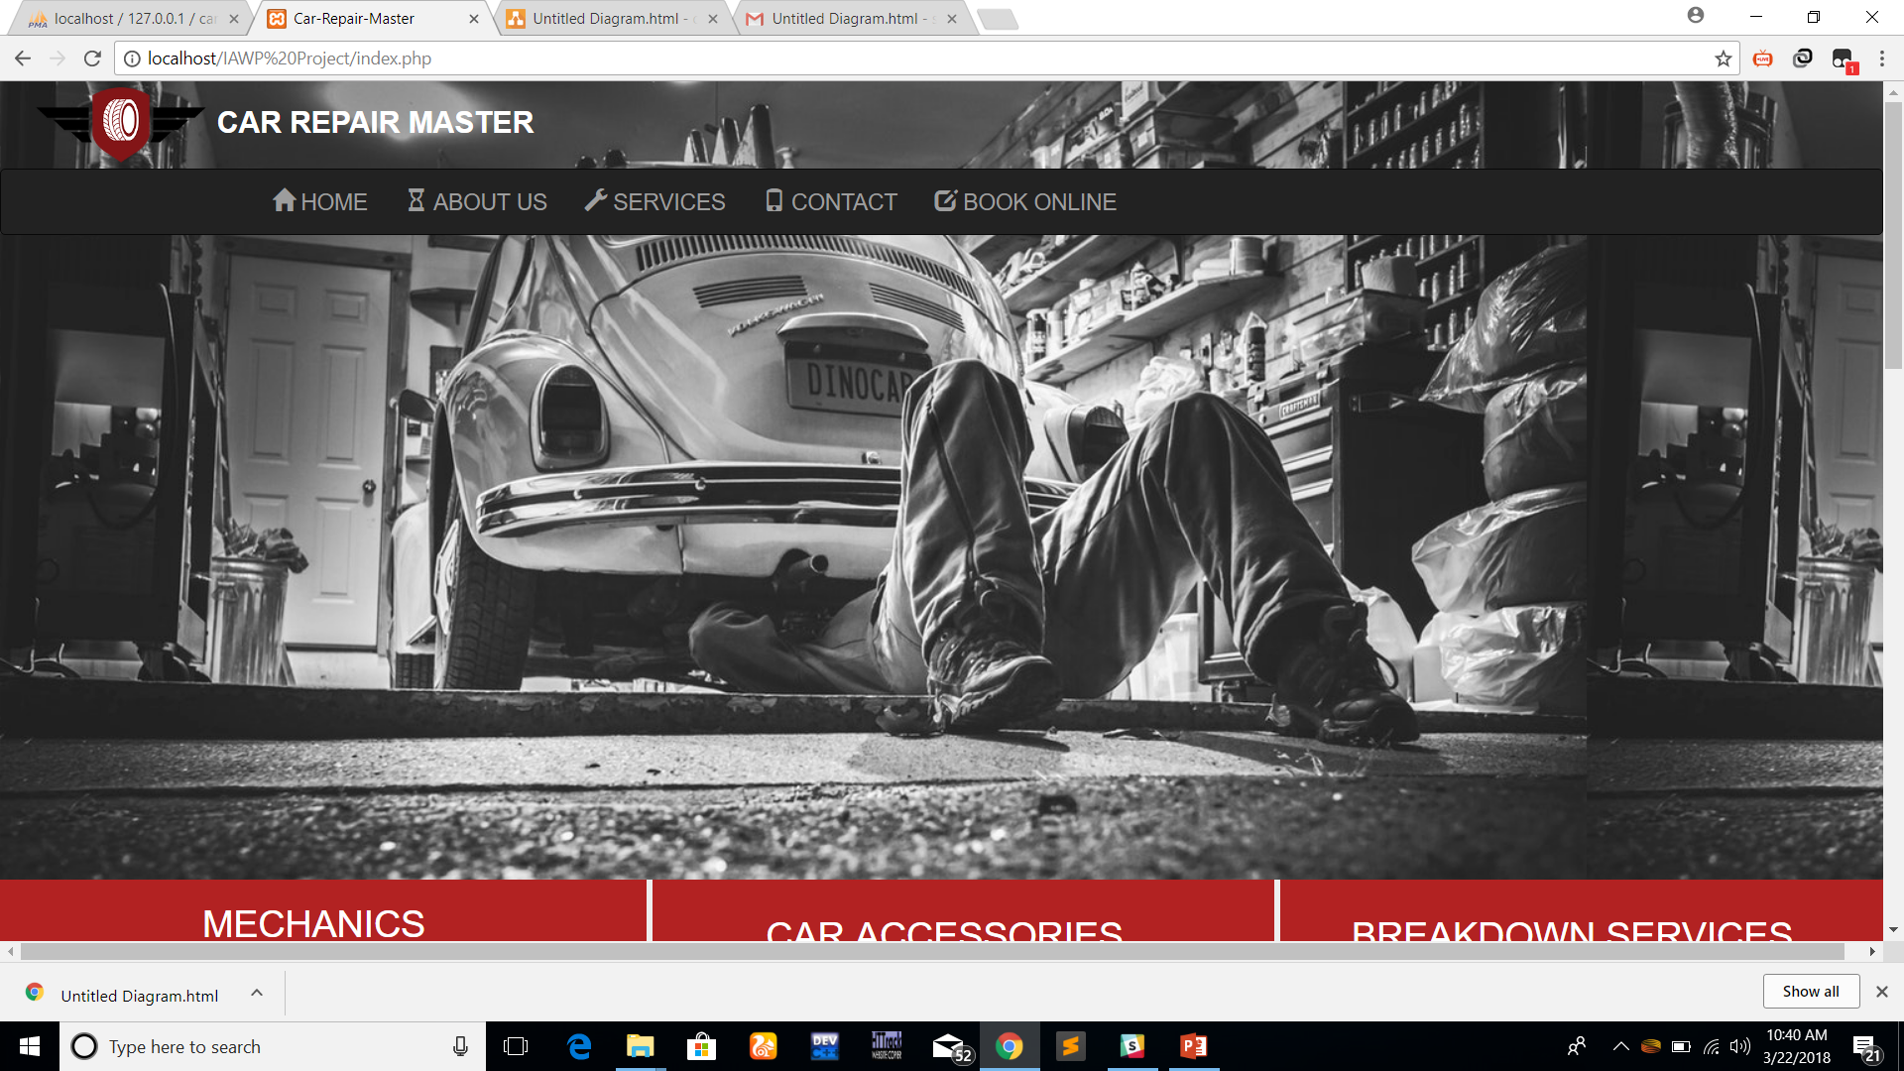
Some Screenshots

Slide 9
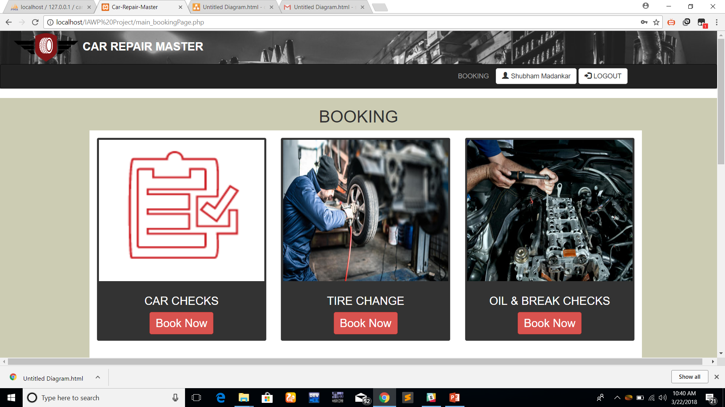

Slide 10
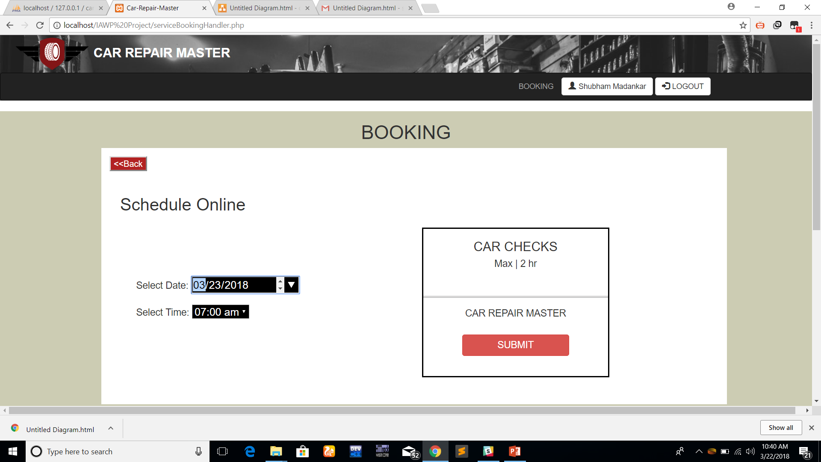

Slide 11
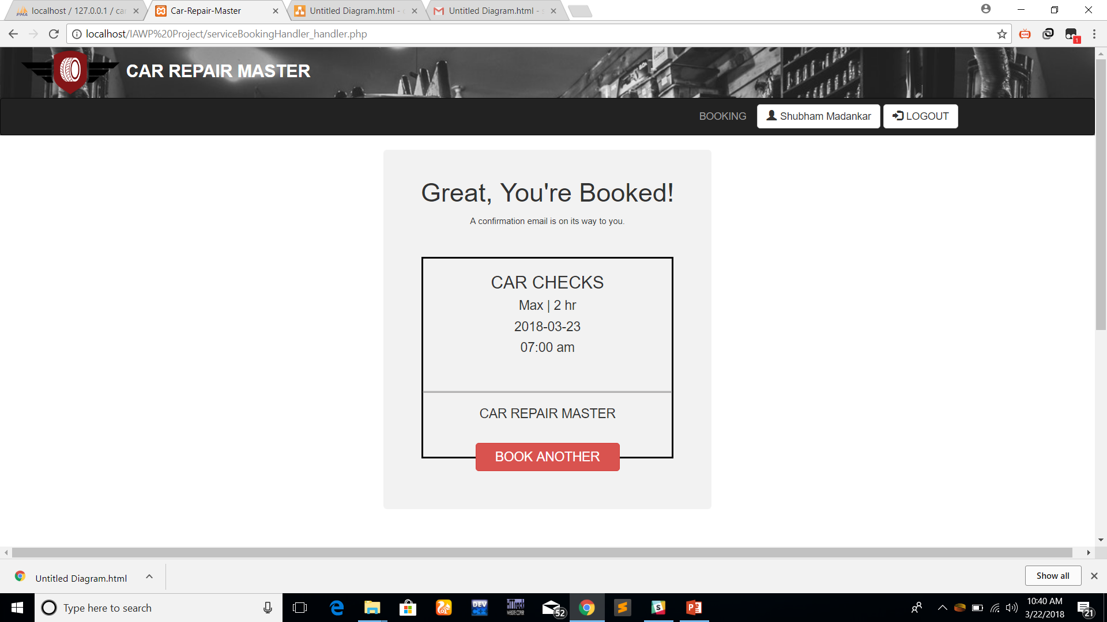

Slide 12
THANK YOU…

