Slide 2
AZ-900 Domain Area | Weight
Describe cloud concepts | 25-30%
Describe Azure architecture and services | 35-40%
Describe Azure management and governance | 30-35%

Slide 3
Your organization wants to leverage Azure for its computing needs while maintaining some data on-premises due to regulatory requirements. Which cloud model would be the most suitable?
A) Public cloud
B) Private cloud
C) Hybrid cloud
D) Multi-cloud
Explanation: A hybrid cloud model allows an organization to use a mix of on-premises, private cloud, and public cloud services, providing flexibility and more deployment options.
Your organization is considering using Azure for its data storage needs. Which Azure service would be ideal for storing unstructured data, such as images and videos?
A) Azure SQL Database
B) Azure Cosmos DB
C) Azure Blob Storage
D) Azure Table Storage
Explanation: Azure Blob Storage is designed to store large amounts of unstructured data, such as images and videos.

Slide 4
Your company wants to implement a messaging service that can handle high-volume, real-time data streaming. Which Azure service would be suitable for this purpose?
A) Azure Queue Storage
B) Azure Service Bus
C) Azure Event Hubs
D) Azure Notification Hubs
Explanation: Azure Event Hubs is a big data streaming platform and event ingestion service, capable of receiving and processing millions of events per second.
Your company needs to automate the orchestration of business processes and workflows. Which Azure service would be suitable for this purpose?
A) Azure Functions
B) Azure Logic Apps
C) Azure Event Grid
D) Azure Service Bus
Explanation: Azure Logic Apps is a cloud service that helps you schedule, automate, and orchestrate tasks, business processes, and workflows when you need to integrate apps, data, systems, and services across enterprises or organizations.

Slide 5
What is the main advantage of using a public cloud model?
A) It provides the highest level of security.
B) It offers the most control over data and applications.
C) It allows for unlimited scalability.
D) It is the most cost-effective option for large-scale deployments.
Explanation: The public cloud model is often the most cost-effective option for large-scale deployments because it allows for high scalability at a lower cost compared to maintaining a private cloud.
Which cloud service model is best suited for a company that wants to use cloud-based applications without the need to manage and maintain the underlying infrastructure?
A) Infrastructure as a Service (IaaS)
B) Platform as a Service (PaaS)
C) Software as a Service (SaaS)
D) None of the above
Explanation: SaaS allows companies to use cloud-based applications without the need to manage and maintain the underlying infrastructure. The service provider takes care of all the maintenance and management tasks.

Slide 6
You are a cloud architect, and your company is planning to migrate its applications to Azure. You need to choose an Azure compute service that allows you to have total control over the operating system and environment. Which Azure compute service would you recommend?
A) Azure Functions
B) Azure App Service
C) Azure Virtual Machines
D) Azure Container Instances
Explanation: Azure Virtual Machines provide infrastructure as a service (IaaS) and allow you to have total control over the operating system and environment. This is ideal when you need to run custom software or hosting configurations.
Your company has a hybrid cloud environment that includes on-premises servers, AWS instances, and Azure resources. You want to manage all these resources through a single pane of glass. Which Azure service would you use?
A) Azure Monitor
B) Azure Site Recovery
C) Azure Arc
D) Azure DevOps
Explanation: Azure Arc allows you to manage resources across on-premises, multiple clouds, and edge through a unified management platform.

Slide 7
You are the Azure administrator for a large organization. You want to customize billing to meet the needs of different departments. What feature of Azure Cost Management and Billing tool would you use?
A) Cost Analysis
B) Budgets
C) Invoice Sections
D) Cost Allocation
Explanation: Invoice Sections allow you to organize charges by department, team, or project within the same billing account. Each invoice section is a line item on the invoice that shows the charges incurred that month.
You are tasked with migrating a large amount of offline data to Azure. Which Azure service would you use to securely transfer this data?
A) Azure Data Box
B) Azure SQL Database
C) Azure Blob Storage
D) Azure Data Lake Storage
Explanation: Azure Data Box is used to migrate large amounts of offline data to Azure. The secure data transfer is facilitated by a physical Data Box storage device that Microsoft ships to you.
Which type of VPN gateway connectivity allows individual devices to connect to virtual networks?
A) Site-to-Site
B) Point-to-Site
C) Network-to-Network
D) Device-to-Device
Explanation: A VPN gateway is a type of virtual network gateway that enables various types of connectivity. Point-to-Site connectivity allows individual devices to connect to virtual networks.

Slide 8
What type of data does Azure Table Storage primarily store?
A) Relational structured data
B) Non-relational structured data
C) Unstructured data
D) Semi-structured data
Explanation: Azure Table Storage is a service that stores non-relational structured data (also known as structured NoSQL data) in the cloud.
You are a cloud architect and your company wants to deploy a new application that requires a lot of computational power for a short period. Which Azure Virtual Machine series would be most cost-effective for this scenario?
A) A-series
B) B-series
C) D-series
D) F-series
Explanation: The F-series VMs are optimized for compute-intensive workloads and would be the most cost-effective for applications requiring high computational power for a short period.
For executing small pieces of code in response to events, the best-suited Azure service is ____________.
A) Azure Virtual Machines
B) Azure App Service
C) Azure Functions
D) Azure Kubernetes Service
Explanation: Azure Functions is a serverless solution that allows you to write less code, maintain less infrastructure, and save on costs. Instead of worrying about deploying and maintaining servers, the cloud infrastructure provides all the up-to-date resources needed to keep your applications running.

Slide 9
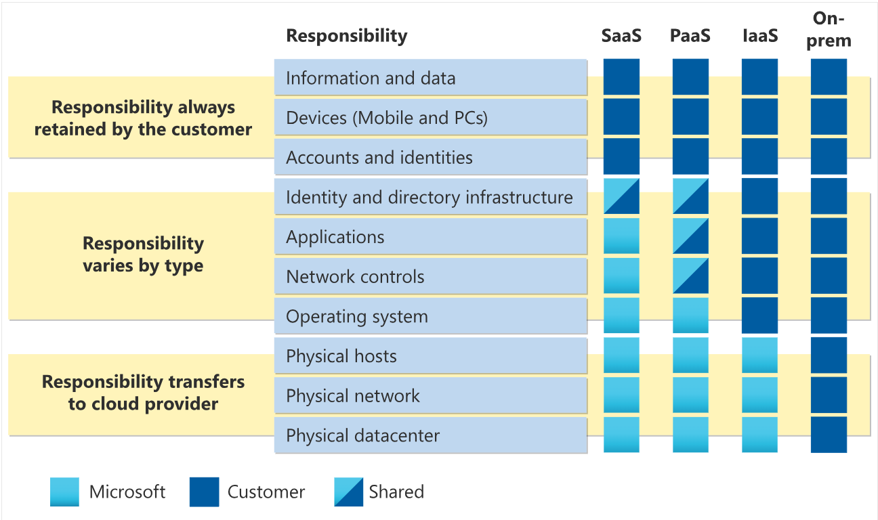
10. Describe The Shared-Responsibility Model

Slide 10
11. Cloud Models and Their Use Cases
Cloud deployment models
When adopting cloud architecture, there are three different types of cloud deployment models that help deliver cloud computing services: public cloud, private cloud, and hybrid cloud.
Public cloud
Public clouds deliver resources, such as compute, storage, network, develop-and-deploy environments, and applications over the internet. They are owned and run by third-party cloud service providers like Google Cloud.
Private cloud
Private clouds are built, run, and used by a single organization, typically located on-premises. They provide greater control, customization, and data security but come with similar costs and resource limitations associated with traditional IT environments.
Hybrid cloud
Environments that mix at least one private computing environment (traditional IT infrastructure or private cloud, including edge) with one or more public clouds are called hybrid clouds. They allow you to leverage the resources and services from different computing environments and choose which is the most optimal for the workloads.
When talking about types of cloud deployment, you may also hear the term multicloud environment. In fact, industry research shows that nearly 90% of companies are now considered multicloud, meaning they combine cloud services from at least two different cloud service providers, whether public or private. Adopting a multicloud approach gives you greater flexibility to choose the solutions that best suit your specific business needs and also reduces the risk of vendor lock-in.
While multicloud and hybrid cloud are sometimes used interchangeably, a hybrid cloud approach can be considered multicloud, but only if it makes use of services from multiple public cloud providers.

Slide 11
Public cloud:
No capital expenditures.
Applications can be quickly provisioned and deprovisioned
Pay for what you use.
Private cloud:
Hardware mush be purchased
Organisations has compete control
Organization is responsible for hardware.
Hybrid cloud:
Provide the most flexibility
Organizations determine where to run their applications
Organizations control security, compliance & legal requirements.

Slide 12
Public cloud | Private cloud | Hybrid cloud
No capital expenditures to scale up | Organizations have complete control over resources and security | Provides the most flexibility
Applications can be quickly provisioned and deprovisioned | Data is not collocated with other organizations’ data | Organizations determine where to run their applications
Organizations pay only for what they use | Hardware must be purchased for startup and maintenance | Organizations control security, compliance, or legal requirements
Organizations don’t have complete control over resources and security | Organizations are responsible for hardware maintenance and updates

Slide 13
12. The Benefits of Cloud Computing
High availability
When you’re deploying an application, a service, or any IT resources, it’s important the resources are available when needed. High availability focuses on ensuring maximum availability, regardless of disruptions or events that may occur.
When you’re architecting your solution, you’ll need to account for service availability guarantees. Azure is a highly available cloud environment with uptime guarantees depending on the service. These guarantees are part of the service-level agreements (SLAs).
Scalability
Another major benefit of cloud computing is the scalability of cloud resources. Scalability refers to the ability to adjust resources to meet demand. If you suddenly experience peak traffic and your systems are overwhelmed, the ability to scale means you can add more resources to better handle the increased demand.
Scaling generally comes in two varieties: vertical and horizontal. Vertical scaling is focused on increasing or decreasing the capabilities of resources. Horizontal scaling is adding or subtracting the number of resources.
Vertical scaling
With vertical scaling, if you were developing an app and you needed more processing power, you could vertically scale up to add more CPUs or RAM to the virtual machine. Conversely, if you realized you had over-specified the needs, you could vertically scale down by lowering the CPU or RAM specifications.
Horizontal scaling
With horizontal scaling, if you suddenly experienced a steep jump in demand, your deployed resources could be scaled out (either automatically or manually). For example, you could add additional virtual machines or containers, scaling out. In the same manner, if there was a significant drop in demand, deployed resources could be scaled in (either automatically or manually), scaling in.

Slide 14
17. Describe Infrastructure-as-a-Service (IaaS)
Infrastructure as a service (IaaS) is the most flexible category of cloud services, as it provides you the maximum amount of control for your cloud resources. In an IaaS model, the cloud provider is responsible for maintaining the hardware, network connectivity (to the internet), and physical security. You’re responsible for everything else: operating system installation, configuration, and maintenance; network configuration; database and storage configuration; and so on. With IaaS, you’re essentially renting the hardware in a cloud datacenter, but what you do with that hardware is up to you.
Scenarios
Some common scenarios where IaaS might make sense include:
Lift-and-shift migration: You’re setting up cloud resources similar to your on-prem datacenter, and then simply moving the things running on-prem to running on the IaaS infrastructure.
Testing and development: You have established configurations for development and test environments that you need to rapidly replicate. You can start up or shut down the different environments rapidly with an IaaS structure, while maintaining complete control.

Slide 15
Platform as a Service
Platform as a service (PaaS) is a middle ground between renting space in a datacenter (infrastructure as a service) and paying for a complete and deployed solution (software as a service). In a PaaS environment, the cloud provider maintains the physical infrastructure, physical security, and connection to the internet. They also maintain the operating systems, middleware, development tools, and business intelligence services that make up a cloud solution. In a PaaS scenario, you don't have to worry about the licensing or patching for operating systems and databases.
PaaS is well suited to provide a complete development environment without the headache of maintaining all the development infrastructure.
Scenarios
Some common scenarios where PaaS might make sense include:
Development framework: PaaS provides a framework that developers can build upon to develop or customize cloud-based applications. Similar to the way you create an Excel macro, PaaS lets developers create applications using built-in software components. Cloud features such as scalability, high-availability, and multi-tenant capability are included, reducing the amount of coding that developers must do.
Analytics or business intelligence: Tools provided as a service with PaaS allow organizations to analyze and mine their data, finding insights and patterns and predicting outcomes to improve forecasting, product design decisions, investment returns, and other business decisions.

Slide 16
Software as a Service
Software as a service (SaaS) is the most complete cloud service model from a product perspective. With SaaS, you’re essentially renting or using a fully developed application. Email, financial software, messaging applications, and connectivity software are all common examples of a SaaS implementation.
While the SaaS model may be the least flexible, it’s also the easiest to get up and running. It requires the least amount of technical knowledge or expertise to fully employ.
Scenarios
Some common scenarios for SaaS are:
Email and messaging.
Business productivity applications.
Finance and expense tracking.
Shared responsibility model
The shared responsibility model applies to all the cloud service types. SaaS is the model that places the most responsibility with the cloud provider and the least responsibility with the user. In a SaaS environment you’re responsible for the data that you put into the system, the devices that you allow to connect to the system, and the users that have access. Nearly everything else falls to the cloud provider. The cloud provider is responsible for physical security of the datacenters, power, network connectivity, and application development and patching.

Slide 18
What is an Azure Region
Simply put, an Azure Region is a set of Datacenters that are connected through a dedicated low-latency network. How many datacenters does a region contain. Well, we do not have a fixed number. It varies. There are regions of different sizes. A Region could be made up of just 1 dataceneter or multiple datacenters. The point is, an Azure Region is a group of one or more Azure Datacenters. As of this course recording, Azure has 58 regions worldwide.
You have the flexibility to deploy your applications and data to any Azure region you want. You can even deploy across multiple regions to deliver cross-region resiliency.
What is an Azure Availability Zone
An Azure Availability Zone is a unique physical location within an Azure region. Each Availability Zone is made up of one or more datacenters with independent power, cooling, and networking. Not all Regions have Availability Zones. Regions that support Availability Zones have a minimum of three separate zones to ensure resiliency.
If one of the Availability Zones has gone down for some reason, we still have our applications and data available from the rest of the two Availability Zones. There is a physical separation between each Availability Zone and it is this separation that protects our applications and data from Datacenter failures. With Availability Zones, Azure offers industry best 99.99% VM uptime SLA.
Availabilty sets protects against hardware failures with in a dataceneter, but availability zones protes against datacenter failures within a region

Slide 19
Describe Azure Resources and Resource Groups: Resource groups are logical containers where you can deploy and manage Azure resources like virtual machines, web apps, databases, and storage accounts. Resources are instances of services that you can create in a resource group, such as virtual machines, storage, and SQL databases.
Describe Azure Subscriptions:
An Azure subscription is a logical container used to provision related business or technical resources in Azure. It holds the details of all your resources like virtual machines (VMs), databases, and more. When you create an Azure resource like a VM, you identify the subscription it belongs to.
Describe Management Groups in Azure:
Azure management groups provide a level of scope above subscriptions. You organize subscriptions into containers called management groups and apply your governance conditions to the management groups. All subscriptions within a management group automatically inherit the conditions applied to the management group.

