Slide 1
EDES 301 PCB Project
Adam Vuong
Due 05/05/2025 @ 11:59pm

Slide 2
Project Options
Can choose one of two options:
Create a PCB based on your Project #1
Create a PCB based on an example project
See Project #2 assignment for specific details
If choosing Option 1
Replace Background Information and System Block Diagram slides with your slides from the Project #1 proposal
Create a Mechanical Drawing
If choosing Option 2
Used provided Background Information and System Block Diagram slides
Create a Mechanical Drawing
Remove this slide in your submission

Slide 3
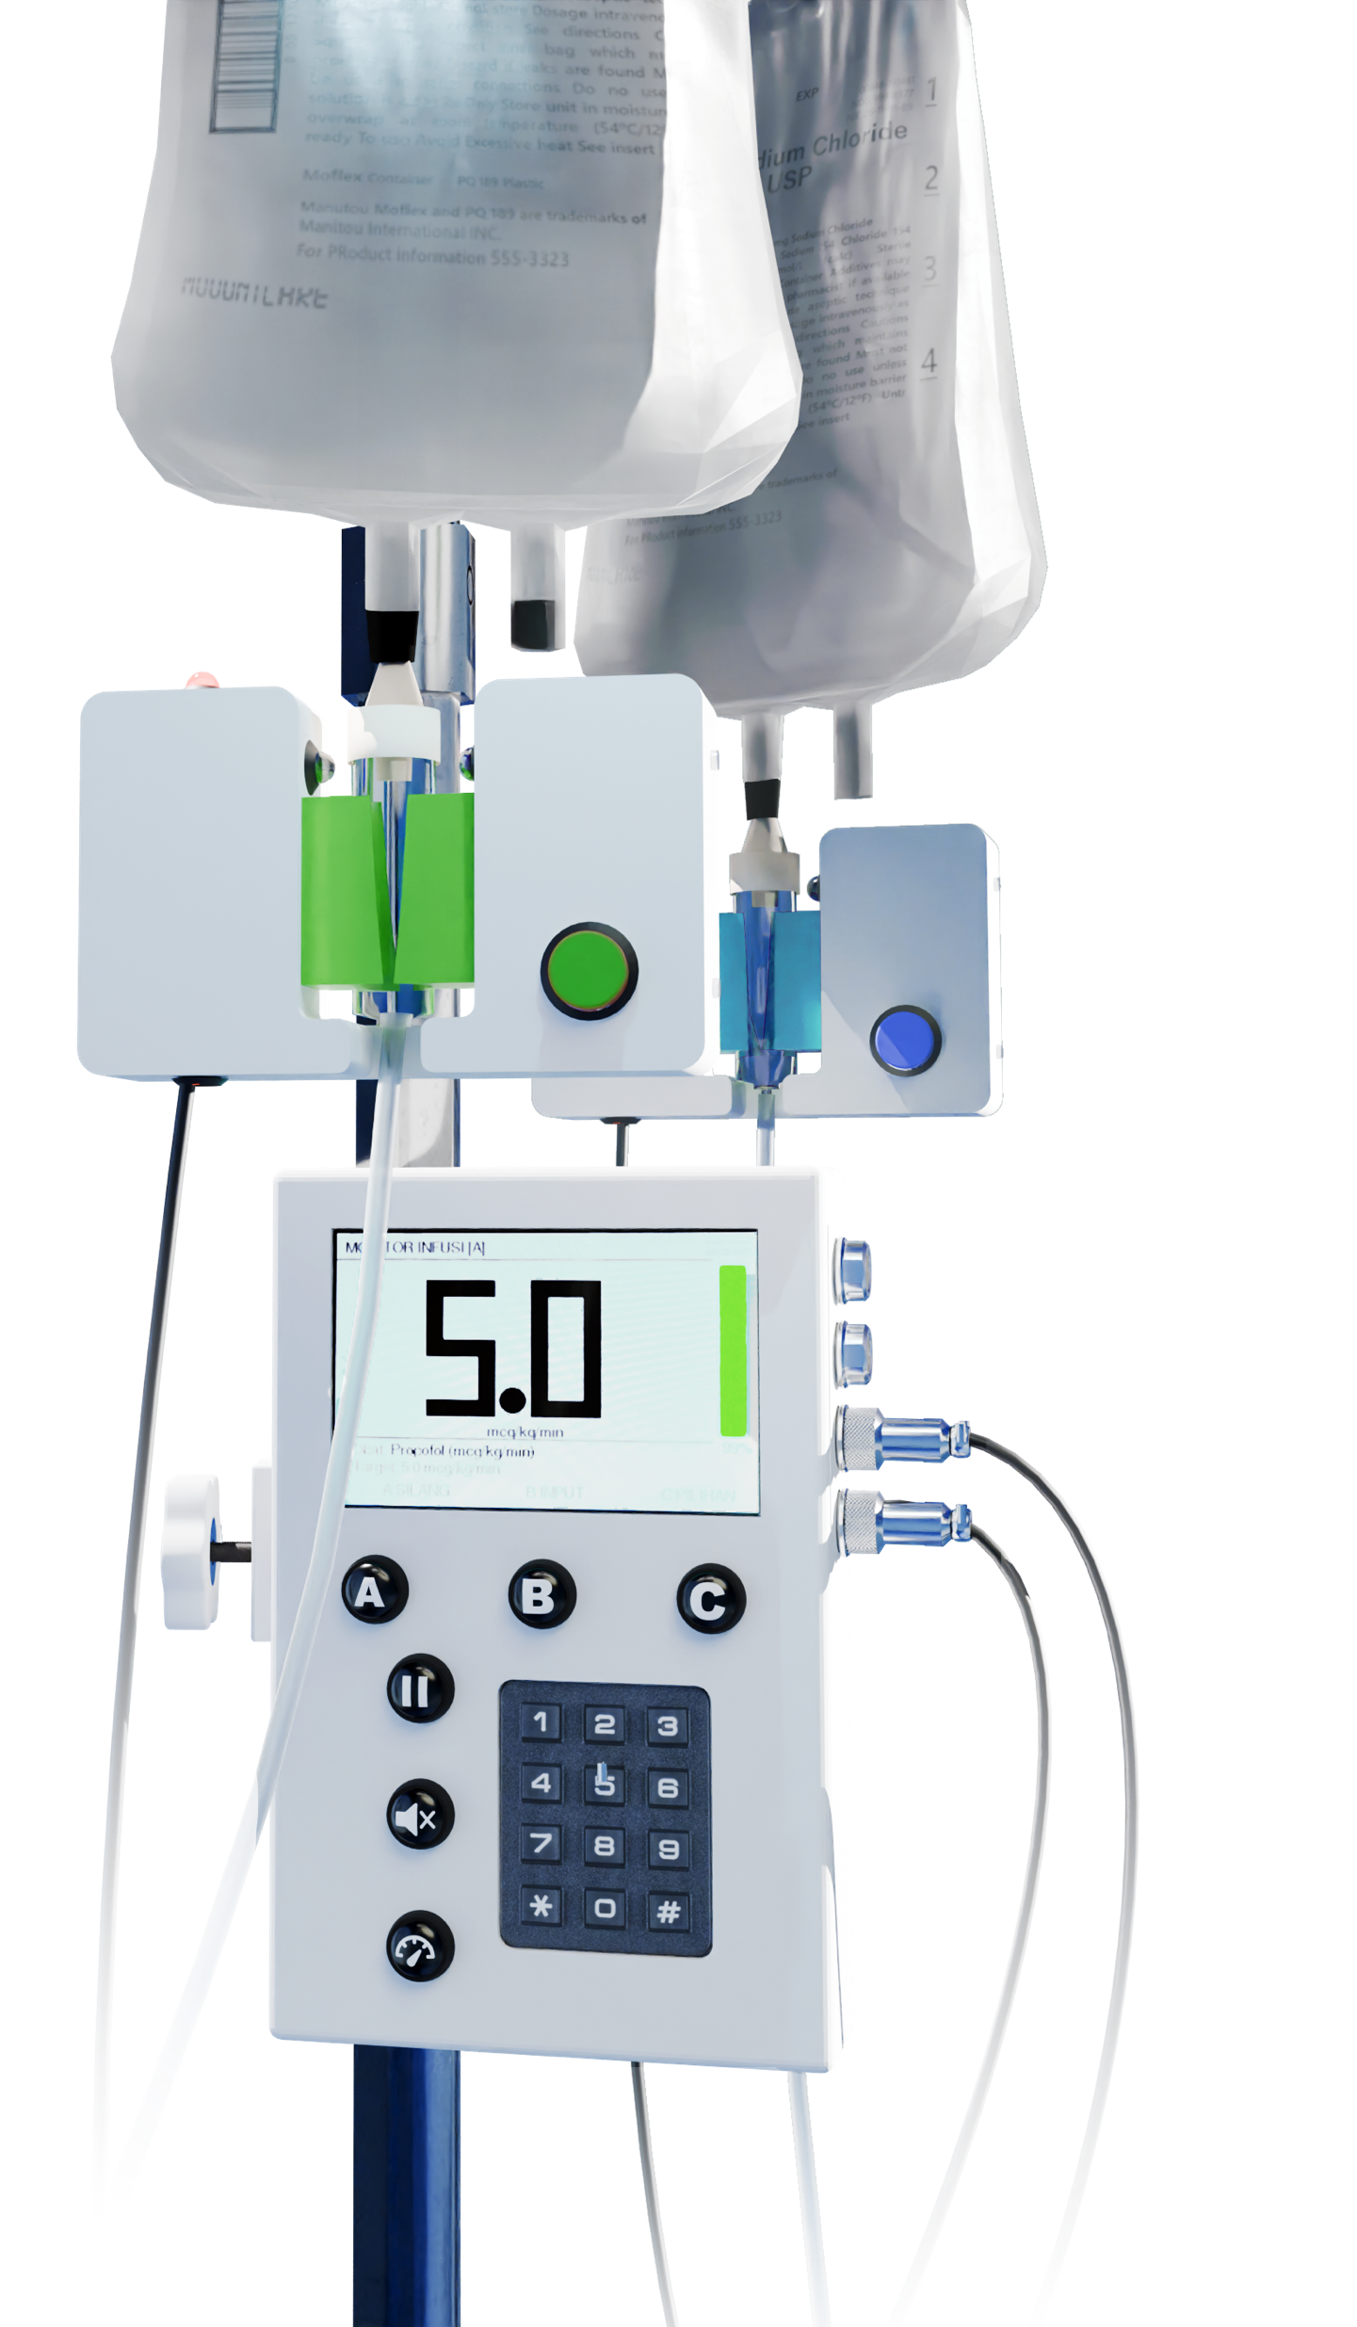
Background Information
Create a PCB for Drip-AID
Remote IV drip rate monitor
Will be modeling the hub (component with screen and keypad)
Hardware:
12-digit number keypad
Two GX-12 cable ports (possible to do four ports)
Six Buttons (three multifunctional options, set drip rate, mute, pause/continue monitoring)
4-inch LCD screen
One buzzer (audio alarm)
Raspberry Pi Pico W
Replace this slide with your own if you are doing a PCB around your Project #1

Slide 4
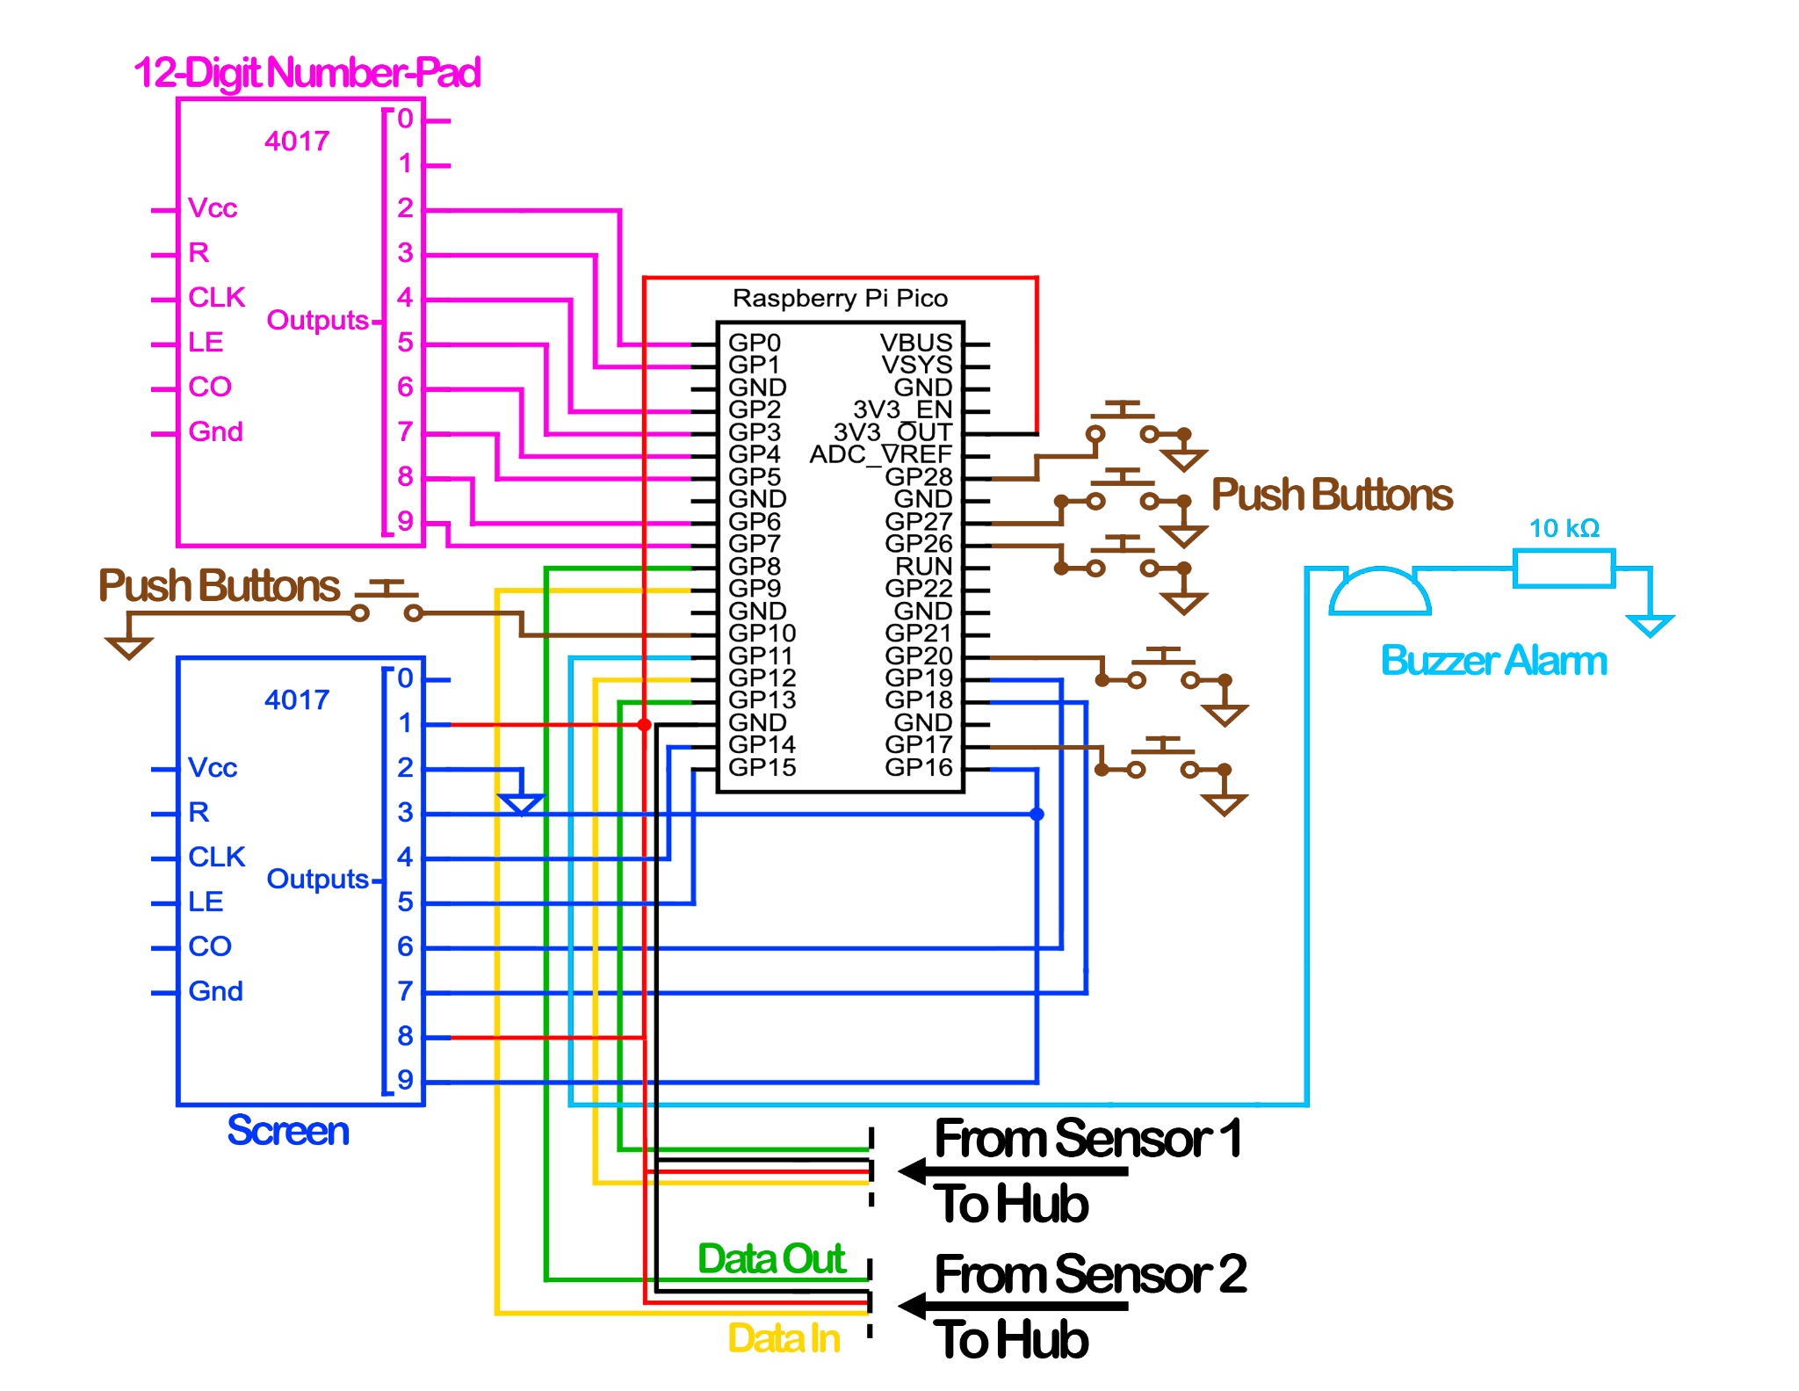
System Block Diagram – Drip-AID

Slide 5
Mechanical Drawing
5”
4.0-inch TFT LCD screen
Buzzer
Button
Button
Button
1”
Raspberry Pi Pico W
12-button Keypad
Button
USB
4”
Button
2”
FRONT
BACK

