Slide 1
Food Category distribution in neighbourhoods of Bangalore
Tarun Madan
Oct 21st,2019

Slide 2
Introduction
To understand the distribution of food category venues for different neighborhood in Bangalore.
Help entrepreneurs to identify the opportunity for newer restaurants and specific cuisines.
This report summarizes the similarity of neighbourhood calculated on basis of venue within food category
The approach can be extended for any available venue category, which can help identify best location for newer entrepreneurial ventures.

Slide 3
Data acquisition and Pre-Processing
Neighbourhoods of Bangalore are defined as per their postal code.
Latitude and longitude information of each postal code is obtained from Indian government website (https://data.gov.in/resources/all-india-pincode-directory-contact-details-along-latitude-and-longitude)
Latitude and longitude information is used with Foursquare API to explore food category venues within 50 m of respective longitude and latitude.
The postal codes with either or both latitude and longitude missing are dropped from analysis.
During data preprocessing it was observed that few food categories within dataset had very few occurrences whereas other categories have significant presence. By analysis of the frequency of each food category, top 9 food categories were selected to obtain the basic data for this study.

Slide 4
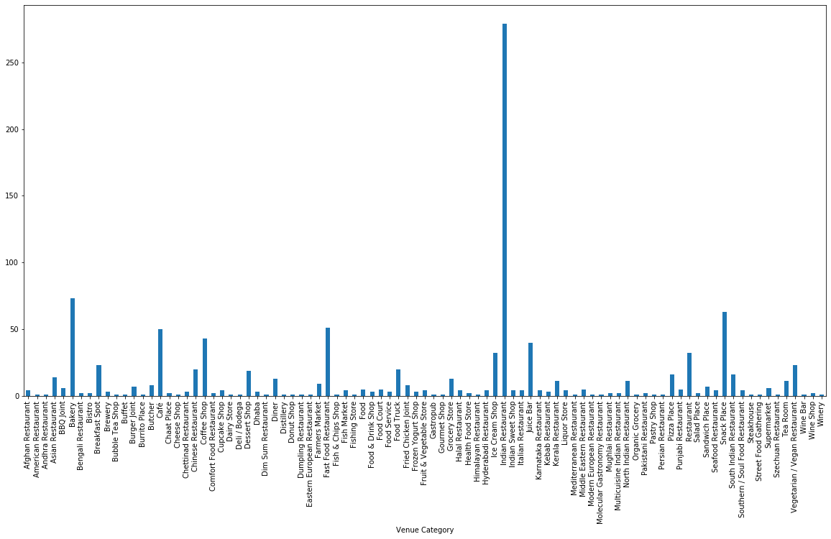
Data acquisition and Pre-Processing
Distribution of food categories in dataset
Food categories within dataset had very few occurrences whereas other categories have significant presence
By analysis of the frequency of each food category, top 9 food categories were selected to obtain the basic data for this study

Slide 5
Data Analysis
To analyze the data, a dataframe with “Neighbourhood” and “Venue Category” is created.
“Venue Category” contains only top 9 food categories identified earlier.
“Venue Category” information is converted using dummies command.
Each row depicting one neighbourhood with their corresponding dummy (0/1) against the listed top 9 categories column-wise.
Dummy “1” represents the presence and dummy “0” represents the absence of a category at a given postal code.

Slide 6
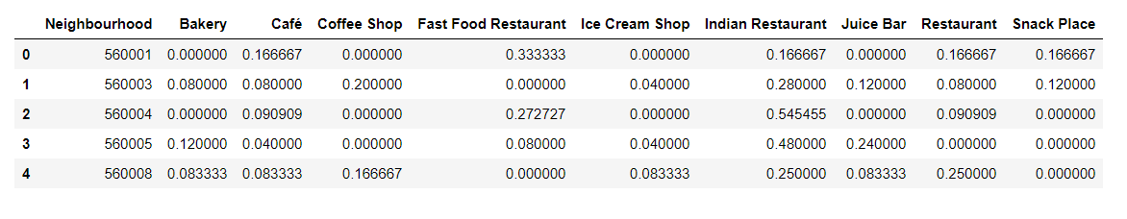
Data Analysis – Feature set
Within each neighbourhood, local mean of each category is calculated.
This weight distribution matrix of each category against respective postal code
Formulates the feature dataset for further segregation to various clusters

Slide 7
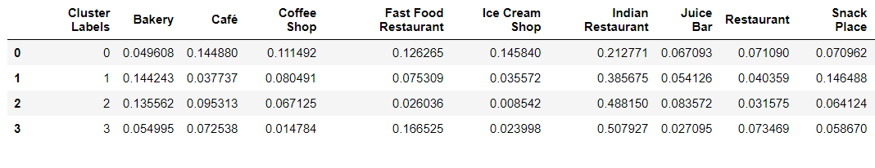
Clustering of data
K- means clustering
Number of clusters are varied between 4 to 8 for best homogeneity.
Optimal 4 clusters formed.
The cluster label identified is added to dataframe with postal code and latitude and longitude details.
This dataframe has multiple rows represent same cluster label.
To have best representation of each cluster, local mean of each category against cluster is performed

Slide 8
Discussions
Feature set of each cluster indicates the presence of top 9 food category venues in those neighbourhoods.
e.g. neighbourhoods in Cluster 1 has “Indian Restaurant” (38%) along with “Bakery” (13%)
Neighbourhoods in Cluster 3 has “Indian Restaurant” (50%) with “Fast food Restaurant” (16%).

Slide 9
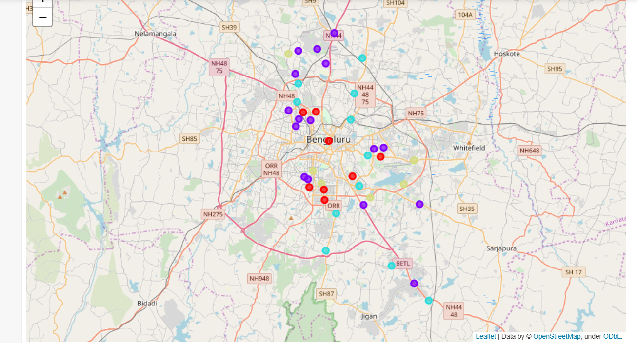
Discussions
Neighbourhood similarity basis K-means clustering

