Slide 1
Similarity of neighbourhoods in Bangalore
Tarun Madan
Oct 21st,2019

Slide 2
Introduction
Explore various venues like café shop, food court, hospitals, bus depot, and other public outlets, in city of Bangalore, India, to understand their local areas of interest.
Dataset generated using FourSquare API has been clustered into various categories to simplify the study and then plot on a map to have a clear insight on the analysis.
Report summarizes the similarity of neighbourhood calculated on basis of venue within food category
Can be extended for any available venue category

Slide 3
Data acquisition and Pre-Processing
The dataset further bucketed according to the postal code along with its latitude and longitude values to enable a connection with data collected from FourSquare API using latitude and longitude.
The study is limited to “food” category from the intersected dataset.
The filtered (food) dataset is then plotted on a bar graph.
Top 9 food categories were selected to obtain the basic dataframe for this study.

Slide 4
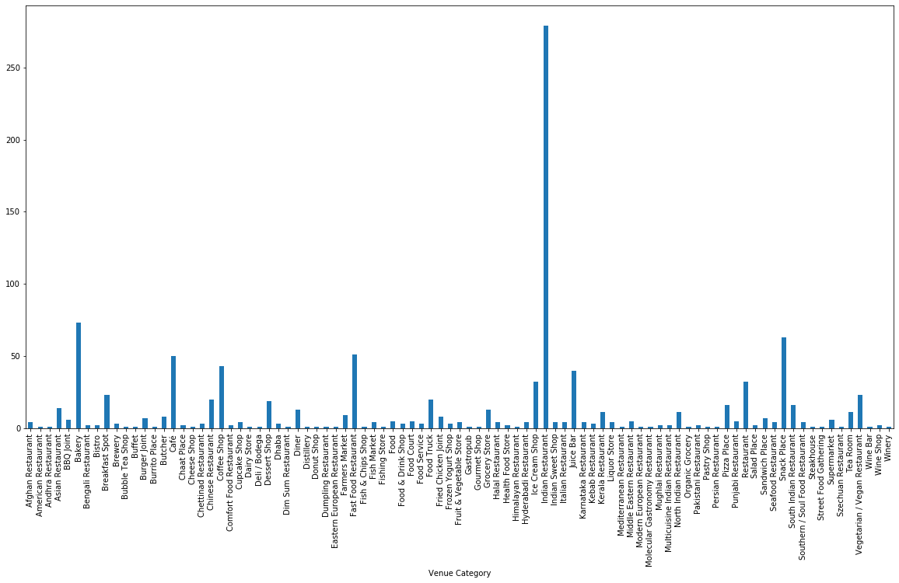
Data acquisition and Pre-Processing
Distribution of food categories in dataset
To identify top 9 food categories

Slide 5
Data Analysis
To analyze the data, a dataframe with “Neighbourhood” and “Venue Category” is created.
“Venue Category” contains only top 9 food categories identified earlier.
“Venue Category” information is converted using dummies command.
Each row depicting one neighbourhood with their corresponding dummy (0/1) against the listed top 9 categories column-wise.
Dummy “1” represents the presence and dummy “0” represents the absence of a category at a given postal code.

Slide 6
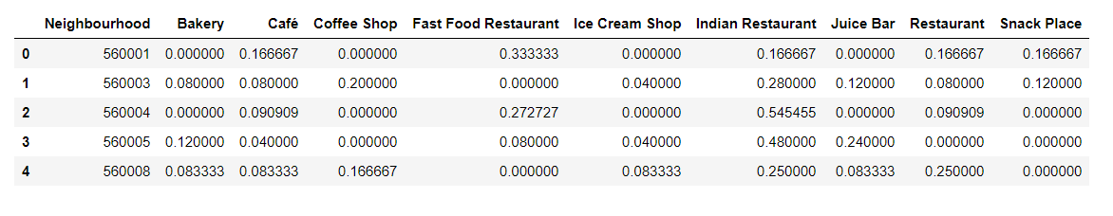
Data Analysis – Feature set
Within each neighbourhood, local mean of each category is calculated.
This weight distribution matrix of each category against respective postal code
Formulates the feature dataset for further segregation to various clusters

Slide 7
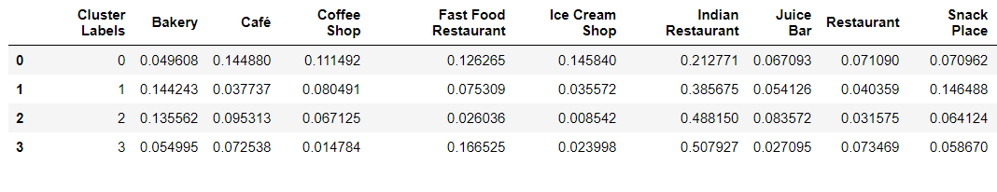
Clustering of data
K- means clustering
Number of clusters are varied between 4 to 8 for best homogeneity.
Optimal 4 clusters formed.
The cluster label identified is added to dataframe with postal code and latitude and longitude details.
This dataframe has multiple rows represent same cluster label.
To have best representation of each cluster, local mean of each category against cluster is performed

Slide 8
Discussions
Feature set of each cluster indicates the presence of top 9 food category venues in those neighbourhoods.
e.g. neighbourhoods in Cluster 1 has “Indian Restaurant” (38%) along with “Bakery” (13%)
Neighbourhoods in Cluster 3 has “Indian Restaurant” (50%) with “Fast food Restaurant” (16%).

Slide 9
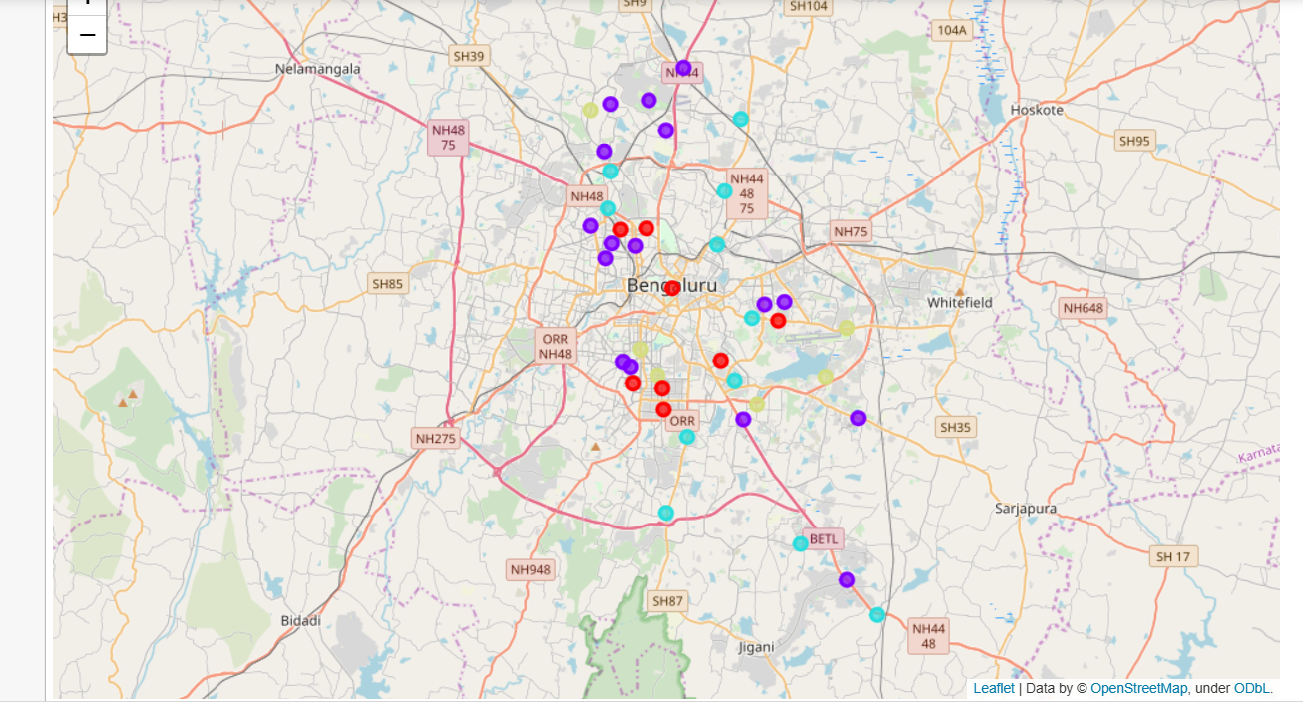
Discussions
Neighbourhood similarity basis K-means clustering

