Slide 1

CROWD SIZE ESTIMATION SYSTEM USING RASPBERRY PI AND OPEN CV
PROJECT BATCH : B-5
PROJECT MEMBERS :
M. Thrinadh(20BQ1A0498)
M. Sudheer(20BQ1A04A3)
K. Preetham(21BQ5A0409)
J. Kiran Naga Sai(20BQ1A0471)
PROJECT GUIDE :
Dr.M.Venkatesh

Slide 2
CONTENTS
Abstract
Introduction
Block diagram
Components Required
Steps to Implement the project
Applications of Crowd size estimation
Code
Output
Reference

Slide 3
ABSTRACT
Crowd size estimation system plays a crucial role in various domains such as event management, crowd control and urban planning. We propose a crowd size estimation system that utilizes the powerful combination of Open CV and Raspberry Pi. Open CV, a popular computer vision library, provides a wide range of tools and algorithms for image processing and analysis, making it well-suited for crowd analysis tasks.
Raspberry Pi, a low cost single-board computer, serves as the hardware platform for our system, offering portability, affordability, and ease of integration .Overall, the Combination of Open CV and Raspberry Pi offers a versatile and practical solution for crowd size estimation.

Slide 4
INTRODUCTION
Digital Image Processing is growing very fast and becoming an important part of many digital devices like mobile, security cameras, laptops. The most common applications of Digital Image Processing are Face Recognition, and people counter. we are going to build an OpenCV crowd counting using Raspberry Pi and ThingSpeak.
Here the pi camera module will be used for continuously capturing the frames and then these frames will be processed with HOG to detect the objects in the image. These frames will be compared with OpenCV’s pre-trained model for people detection. The people counting will be displayed on the ThingSpeak channel which can be monitored from anywhere in the world.

Slide 5
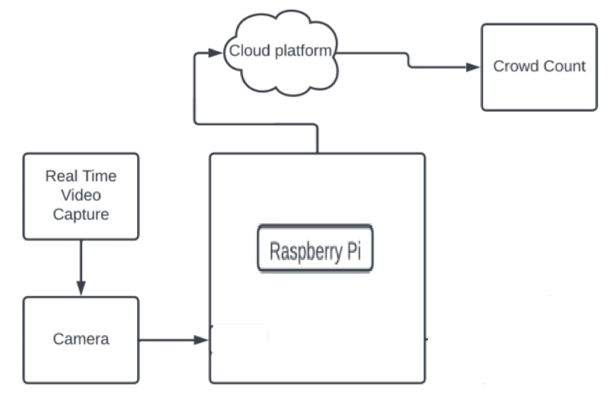
Block Diagram

Slide 6
COMPONENTS REQUIRED
Hardware:
Raspberry Pi 3
Pi Camera
Software:
ThingSpeak
Python 3.0
OpenCV 3.0

Slide 7

OpenCV
OpenCV (Open Source Computer Vision Library) is an open-source computer vision and machine learning software library.
It provides a wide range of tools and functions for performing various tasks related to image and video analysis, manipulation, and understanding.
OpenCV serves as a powerful tool for computer vision tasks and allows you to leverage advanced techniques and algorithms without starting from scratch.

Slide 8
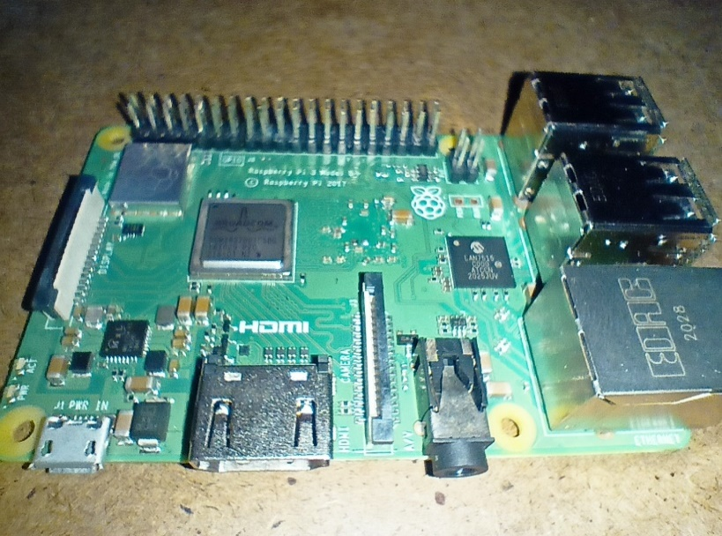
RASPBERRY PI
Raspberry Pi works as a versatile and customizable platform that allows us to create, experiment, and innovate in various domains, including programming, electronics, and IOT projects.
Its combination of hardware capabilities, operating system compatibility, and software flexibility.

Slide 9
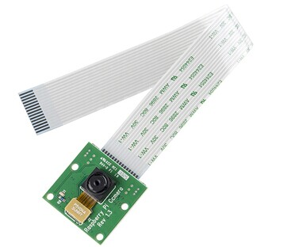
PI CAMERA
The Raspberry Pi Camera Module is a small-sized camera accessory designed specifically for Raspberry Pi single-board computers.
It allows you to capture images and videos directly from your Raspberry Pi and integrate them into various projects and applications.
The camera module offers a convenient and compact solution for adding visual capabilities to your Raspberry Pi-based projects.

Slide 10
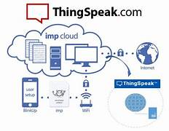
ThingSpeak
ThingSpeak is an Internet of Things (IoT) platform that allows you to collect, analyze, and visualize data from sensors and devices in real-time.
It provides a cloud-based infrastructure that enables you to easily capture, store, and analyze data streams generated by various IoT devices.
ThingSpeak is particularly popular for monitoring and managing sensor data, as well as creating interactive visualizations and applications.

Slide 11
STEPS TO IMPLEMENT THE PROJECT
1.Set Up Raspberry Pi :
Insert the microSD card slot on the Raspberry Pi and connect the peripherals .Boot up the Raspberry Pi by giving power supply and connect the Raspberry Pi Camera Module.
2. Installing OpenCV in Raspberry Pi:
OpenCV library will be used to detect the crowd. To install the OpenCV update the Raspberry Pi. Install the required dependencies for installing OpenCV on your Raspberry Pi.

Slide 12
3.Installing other Required Software Packages:
A)Installing imutils: imutils is used to execute few necessary image processing functions such as translation, rotation, resizing, skeletonization, and displaying Matplotlib images easier with OpenCV.
B)matplotlib: After that, install the matplotlib library. Matplotlib is a comprehensive library for creating static, animated, and interactive visualizations in Python.
4)ThingSpeak Setup for People Counting:
To create a channel on Thingspeak Sign up on ThingSpeak. create a new channel by clicking the New Channel button.To send data to ThingSpeak, enter the API key and channel ID in Python script

Slide 13
Applications of Crowd Size Estimation
Emergency Situations : Aids in disaster management situations, allowing authorities to estimate and address the needs of affected populations more effectively.
Evacuation Planning: In the event of a disaster or emergency, knowing the size and location of crowds can aid in planning safe evacuation routes and ensuring that everyone is accounted for.
Medical Response: Medical teams can use crowd size estimates to prepare for potential casualties, ensuring they have enough medical personnel and supplies on hand.
Resource Allocation: Estimating crowd sizes helps emergency responders allocate resources such as personnel, medical supplies, and equipment more effectively to areas with the greatest need.

Slide 14
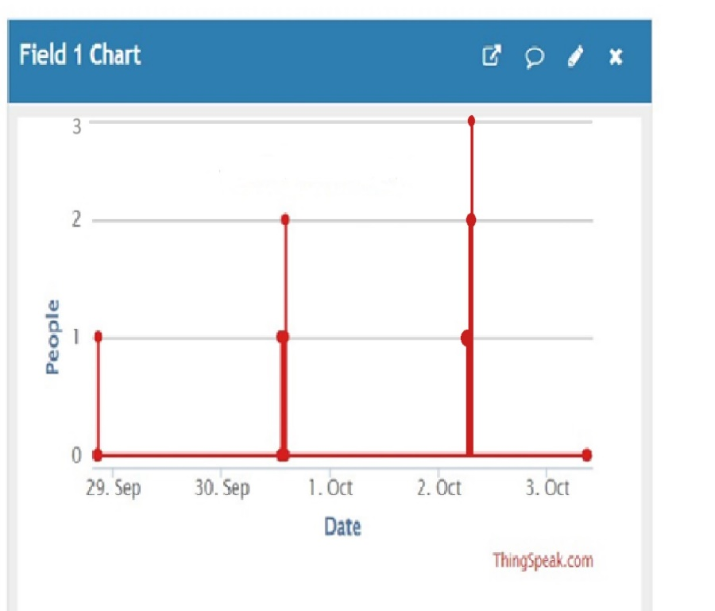
Fig. This Graph shows how many people were counted in an area at different times. We used a camera with a raspberry pi to count them, and the graph helps us understand when there were more or fewer people

Slide 15
REFERENCE
https://en.wikipedia.org/wiki/ThingSpeak
https://en.wikipedia.org/wiki/Raspberry_Pi
https://en.wikipedia.org/wiki/OpenCV
Crowd Size Estimation Using OpenCV and Raspberry Pi (circuitdigest.com)

Slide 16
THANK YOU

