Slide 1

Project Title – seasonal agricultural performance analysis
Student Name- Madapu Indraja
College Name- Sridevi women’s engineering college
AICTE STU ID :STU68695f18dab7e1751736088

Slide 2

PROBLEM STATEMENT
Market Price Volatility and Seasonal Revenue Disparities Agricultural market prices drop during peak harvest seasons due to local oversupply, while off-season prices rise despite low yield availability. Raw crop production data does not correlate seasonal harvest timing with market price trends, leaving farmers unable to schedule plantings for peak financial return. The problem is to analyze seasonal yield output alongside pricing trends to determine optimal harvest and marketing windows that shield farmers from price crashes.

Slide 3
PROJECT DESCRIPTION
Agricultural prices often crash right when farmers harvest their crops, simply because the market gets flooded all at once. Conversely, prices shoot up off-season when there is hardly any produce left to sell. This project dives into historical farm data to tackle that exact problem by linking harvest timing and yield volumes directly to real-world market prices
The main goal of this work is to give farmers, planners, and agricultural officers actionable insights. Instead of sticking to rigid, traditional planting dates, decision-makers can use these findings to stagger crop schedules, schedule harvests for peak price windows, and make smarter use of post-harvest storage to avoid selling at a loss.

Slide 4

WHO ARE THE END USERS?
Local Farmers & Farm Cooperatives: Small-scale growers and agricultural groups who need simple, practical advice on when to harvest, when to hold produce, and how to avoid selling their crops during steep price crashes.
Regional Farm Managers & Planners: Agricultural professionals responsible for day-to-day operations who need data to schedule planting cycles, manage local field labor, and allocate irrigation and fertilizer efficiently.
Agricultural Policy Decision-Makers: Government and local officers who rely on seasonal market trends to set up cold storage facilities, plan subsidies, and stabilize local food supply chains.

Slide 5

TECHNOLOGY USED
Development Environment & Editors
Visual Studio Code (VS Code): The primary Integrated Development Environment (IDE) used to write, execute, and debug the analysis.
VS Code Jupyter Extension: Enables native execution of .ipynb notebook cells directly inside VS Code, offering interactive data previews, inline plot rendering, and seamless variable management.
Python Extension for VS Code: Provides full Python language support, intelligent code completion (IntelliSense), syntax highlighting, and virtual environment auto-detection.
Core Data Stack Executed in VS Code
Pandas & NumPy: For dataset manipulation, filtering, and statistical calculations.
Matplotlib & Seaborn: For generating inline plots, charts, and heatmaps within the VS Code interactive window.

Slide 6
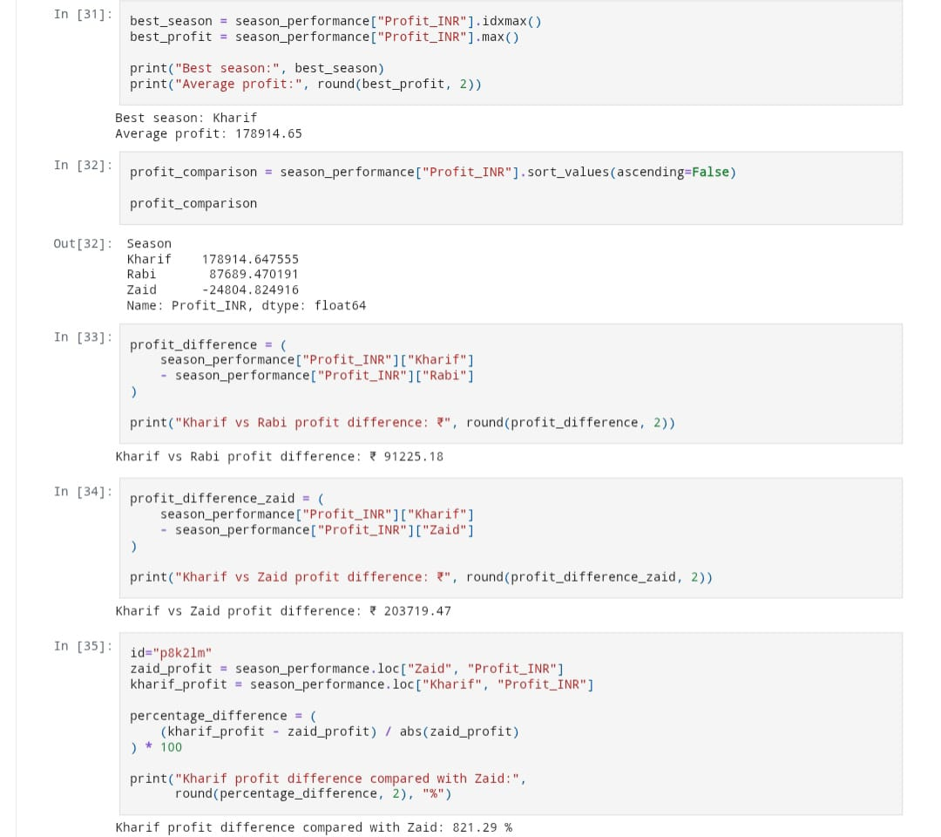
RESULTS

Slide 7
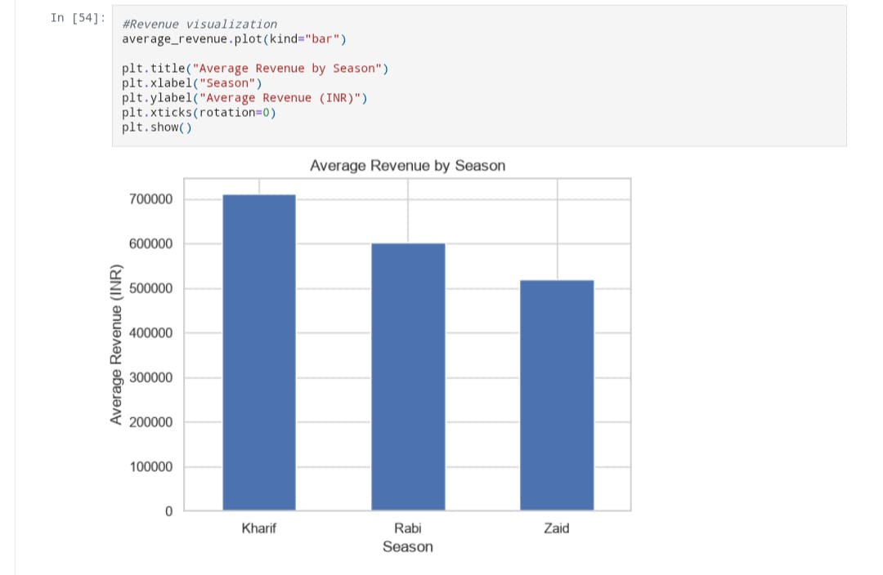
RESULTS

Slide 8
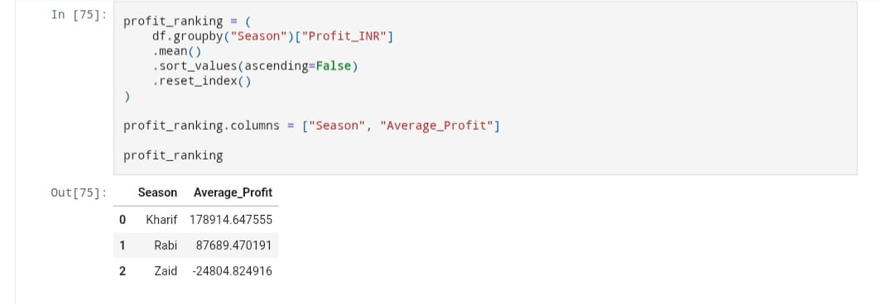
RESULTS

Slide 9
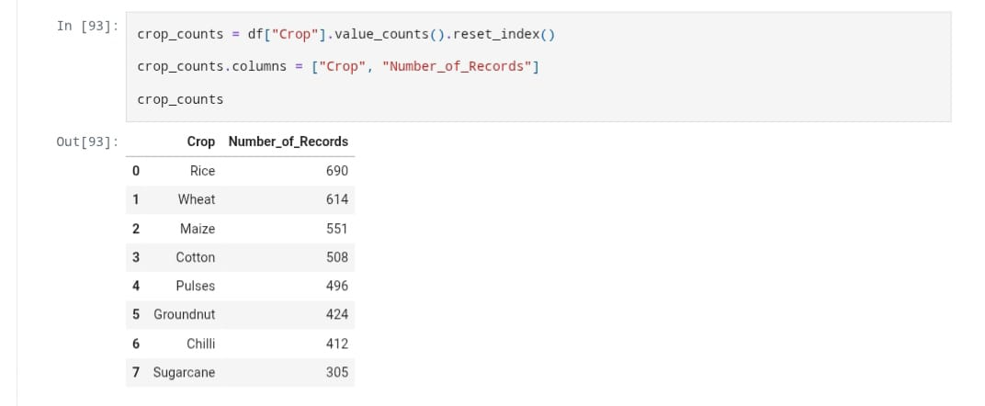
RESULTS
[Add screen shots of your code ]

Slide 10
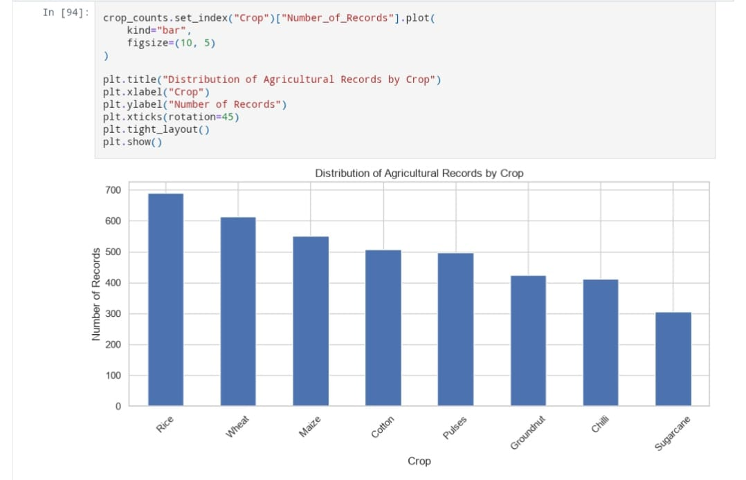
RESULTS
[Add screen shots of your code ]

Slide 11
Predictive Price & Demand Forecasting Models
Soil Nutrient & Crop Rotation Optimization
Contract Farming & Direct-to-Consumer Channel Planning: Expand the analysis to evaluate alternative sales channels, helping farm cooperatives
Storage & Cold-Chain Logistics Optimization integrations of Satellite & Remote Sensing Data: Combine crop yield patterns with satellite imagery (like Sentinel or Landsat) to monitor crop growth health, estimate harvest timing early, and predict seasonal market supply surges before crops leave the field
FUTURE SCOPE

Slide 12
GITHUB LINK
https://github.com/madapuindraja/Seasonal_Agriculture_Performance_Analysis

Slide 13

VOIS Course completion certificate -
Course name- Data Visualization

Slide 14
THANK YOU
.
.

