Slide 1
Python with SQL
Day 3: SQL Fundamentals & Integration

Slide 2
Today's Agenda
SQL Basics & Database Concepts
Data Retrieval with SELECT
Filtering & Sorting Data
Joins & Relationships
Aggregations & Grouping
Python-SQL Integration
Practical Hands-on Project

Slide 3

What is SQL?
Structured Query Language
Standard language for managing relational databases
Used to CREATE, READ, UPDATE, and DELETE data
Why SQL Matters for Developers
Powers most web applications and business systems
Essential skill for backend development
Works seamlessly with Python, Java, JavaScript
Critical for data analysis and reporting

Slide 4



Database Fundamentals
Tables
Primary Key
Foreign Key
Store data in rows and columns, like spreadsheets
Unique identifier for each row in a table
Links tables together through relationships

Slide 5
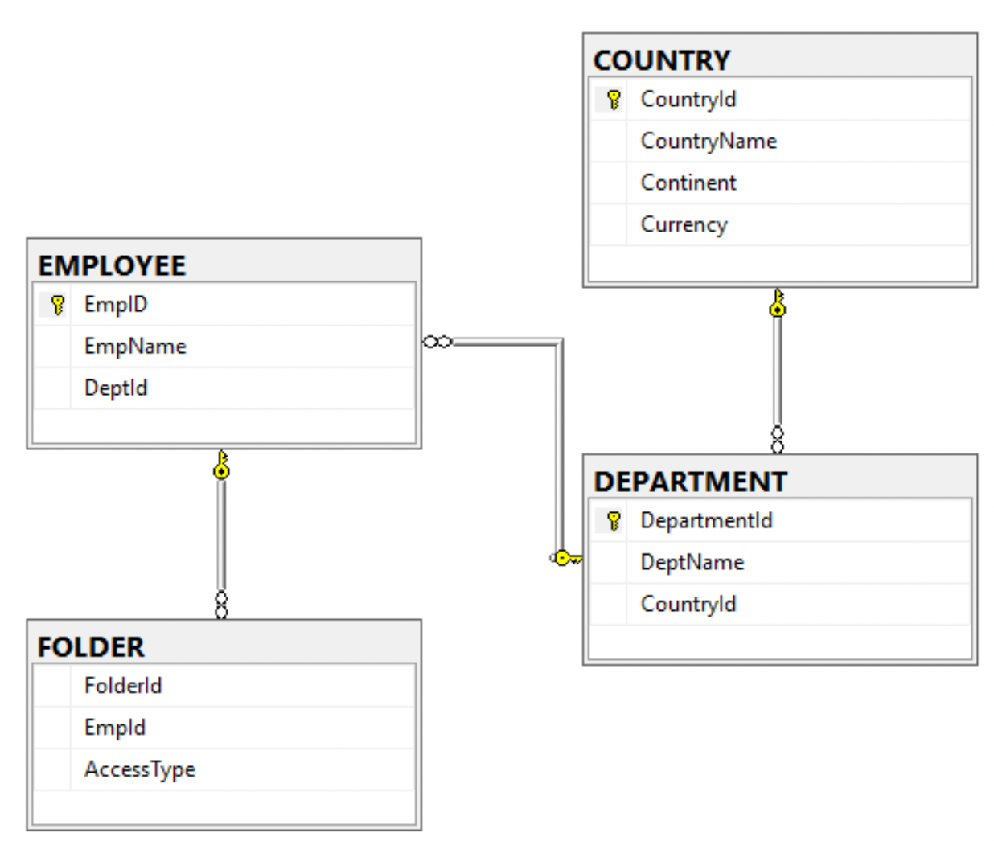
ER Model
Entity - A real-world object or concept stored as data.
Attribute – Properties that describe an entity.
Relationship – How entities are connected.

Slide 6
Common SQL Data Types
Data Type | Description | Example
INTEGER | Whole numbers | 25, -100, 0
VARCHAR(n) | Variable-length text | 'Hello', 'Student'
DATE | Date values | '2026-02-25'
DECIMAL(p,s) | Precise decimal numbers | 99.99, 1234.56
BOOLEAN | True/False values | TRUE, FALSE
TEXT | Large text fields | Long descriptions

Slide 7

Creating Tables
Syntax
CREATE TABLE students (
student_id INTEGER PRIMARY KEY,
first_name VARCHAR(50) NOT NULL,
last_name VARCHAR(50) NOT NULL,
email VARCHAR(100) UNIQUE,
enrollment_date DATE,
gpa DECIMAL(3,2)
);

Slide 8
Inserting Data
Single Row
Multiple Rows
INSERT INTO students
VALUES (1, 'John', 'Doe',
'john@example.com',
'2023-09-01', 3.75);
INSERT INTO students VALUES
(2, 'Jane', 'Smith', ...),
(3, 'Mike', 'Johnson', ...);
💡 Best Practice: Always specify column names for clarity

Slide 9

SELECT - Retrieving Data
The most used SQL command!
All Columns
SELECT * FROM students;
Specific Columns
SELECT first_name, email
FROM students;
With Alias
SELECT first_name AS name,
gpa AS grade_point
FROM students;

Slide 10
Filtering with WHERE
Examples
Comparison Operators
-- GPA greater than 3.5
WHERE gpa > 3.5
-- Names starting with 'J'
WHERE first_name LIKE 'J%'
-- Enrolled in 2023
WHERE YEAR(enrollment_date)
= 2023
= (equal)
!= or <> (not equal)
> , < , >= , <=
BETWEEN ... AND ...
IN (value1, value2, ...)
LIKE (pattern matching)
IS NULL / IS NOT NULL

Slide 11
Combining Conditions
-- AND: Both conditions must be true
SELECT * FROM students
WHERE gpa > 3.5 AND enrollment_date > '2023-01-01';
-- OR: At least one condition must be true
SELECT * FROM students
WHERE first_name = 'John' OR last_name = 'Smith';
-- NOT: Negates a condition
SELECT * FROM students
WHERE NOT gpa < 2.0;

Slide 12
Sorting Results - ORDER BY
Ascending Order (A→Z, 0→9)
Descending Order (Z→A, 9→0)
SELECT * FROM students
ORDER BY last_name ASC;
SELECT * FROM students
ORDER BY gpa DESC;
Multiple Columns
SELECT * FROM students
ORDER BY gpa DESC, last_name ASC;

Slide 13
Limiting Results - LIMIT
Control the number of rows returned
Top 5 Students by GPA
Skip First 10, Get Next 5
SELECT * FROM students
ORDER BY gpa DESC LIMIT 5;
SELECT * FROM students
LIMIT 5 OFFSET 10;
💡 Use LIMIT for pagination in web applications!

Slide 14

Aggregate Functions
Perform calculations on multiple rows
Function | Description | Example
COUNT() | Count rows | COUNT(*)
SUM() | Total of values | SUM(gpa)
AVG() | Average value | AVG(gpa)
MIN() | Minimum value | MIN(gpa)
MAX() | Maximum value | MAX(gpa)
SELECT COUNT(*) as total_students, AVG(gpa) as avg_gpa FROM students;

Slide 15
Grouping Data - GROUP BY
Group rows with same values and apply aggregate functions
-- Count students by enrollment year
SELECT YEAR(enrollment_date) as year,
COUNT(*) as student_count,
AVG(gpa) as average_gpa
FROM students
GROUP BY YEAR(enrollment_date);
💡 HAVING filters groups (like WHERE filters rows)

Slide 16
Table Relationships - JOINs
Combine data from multiple tables
students
courses
JOIN
INNER JOIN
Returns only matching records from both tables
LEFT JOIN
Returns all from left table + matching from right

Slide 17
INNER JOIN Example
-- Get student names with their enrolled courses
SELECT s.first_name, s.last_name, c.course_name
FROM students s
INNER JOIN enrollments e ON s.student_id = e.student_id
INNER JOIN courses c ON e.course_id = c.course_id;
💡 Table aliases (s, e, c) make queries shorter and more readable

Slide 18
Updating Data - UPDATE
Update Single Student
UPDATE students
SET gpa = 3.85, email = 'newemail@example.com'
WHERE student_id = 1;
Update Multiple Rows
UPDATE students
SET gpa = gpa + 0.1
WHERE gpa >= 3.5;
⚠️ ALWAYS use WHERE clause or you'll update ALL rows!

Slide 19
Deleting Data - DELETE
Delete Specific Row
DELETE FROM students
WHERE student_id = 5;
Delete Multiple Rows
DELETE FROM students
WHERE gpa < 2.0;
⚠️ DELETE without WHERE removes ALL rows!
⚠️ DELETE is permanent - no undo!

Slide 20

Python + SQL Integration
Connecting Python to Databases
sqlite3
Built-in, perfect for learning
File-based database
mysql-connector
For MySQL databases
Web applications
psycopg2
For PostgreSQL
Enterprise apps
SQLAlchemy
ORM framework
Complex projects

Slide 21
Python + MySQL Example
import mysql.connector
# Connect to database
conn = mysql.connector.connect(
host="localhost",
user="root",
password="Prakash@000",
database="user_db"
)
cursor = conn.cursor()
# Execute query
cursor.execute('SELECT * FROM students WHERE gpa > ?', (3.5,))
# Fetch results
results = cursor.fetchall()
for row in results:
print(row)
# Close connection
conn.close()

Slide 22
Python + SQLite Example
import sqlite3
# Connect to database
conn = sqlite3.connect('students.db')
cursor = conn.cursor()
# Execute query
cursor.execute('SELECT * FROM students WHERE gpa > ?', (3.5,))
# Fetch results
results = cursor.fetchall()
for row in results:
print(row)
# Close connection
conn.close()

Slide 23

SQL Best Practices
Security & Performance
Use Parameterized Queries
cursor.execute('SELECT * FROM users WHERE id = ?', (user_id,))
Prevents SQL injection attacks
Index Important Columns
CREATE INDEX idx_email ON students(email);
Speeds up queries on large tables
Use Transactions
BEGIN; ... COMMIT; or ROLLBACK;
Ensures data consistency
Avoid SELECT *
SELECT name, email FROM students;
Only select columns you need

Slide 24
Hands-on Project
Build a Student Management System
Create Database Schema
Students, Courses, Enrollments tables with relationships
Insert Sample Data
Add at least 10 students and 5 courses
Build Python Interface
Functions to add students, enroll in courses, view grades
Generate Reports
Top students by GPA, course enrollment stats, etc.

Slide 25
Learning Resources
SQLZoo
Interactive SQL tutorials - sqlzoo.net
SQLite Tutorial
Official documentation - sqlite.org/docs.html
W3Schools SQL
Comprehensive reference - w3schools.com/sql
SQLBolt
Learn SQL with exercises - sqlbolt.com
Python DB-API
Database programming in Python - python.org/dev/peps/pep-0249

Slide 26
Questions?
Let's build something amazing with Python + SQL!
Happy Coding! 🚀

