Slide 1
4-Day Hands-on Workshop
Python & SQL
About Me
Prakash Madariya
BE in Computer Science Eng.
Around 9 Years of IT experience as Full Stack Developer
Currently working at Virtusa as Tech Lead Engineer
Mentored over 1000+ students

Slide 2
Workshop Objective
Build strong Python fundamentals
Improve logical thinking and problem solving skills
Because
Companies don’t hire based on theory
They test problem solving
They test logic
They test debugging
They test database understanding

Slide 3
What You Will Build
By Day 4:
Connect Python with database
Build mini backend system
Write optimized queries
Think like IT professional

Slide 4
Where Python Is Used
Backend development
Roles: Python Developer, Backend Engineer, API Developer, Django/Flask Developer
Automation & scripting
Roles: Automation Engineer, Python Scripting Engineer, Automation Tester, Software Development Engineer in Test (SDET)
Data engineering & AI
Roles: Data Engineer, Data Scientist, Machine Learning Engineer, Data Analyst
DevOps & Cloud integration
Roles: DevOps Engineer, Cloud Engineer, Site Reliability Engineer (SRE), Infrastructure as Code (IaC) Engineer

Slide 5
Day 1 – Python Fundamentals and Logic building

Slide 6
How Python Executes Code
Lexer convert the source code in tokens called tokenizer.
KEYWORD(if) NAME(x) OP(>) NUMBER(10) OP(:) NEWLINE INDENT NAME(print) LPAREN STRING("Hi") RPAREN NEWLINE DEDENT
Parser checks whether tokens follow grammar rules.
If tokens don’t match grammar → parser fails → SyntaxError.
Colon missing → Parser cannot match grammar → SyntaxError.
The interpreter runs the program instruction by instruction and stops if a runtime error happens.
Source Code
Lexer (Tokenizer)
Lexical Analysis
Parser
Syntax Analysis
Python Virtual Machine (PVM)
Interpreter
Bytecode(.pyc)
Python Compiler
CPU

Slide 7
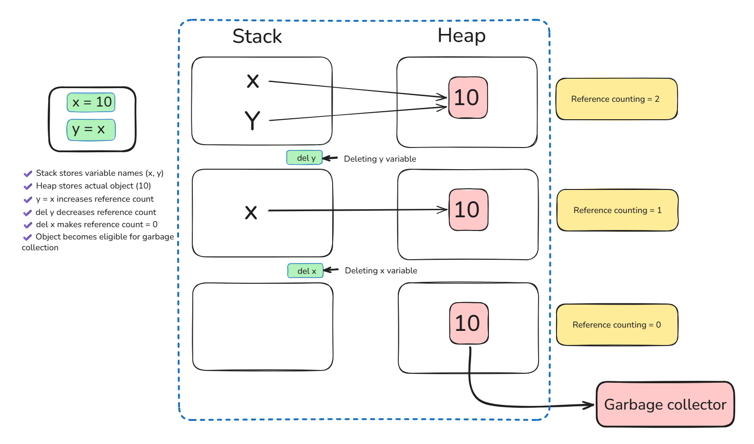
Memory Management and Garbage Collector in python

Slide 8
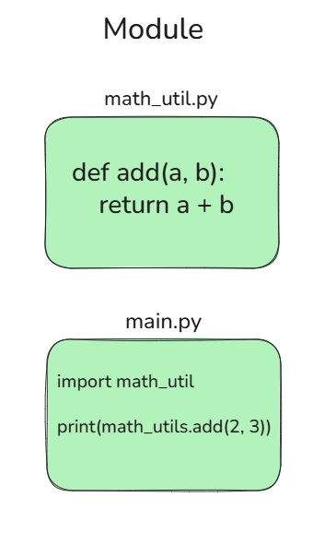
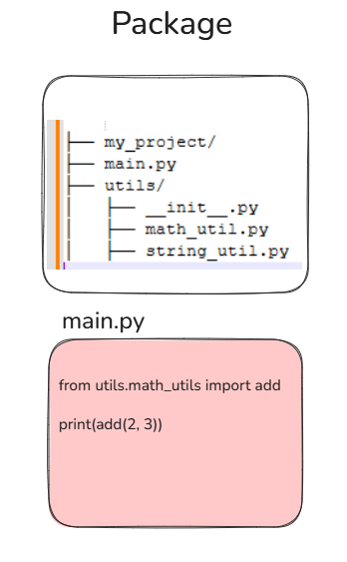
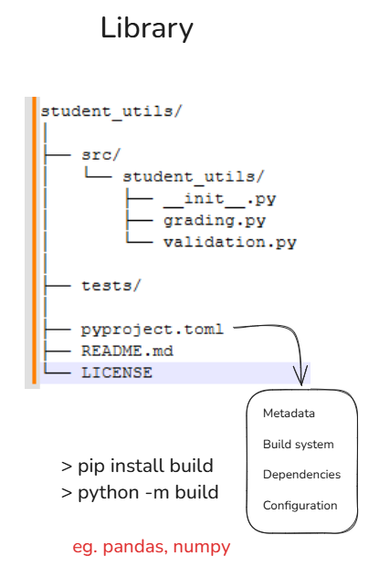
Module VS Package Vs Library

Slide 9
Core Data Types (With Use Cases)
int – IDs, counters
float – prices, metrics
str – user input, APIs
list, tuple, set – collections of records
dict – structured data (key-value)

Slide 10
Mutable vs Immutable Data Types
Mutable: list, dict, set
Mutable → Can change after creation
List is mutable because we modified it without creating a new object.
Dictionary values can be changed.
Set can be modified.
Immutable: int, str, tuple
Immutable → Cannot change after creation
New int object is created when value changes.
Strings cannot be modified directly.
Tuple elements cannot be changed.

Slide 11
Conditional Logic in Real Projects
Access control
Authentication → Who are you?
Authorization → What can you do?
Role-Based Access Control (RBAC)
Validation checks
Input validation (form validation)
Business validation
Cross-field validation(relationship between one field to another field)
Database constraint validation
Feature toggles
Gradual rollouts (increasing hike percentage)
Emergency rollback
Beta features
Business rules
Core domain logic that defines how the system behaves.
Example:
IF age > 60
AND pre-existing disease = True
AND coverage > 10L
THEN require medical test

Slide 12
Loops in Production Code
Processing records
Monthly salary processing
EMI auto-deduction
Subscription renewal
Invoice generation
Reading files
Upload bulk employee data
Import banking transactions
Read log files
ETL pipelines
AI dataset preprocessing
Iterating over API responses
Fetch AWS logs
Sync payment gateway data
Collect analytics data
Handling batch operations
Payroll processing
Sending 10,000 emails
Updating product prices
Generating reports
ML training data processing

Slide 13
Common Beginner Mistakes
No Input Validation
Writing Everything in One Function
Not Using Logging Properly
Not Writing Tests
Ignoring Performance
Ignoring error messages
Hardcoded values
Copy-Paste Programming
Ignoring Security Basics eg.(CSRF, Input sanitization)

Slide 14
Debugging Mindset
Read the error message carefully
Identify line number (e.g. File “app.py”, line 45)
Understand expected vs actual behavior
Fix root cause, not symptom
Reduce the Problem Scope - Simplify.
“Good developers write code. Great engineers debug efficiently.”

Slide 15
What Companies Look For
Clean, readable code
Modular structure
Edge case handling
Proper naming conventions
Debugging skills

Slide 16
How to Improve Coding Skills
Solve 1 problem daily
Practice on LeetCode / HackerRank
Build small projects
Review and refactor code

Slide 17
Mini Code Challenge
Student Ranking & Grading System
Problem Statement
Create a program that:
Takes number of students as input.
For each student, take:
name
age
marks
Store data in a list of dictionaries.
Sort students by marks using lambda.
Print ranked list using enumerate().
Use match statement to assign grade:
90+ → A
75+ → B
50+ → C
Otherwise → Fail

Slide 18
Day 1 Recap
Python fundamentals and basics
Data types and their built-in methods
Conditional logic & loops
Problem solving approach

Slide 19
Assignment
Build Student Grade Calculator
Take Student name and input for 5 subjects
Calculate average
Assign grade based on marks
Features: - Takes student name - Takes marks for 5 subjects - Validates marks (0–100) - Calculates total and average - Checks individual subject fail condition - Assigns grade using match - Displays formatted result

Slide 20
Closing Note
Don’t aim to finish the workshop.
Aim to think like a developer.
See you on Day 2 – Functions & File Handling!

