Slide 1
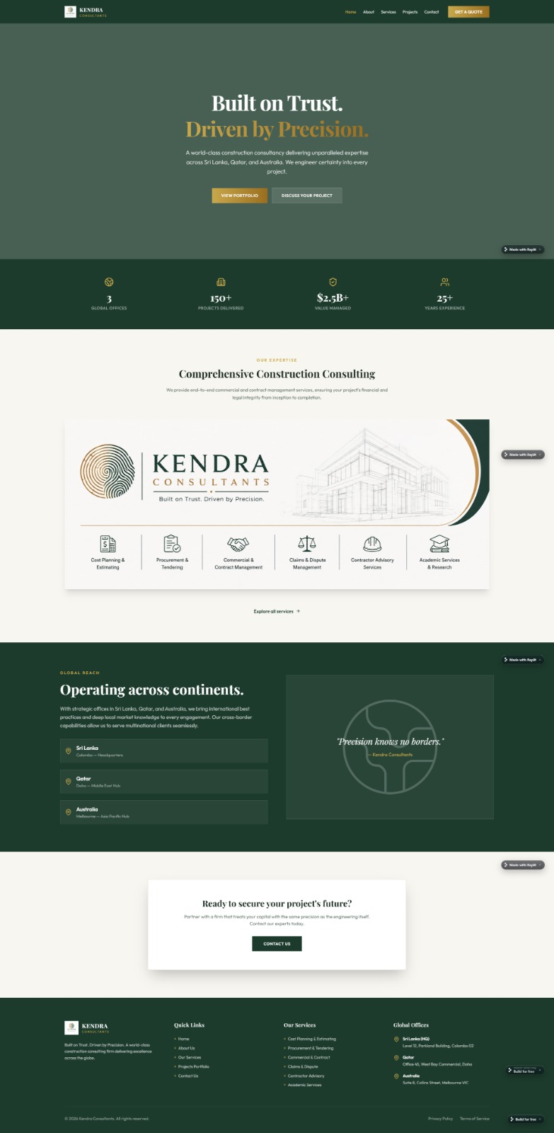



















Write - Consult Kendra
May be like we discussed put the logo and name in the center or left corner
Delivering trusted construction consultancy across Sri Lanka, the Middle East and Australia, Kendra Consultants combines precision, expertise and integrity to provide world-class quantity surveying, commercial management and contract advisory services that bring certainty to every project.
May be put the logo like a water mark, if possible, try blending the colours
Remove for the moment
Remove for the moment
Remove
Remove for the moment

Slide 2













Delivering Confidence at Every Stage
We provide integrated quantity surveying, commercial management, procurement, contract advisory and claims consultancy services across Sri Lanka, the Middle East and Australia. Combining technical expertise, commercial acumen, and a commitment to ethical excellence, we support clients in making strategic decisions, optimizing project performance, mitigating risks, and delivering sustainable value throughout the project lifecycle.
Bcs we are giving it above
Highlight this part

Slide 3









With a strategic presence across Sri Lanka, the Middle East and Australia, we bring trusted expertise, commercial insight and professional excellence to support clients in delivering successful projects across international markets.
Connecting Expertise Across Markets
“Precision Beyond Borders”

Slide 4








Built on trust. Dri….
A globally trusted leader in shaping the future of the built environment.

Slide 5
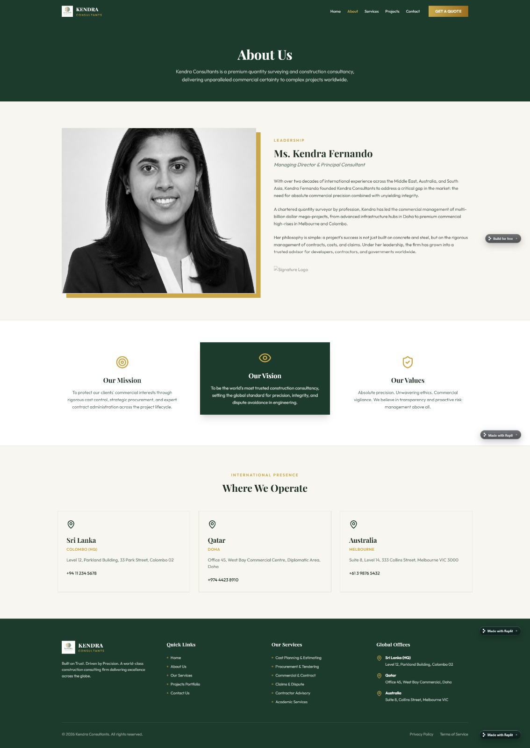









Kendra Consultants is a globally trusted consultancy firm committed to shaping the future of the built environment through integrity, precision, and professional excellence. With a presence across Sri Lanka, the Middle East, and Australia, we build trusted partnerships by providing strategic insight, creating lasting value, and upholding the highest standards of quality, ethics, and professionalism throughout every project we support..
Kaushala Fonseka
Founder & Managing Director
Keep it small and keep only the colour version – see what's best

Slide 6
Under leadership ----→
Kendra Consultants was founded with a vision to establish a trusted consultancy that delivers professional excellence, integrity and value across the built environment. Under the leadership of Kaushala Fonseka, the firm is driven by a commitment to precision, ethical practice and creating meaningful outcomes for clients.
Supported by a team committed to professional excellence, Kendra Consultants applies industry knowledge, commercial insight and collaborative approaches to deliver informed decisions and value-driven outcomes throughout the project lifecycle.
Through Kendra Consultants, the focus remains on embracing international best practices, strengthening industry standards and contributing to a sustainable and progressive built environment.

Slide 7









Our Mission
To deliver high-quality quantity surveying, commercial management, contract advisory and construction consultancy services through expert knowledge, commercial insight and strategic solutions. We are committed to providing trusted and ethical advice, building lasting client relationships and maintaining the highest standards of integrity, competence and excellence throughout every stage of the project lifecycle.
Our Vision
To be a globally trusted leader in shaping the future of the built environment.
Our Values
Absolute Precision. Unwavering Ethics. Commercial Insight.
We believe in transparency, professional integrity and proactive risk management, delivering trusted advice and strategic solutions that create lasting value for our clients and contribute to a sustainable built environment.

Slide 8


Update according to the Our Offices Section in the last page

Slide 9
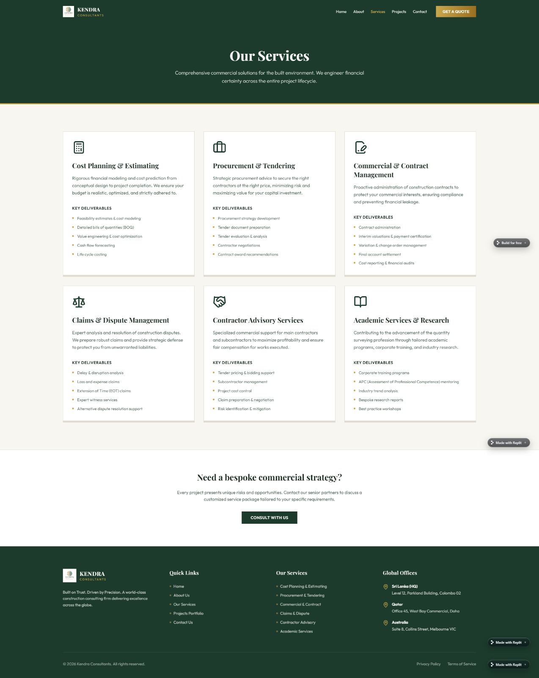


Delivering trusted consultancy solutions for the built environment.
We provide strategic commercial expertise and informed guidance to support successful project outcomes throughout the project lifecycle.

Slide 10
Cost Planning & Estimating
Rigorous financial modelling and cost forecasting from project inception through completion. We help clients establish realistic budgets, optimise project costs, and maintain financial control throughout the project lifecycle.
Key Deliverables
Feasibility Cost Estimates
Cost Planning & Budget Development
Bills of Quantities
Value Engineering
Cash Flow Forecasting
Life Cycle Costing

Slide 11
Procurement & Tendering
Strategic procurement advice and tender management to secure the right contractors, achieve commercial certainty, and maximise value throughout the procurement process.
Key Deliverables
Procurement Strategy Development
Preparation of Tender Documentation
Tender Evaluation & Analysis
Tender Clarifications & Negotiations
Contract Award Recommendations

Slide 12
Commercial & Contract Management
Proactive contract and commercial management services that protect client interests, promote contractual compliance, manage commercial risk, and provide effective financial control throughout the project lifecycle.
Key Deliverables
Contract Administration
Interim Valuations & Payment Certification
Variation Assessment & Change Management
Cost Reporting & Commercial Performance Monitoring
Risk Identification & Commercial Advisory
Final Account Preparation & Agreement

Slide 13
Claims & Dispute Management
Professional claims consultancy and commercial advice to support the preparation, evaluation, and resolution of contractual claims while minimising the impact of disputes.
Key Deliverables
Delay & Disruption Analysis
Extension of Time (EOT) Assessments
Loss & Expense Claims
Claims Preparation & Evaluation
Alternative Dispute Resolution Support

Slide 14
Contractor Advisory Services
Specialised commercial advisory support for contractors, subcontractors, developers, and project stakeholders to strengthen commercial performance and manage contractual risk.
Key Deliverables
Tender Pricing
Project Cost Control
Subcontract Administration
Claims Preparation & Negotiation
Commercial Risk Management

Slide 15
Academic Services & Research
Supporting industry development through professional training, technical research and knowledge-sharing initiatives tailored to organisations and construction professionals.
Key Deliverables
Professional Training Programmes
Corporate Learning Solutions
Industry Research
Technical Publications
Best Practice Workshops

Slide 16




Need expert guidance for your project?
Every project presents unique challenges and opportunities. Connect with our team to discuss how Kendra Consultants can provide tailored solutions and strategic support aligned with your project objectives.
CONSULT KENDRA

Slide 17
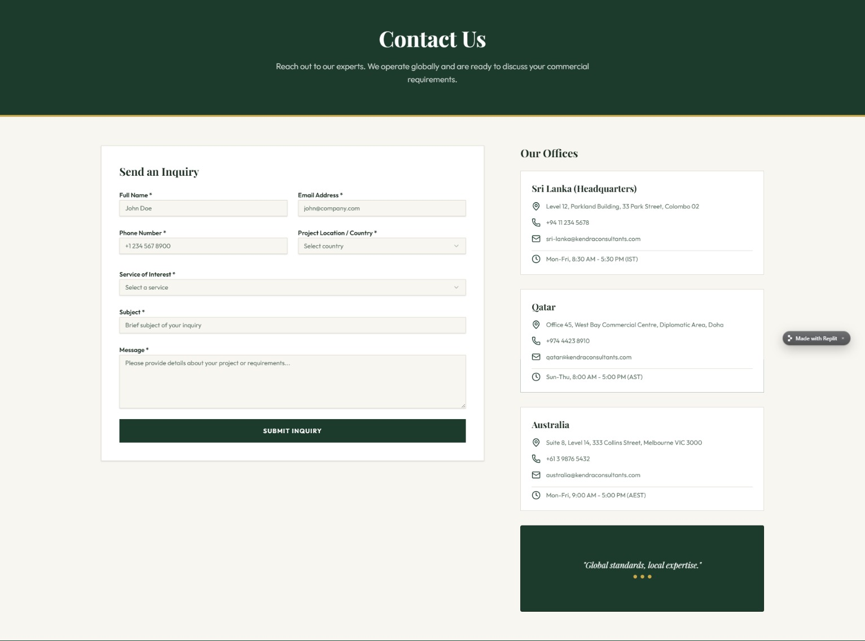







Reach out to our experts. We operate globally and are ready to discuss your project needs and provide tailored solutions to support your objectives.
+94713315789
Keep the key services in the banner as the options

